Slide 1
Unit 8 Impulse and Momentum
Unit Goal: To understand and apply the new concepts of impulse and momentum.
Slide 9-2

Slide 2
Chapter 9 Preview
Slide 9-3

Slide 3
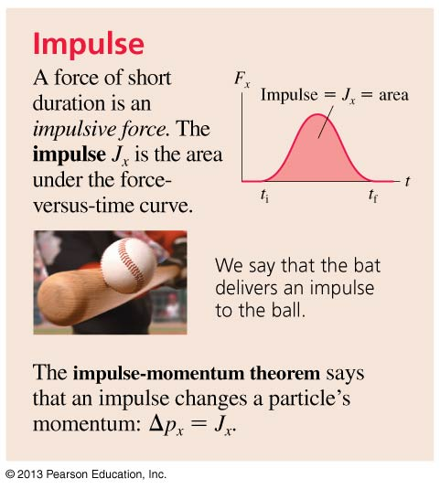
Chapter 9 Preview
Slide 9-4

Slide 4
Chapter 9 Preview
Slide 9-5

Slide 5
Chapter 9 Preview
Slide 9-6

Slide 6
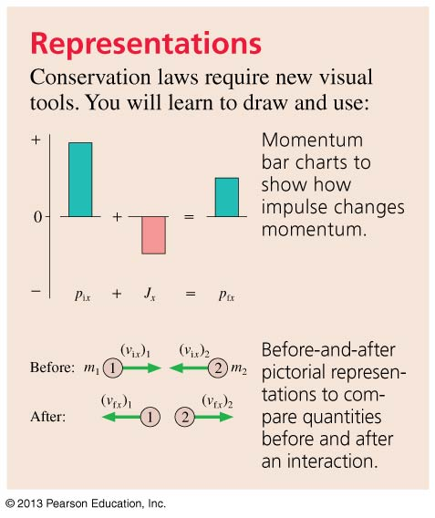
Chapter 9 Preview
Slide 9-7

Slide 7
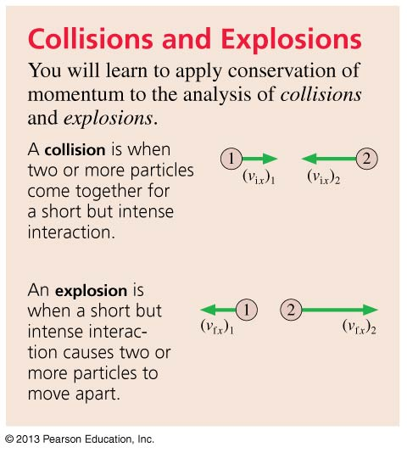
Chapter 9 Preview
Slide 9-8

Slide 8
Reading Question 9.1
Momentum is
Mass times velocity.
½ mass times speed-squared.
The area under the force curve in a force-versus-time graph.
Velocity per unit mass.
Slide 9-10
Notes:
8
Answer: A

Slide 9
Reading Question 9.1
Momentum is
Mass times velocity.
½ mass times speed-squared.
The area under the force curve in a force-versus-time graph.
Velocity per unit mass.
Slide 9-11
Notes:
9

Slide 10
Reading Question 9.2
Impulse is
A force that is applied at a random time.
A force that is applied very suddenly.
The area under the force curve in a force-versus-time graph.
The time interval that a force lasts.
Slide 9-12
Notes:
10
Answer: C

Slide 11
Reading Question 9.2
Impulse is
A force that is applied at a random time.
A force that is applied very suddenly.
The area under the force curve in a force-versus-time graph.
The time interval that a force lasts.
Slide 9-13
Notes:
11

Slide 12
Reading Question 9.4
The total momentum of a system is conserved
Always.
If the system is isolated.
If the forces are conservative.
Never; it’s just an approximation.
Slide 9-16
Notes:
12
Answer: B

Slide 13
Reading Question 9.4
The total momentum of a system is conserved
Always.
If the system is isolated.
If the forces are conservative.
Never; it’s just an approximation.
Slide 9-17
Notes:
13

Slide 14
Reading Question 9.5
In an inelastic collision,
Impulse is conserved.
Momentum is conserved.
Force is conserved.
Energy is conserved.
Elasticity is conserved.
Slide 9-18
Notes:
14
Answer: B

Slide 15
Reading Question 9.5
In an inelastic collision,
Impulse is conserved.
Momentum is conserved.
Force is conserved.
Energy is conserved.
Elasticity is conserved.
Slide 9-19
Notes:
15

Slide 16
Momentum
The product of a particle’s mass and velocity is called the momentum of the particle:
Momentum is a vector, with units of kg m/s.
A particle’s momentum vector can be decomposed into x- and y-components.
Slide 9-21

Slide 17
QuickCheck 9.1
The cart’s change of momentum Δp_{x} is
–20 kg m/s.
–10 kg m/s.
0 kg m/s.
10 kg m/s.
30 kg m/s.
Slide 9-22
Notes:
17

Slide 18
QuickCheck 9.1
The cart’s change of momentum Δp_{x} is
–20 kg m/s.
–10 kg m/s.
0 kg m/s.
10 kg m/s.
30 kg m/s.
Δp_{x} = 10 kg m/s − (−20 kg m/s) = 30 kg m/s
Negative initial momentum because motion is to the left and v_{x} < 0.
Slide 9-23
Notes:
18

Slide 19
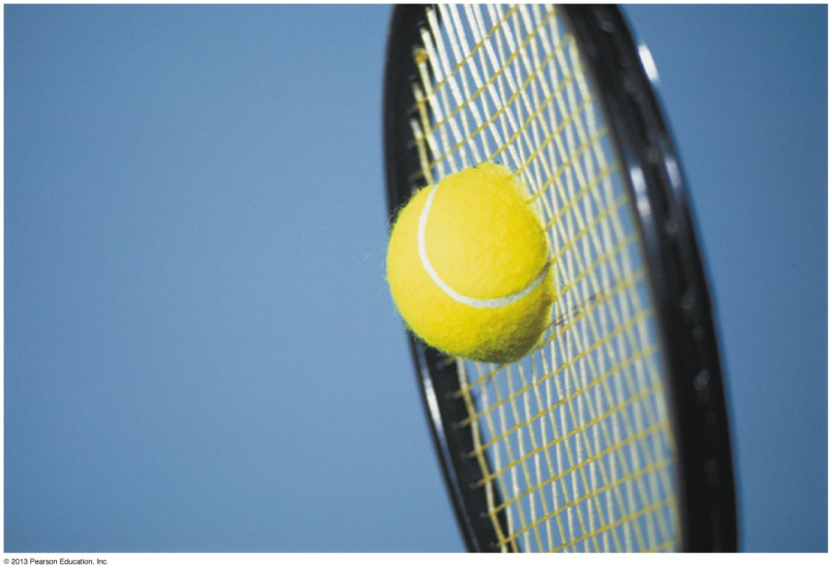
Collisions
A collision is a short-duration interaction between two objects.
The collision between a tennis ball and a racket is quick, but it is not instantaneous.
Notice that the right side of the ball is flattened.
It takes time to compress the ball, and more time for the ball to re-expand as it leaves the racket.
Slide 9-24

Slide 20
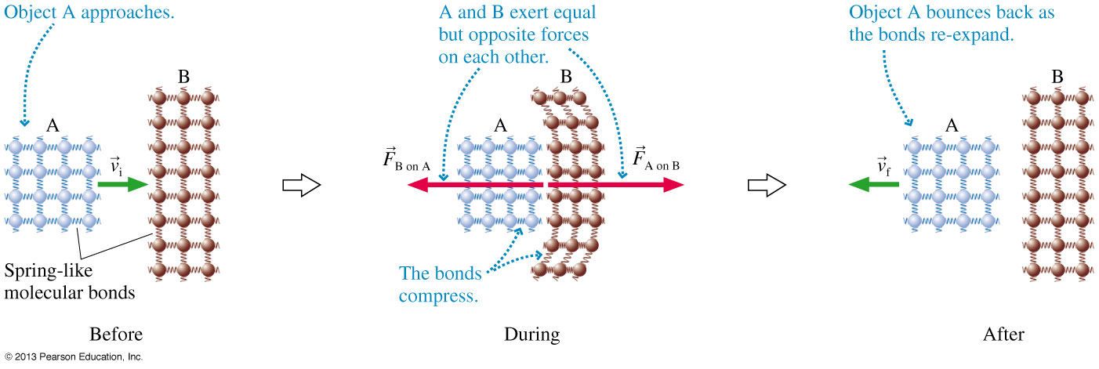
Atomic Model of a Collision
Slide 9-25

Slide 21
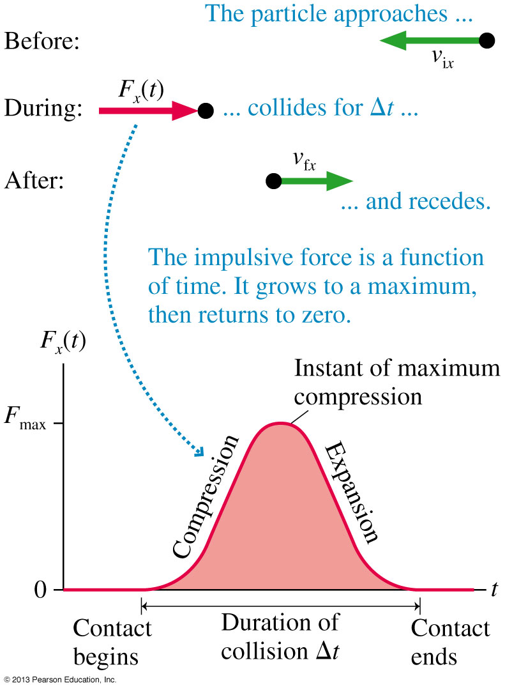
Impulse During a Collision
A large force exerted for a small interval of time is called an impulsive force.
The figure shows a particle with initial velocity .
The particle experiences an impulsive force of short duration Δt.
The particle leaves with final velocity .
Slide 9-26

Slide 22
Impulse
Newton’s second law may be formulated in terms of momentum rather than acceleration:
$Σ\vec{F}=m\vec{a}=m∗\frac{∆v}{∆t}$ = $\frac{m∆v}{∆t}$= $\frac{∆p}{∆t}$
Rearranging, we have:
$∆p_{x}=p_{f_{x}}−p_{i_{x}}$= ${ΣF}_{x}∆t$
We define the right-hand side to be the impulse.
$$Impluse=J_{x}≝{ΣF}_{x}∆t$$
Impulse $=$the area under the curve of a F vs t graph
Impulse has units of N s, which are equivalent to kg m/s.
Slide 9-27

Slide 23
The Impulse-Momentum Theorem
A particle experiences an impulsive force in the x-direction.
The impulse delivered to the particle is equal to the change in the particle’s momentum.
Slide 9-29

Slide 24
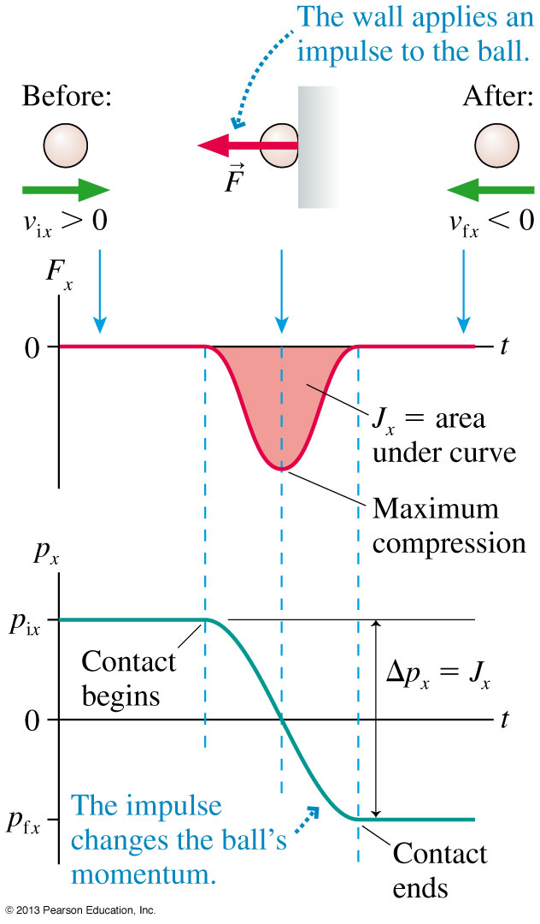
The Impulse-Momentum Theorem
A rubber ball bounces off a wall.
The ball is initially traveling toward the right, so v_{ix} and p_{ix} are positive.
After the bounce, v_{fx} and p_{fx} are negative.
The force on the ball is toward the left, so F_{x} is negative.
In this example, the impulse, or area under the force curve, has a negative value.
Slide 9-30

Slide 25
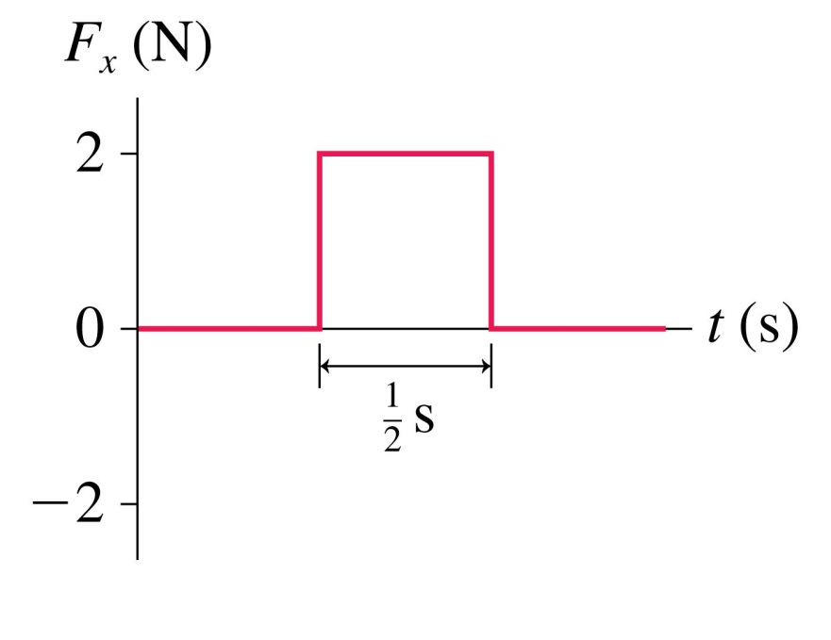
QuickCheck 9.2
A 2.0 kg object moving to the right with speed 0.50 m/s experiences the force shown. What are the object’s speed and direction after the force ends?
0.50 m/s left.
At rest.
0.50 m/s right.
1.0 m/s right.
2.0 m/s right.
Slide 9-31
Notes:
25

Slide 26
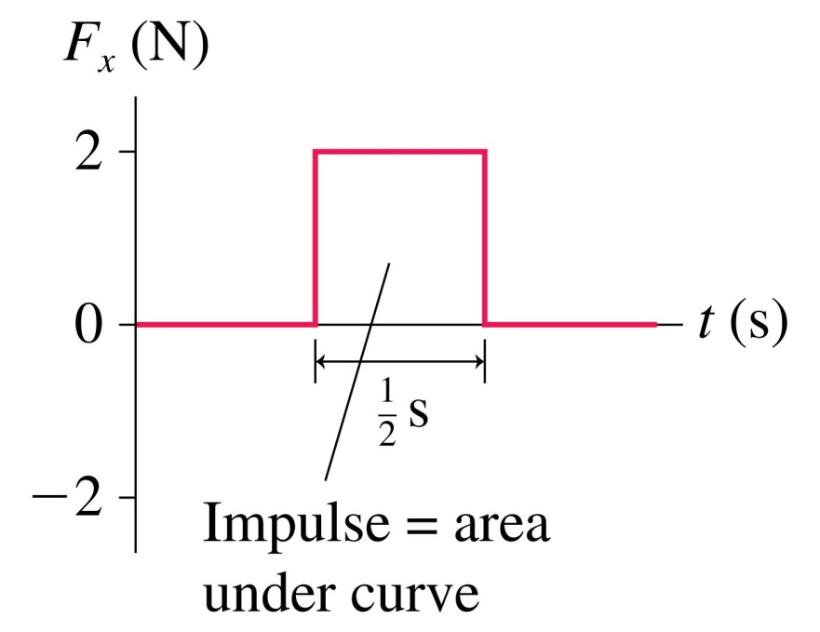
QuickCheck 9.2
A 2.0 kg object moving to the right with speed 0.50 m/s experiences the force shown. What are the object’s speed and direction after the force ends?
0.50 m/s left.
At rest.
0.50 m/s right.
1.0 m/s right.
2.0 m/s right.
Δp_{x} = J_{x} or p_{fx} = p_{ix} + J_{x}
Slide 9-32
Notes:
26

Slide 27
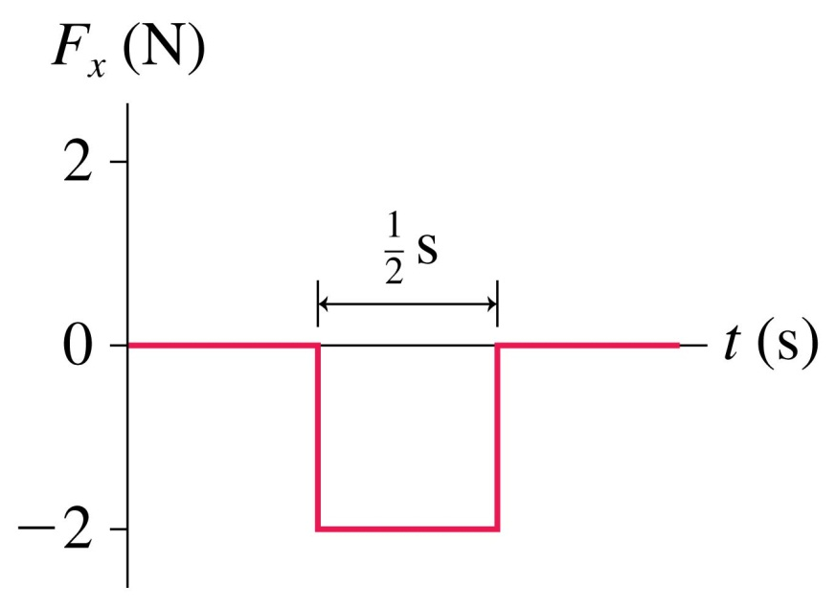
QuickCheck 9.3
A 2.0 kg object moving to the right with speed 0.50 m/s experiences the force shown. What are the object’s speed and direction after the force ends?
0.50 m/s left.
At rest.
0.50 m/s right.
1.0 m/s right.
2.0 m/s right.
Slide 9-33
Notes:
27

Slide 28
QuickCheck 9.3
A 2.0 kg object moving to the right with speed 0.50 m/s experiences the force shown. What are the object’s speed and direction after the force ends?
0.50 m/s left.
At rest.
0.50 m/s right
1.0 m/s right.
2.0 m/s right.
Slide 9-34
Notes:
28

Slide 29
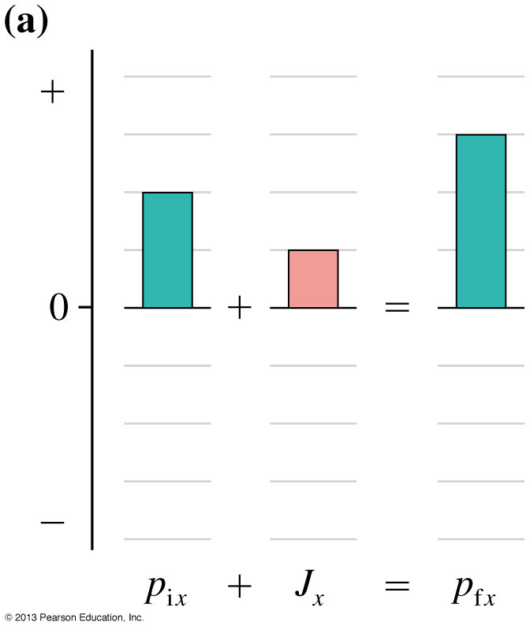
Momentum Bar Charts
Impulse J_{x} transfers momentum to an object.
If an object has an initial momentum of 2 kg m/s, a +1 kg m/s impulse exerted on the object increases its momentum to 3 kg m/s.
p_{fx} = p_{ix} + J_{x}
We can represent this “momentum accounting” with a momentum bar chart.
The figure shows how one 1 unit of impulse adds to 2 units of initial momentum to give 3 units of final momentum.
Slide 9-35

Slide 30
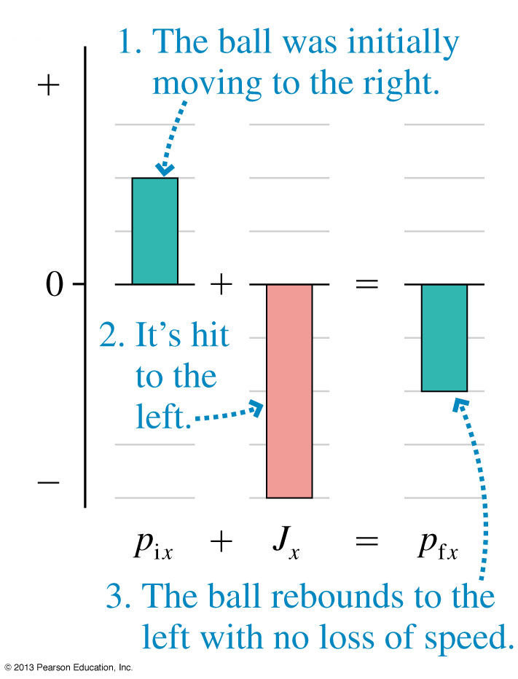
Momentum Bar Charts
A rubber ball is initially moving to the right with p_{ix} = +2 kg m/s.
It collides with a wall which delivers an impulse of J_{x} = −4 N s.
The figure shows the momentum bar chart to help analyze this collision.
The final momentum is p_{fx} = −2 kg m/s.
Slide 9-36

Slide 31
QuickCheck 9.4
A force pushes the cart for 1 s, starting from rest. To achieve the same speed with a force half as big, the force would need to push for
s.
s.
1 s.
2 s.
4 s.
1
4
1
2
Slide 9-37
Notes:
31

Slide 32
QuickCheck 9.4
A force pushes the cart for 1 s, starting from rest. To achieve the same speed with a force half as big, the force would need to push for
s.
s.
1 s.
2 s.
4 s.
1
4
1
2
Slide 9-38
Notes:
32

Slide 33
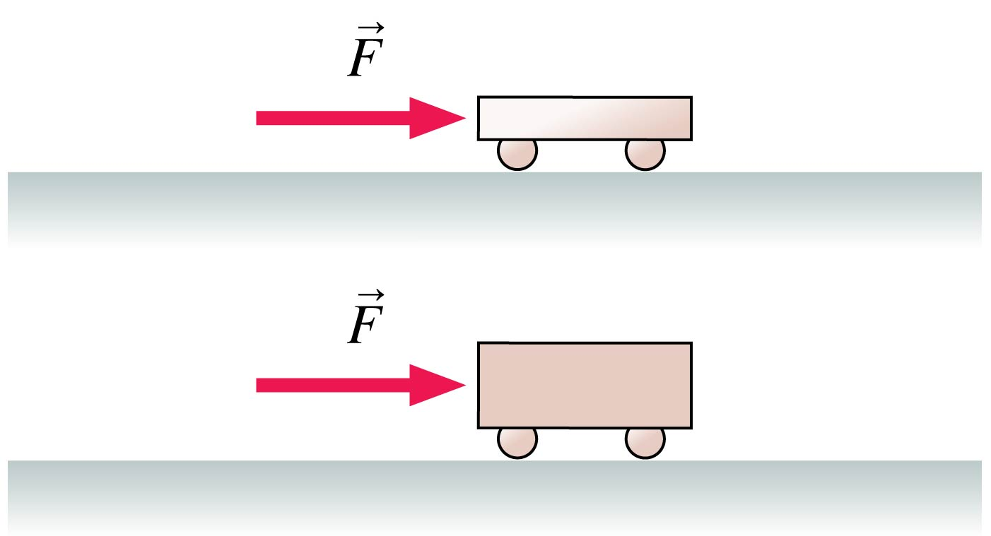
QuickCheck 9.5
A light plastic cart and a heavy steel cart are both pushed with the same force for 1.0 s, starting from rest. After the force is removed, the momentum of the light plastic cart is ________ that of the heavy steel cart.
greater than
equal to
less than
Can’t say. It depends on how big the force is.
Slide 9-39
Notes:
33

Slide 34
QuickCheck 9.5
A light plastic cart and a heavy steel cart are both pushed with the same force for 1.0 s, starting from rest. After the force is removed, the momentum of the light plastic cart is ________ that of the heavy steel cart.
greater than
equal to
less than
Can’t say. It depends on how big the force is.
Same force, same time ⇒ same impulse
Same impulse ⇒ same change of momentum
Slide 9-40
Notes:
34

Slide 35
Tactics: Drawing a Before-and-After Pictorial Representation
Slide 9-41

Slide 36
Tactics: Drawing a Before-and-After Pictorial Representation
Slide 9-42

Slide 37
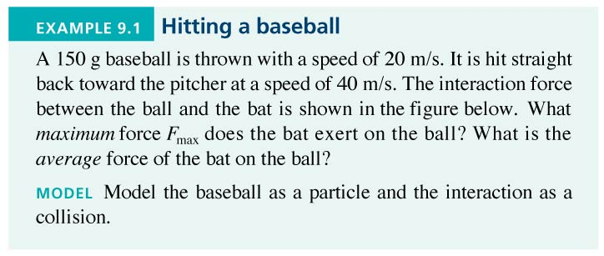
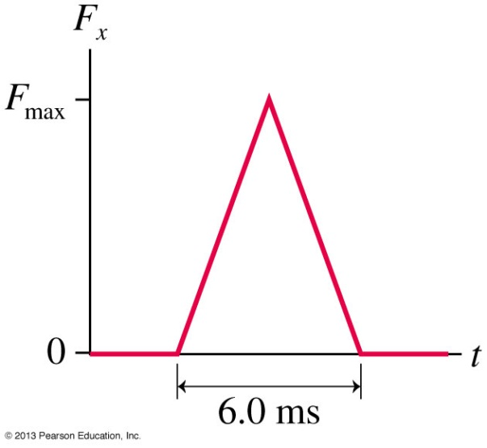
Example 9.1 Hitting a Baseball
Slide 9-43

Slide 38
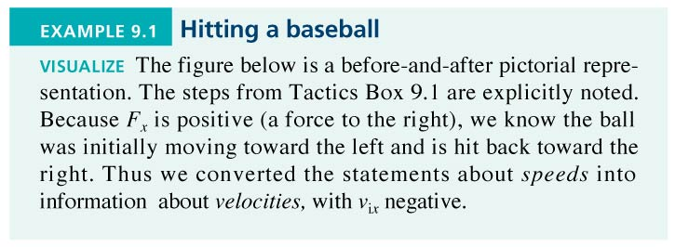
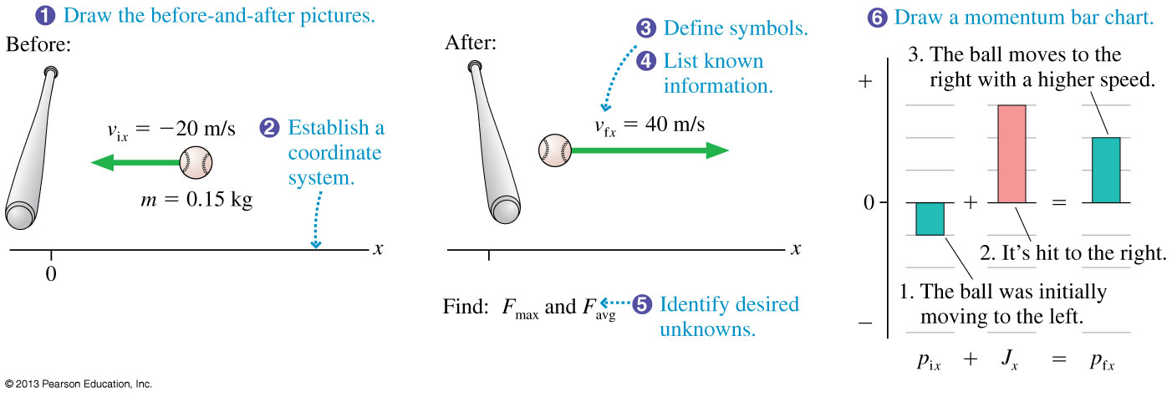
Example 9.1 Hitting a Baseball
Slide 9-44

Slide 39
Example 9.1 Hitting a Baseball
Slide 9-45

Slide 40
Example 9.1 Hitting a Baseball
Slide 9-46

Slide 41
Example 9.1 Hitting a Baseball
Slide 9-47

Slide 42
Example 9.1 Hitting a Baseball
Slide 9-48

Slide 43
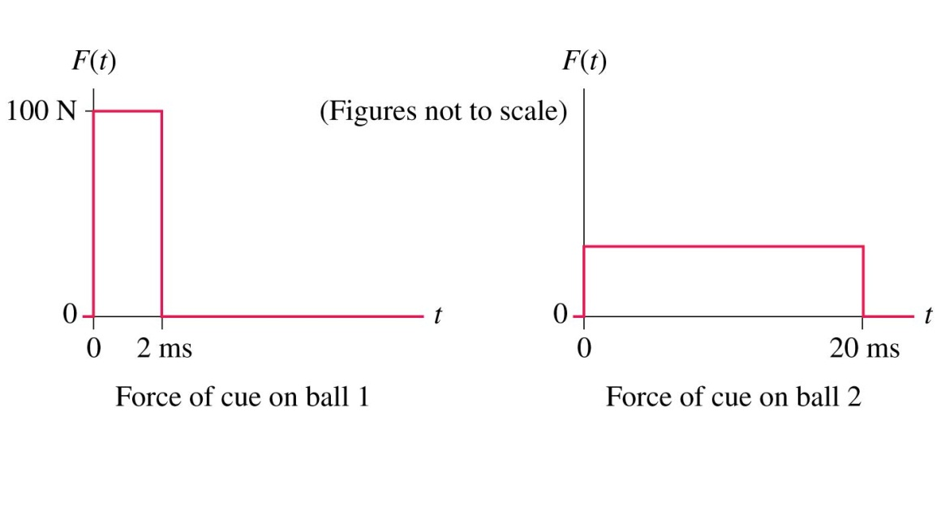
QuickCheck 9.6
Two 1.0 kg stationary cue balls are struck by cue sticks. The cues exert the forces shown. Which ball has the greater final speed?
Ball 1.
Ball 2.
Both balls have the same final speed.
Slide 9-49
Notes:
43
Answer: C. Both balls receive the same impulse and have the same mass, so they will have the same final speed.

Slide 44
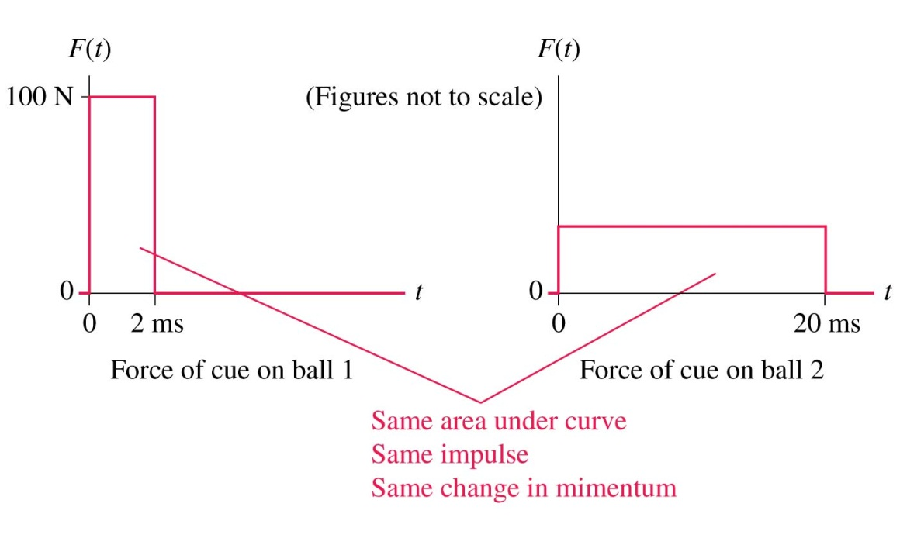
QuickCheck 9.6
Two 1.0 kg stationary cue balls are struck by cue sticks. The cues exert the forces shown. Which ball has the greater final speed?
Ball 1.
Ball 2.
Both balls have the same final speed.
Slide 9-50
Notes:
44
Answer: C. Both balls receive the same impulse and have the same mass, so they will have the same final speed.

Slide 45
QuickCheck 9.7
You awake in the night to find that your living room is on fire. Your one chance to save yourself is to throw something that will hit the back of your bedroom door and close it, giving you a few seconds to escape out the window. You happen to have both a sticky ball of clay and a super-bouncy Superball next to your bed, both the same size and same mass. You’ve only time to throw one. Which will it be? Your life depends on making the right choice!
Throw the Superball.
Throw the ball of clay.
It doesn’t matter. Throw either.
Slide 9-51
Notes:
45
STT1.2

Slide 46
QuickCheck 9.7
You awake in the night to find that your living room is on fire. Your one chance to save yourself is to throw something that will hit the back of your bedroom door and close it, giving you a few seconds to escape out the window. You happen to have both a sticky ball of clay and a super-bouncy Superball next to your bed, both the same size and same mass. You’ve only time to throw one. Which will it be? Your life depends on making the right choice!
Throw the Superball.
Throw the ball of clay.
It doesn’t matter. Throw either.
Larger Δp ⇒ more impulse to door
Slide 9-52
Notes:
46
STT1.2

Slide 47
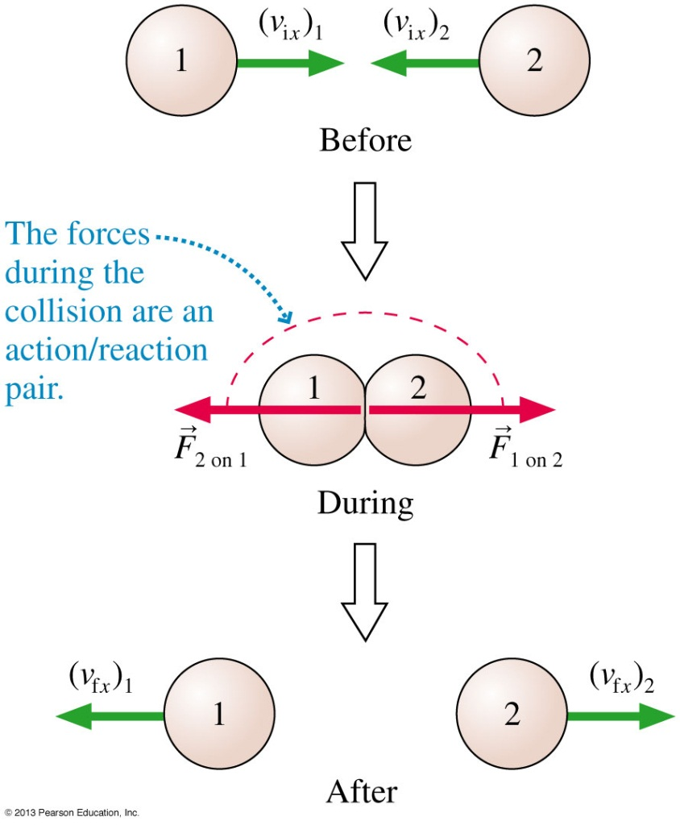
Conservation of Momentum
Two objects collide, as shown.
Neglect all outside forces on the objects.
Due to the fact that the only forces on the objects are equal and opposite, the sum of their momenta is:
This is a conservation law!
The sum of the momenta before and after the collision are equal:
Slide 9-53

Slide 48
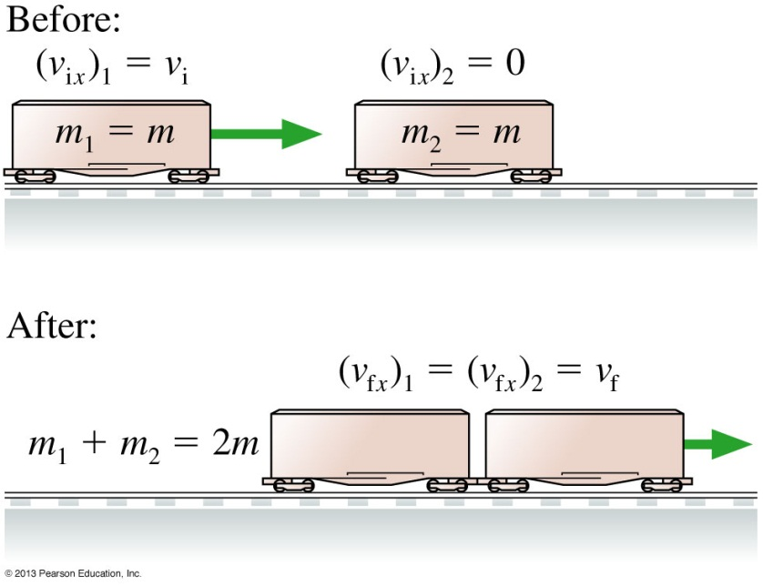
Conservation of Momentum: Quick Example
A train car moves to the right with initial speed v_{i}. It collides with a stationary train car of equal mass. After the collision the two cars are stuck together. What is the train cars’ final velocity?
According to conservation of momentum, before and after the collision:
m₁ (v_{fx})₁ + m₂ (v_{fx})₂ = m₁ (v_{ix})₁ + m₂ (v_{ix})₂
mv_{f} + mv_{f} = 2mv_{f} = mv_{i} + 0
The mass cancels, and we find that the final velocity is v_{f} = ½ v_{i}.
Slide 9-54

Slide 49
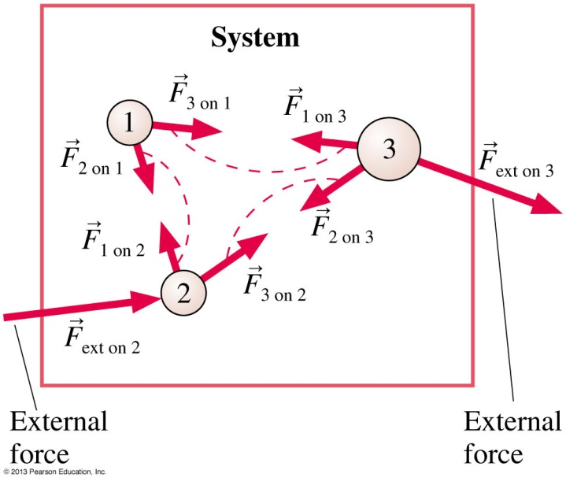
Momentum of a System
Consider a system of N interacting particles.
The figure shows a simple case where N = 3.
The system has a total momentum:
$\vec{P}=total momentum={\vec{p}}_{1}+{\vec{p}}_{2}$+ ${\vec{p}}_{3}+…+{\vec{p}}_{N}$
Applying Newton’s second law for each individual particle, we find the rate of change of the total momentum of the system is:
$$\frac{∆\vec{P}}{∆t}=ΣF_{Internal}+ΣF_{External}$$
Slide 9-55

Slide 50
Momentum of a System
The interaction forces come in action/reaction pairs, with
.
Consequently, the sum of all the interaction forces is zero.
Therefore:
$$\frac{∆\vec{P}}{∆t}=ΣF_{External}$$
The rate of change of the total momentum of the system is equal to the net force applied to the system.
This result justifies our particle model: Internal forces between atoms in an object do not affect the motion of the object as a whole.
Slide 9-56

Slide 51
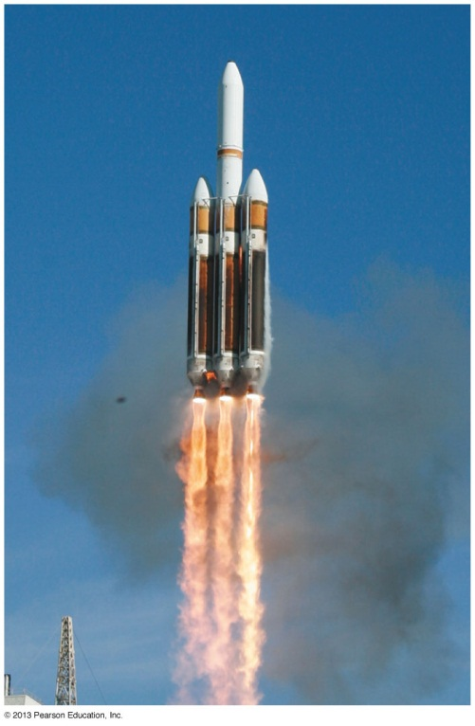
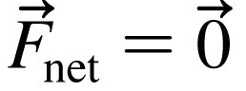
Law of Conservation of Momentum
An isolated system is a system for which the net external force is zero:
For an isolated system:
$\frac{∆\vec{P}}{∆t}=0$for an isolated system
Or, written mathematically:
Slide 9-57

Slide 52
Problem-Solving Strategy: Conservation of Momentum
Slide 9-58

Slide 53
Problem-Solving Strategy: Conservation of Momentum
Slide 9-59

Slide 54
QuickCheck 9.8
A mosquito and a truck have a head-on collision. Splat! Which has a larger change of momentum?
The mosquito.
The truck.
They have the same change of momentum.
Can’t say without knowing their initial velocities.
Slide 9-60
Notes:
54
STT1.2

Slide 55
QuickCheck 9.8
A mosquito and a truck have a head-on collision. Splat! Which has a larger change of momentum?
The mosquito.
The truck.
They have the same change of momentum.
Can’t say without knowing their initial velocities.
Momentum is conserved, so Δp_{mosquito} + Δp_{truck} = 0.
Equal magnitude (but opposite sign) changes in momentum.
Slide 9-61
Notes:
55
STT1.2

Slide 56
Example 9.4 Rolling Away
Slide 9-62

Slide 57
Example 9.4 Rolling Away
Slide 9-63

Slide 58
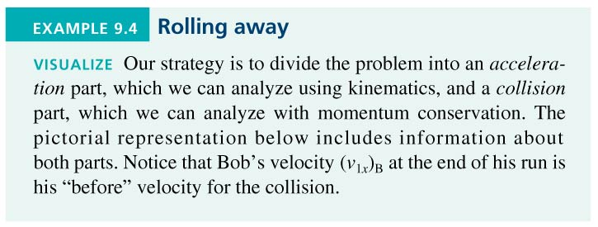
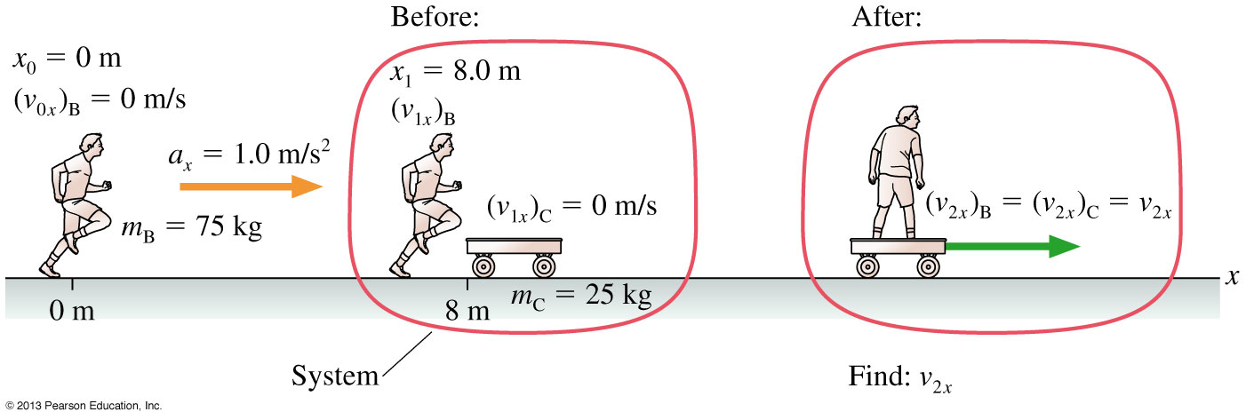
Example 9.4 Rolling Away
Slide 9-64

Slide 59
Example 9.4 Rolling Away
Slide 9-65

Slide 60
Example 9.4 Rolling Away
Slide 9-66

Slide 61
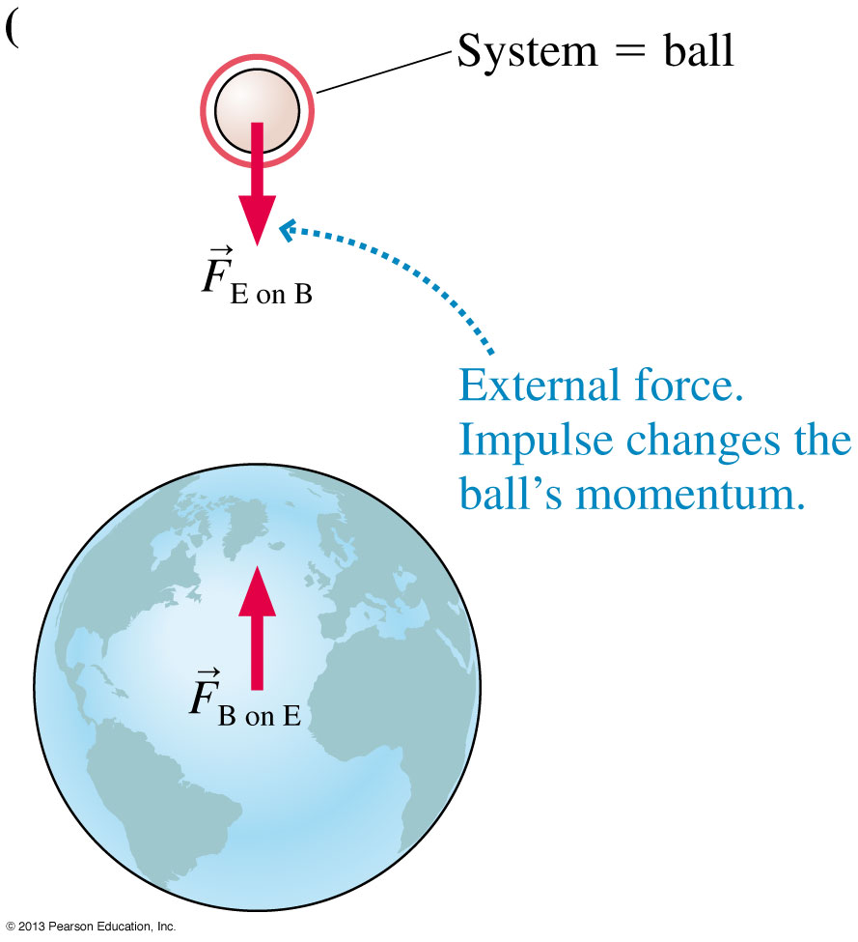
Conservation of Momentum Depends on the Choice of System
A rubber ball is dropped, and falls toward earth.
Define the ball as the System.
The gravitational force of the earth is an external force.
The momentum of the system is not conserved.
Slide 9-67

Slide 62
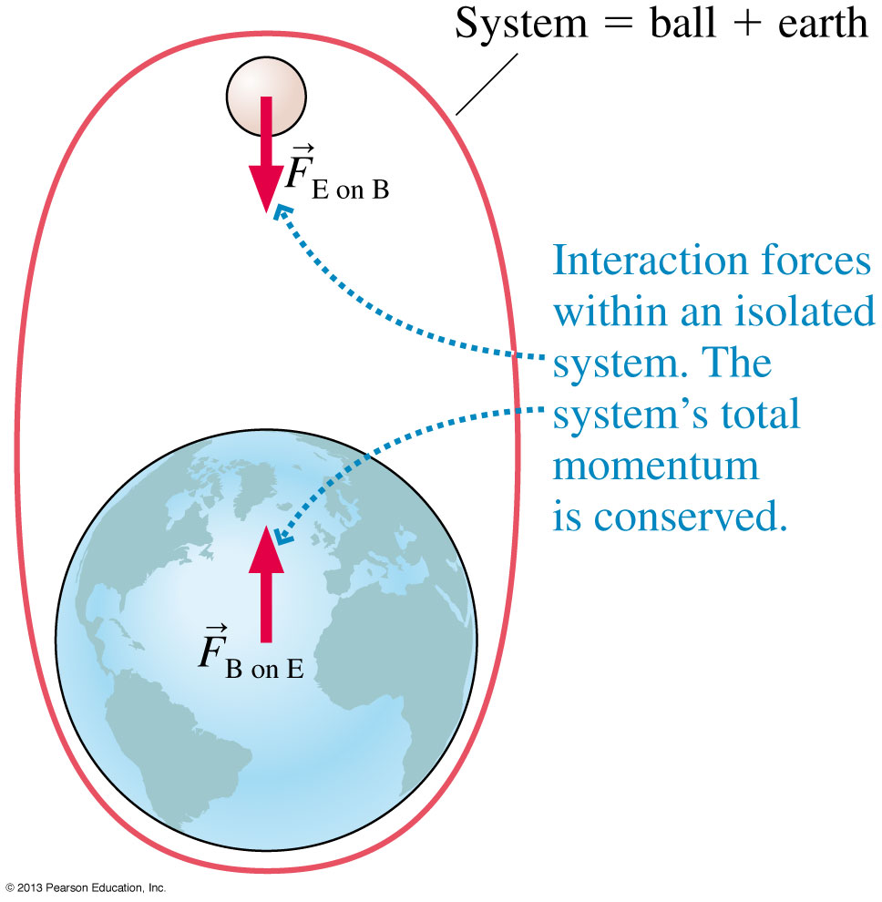
Conservation of Momentum Depends on the Choice of System
A rubber ball is dropped, and falls toward earth.
Define the ball + earth as the System.
The gravitational forces are interactions within the system.
This is an isolated system, so the total momentum is conserved.
Slide 9-68

Slide 63
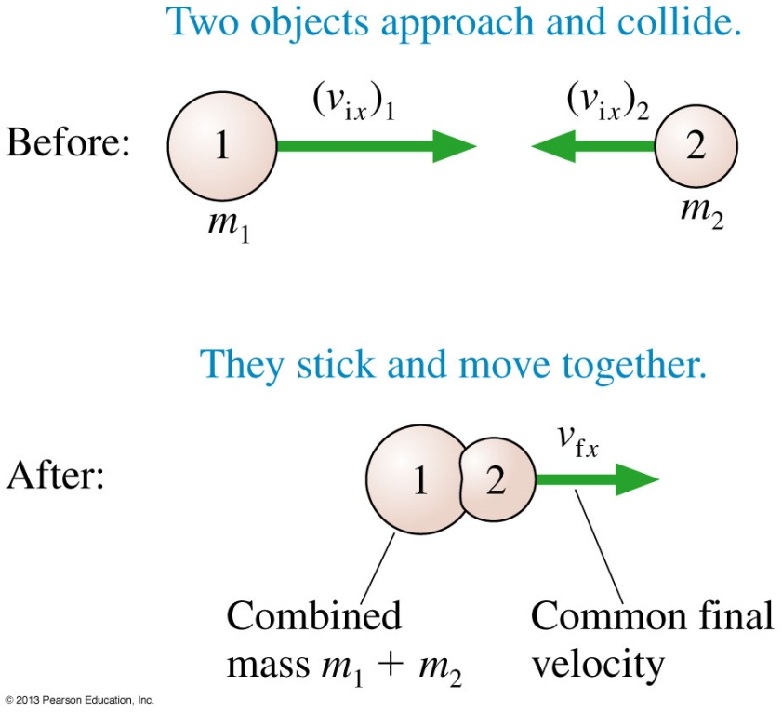
Inelastic Collisions
A collision in which the two objects stick together and move with a common final velocity is called a perfectly inelastic collision.
Examples of inelastic collisions:
A piece of clay hits the floor.
A bullet strikes a block of wood and embeds itself in the block.
Railroad cars coupling together upon impact.
A dart hitting a dart board.
Slide 9-69

Slide 64
QuickCheck 9.9
The 1 kg box is sliding along a frictionless surface. It collides with and sticks to the 2 kg box. Afterward, the speed of the two boxes is
0 m/s.
1 m/s.
2 m/s.
3 m/s.
There’s not enough information to tell.
Slide 9-70
Notes:
64
Answer: B

Slide 65
QuickCheck 9.9
The 1 kg box is sliding along a frictionless surface. It collides with and sticks to the 2 kg box. Afterward, the speed of the two boxes is
0 m/s.
1 m/s.
2 m/s.
3 m/s.
There’s not enough information to tell.
Slide 9-71
Notes:
65
Answer: B

Slide 66
QuickCheck 9.10
The two boxes are sliding along a frictionless surface. They collide and stick together. Afterward, the velocity of the two boxes is
2 m/s to the left.
1 m/s to the left.
0 m/s, at rest.
1 m/s to the right.
2 m/s to the right.
Slide 9-72
Notes:
66
Answer: B

Slide 67
QuickCheck 9.10
The two boxes are sliding along a frictionless surface. They collide and stick together. Afterward, the velocity of the two boxes is
2 m/s to the left.
1 m/s to the left.
0 m/s, at rest.
1 m/s to the right.
2 m/s to the right.
Slide 9-73
Notes:
67
Answer: B

Slide 68
Example 9.5 An Inelastic Glider Collision
Slide 9-74

Slide 69
Example 9.5 An Inelastic Glider Collision
Slide 9-75

Slide 70
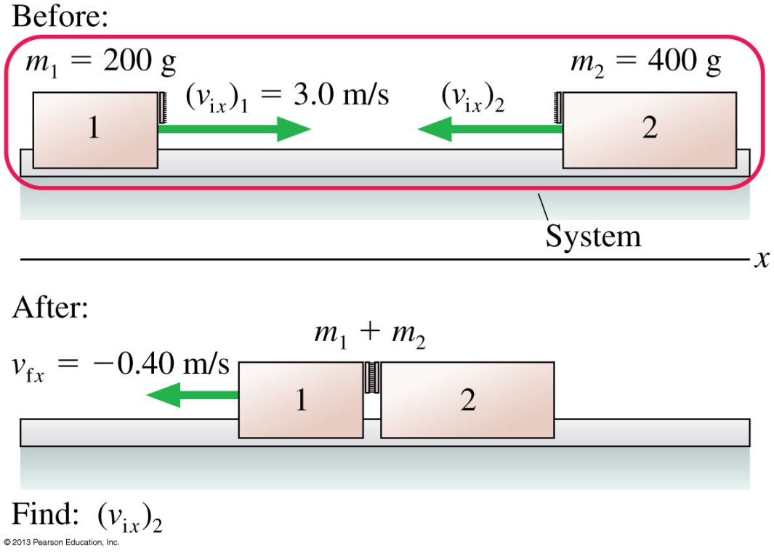
Example 9.5 An Inelastic Glider Collision
Slide 9-76

Slide 71
Example 9.5 An Inelastic Glider Collision
Slide 9-77

Slide 72
Explosions
An explosion is the opposite of a collision.
The particles first have a brief, intense interaction, then they move apart from each other.
The explosive forces are internal forces.
If the system is isolated, its total momentum during the explosion will be conserved.
Slide 9-78

Slide 73
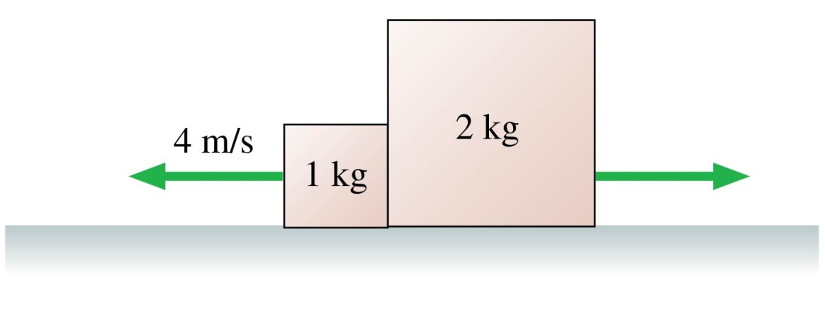
QuickCheck 9.11
The two boxes are on a frictionless surface. They had been sitting together at rest, but an explosion between them has just pushed them apart. How fast is the 2 kg box going?
1 m/s.
2 m/s.
4 m/s.
8 m/s.
There’s not enough information to tell.
Slide 9-79
Notes:
73
Answer: B

Slide 74
QuickCheck 9.11
The two boxes are on a frictionless surface. They had been sitting together at rest, but an explosion between them has just pushed them apart. How fast is the 2 kg box going?
1 m/s.
2 m/s.
4 m/s.
8 m/s.
There’s not enough information to tell.
Slide 9-80
Notes:
74
Answer: B

Slide 75
Example 9.7 Recoil
Slide 9-81

Slide 76
Example 9.7 Recoil
Slide 9-82

Slide 77
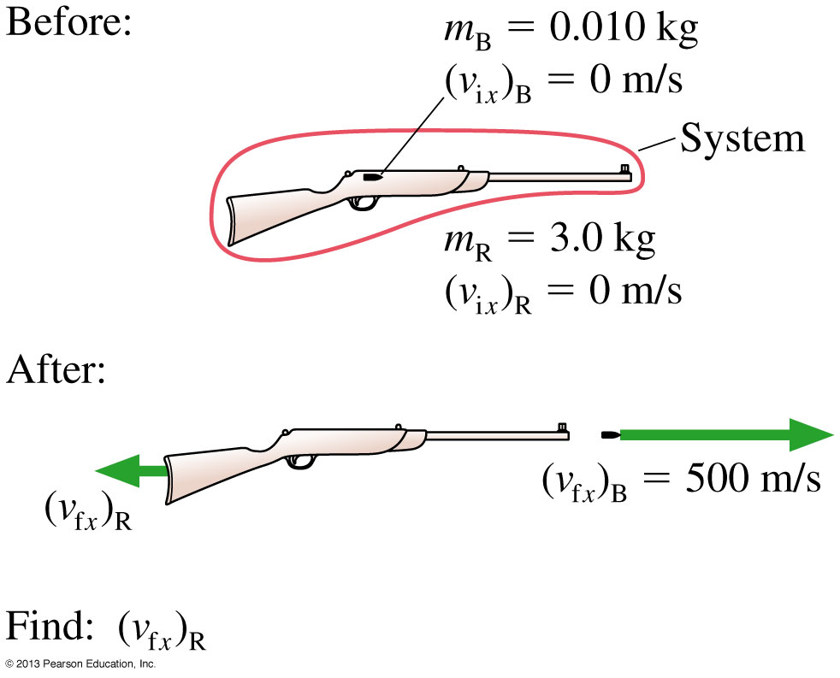
Example 9.7 Recoil
Slide 9-83

Slide 78
Example 9.7 Recoil
Slide 9-84

Slide 79
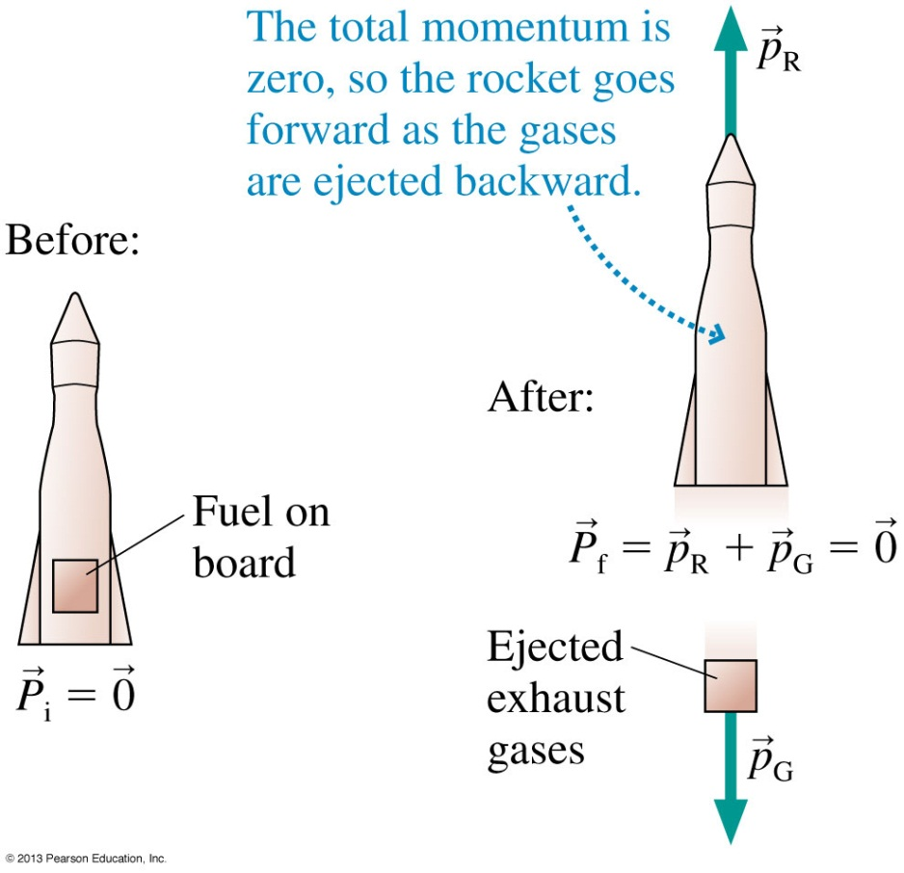
Rocket or Jet Propulsion
The figure shows a rocket with a parcel of fuel on board.
If we choose rocket + gases to be the system, the burning and expulsion are both internal forces.
The exhaust gases gain backward momentum as they are shot out the back.
The total momentum of the system remains zero.
Therefore, the rocket gains forward momentum.
Slide 9-85

Slide 80
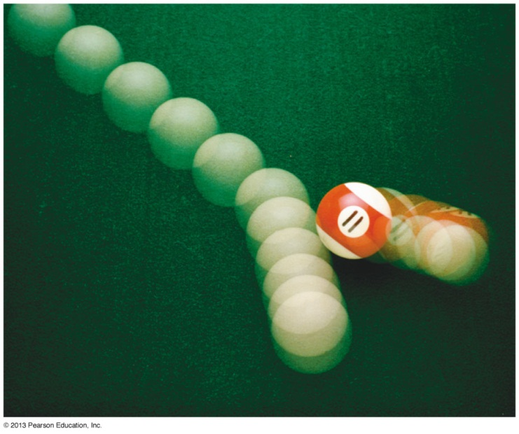
Momentum in Two Dimensions
The total momentum is a vector sum of the momenta of the individual particles.
Momentum is conserved only if each component of is conserved:
Slide 9-86

Slide 81
QuickCheck 9.12
A cart is rolling at 5 m/s. A heavy lead weight is suspended by a thread beneath the cart. Suddenly the thread breaks and the weight falls. Immediately afterward, the speed of the cart is
Less than 5 m/s.
Still 5 m/s.
More than 5 m/s.
Slide 9-87
Notes:
81

Slide 82
QuickCheck 9.12
A cart is rolling at 5 m/s. A heavy lead weight is suspended by a thread beneath the cart. Suddenly the thread breaks and the weight falls. Immediately afterward, the speed of the cart is
Less than 5 m/s.
Still 5 m/s.
More than 5 m/s.
No external forces to exert an impulse.
The falling weight still has forward momentum.
Slide 9-88
Notes:
82

Slide 83
Chapter 9 Summary Slides
Slide 9-89

Slide 84
General Principles
$$ΣF=\frac{∆\vec{P}}{∆t}$$
Slide 9-90

Slide 85
General Principles
Slide 9-91

Slide 86
Important Concepts
$$J=ΣF∆t$$
Slide 9-92

Slide 87
Important Concepts
Slide 9-93

