Slide 1
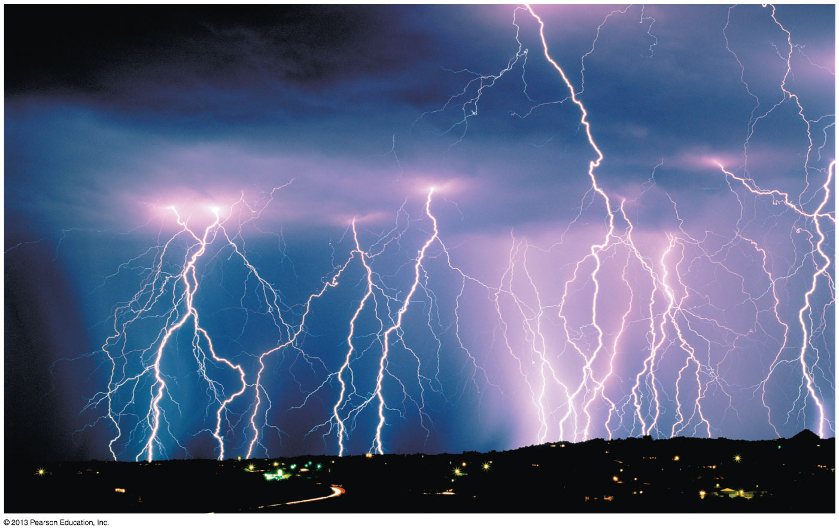
Chapter 25 Electric Charges and Forces
Pickup PSE3e
Photo from page 720, lightning
(perhaps change the fonts and make this photo fill the entire slide)
Chapter Goal: To describe electric phenomena in terms of charges, forces, and fields.
Slide 25-2

Slide 2
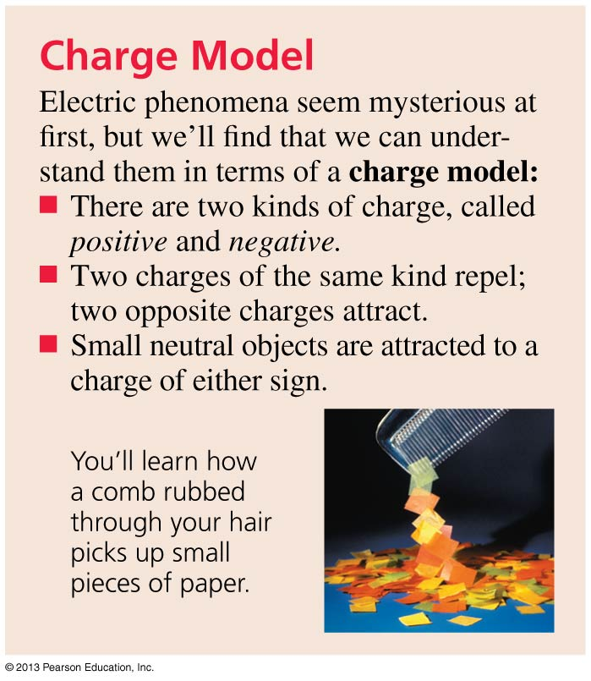
Chapter 25 Preview
Slide 25-3

Slide 3
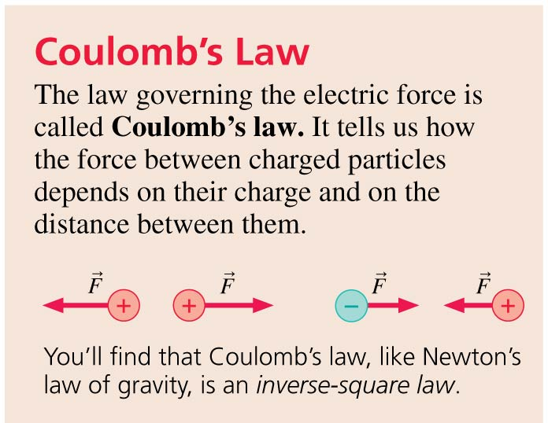
Chapter 25 Preview
Slide 25-4

Slide 4
Chapter 25 Preview
Slide 25-5

Slide 5
Chapter 25 Preview
Slide 25-6

Slide 6
Chapter 25 Preview
Slide 25-7

Slide 7
Chapter 25 Preview
Slide 25-8

Slide 8
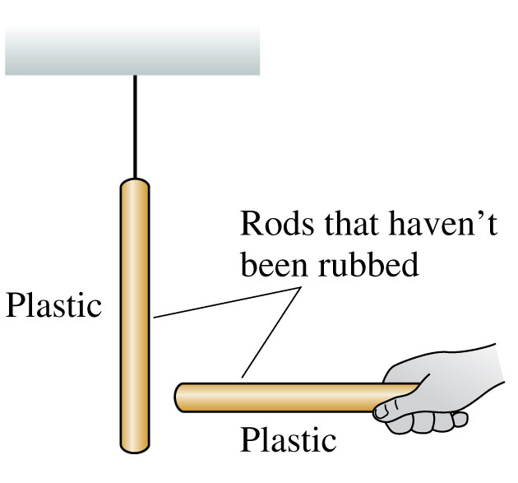
Discovering Electricity: Experiment 1
Take a plastic rod that has been undisturbed for a long period of time and hang it by a thread.
Pick up another undisturbed plastic rod and bring it close to the hanging rod.
Nothing happens to either rod.
No forces are observed.
We will say that the original objects are neutral.
Slide 25-19

Slide 9
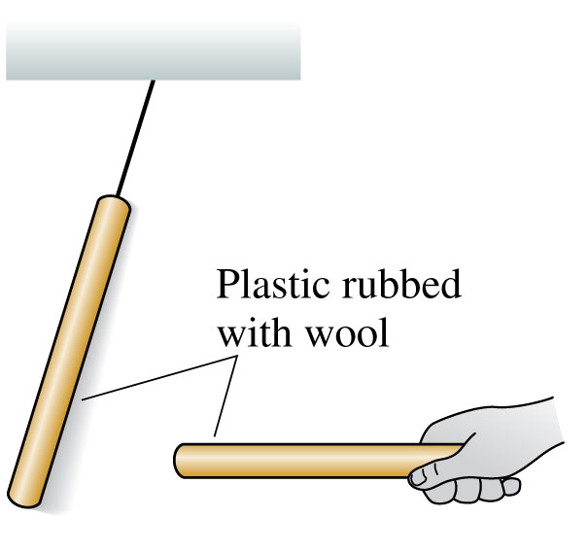
Discovering Electricity: Experiment 2
Rub both plastic rods with wool.
Now the hanging rod tries to move away from the handheld rod when you bring the two close together.
Two glass rods rubbed with silk also repel each other.
There is a long-range repulsive force, requiring no contact, between two identical objects that have been charged in the same way.
Slide 25-20

Slide 10
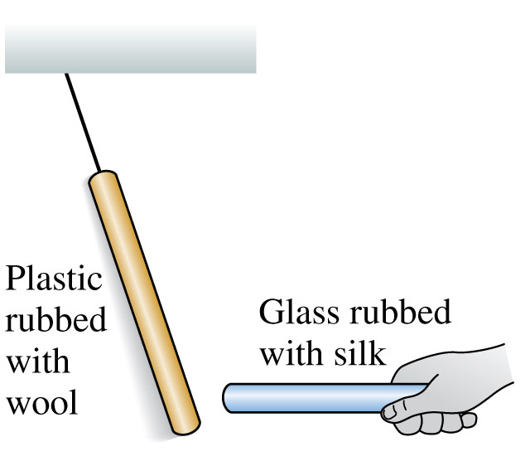
Discovering Electricity: Experiment 3
Bring a glass rod that has been rubbed with silk close to a hanging plastic rod that has been rubbed with wool.
These two rods attract each other.
These particular two types of rods are different materials, charged in a somewhat different way, and they attract each other rather than repel.
Slide 25-21

Slide 11
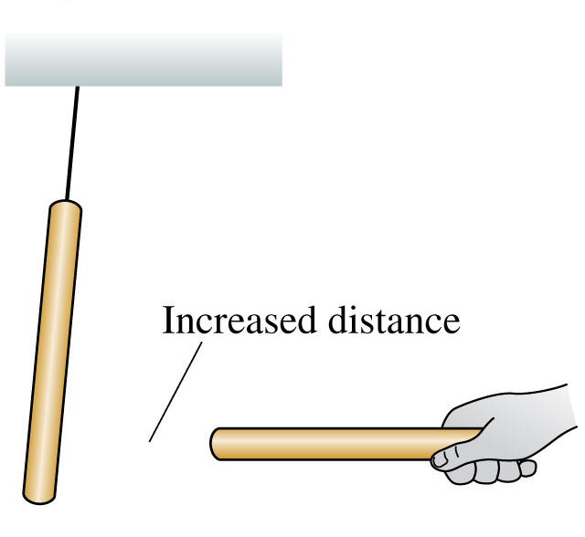
Discovering Electricity: Experiment 4
Rub rods with wool or silk and observe the forces between them.
These forces are greater for rods that have been rubbed more vigorously.
The strength of the forces decreases as the separation between the rods increases.
The force between two charged objects depends on the distance between them.
Slide 25-22

Slide 12
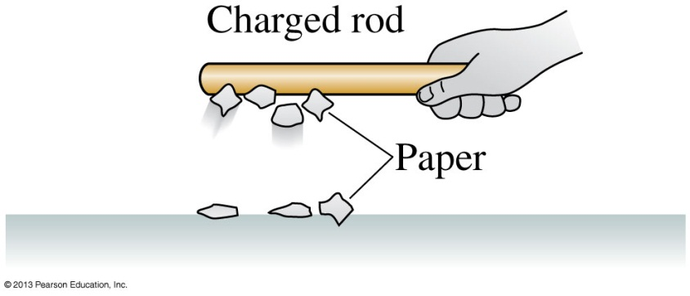
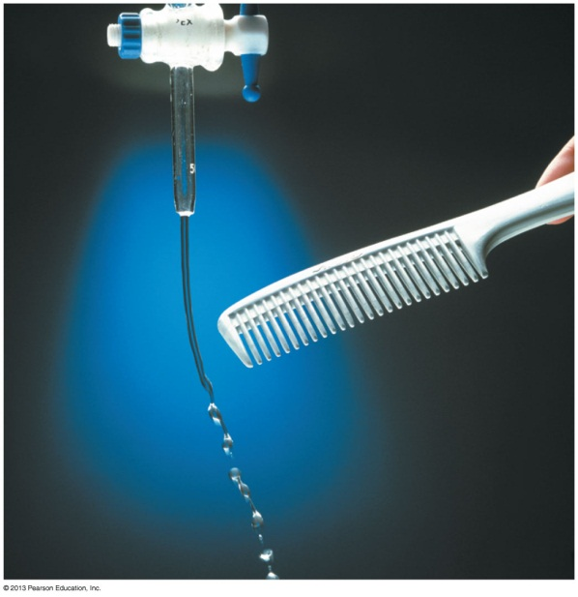
Discovering Electricity: Experiment 5
Hold a charged (i.e., rubbed) plastic rod over small pieces of paper on the table.
The pieces of paper leap up and stick to the rod.
A charged glass rod does the same.
However, a neutral rod has no effect on the pieces of paper.
There is an attractive force between a charged object and a neutral (uncharged) object.
Slide 25-23

Slide 13
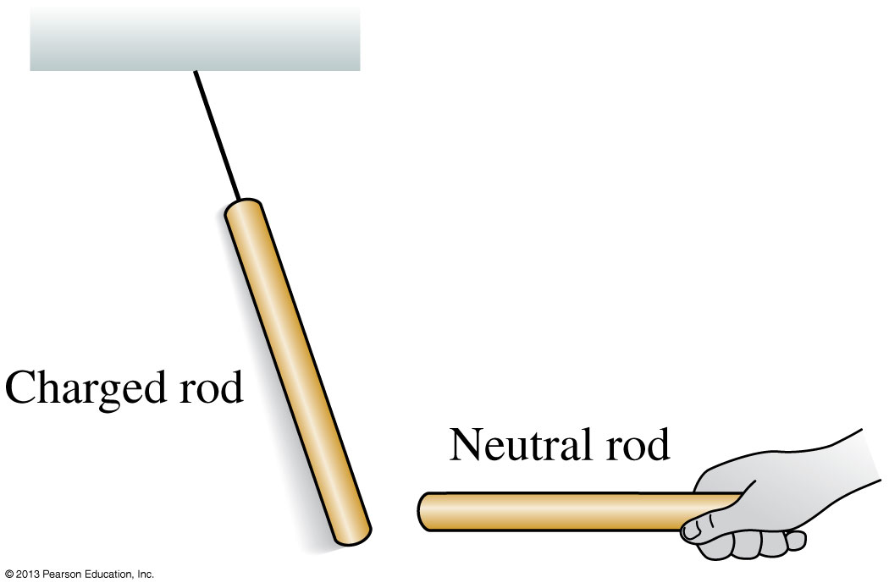
Discovering Electricity: Experiment 6
Rub a plastic rod with wool and a glass rod with silk.
Hang both by threads, some distance apart.
Both rods are attracted to a neutral object that is held close.
There is an attractive force between a charged object and a neutral (uncharged) object.
Slide 25-24

Slide 14
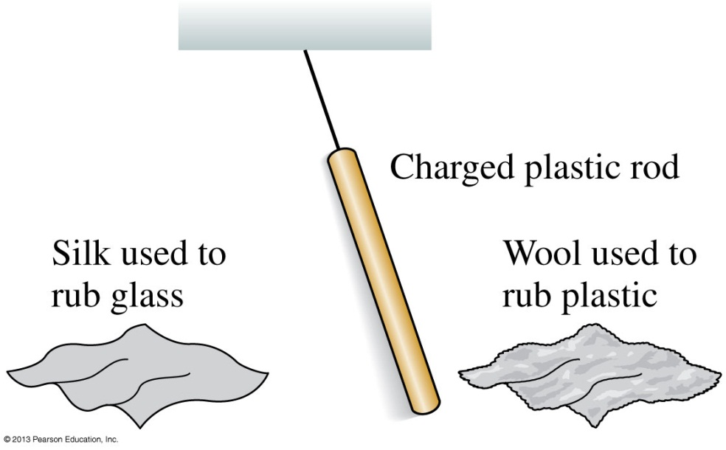
Discovering Electricity: Experiment 7
Rub a hanging plastic rod with wool and then hold the wool close to the rod.
The rod is weakly attracted to the wool.
The plastic rod is repelled by a piece of silk that has been used to rub glass.
The silk starts out with equal amounts of “glass charge” and “plastic charge” and the rubbing somehow transfers “glass charge” from the silk to the rod.
Slide 25-27

Slide 15
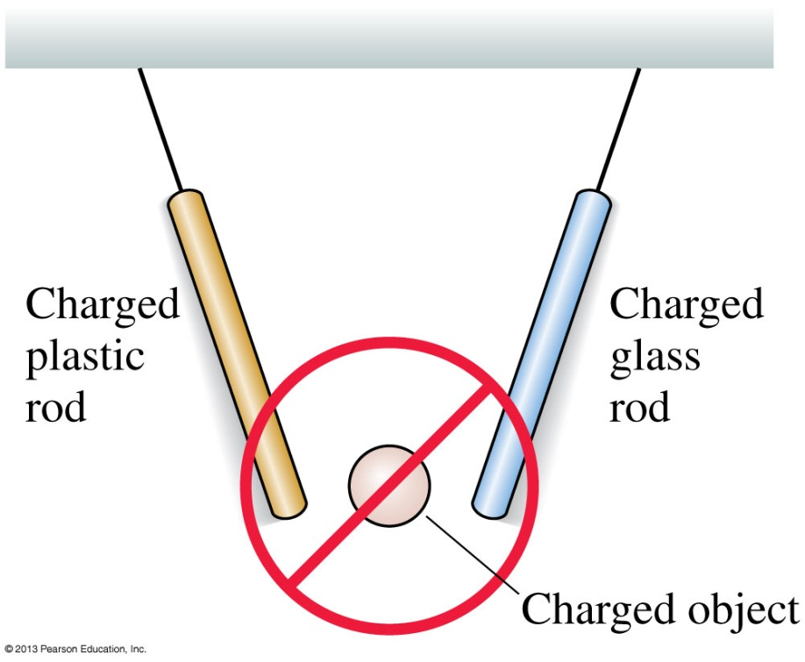
Discovering Electricity: Experiment 8
Other objects, after being rubbed, attract one of the hanging charged rods (plastic or glass) and repel the other.
These objects always pick up small pieces of paper.
There appear to be no objects that, after being rubbed, pick up pieces of paper and attract both the charged plastic and glass rods.
There are only two types of charge: “like plastic” and “like glass”; there is no third kind of charge.
Slide 25-28

Slide 16
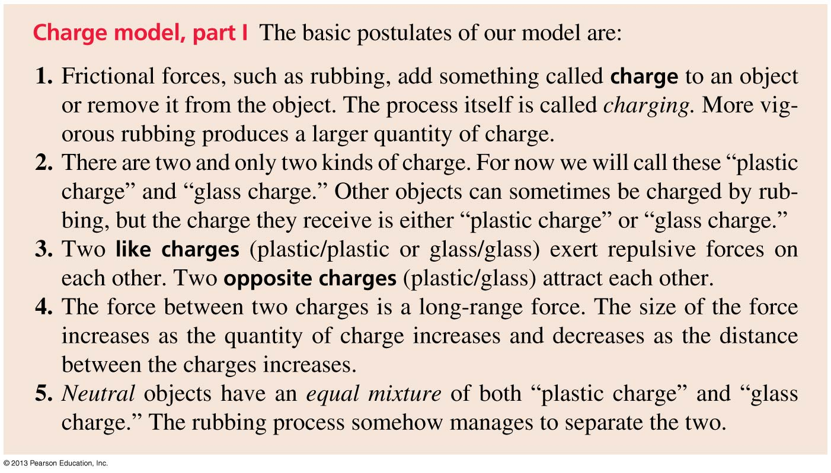
Charge Model, Part I
Slide 25-29

Slide 17
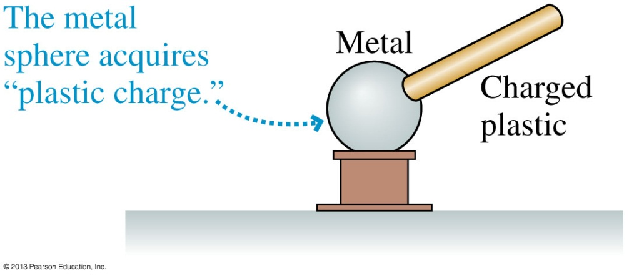
Discovering Electricity: Experiment 9
Charge a plastic rod by rubbing it with wool.
Touch a neutral metal sphere with the rubbed area of the rod.
The metal sphere then picks up small pieces of paper and repels a charged, hanging plastic rod.
The metal sphere appears to have acquired “plastic charge”.
Charge can be transferred from one object to another, but only when the objects touch.
Slide 25-30

Slide 18
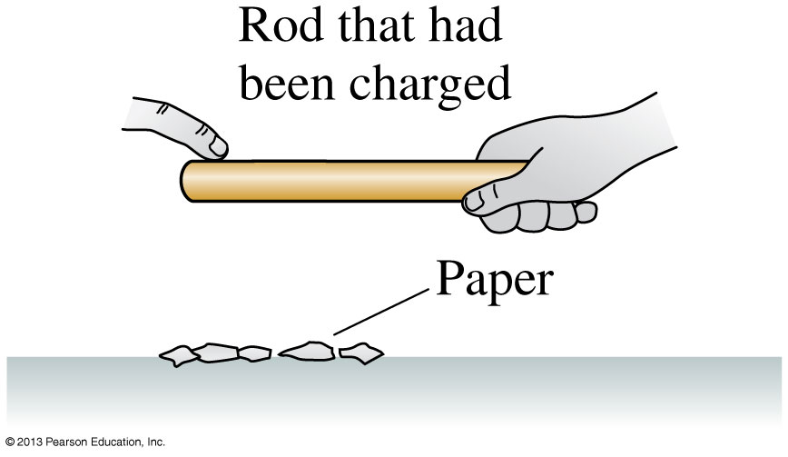
Discovering Electricity: Experiment 10
Charge a plastic rod, then run your finger along it.
After you’ve done so, the rod no longer picks up small pieces of paper or repels a charged, hanging plastic rod.
Similarly, the metal sphere of Experiment 9 no longer repels the plastic rod after you touch it with your finger.
Removing charge from an object, which you can do by touching it, is called discharging.
Slide 25-31

Slide 19
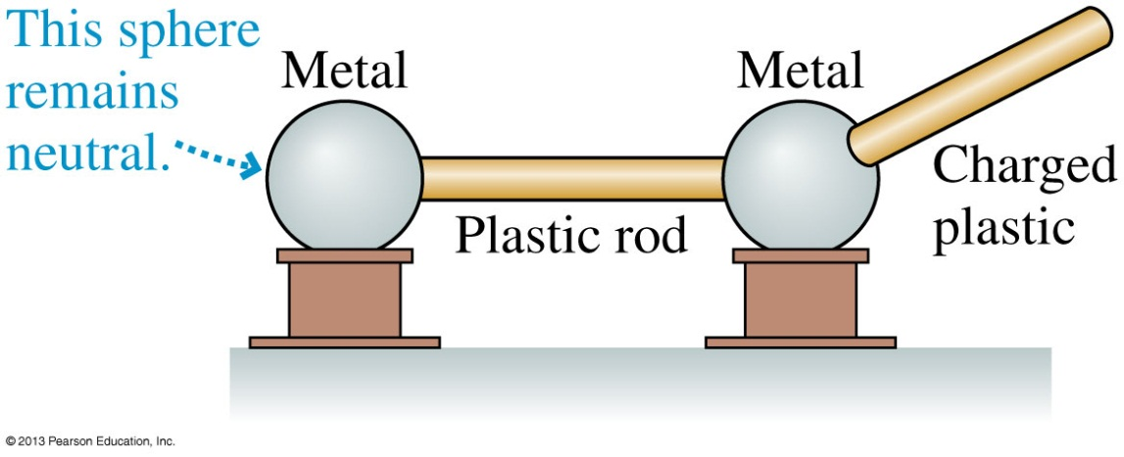
Discovering Electricity: Experiment 11
Place two metal spheres close together with a plastic rod connecting them.
Charge a second plastic rod, by rubbing, and touch it to one of the metal spheres.
Afterward, the metal sphere that was touched picks up small pieces of paper and repels a charged, hanging plastic rod.
The other metal sphere does neither.
Slide 25-32

Slide 20
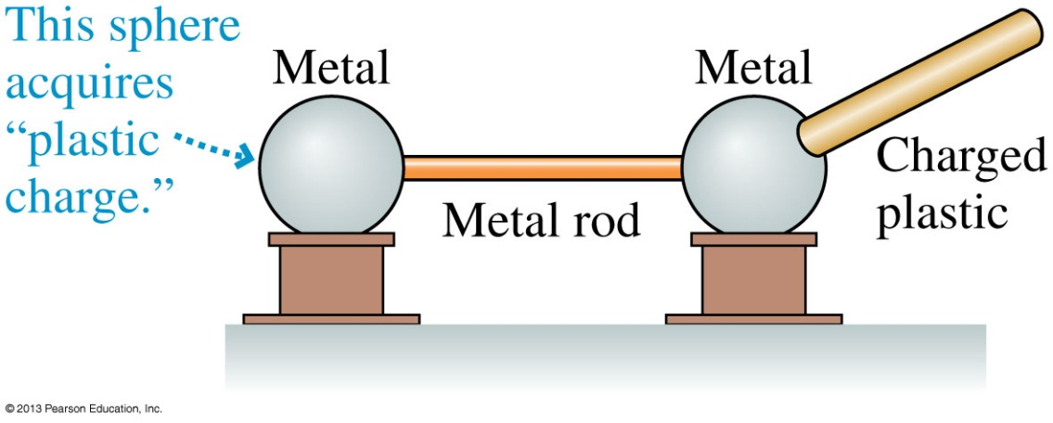
Discovering Electricity: Experiment 12
Repeat Experiment 11 with a metal rod connecting the two metal spheres.
Touch one metal sphere with a charged plastic rod.
Afterward, both metal spheres pick up small pieces of paper and repel a charged, hanging plastic rod.
Metal is a conductor: Charge moves easily through it. Glass and plastic are insulators: Charges remain immobile.
Slide 25-33

Slide 21
Charge Model, Part II
Slide 25-34

Slide 22
Example 25.1 Transferring Charge
Slide 25-35

Slide 23
Example 25.1 Transferring Charge
Slide 25-36

Slide 24
Charge
The modern names for the two types of charge, coined by Benjamin Franklin, are positive charge and negative charge.
Franklin established the convention that a glass rod that has been rubbed with silk is positively charged.
Any other object that repels a charged glass rod is also positively charged, and any charged object that attracts a charged glass rod is negatively charged.
Thus a plastic rod rubbed with wool is negative.
This convention was established long before the discovery of electrons and protons.
Slide 25-37

Slide 25
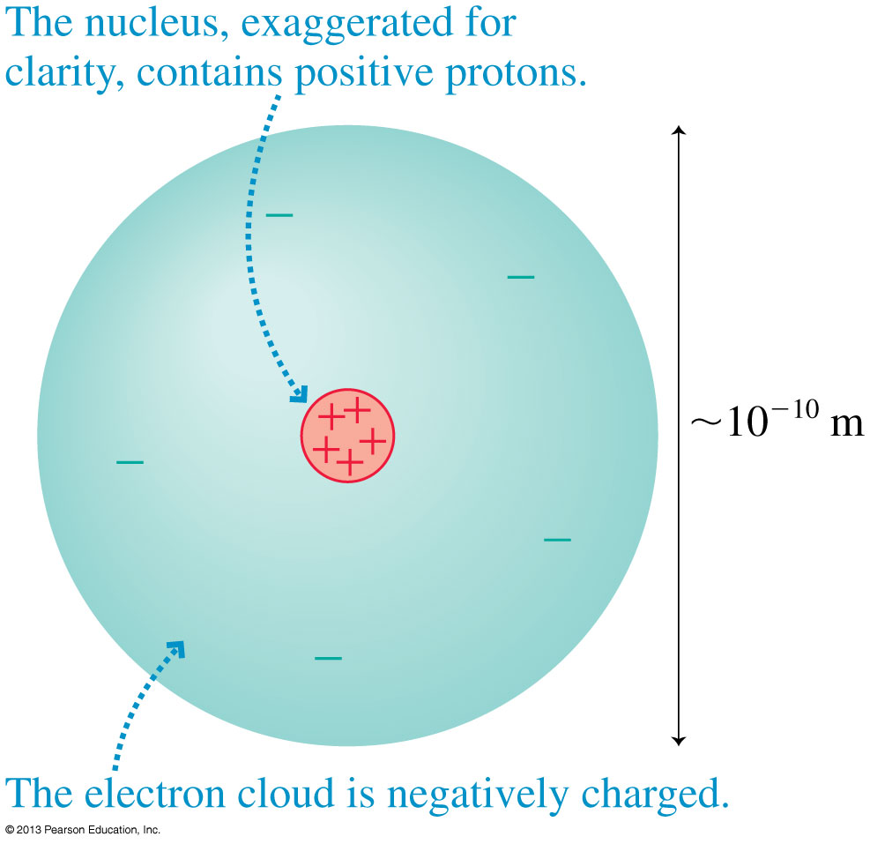
Atoms and Electricity
An atom consists of a very small and dense nucleus, surrounded by much less massive orbiting electrons.
The nucleus contains both protons and neutrons.
Slide 25-40

Slide 26
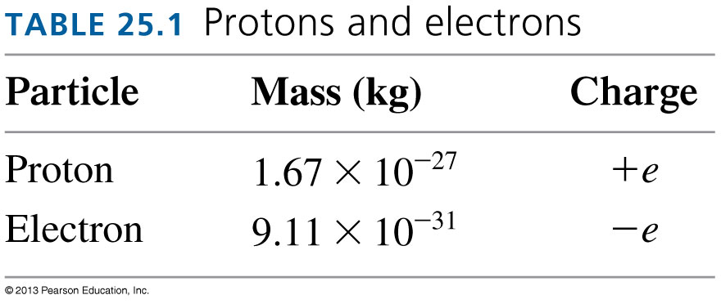
Atoms and Electricity
The atom is held together by the attractive electric force between the positive nucleus and the negative electrons.
Electrons and protons have charges of opposite sign but exactly equal magnitude.
This atomic-level unit of charge, called the fundamental unit of charge, is represented by the symbol e.
Slide 25-41

Slide 27
Charge Quantization
A macroscopic object has net charge:
Where N_{p} and N_{e} are the number of protons and electrons contained in the object.
Most macroscopic objects have an equal number of protons and electrons and therefore have q = 0.
A charged object has an unequal number of protons and electrons.
Notice that an object’s charge is always an integer multiple of e.
This is called charge quantization.
Slide 25-42

Slide 28
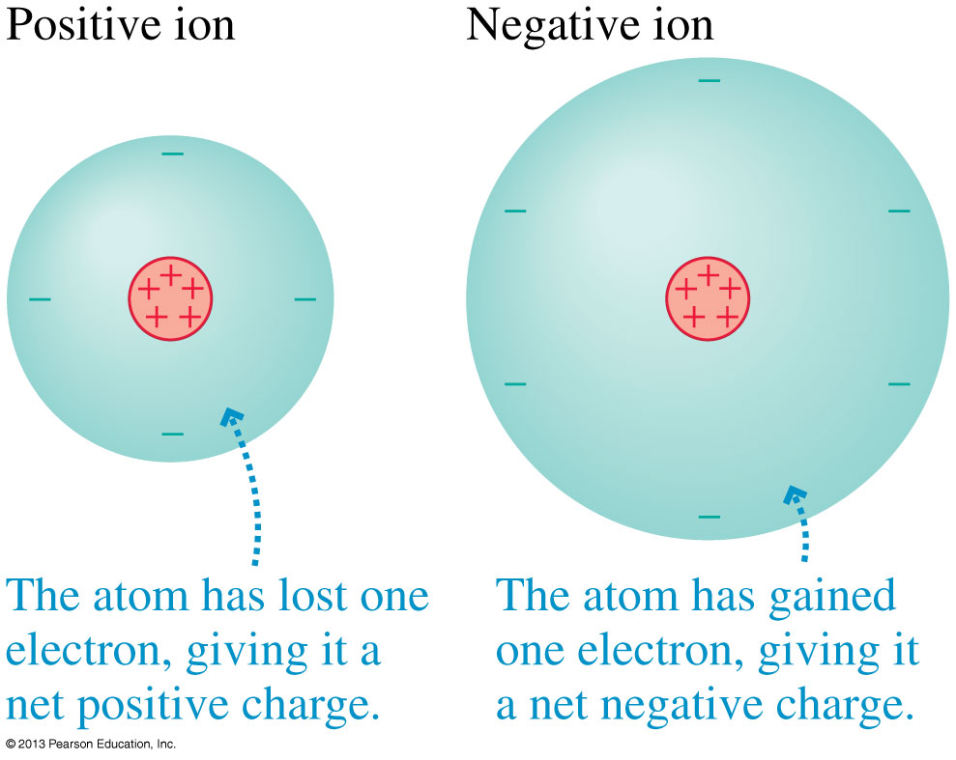
Atoms and Electricity
The process of removing an electron from the electron cloud of an atom, or adding an electron to it, is called ionization.
Slide 25-43

Slide 29
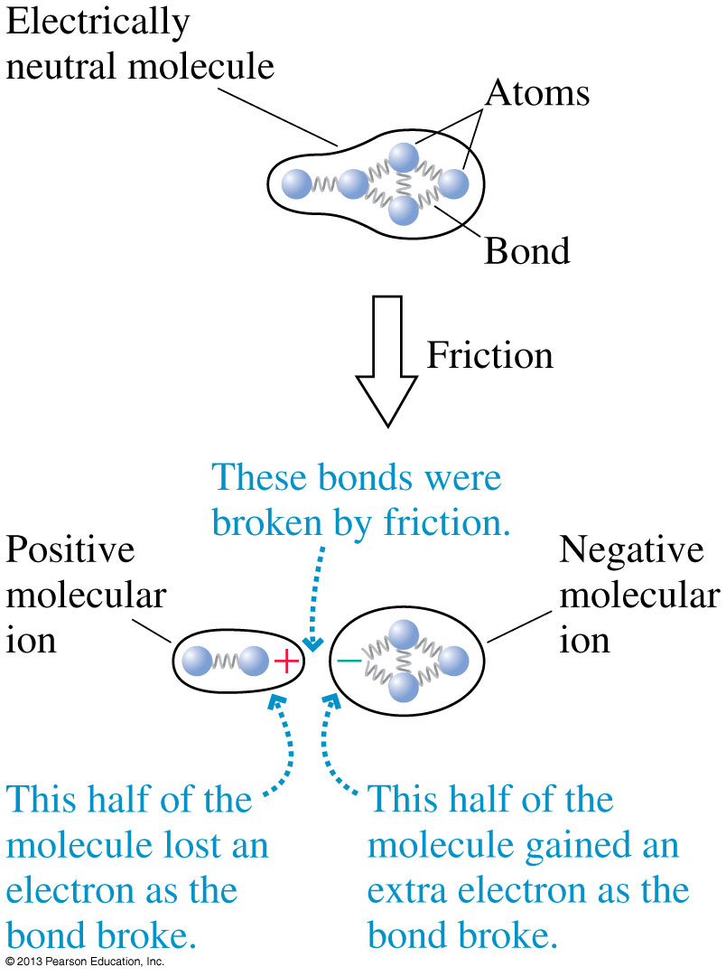
Atoms and Electricity
Molecular ions can be created when one of the bonds in a large molecule is broken.
This is the way in which a plastic rod is charged by rubbing with wool or a comb is charged by passing through your hair.
Slide 25-44

Slide 30
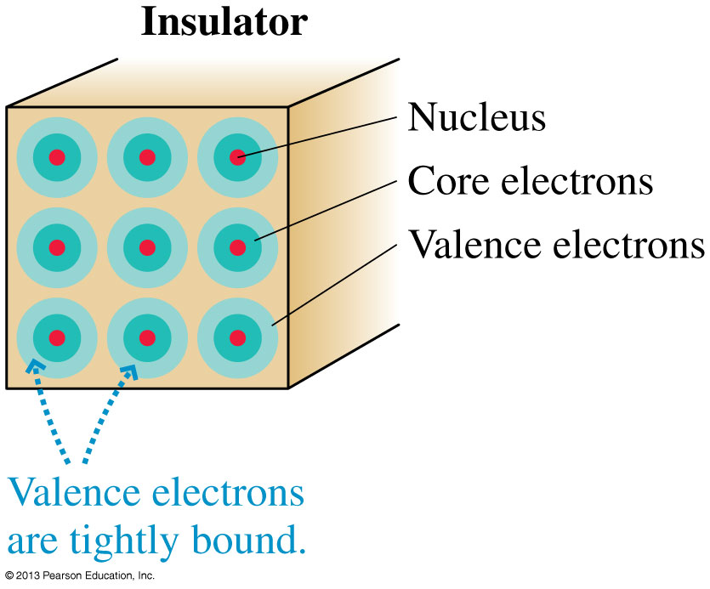
Insulators
The electrons in an insulator are all tightly bound to the positive nuclei and not free to move around.
Charging an insulator by friction leaves patches of molecular ions on the surface, but these patches are immobile.
Slide 25-45

Slide 31
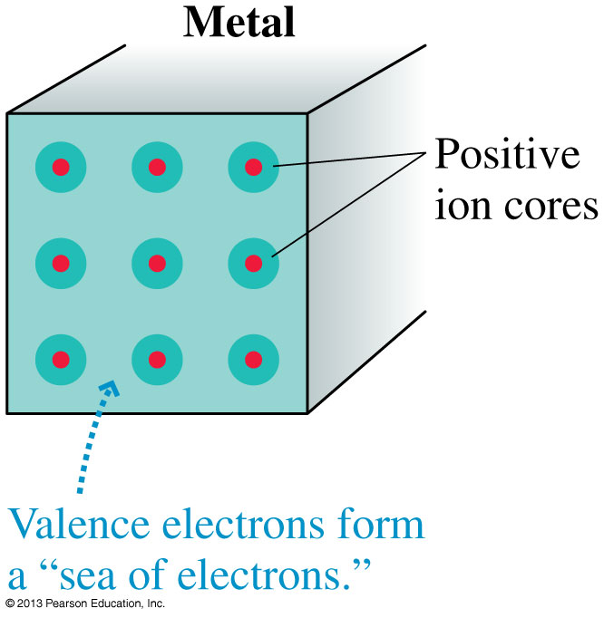
Conductors
In metals, the outer atomic electrons are only weakly bound to the nuclei.
These outer electrons become detached from their parent nuclei and are free to wander about through the entire solid.
The solid as a whole remains electrically neutral, but the electrons are now like a negatively charged liquid permeating an array of positively charged ion cores.
Slide 25-46

Slide 32
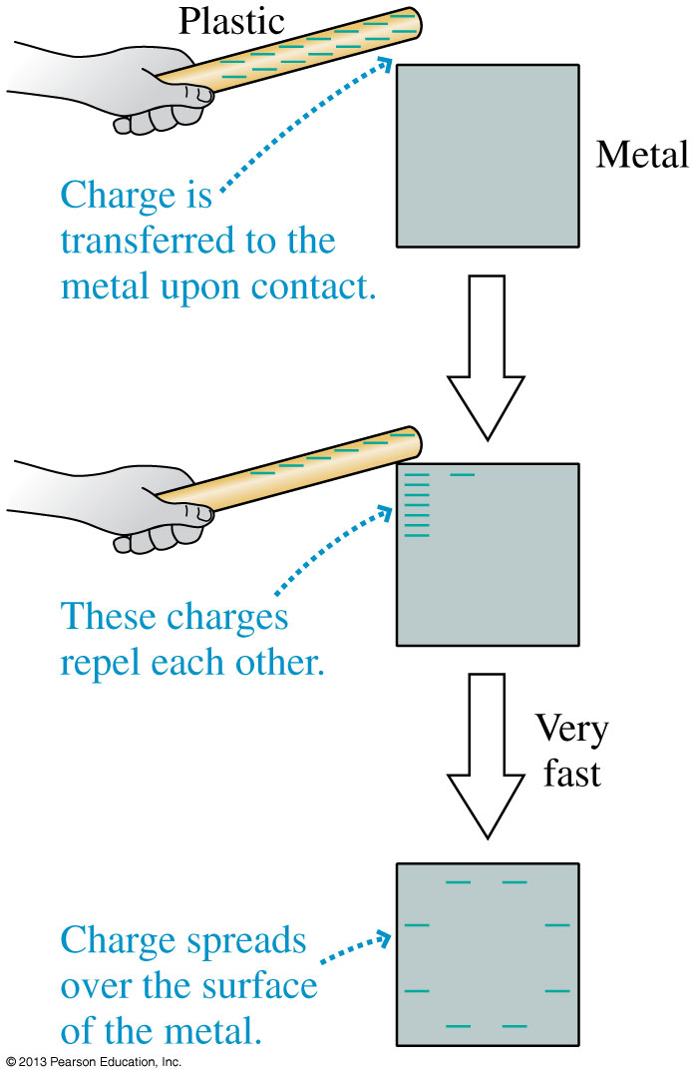
Charging
The figure shows how a conductor is charged by contact with a charged plastic rod.
Electrons in a conductor are free to move.
Once charge is transferred to the metal, repulsive forces between the electrons cause them to move apart from each other.
Slide 25-47

Slide 33
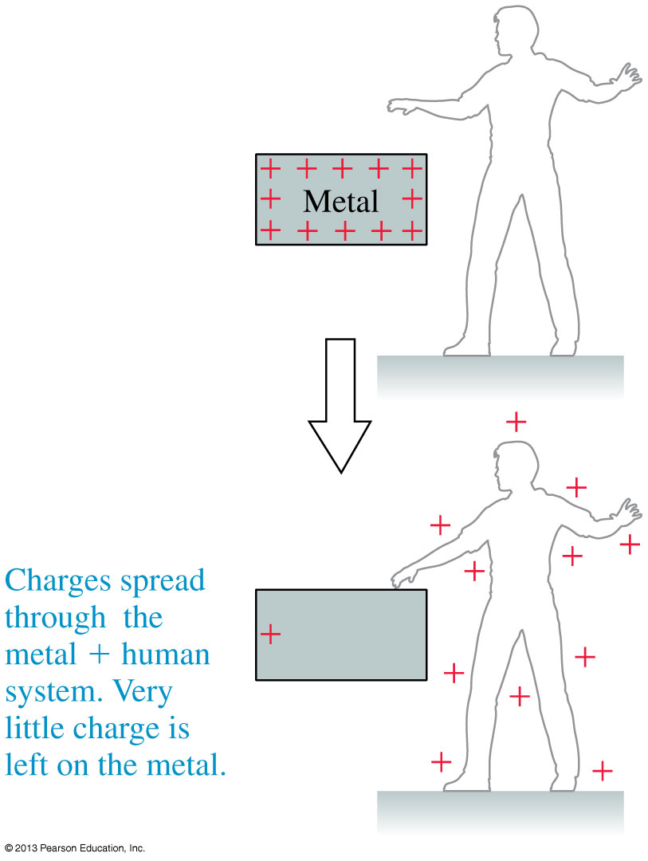
Discharging
The figure shows how touching a charged metal discharges it.
Any excess charge that was initially confined to the metal can now spread over the larger metal + human conductor.
- Charges flow to the metal NOT + charges to the man.
Slide 25-48

Slide 34
Charge Polarization
The figure shows how a charged rod held close to an electroscope causes the leaves to repel each other.
How do charged objects of either sign exert an attractive force on a neutral object?
Slide 25-49

Slide 35
Charge Polarization
Although the metal as a whole is still electrically neutral, we say that the object has been polarized.
Charge polarization is a slight separation of the positive and negative charges in a neutral object.
Slide 25-50

Slide 36
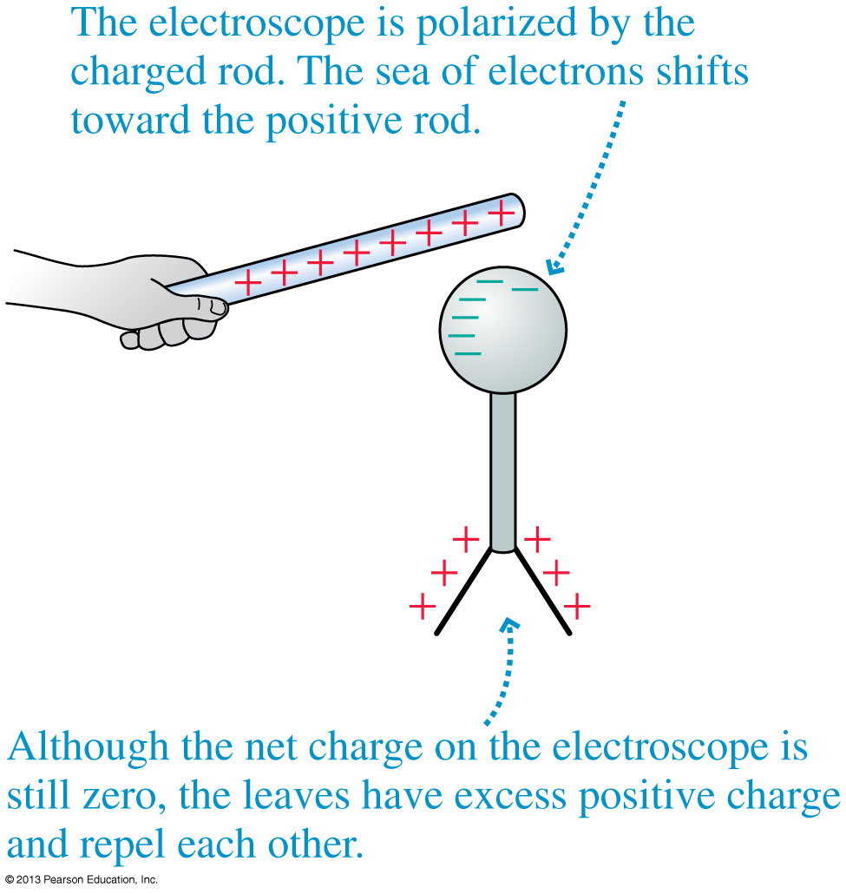
Charge Polarization
Charge polarization produces an excess positive charge on the leaves of the electroscope, so they repel each other.
Because the electroscope has no net charge, the electron sea quickly readjusts once the rod is removed.
Slide 25-51

Slide 37
Polarization Force
The figure below shows a positively charged rod near a neutral piece of metal.
Because the electric force decreases with distance, the attractive force on the electrons at the top surface is slightly greater than the repulsive force on the ions at the bottom.
The net force toward the charged rod is called a polarization force.
Slide 25-52

Slide 38
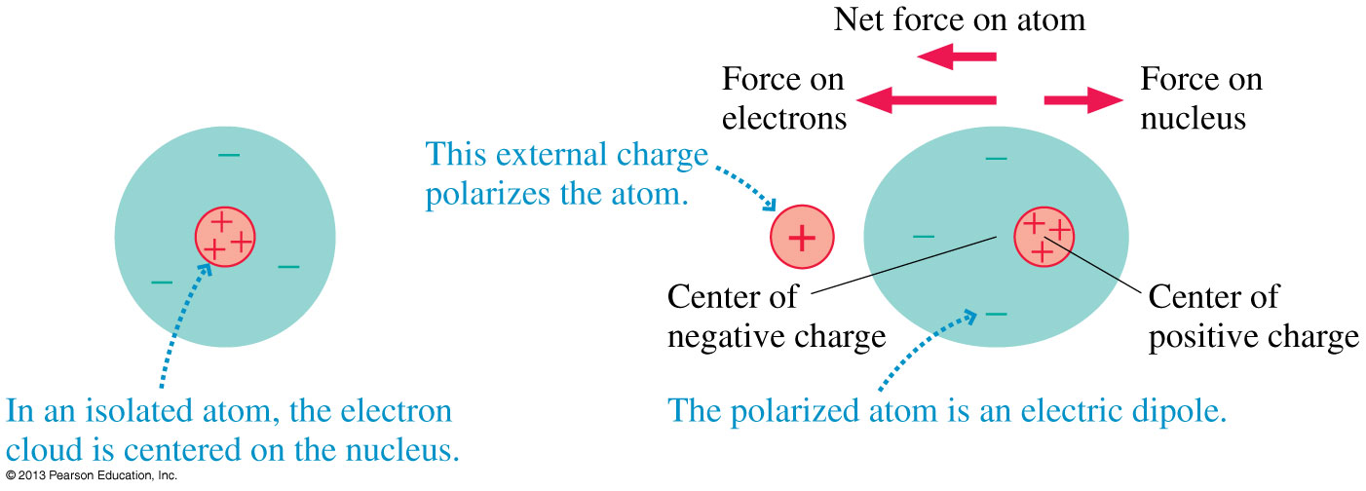
The Electric Dipole
The figure below shows how a neutral atom is polarized by an external charge, forming an electric dipole.
Slide 25-53

Slide 39
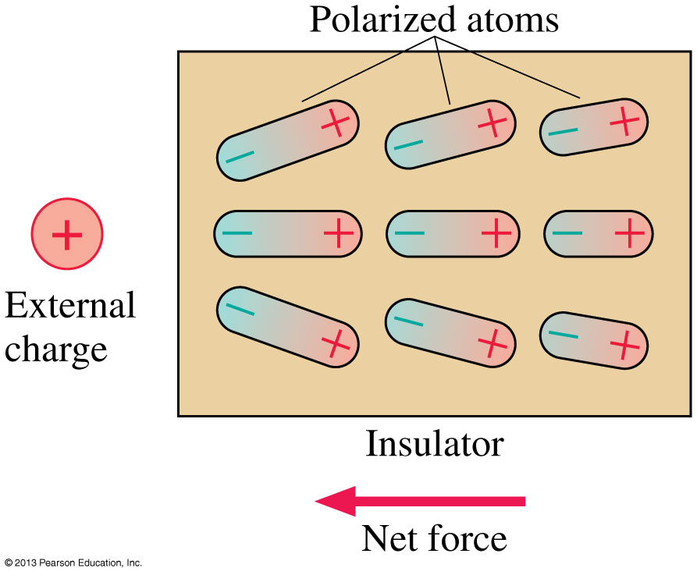
The Electric Dipole
When an insulator is brought near an external charge, all the individual atoms inside the insulator become polarized.
The polarization force acting on each atom produces a net polarization force toward the external charge.
Slide 25-54

Slide 40
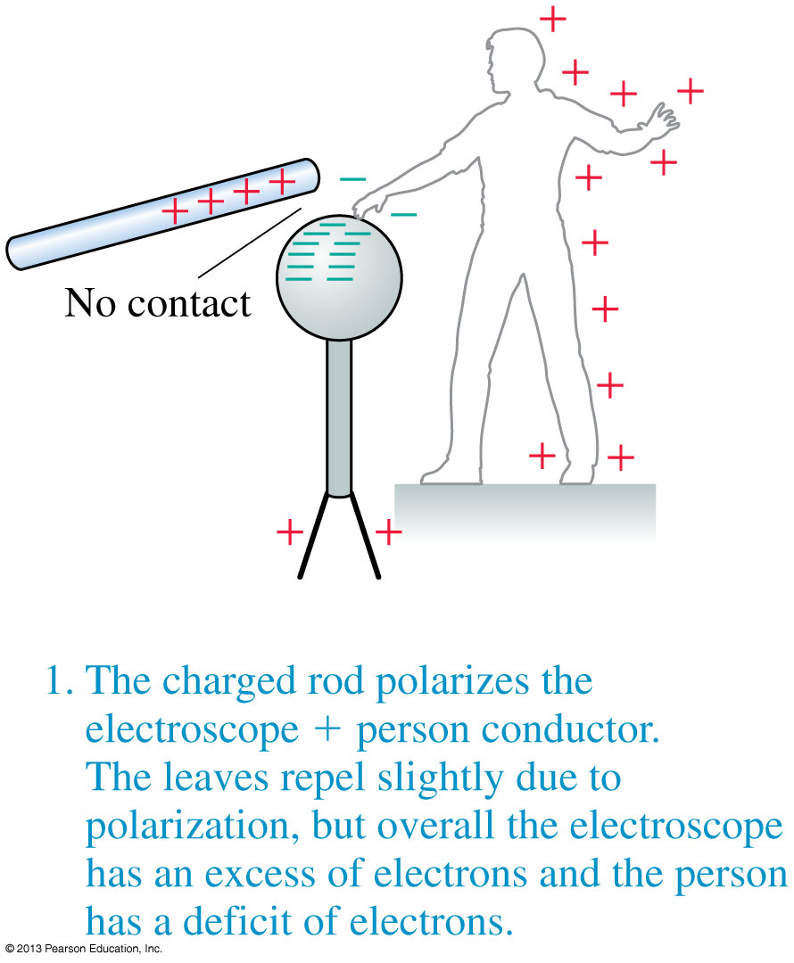
Charging by Induction, Step 1
Slide 25-55

Slide 41
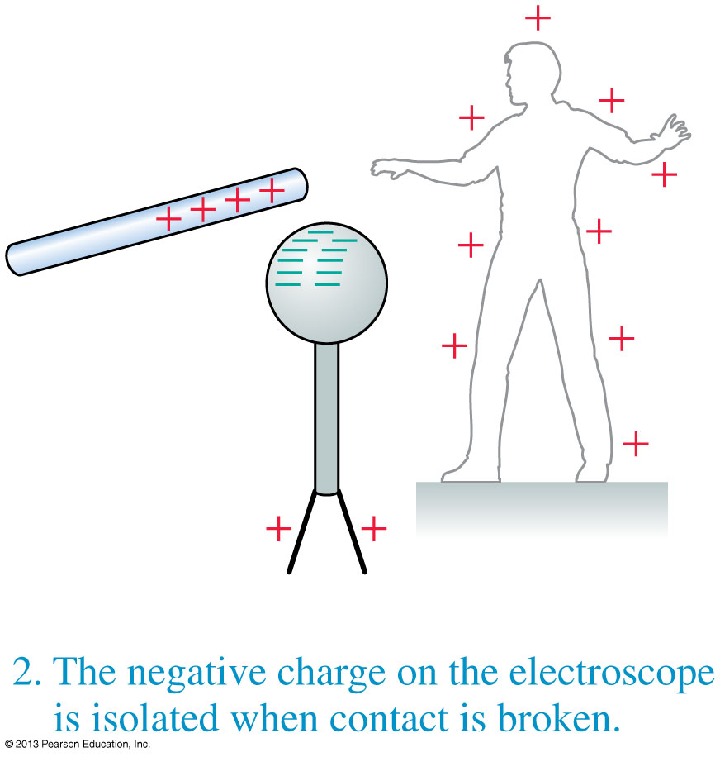
Charging by Induction, Step 2
Slide 25-56

Slide 42
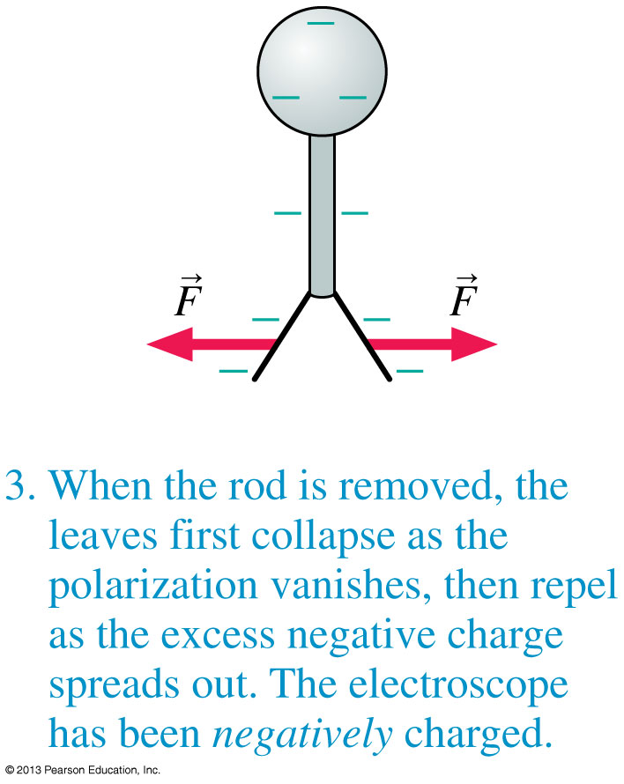
Charging by Induction, Step 3
Slide 25-57

Slide 43
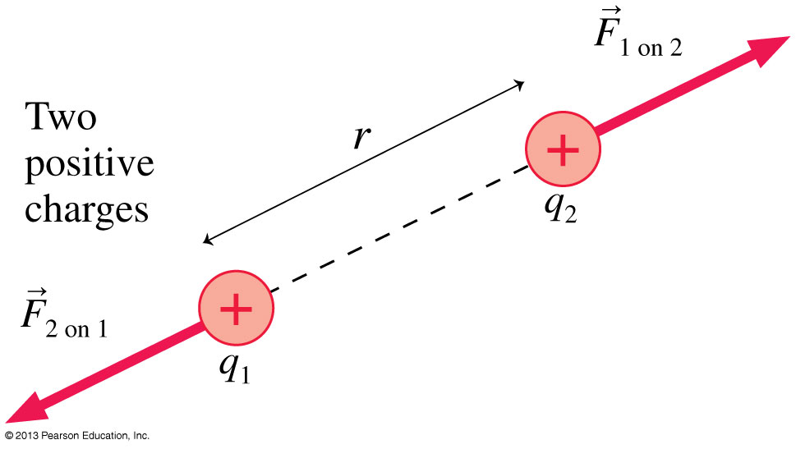
Coulomb’s Law
When two positively charged particles are a distance, r, apart, they each experience a repulsive force.
In SI units K = 8.99 × 10⁹ N m²/C².
Slide 25-66

Slide 44
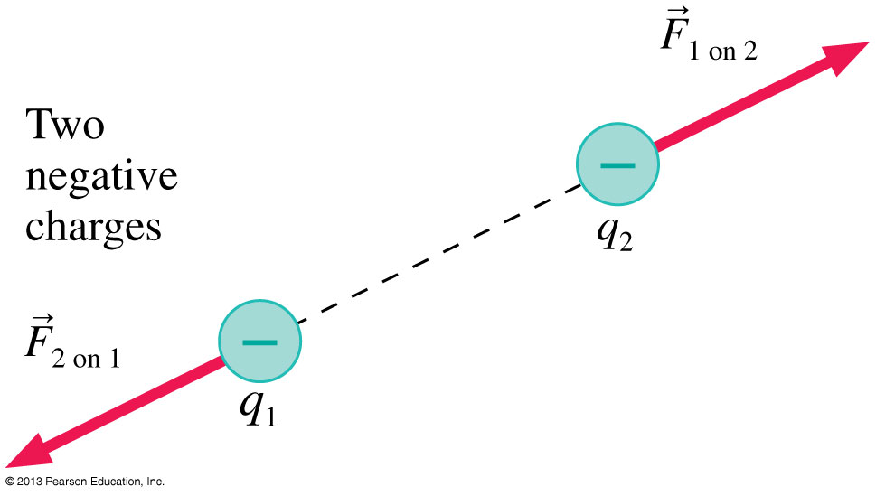
Coulomb’s Law
When two negatively charged particles are a distance, r, apart, they each experience a repulsive force.
In SI units K = 8.99 × 10⁹ N m²/C².
Slide 25-67

Slide 45
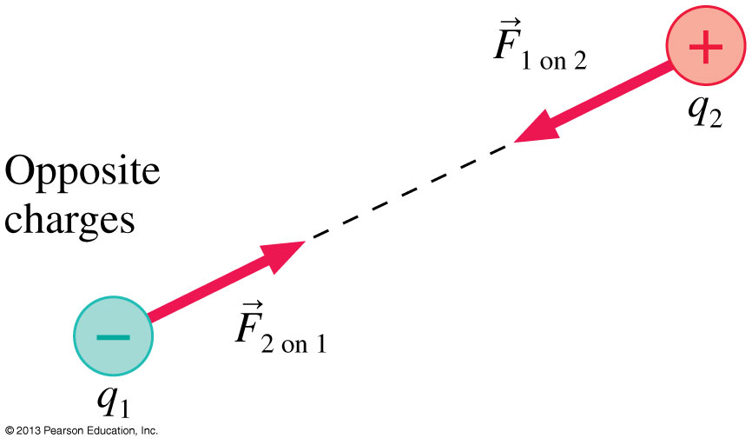
Coulomb’s Law
When two oppositely charged particles are a distance, r, apart, they each experience an attractive force.
In SI units K = 8.99 × 10⁹ N m²/C².
Slide 25-68

Slide 46
Coulomb’s Law
In SI units K = 8.99 × 10⁹ N m²/C².
Slide 25-69

Slide 47
The Permittivity Constant
We can make many future equations easier to use if we rewrite Coulomb’s law in a somewhat more complicated way.
Let’s define a new constant, called the permittivity constant ₀:
∋
Rewriting Coulomb’s law in terms of ₀ gives us:
∋
Slide 25-74

Slide 48
Problem-Solving Strategy: Electrostatic Forces and Coulomb’s law
Slide 25-75

Slide 49
Problem-Solving Strategy: Electrostatic Forces and Coulomb’s law
Slide 25-76

Slide 50
Example 25.5 Lifting a Glass Bead
Slide 25-81

Slide 51
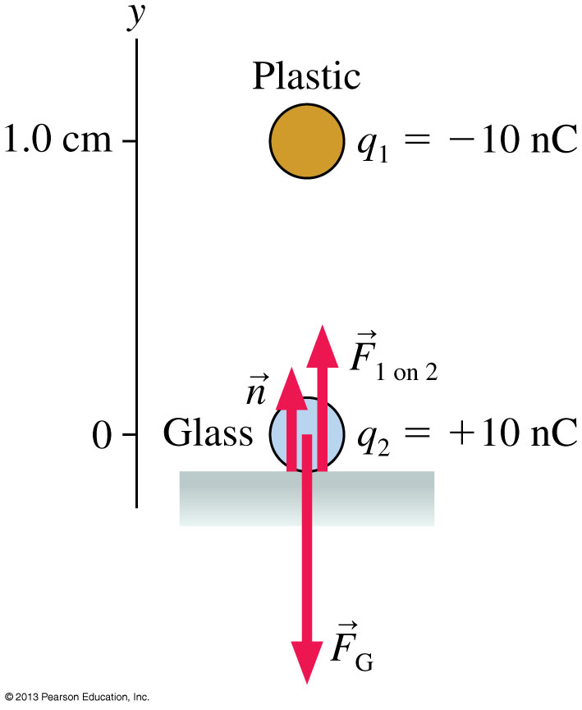
Example 25.5 Lifting a Glass Bead
Slide 25-82

Slide 52
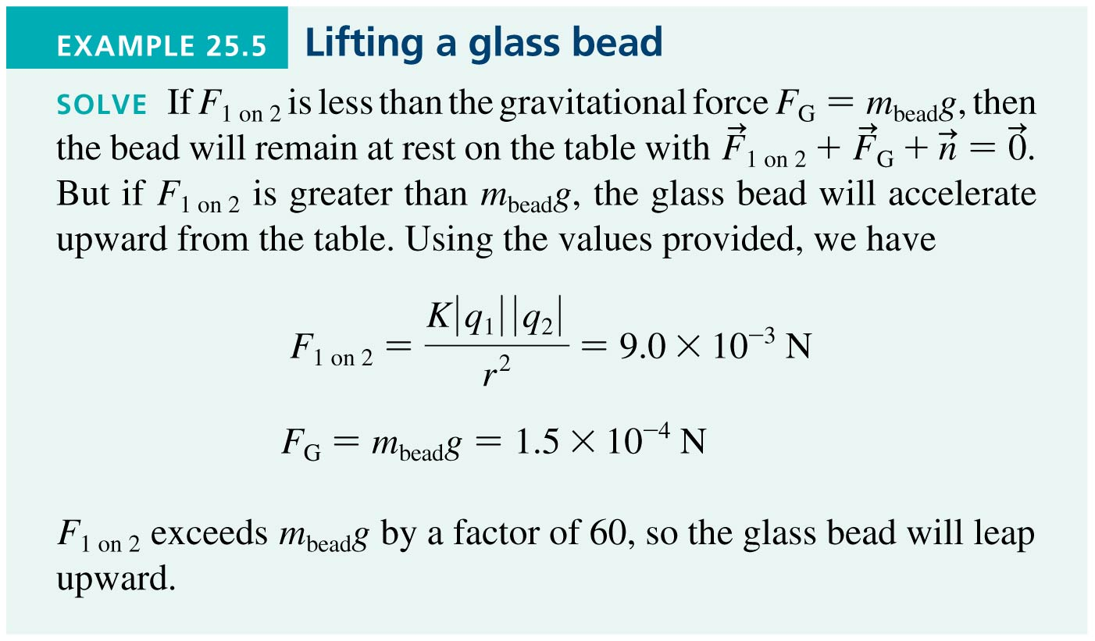
Example 25.5 Lifting a Glass Bead
Slide 25-83

Slide 53
Example 25.5 Lifting a Glass Bead
Slide 25-84

Slide 54
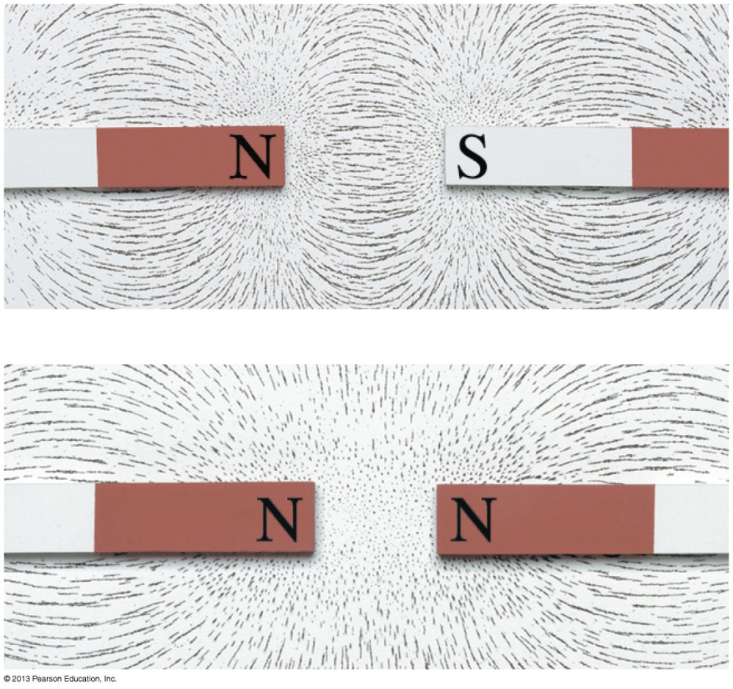
The Field Model
The photos show the patterns that iron filings make when sprinkled around a magnet.
These patterns suggest that space itself around the magnet is filled with magnetic influence.
This is called the magnetic field.
The concept of such a “field” was first introduced by Michael Faraday in 1821.
Slide 25-87

Slide 55
The Field Model
A field is a function that assigns a vector to every point in space.
The alteration of space around a mass is called the gravitational field.
Similarly, the space around a charge is altered to create the electric field.
Slide 25-88

Slide 56
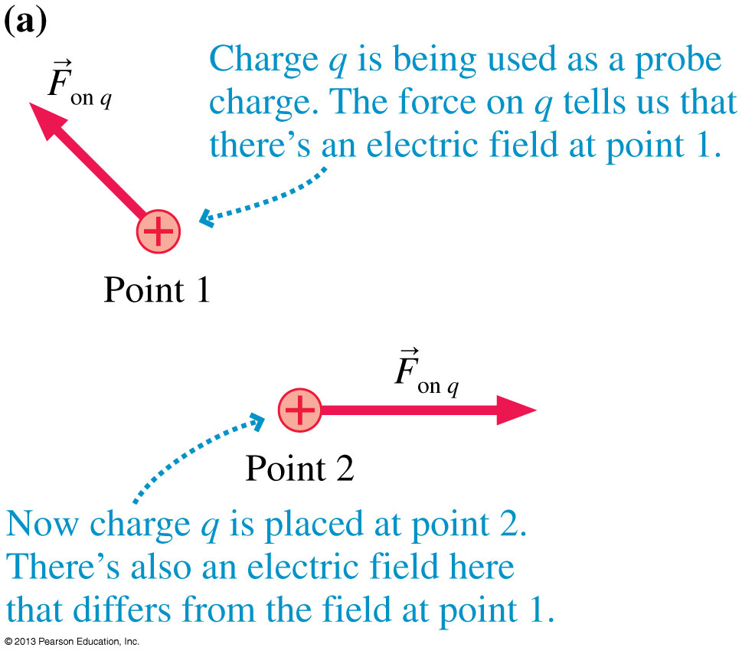
The Electric Field
If a probe charge q experiences an electric force at a point in space, we say that there is an electric field at that point causing the force.
The units of the electric field are N/C. The magnitude E of the electric field is called the electric field strength.
Slide 25-89

Slide 57
The Electric Field
A charged particle with charge q at a point in space where the electric field is experiences an electric force:
If q is positive, the force on the particle is in the direction of .
The force on a negative charge is opposite the direction of .
Slide 25-90

Slide 58
Example 25.7 Electric Forces in a Cell
Slide 25-91

Slide 59
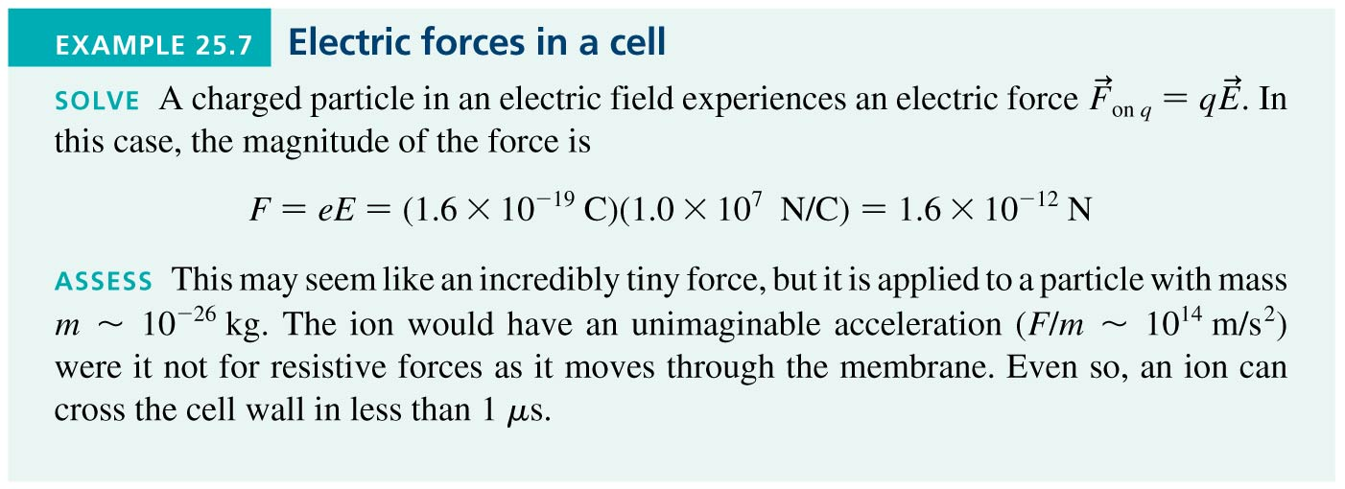
Example 25.7 Electric Forces in a Cell
Slide 25-92

Slide 60
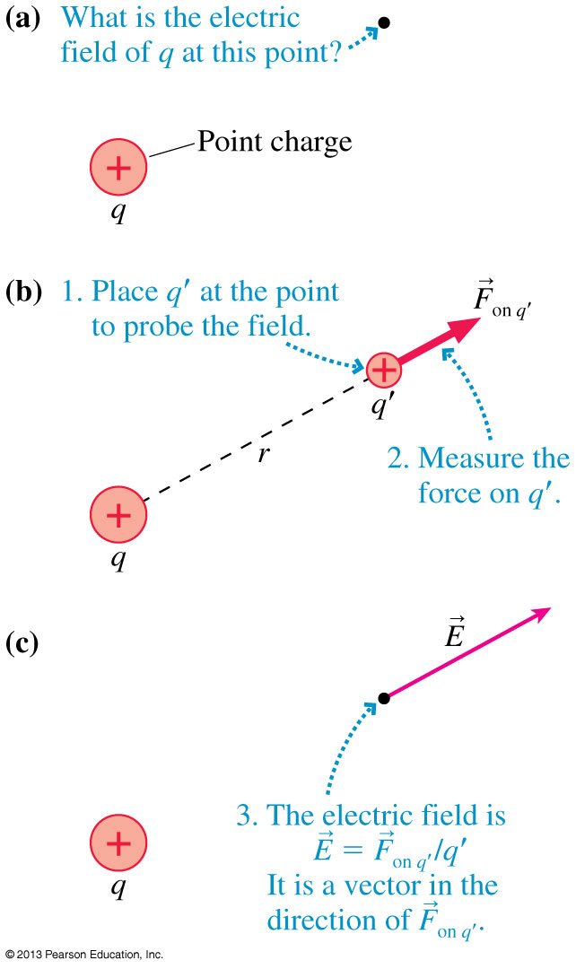
The Electric Field of a Point Charge
Figure (a) shows charge q, and a point in space where we would like to know the electric field.
We need a second charge, shown in figure (b), to serve as a probe fore the electric field.
The electric field, shown in figure (c), is given by:
Slide 25-93

Slide 61
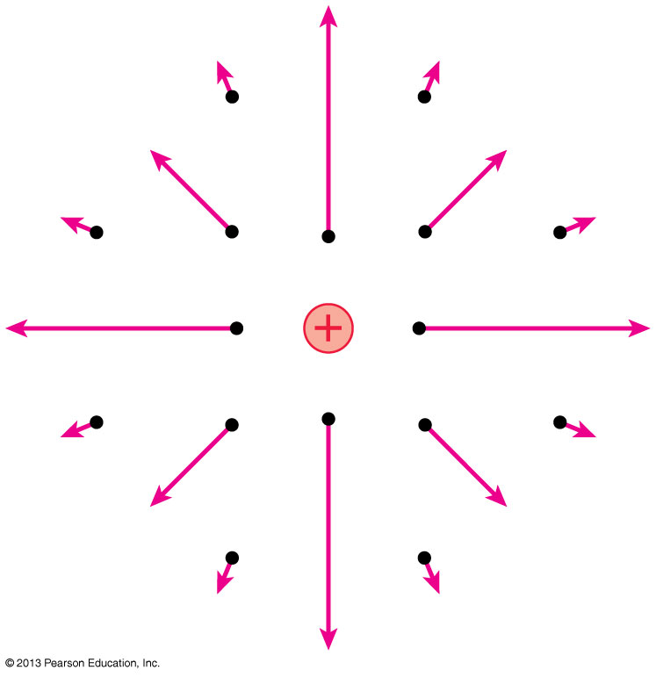
The Electric Field of a Point Charge
If we calculate the field at a sufficient number of points in space, we can draw a field diagram.
Notice that the field vectors all point straight away from charge q.
Also notice how quickly the arrows decrease in length due to the inverse-square dependence on r.
Slide 25-94

Slide 62
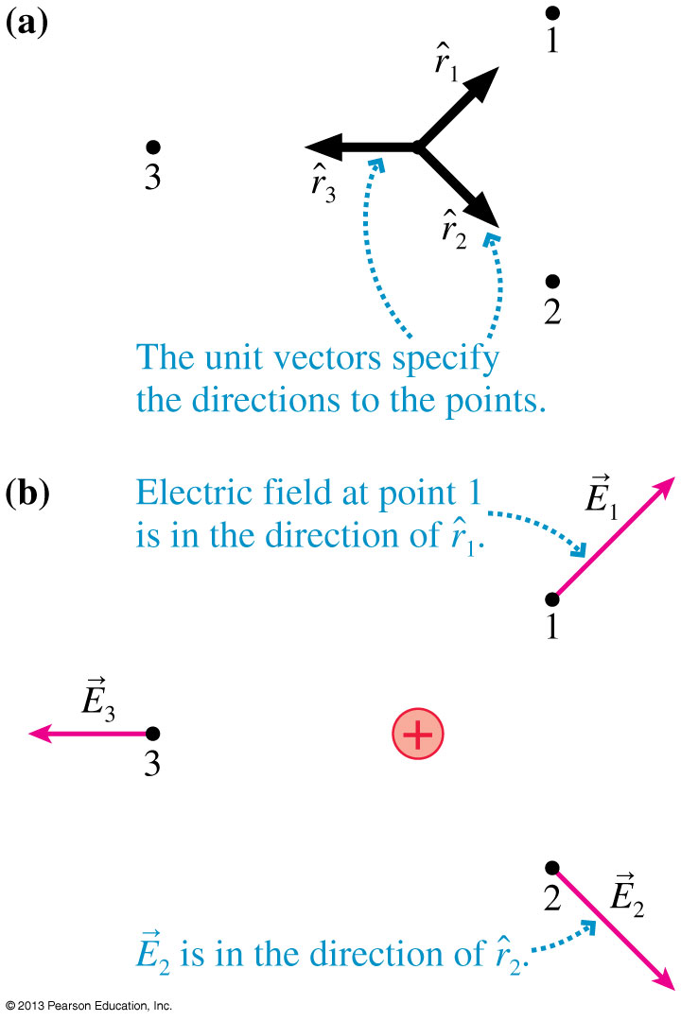
Unit Vector Notation
Figure (a) shows unit vectors pointing toward points 1, 2, and 3.
Unit vector specifies the direction “straight outward from this point”.
Figure (b) shows the electric fields at points 1, 2, and 3 due to a positive charge at the origin.
The electric field points in the direction of the unit vector .
Slide 25-97

Slide 63
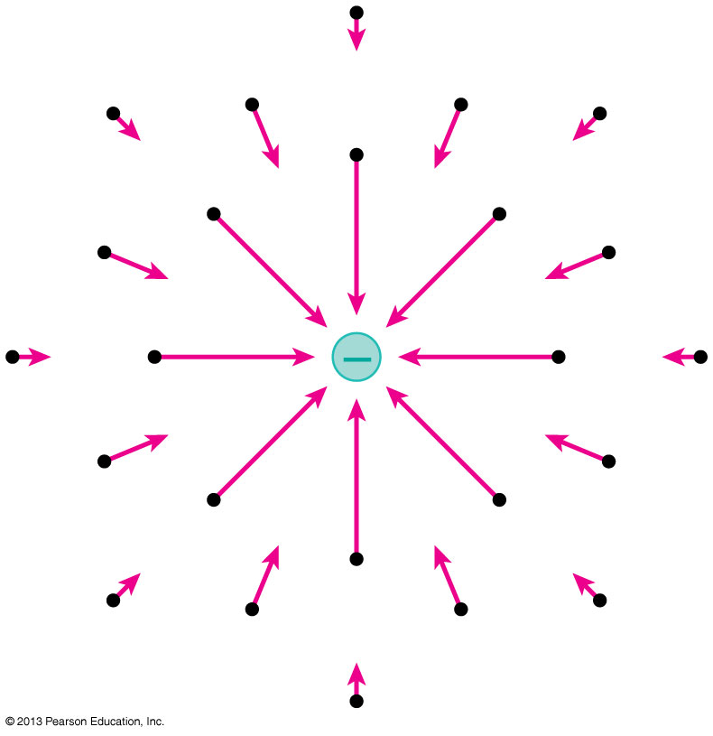
The Electric Field of a Point Charge
Using unit vector notation, the electric field at a distance r from a point charge q is:
A negative sign in front of a vector simply reverses its direction.
The figure shows the electric field of a negative point charge.
Slide 25-100

Slide 64
Example 25.9 The Electric Field of a Proton
Slide 25-103

Slide 65
Example 25.9 The Electric Field of a Proton
Slide 25-104

Slide 66
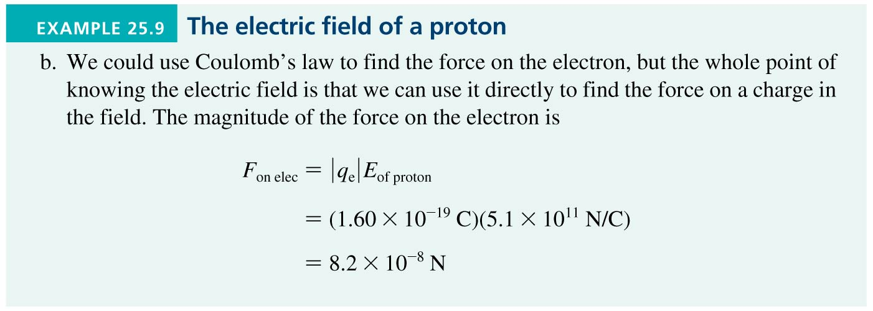
Example 25.9 The Electric Field of a Proton
Slide 25-105

Slide 67
Chapter 25 Summary Slides
Slide 25-106

Slide 68
General Principles
Slide 25-107

Slide 69
Important Concepts
Slide 25-108

Slide 70
Important Concepts
Slide 25-109

Slide 71
Important Concepts
Slide 25-110

Slide 72
Important Concepts
Slide 25-111

