Slide 1
Chapter 33 Preview
Slide 33-3

Slide 2
Chapter 33 Preview
Slide 33-4

Slide 3
Chapter 33 Preview
Slide 33-5

Slide 4
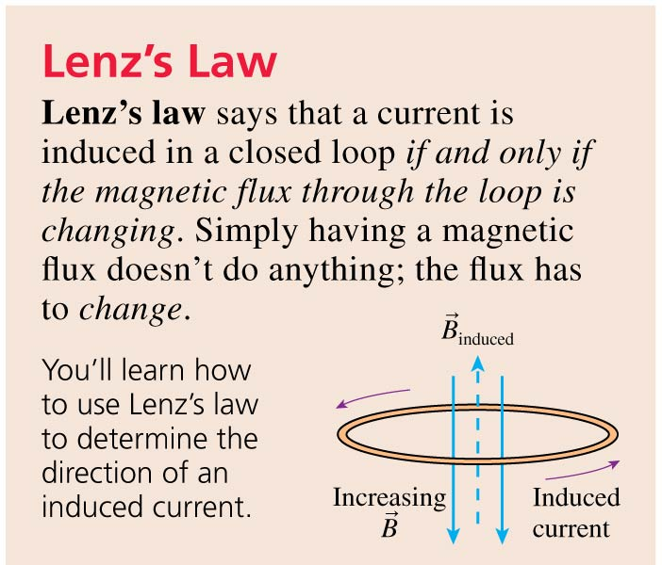
Chapter 33 Preview
Slide 33-6

Slide 5
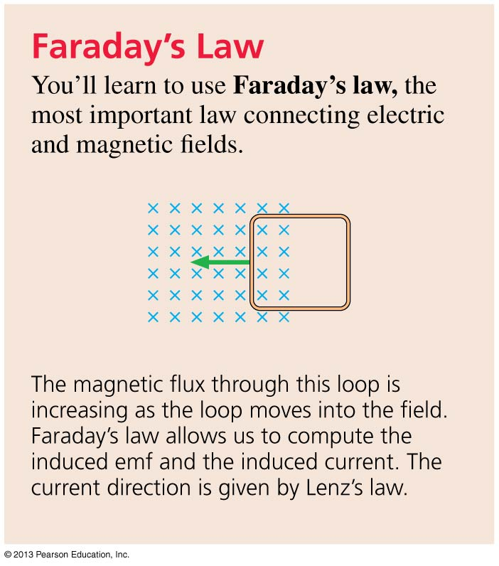
Chapter 33 Preview
Slide 33-7

Slide 6
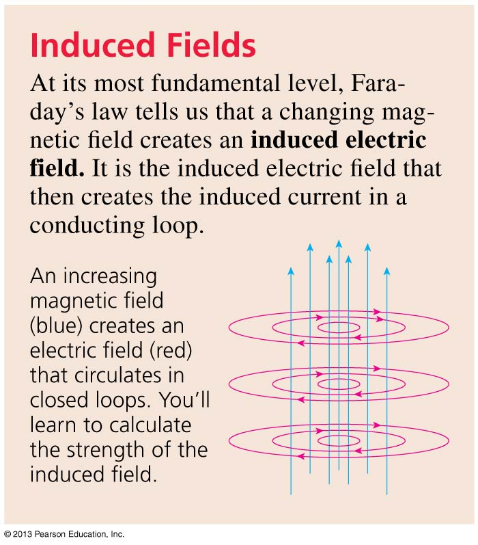
Chapter 33 Preview
Slide 33-8

Slide 7
Reading Question 33.1
Currents circulate in a piece of metal that is pulled through a magnetic field. What are these currents called?
Induced currents.
Displacement currents.
Faraday’s currents.
Eddy currents.
This topic is not covered in Chapter 33.
Slide 33-10

Slide 8
Reading Question 33.1
Currents circulate in a piece of metal that is pulled through a magnetic field. What are these currents called?
Induced currents.
Displacement currents.
Faraday’s currents.
Eddy currents.
This topic is not covered in Chapter 33.
Slide 33-11

Slide 9
Reading Question 33.2
Electromagnetic induction was discovered by
Faraday.
Henry.
Maxwell.
Both Faraday and Henry.
All three.
Slide 33-12

Slide 10
Reading Question 33.2
Electromagnetic induction was discovered by
Faraday.
Henry.
Maxwell.
Both Faraday and Henry.
All three.
Slide 33-13

Slide 11
Reading Question 33.3
The direction that an induced current flows in a circuit is given by
Faraday’s law.
Lenz’s law.
Henry’s law.
Hertz’s law.
Maxwell’s law.
Slide 33-14

Slide 12
Reading Question 33.3
The direction that an induced current flows in a circuit is given by
Faraday’s law.
Lenz’s law.
Henry’s law.
Hertz’s law.
Maxwell’s law.
Slide 33-15

Slide 13
Reading Question 33.4
After thinking about electromagnetic induction, James Clerk Maxwell was lead to propose that
An electric current can be induced by a changing magnetic flux.
A magnetic field can be produced by an electric current.
Light is an electromagnetic wave.
Moving charges accelerate in an magnetic field.
Nothing can travel faster than the speed of light.
Slide 33-16

Slide 14
Reading Question 33.4
After thinking about electromagnetic induction, James Clerk Maxwell was lead to propose that
An electric current can be induced by a changing magnetic flux.
A magnetic field can be produced by an electric current.
Light is an electromagnetic wave.
Moving charges accelerate in an magnetic field.
Nothing can travel faster than the speed of light.
Slide 33-17

Slide 15
Reading Question 33.5
A transformer
Boosts the maximum current provided by a battery.
Changes mechanical energy to electrical energy.
Changes the voltage of an alternating current.
Resists changes in current.
Converts alternating current to direct current.
Slide 33-18

Slide 16
Reading Question 33.5
A transformer
Boosts the maximum current provided by a battery.
Changes mechanical energy to electrical energy.
Changes the voltage of an alternating current.
Resists changes in current.
Converts alternating current to direct current.
Slide 33-19

Slide 17
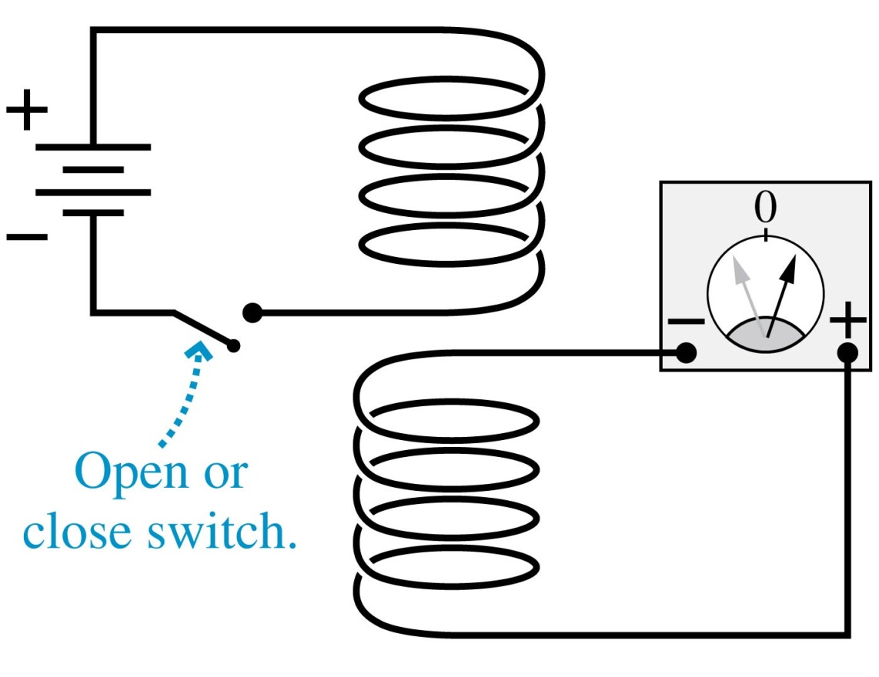
Faraday’s Discovery of 1831
When one coil is placed directly above another, there is no current in the lower circuit while the switch is in the closed position.
A momentary current appears whenever the switch is opened or closed.
Slide 33-21

Slide 18
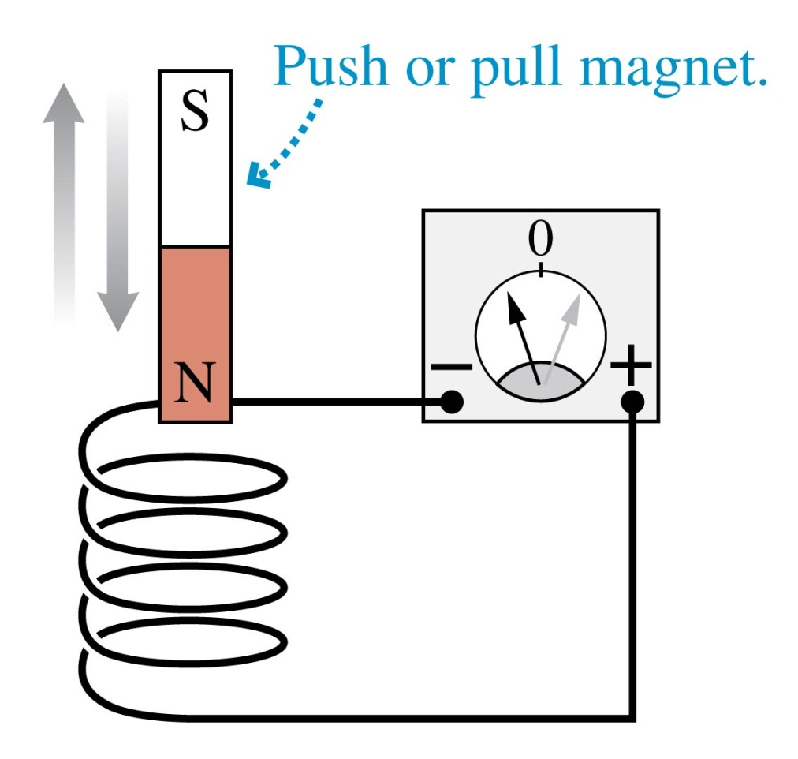
Faraday’s Discovery of 1831
When a bar magnet is pushed into a coil of wire, it causes a momentary deflection of the current-meter needle.
Holding the magnet inside the coil has no effect.
A quick withdrawal of the magnet deflects the needle in the other direction.
Slide 33-22

Slide 19
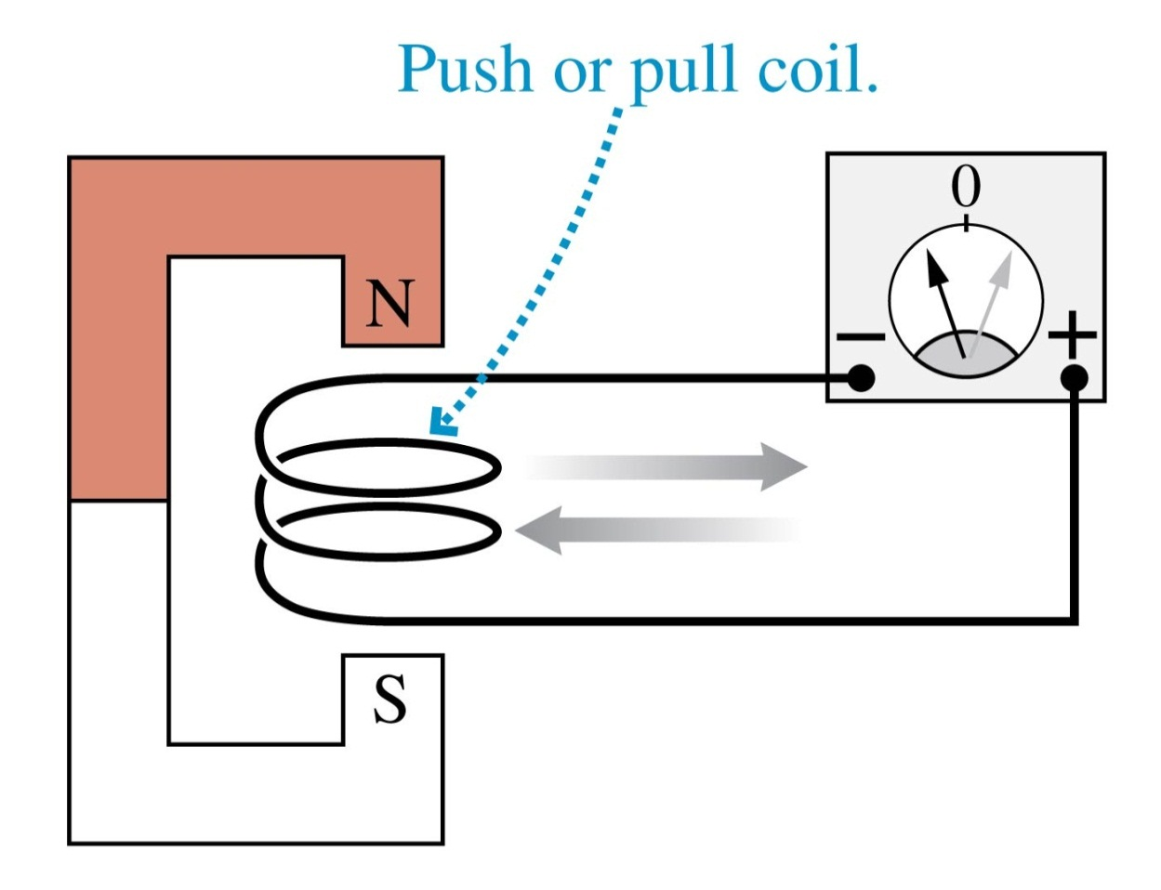
Faraday’s Discovery of 1831
A momentary current is produced by rapidly pulling a coil of wire out of a magnetic field.
Pushing the coil into the magnet causes the needle to deflect in the opposite direction.
Slide 33-23

Slide 20
Motional emf
Slide 33-24

Slide 21
Motional emf
Slide 33-25

Slide 22
Motional emf
Slide 33-26

Slide 23
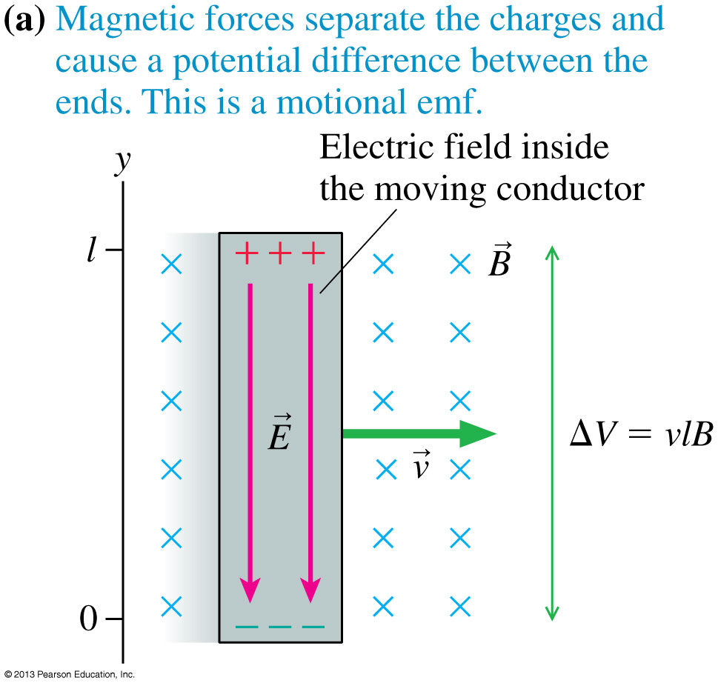
Motional emf
The magnetic force on the charge carriers in a moving conductor creates an electric field of strength E = vB inside the conductor.
For a conductor of length l, the motional emf perpendicular to the magnetic field is:
Slide 33-27

Slide 24
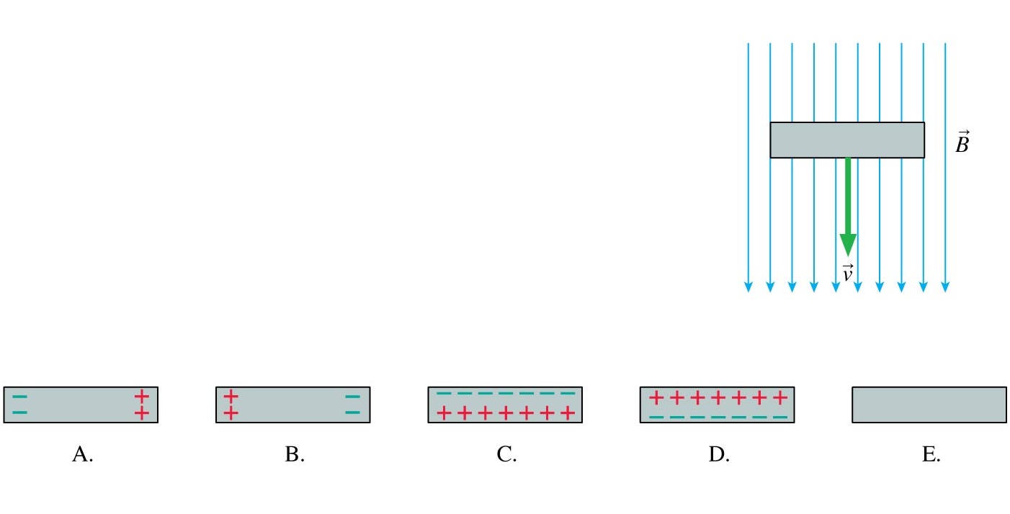
QuickCheck 33.1
A metal bar moves through a magnetic field. The induced charges on the bar are
Slide 33-28
Notes:
24

Slide 25
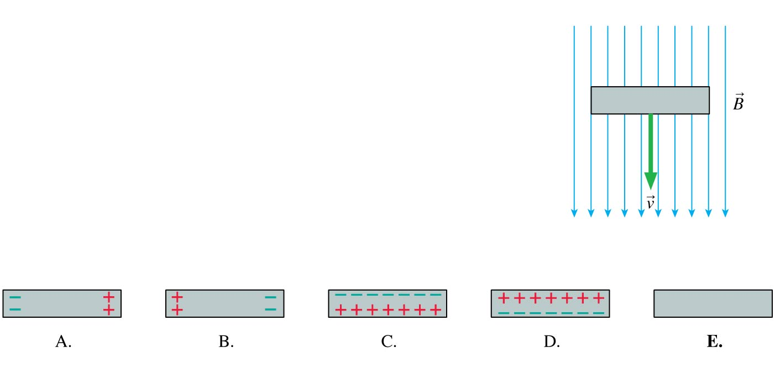
QuickCheck 33.1
A metal bar moves through a magnetic field. The induced charges on the bar are
Slide 33-29
Notes:
25

Slide 26
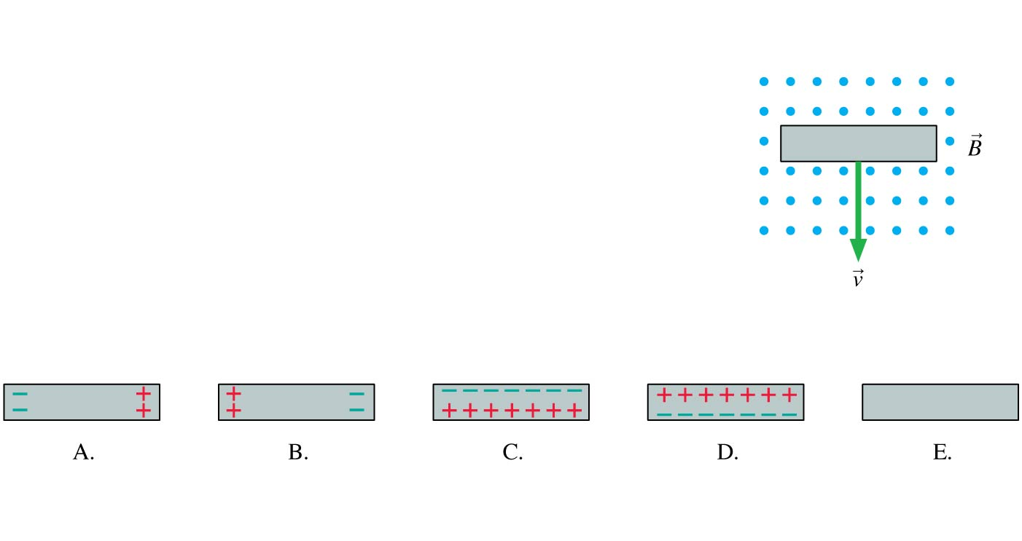
QuickCheck 33.2
A metal bar moves through a magnetic field. The induced charges on the bar are
Slide 33-30
Notes:
26

Slide 27
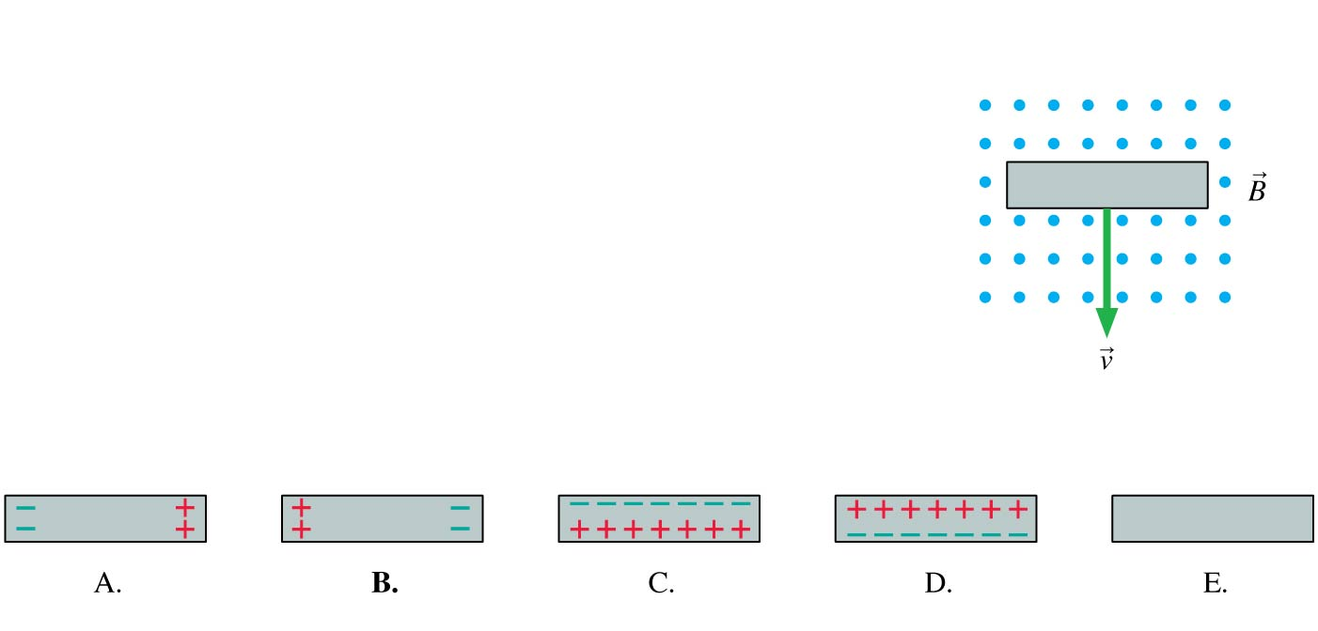
QuickCheck 33.2
A metal bar moves through a magnetic field. The induced charges on the bar are
Slide 33-31
Notes:
27

Slide 28
Example 33.1 Measuring the Earth’s Magnetic Field
Slide 33-32

Slide 29
Example 33.1 Measuring the Earth’s Magnetic Field
Slide 33-33

Slide 30
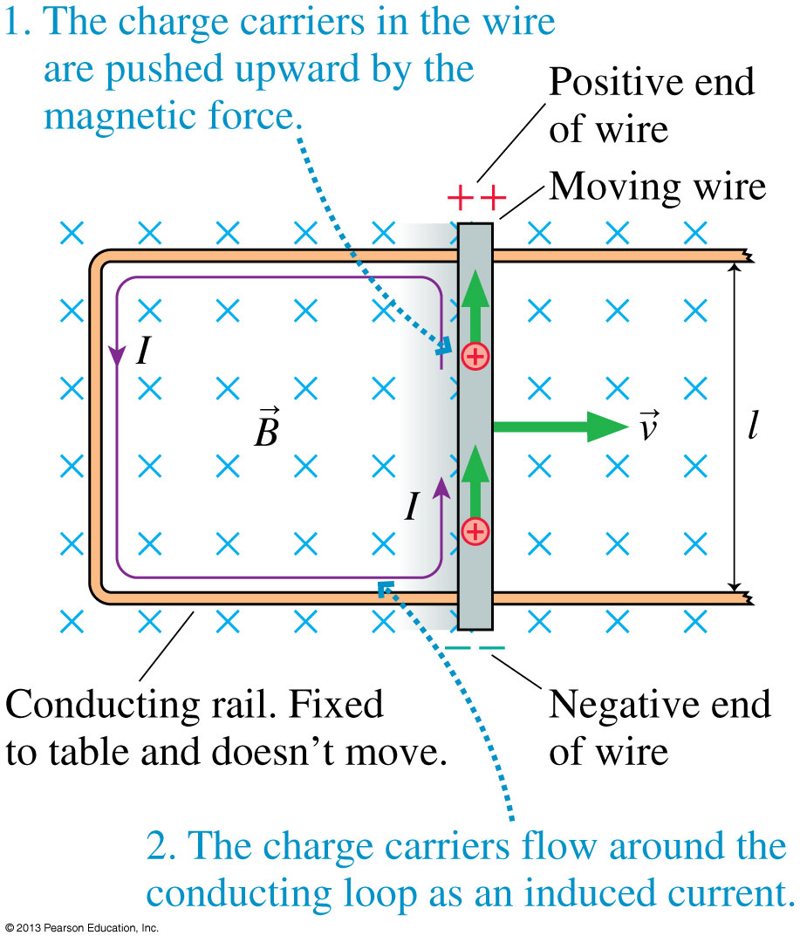
Induced Current
If we slide a conducting wire along a U-shaped conducting rail, we can complete a circuit and drive an electric current.
If the total resistance of the circuit is R, the induced current is given by Ohm’s law as:
Slide 33-34

Slide 31
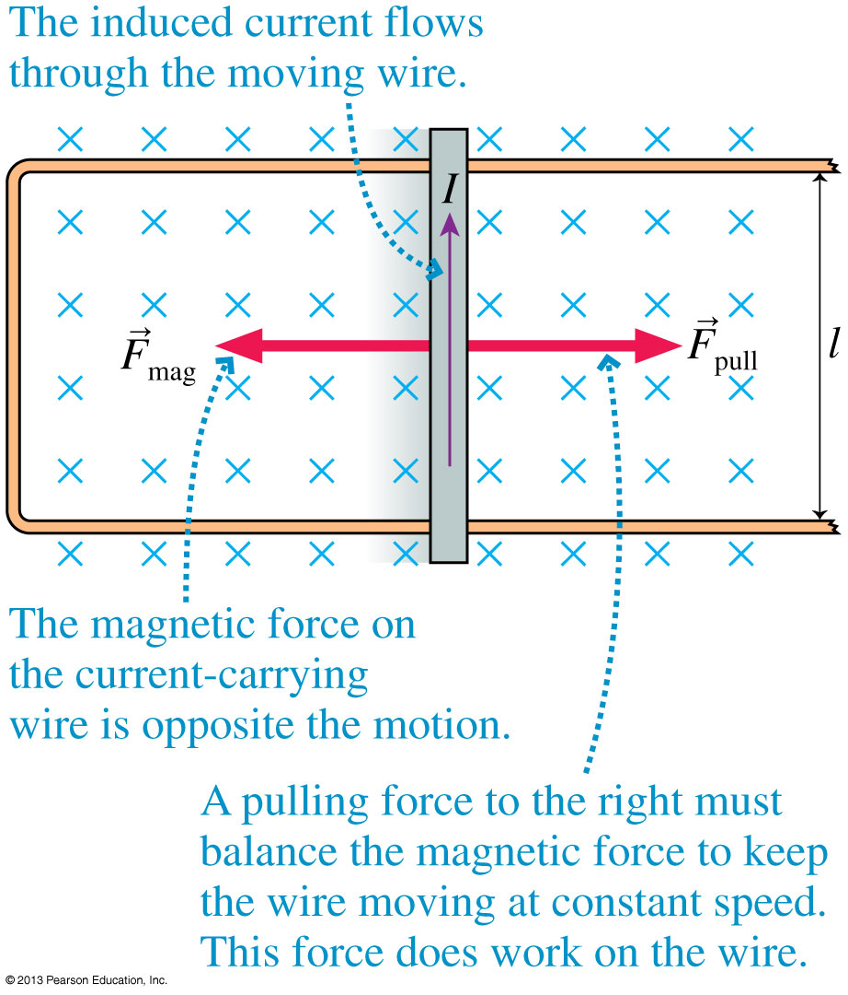
Induced Current
To keep the wire moving at a constant speed v, we must apply a pulling force F_{pull} = vl²B²/R.
This pulling force does work at a rate:
All of this power is dissipated by the resistance of the circuit.
Slide 33-35

Slide 32
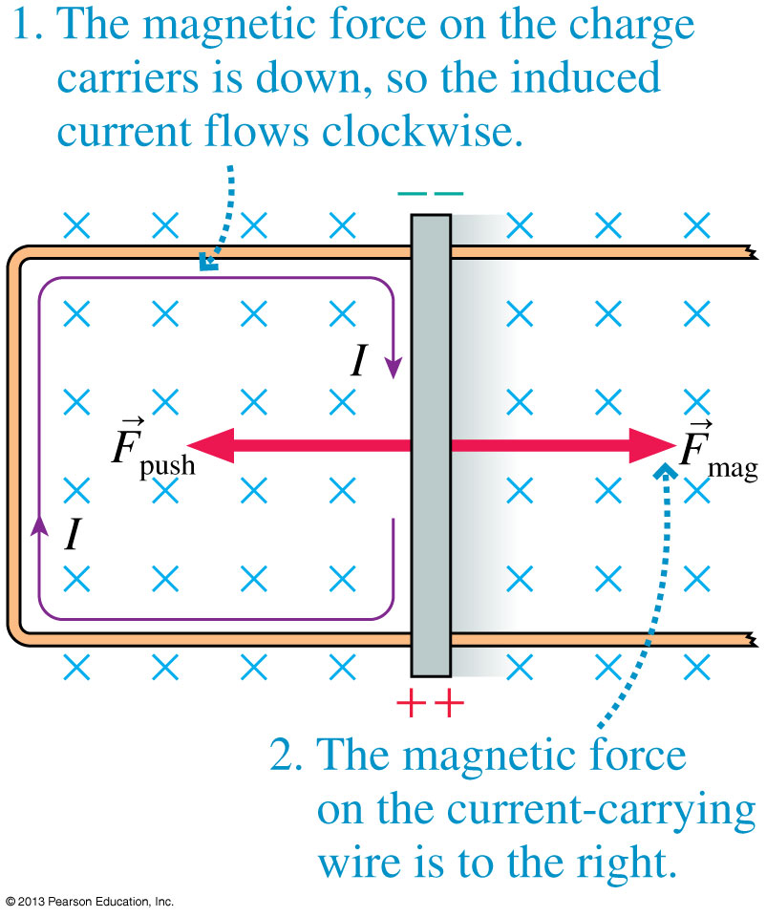
Induced Current
The figure shows a conducting wire sliding to the left.
In this case, a pushing force is needed to keep the wire moving at constant speed.
Once again, this input power is dissipated in the electric circuit.
A device that converts mechanical energy to electric energy is called a generator.
Slide 33-36

Slide 33
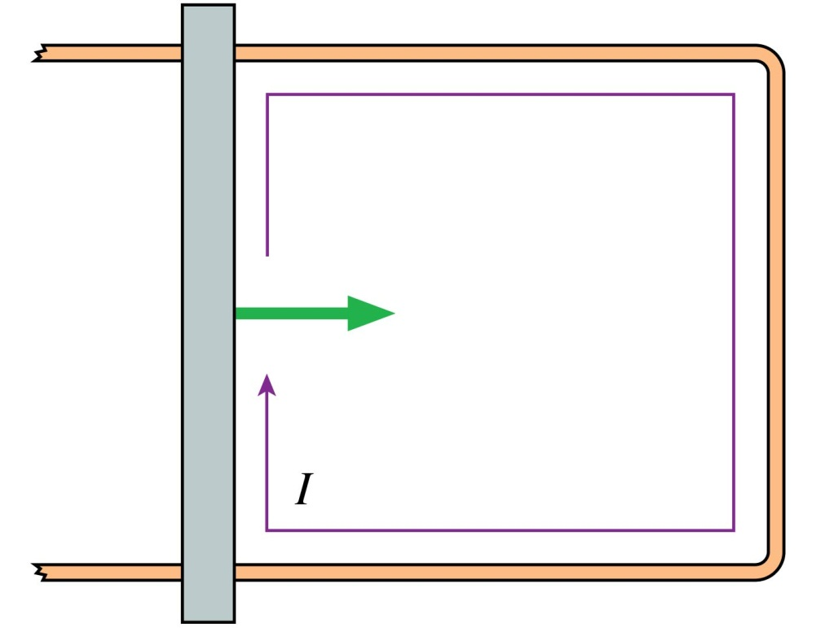
QuickCheck 33.3
An induced current flows clockwise as the metal bar is pushed to the right. The magnetic field points
Up.
Down.
Into the screen.
Out of the screen.
To the right.
Slide 33-37
Notes:
33

Slide 34
QuickCheck 33.3
An induced current flows clockwise as the metal bar is pushed to the right. The magnetic field points
Up.
Down.
Into the screen.
Out of the screen.
To the right.
Slide 33-38
Notes:
34

Slide 35
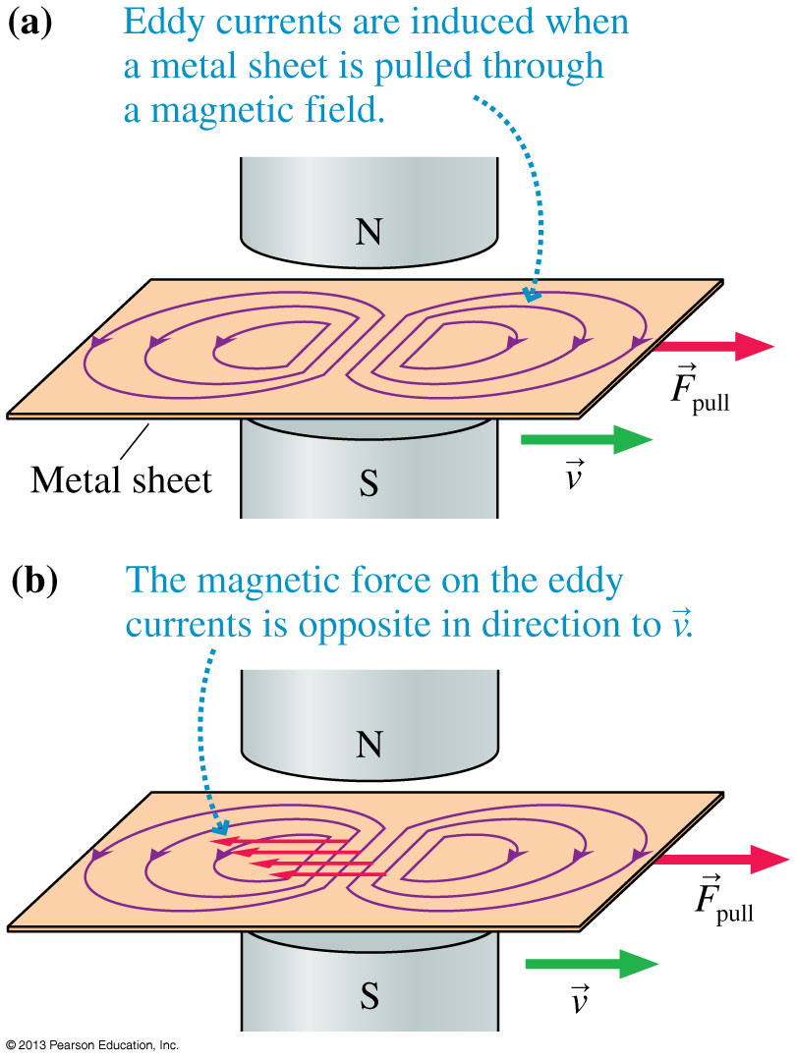
Eddy Currents
Consider pulling a sheet of metal through a magnetic field.
Two “whirlpools” of current begin to circulate in the solid metal, called eddy currents.
The magnetic force on the eddy currents is a retarding force.
This is a form of magnetic braking.
Slide 33-39

Slide 36
The Basic Definition of Flux
Imagine holding a rectangular wire loop of area A = ab in front of a fan.
The volume of air flowing through the loop each second depends on the angle between the loop and the direction of flow.
No air goes through the same loop if it lies parallel to the flow.
The flow is maximum through a loop that is perpendicular to the airflow.
This occurs because the effective area is greatest at this angle.
The effective angle (as seen facing the fan) is:
Slide 33-40

Slide 37
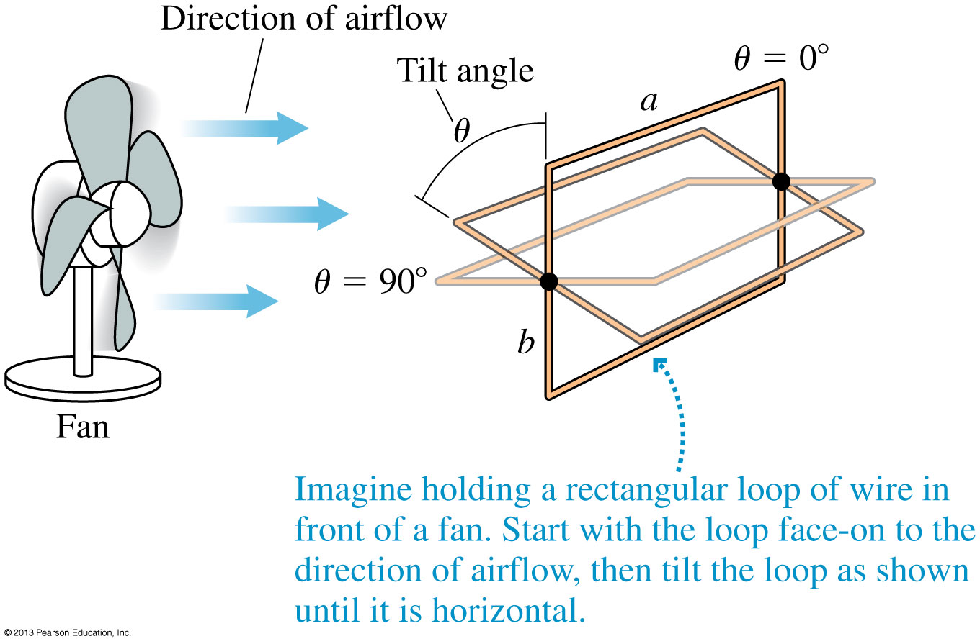
The Basic Definition of Flux
Slide 33-41

Slide 38
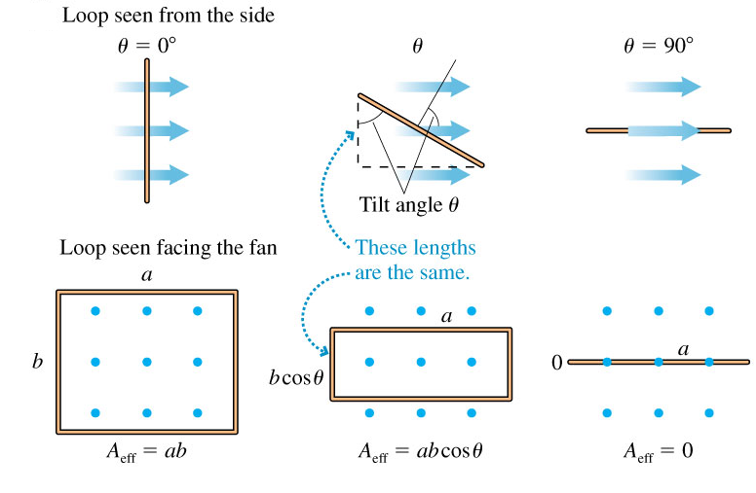
The Basic Definition of Flux
Slide 33-42

Slide 39
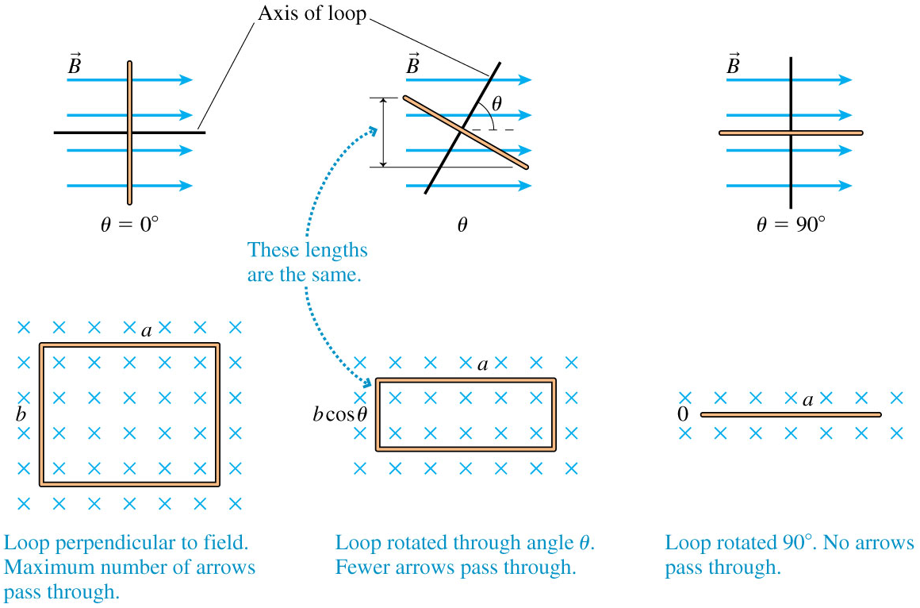
Magnetic Flux Through a Loop
Slide 33-43

Slide 40
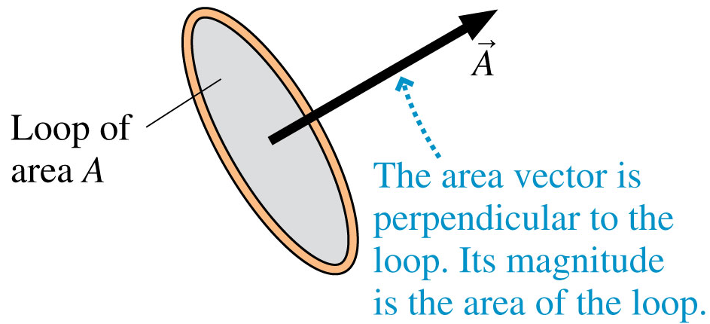
The Area Vector
Let’s define an area vector to be a vector in the direction of, perpendicular to the surface, with a magnitude A equal to the area of the surface.
Vector has units of m².
Slide 33-44

Slide 41
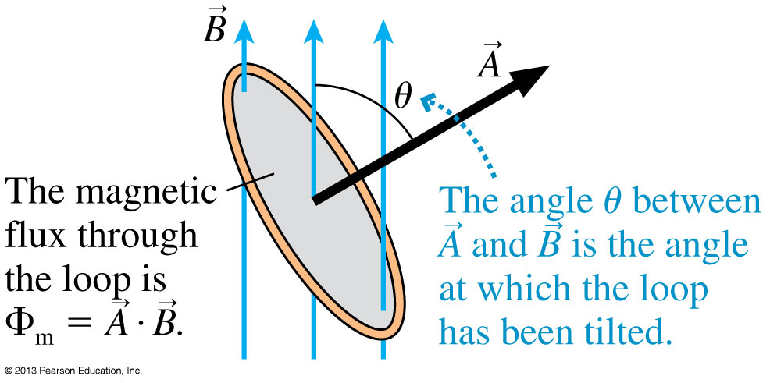
Magnetic Flux
The magnetic flux measures the amount of magnetic field passing through a loop of area A if the loop is tilted at an angle θ from the field.
The SI unit of magnetic flux is the weber:
1 weber = 1 Wb = 1 T m²
Slide 33-45

Slide 42
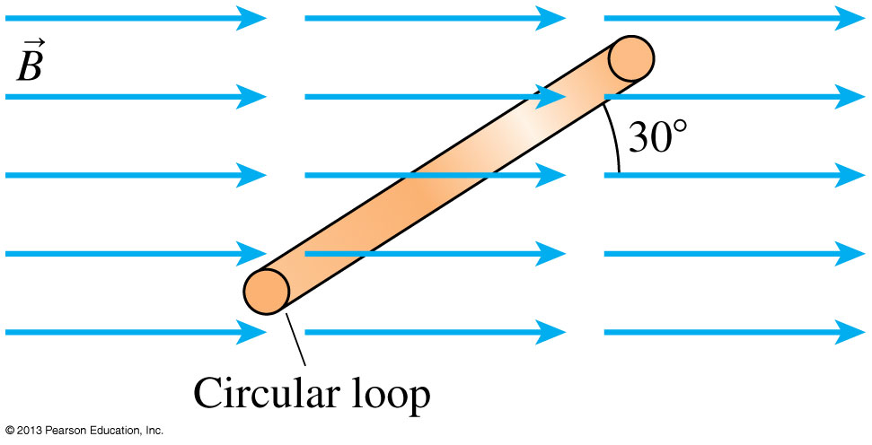
Example 33.4 A Circular Loop in a Magnetic Field
Slide 33-46

Slide 43
Example 33.4 A Circular Loop in a Magnetic Field
Slide 33-47

Slide 44
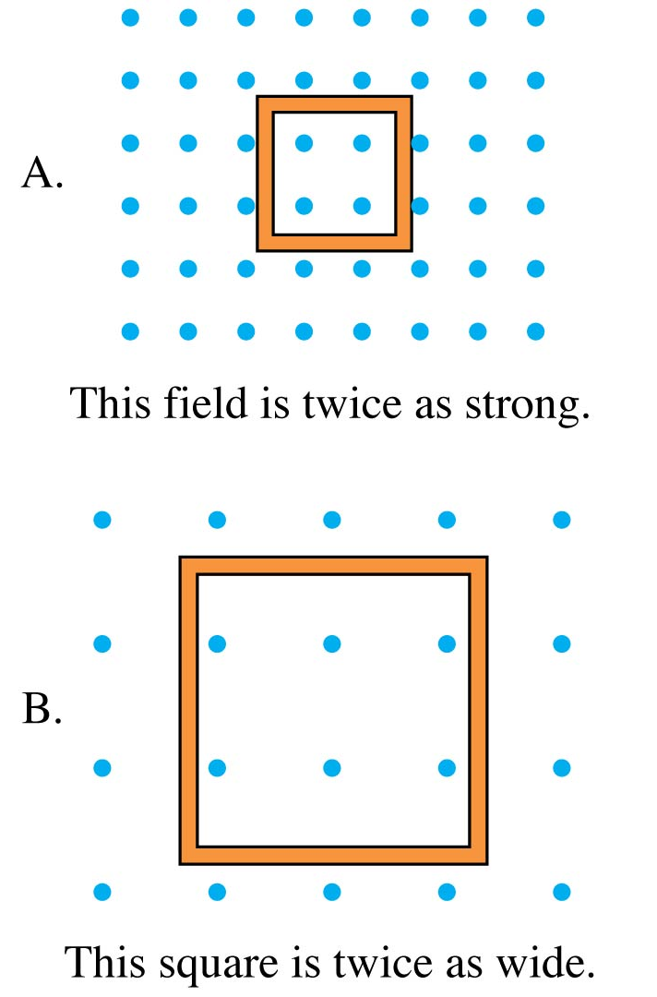
QuickCheck 33.4
Which loop has the larger magnetic flux through it?
Loop A.
Loop B.
The fluxes are the same.
Not enough information to tell.
Slide 33-48
Notes:
44

Slide 45
QuickCheck 33.4
Which loop has the larger magnetic flux through it?
Loop A.
Loop B.
The fluxes are the same.
Not enough information to tell.
Φ_{m} = L²B
Slide 33-49
Notes:
45

Slide 46
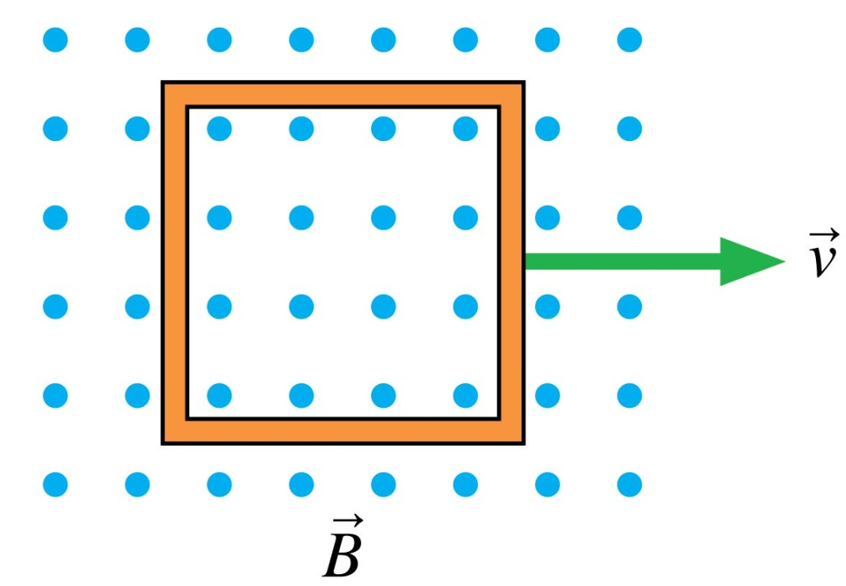
QuickCheck 33.5
The metal loop is being pulled through a uniform magnetic field. Is the magnetic flux through the loop changing?
Yes.
No.
Slide 33-50
Notes:
46

Slide 47
QuickCheck 33.5
The metal loop is being pulled through a uniform magnetic field. Is the magnetic flux through the loop changing?
Yes.
No.
Slide 33-51
Notes:
47

Slide 48
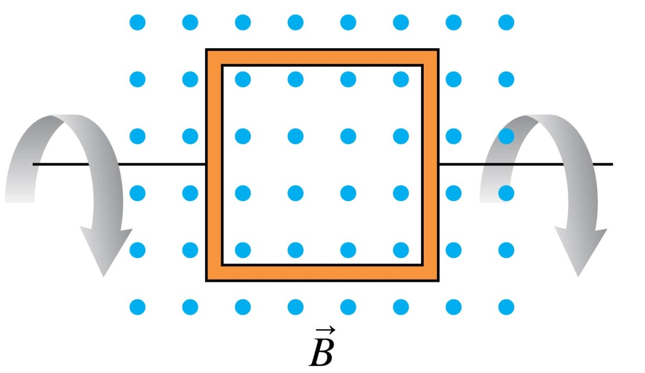
QuickCheck 33.6
The metal loop is rotating in a uniform magnetic field. Is the magnetic flux through the loop changing?
Yes.
No.
Slide 33-52
Notes:
48

Slide 49
QuickCheck 33.6
The metal loop is rotating in a uniform magnetic field. Is the magnetic flux through the loop changing?
Yes.
No.
Slide 33-53
Notes:
49

Slide 50
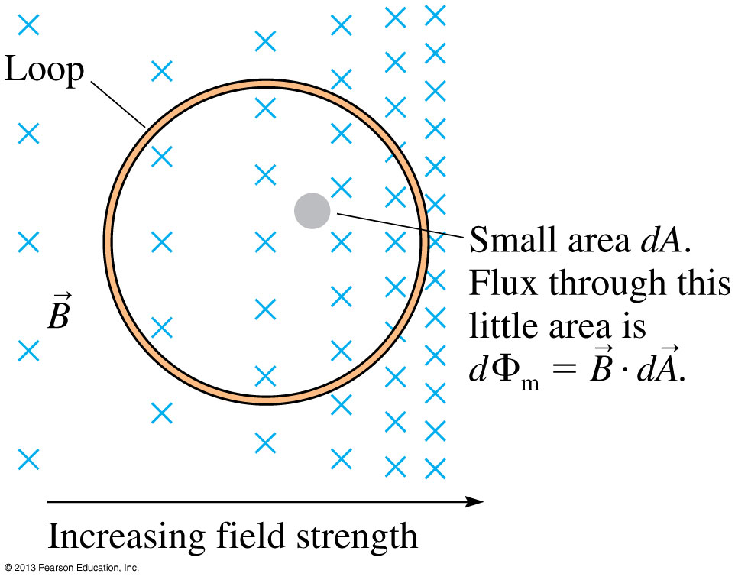
Magnetic Flux in a Nonuniform Field
The figure shows a loop in a nonuniform magnetic field.
The total magnetic flux through the loop is found with an area integral.
Slide 33-54

Slide 51
Lenz’s Law
Slide 33-55

Slide 52
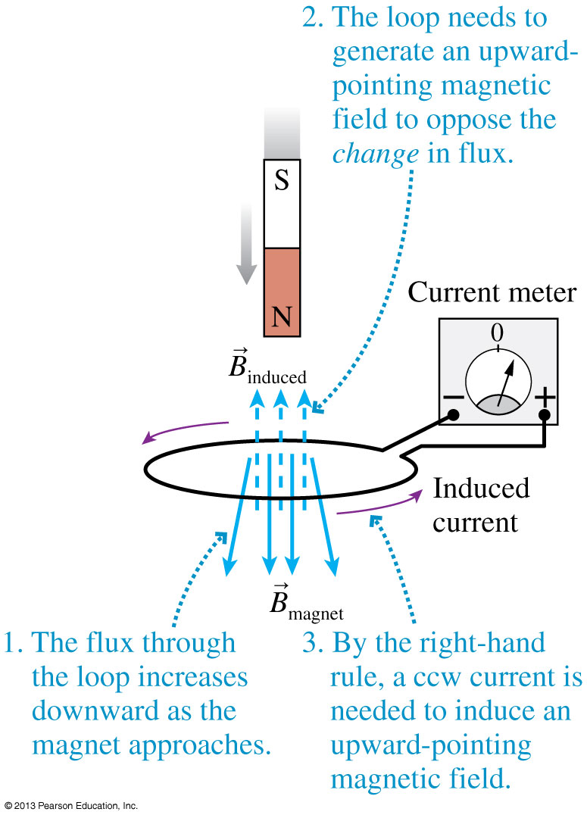
Lenz’s Law
Pushing the bar magnet into the loop causes the magnetic flux to increase in the downward direction.
To oppose the change in flux, which is what Lenz’s law requires, the loop itself needs to generate an upward-pointing magnetic field.
The induced current ceases as soon as the magnet stops moving.
Slide 33-56

Slide 53
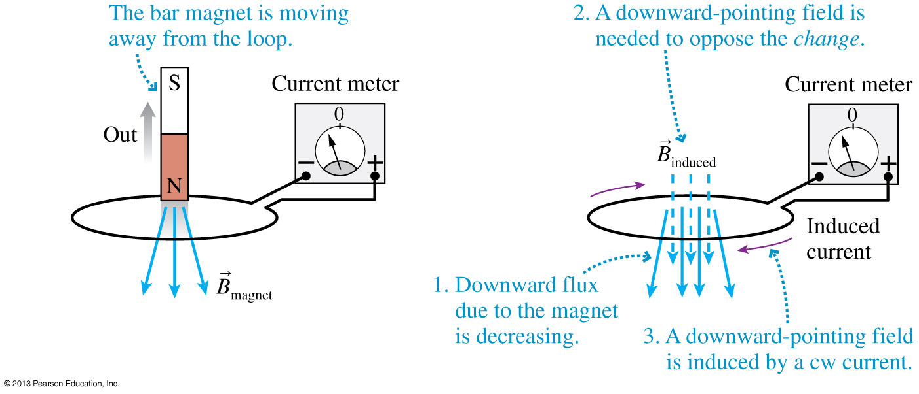
Lenz’s Law
Pushing the bar magnet away from the loop causes the magnetic flux to decrease in the downward direction.
To oppose this decrease, a clockwise current is induced.
Slide 33-57

Slide 54
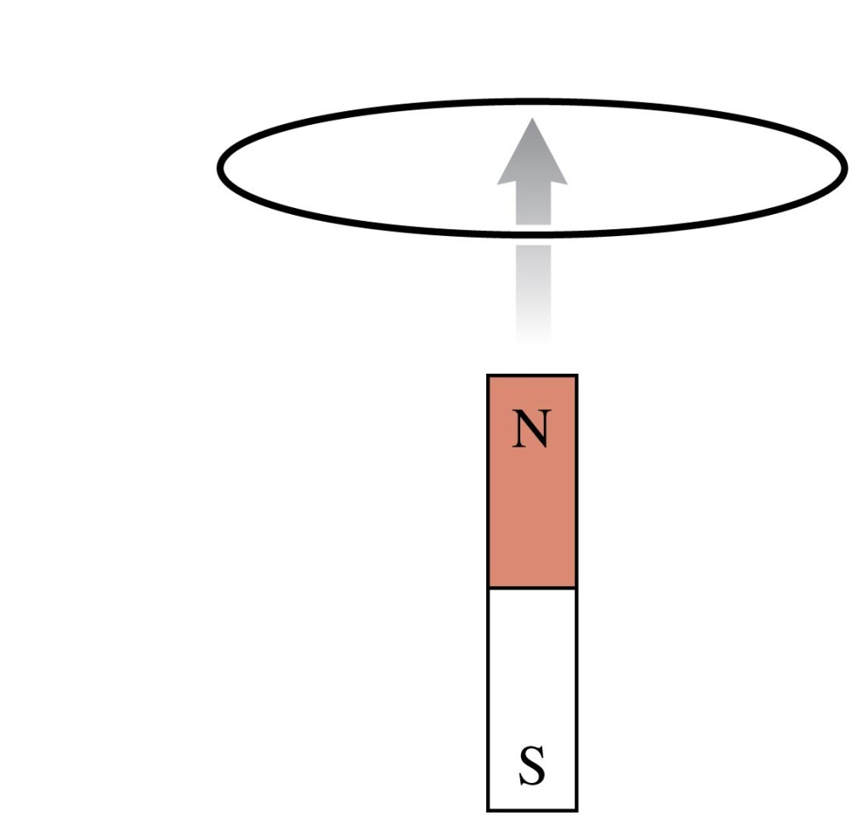
QuickCheck 33.7
The bar magnet is pushed toward the center of a wire loop. Which is true?
There is a clockwise induced current in the loop.
There is a counterclockwise induced current in the loop.
There is no induced current in the loop.
Slide 33-58
Notes:
54

Slide 55
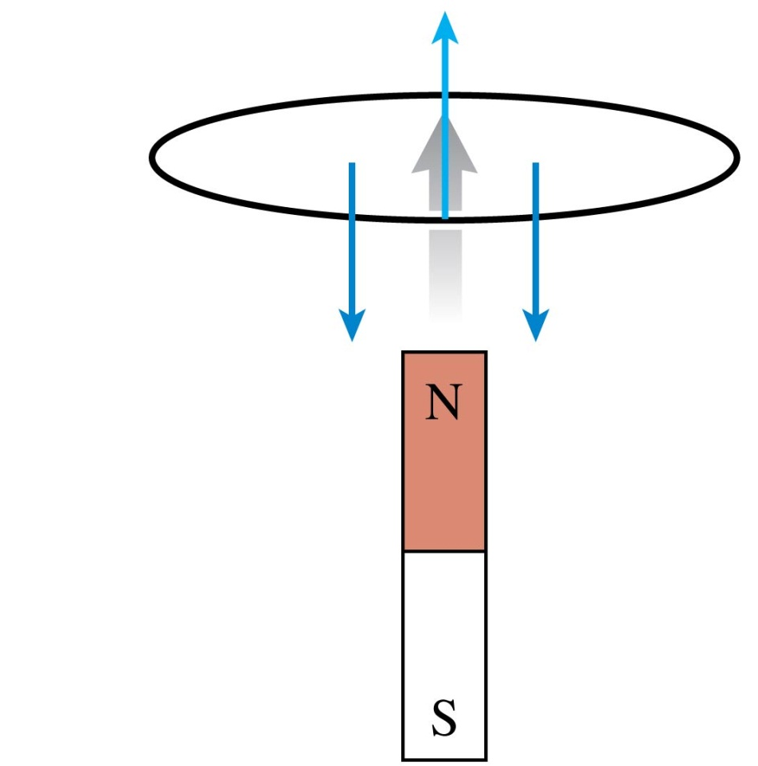
QuickCheck 33.7
The bar magnet is pushed toward the center of a wire loop. Which is true?
There is a clockwise induced current in the loop.
There is a counterclockwise induced current in the loop.
There is no induced current in the loop.
Upward flux from magnet is increasing.
To oppose the increase, the field of the induced current points down.
From the right-hand rule, a downward field needs a cw current.
Slide 33-59
Notes:
55

Slide 56
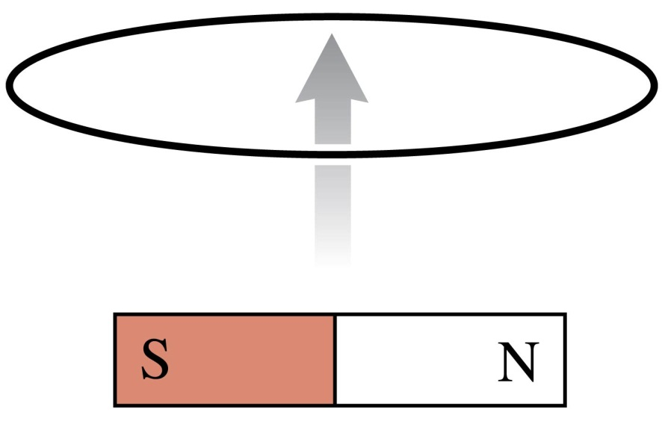
QuickCheck 33.8
The bar magnet is pushed toward the center of a wire loop. Which is true?
There is a clockwise induced current in the loop.
There is a counterclockwise induced current in the loop.
There is no induced current in the loop.
Slide 33-60
Notes:
56

Slide 57
QuickCheck 33.8
The bar magnet is pushed toward the center of a wire loop. Which is true?
There is a clockwise induced current in the loop.
There is a counterclockwise induced current in the loop.
There is no induced current in the loop.
Magnetic flux is zero, so there’s no change of flux.
Slide 33-61
Notes:
57

Slide 58
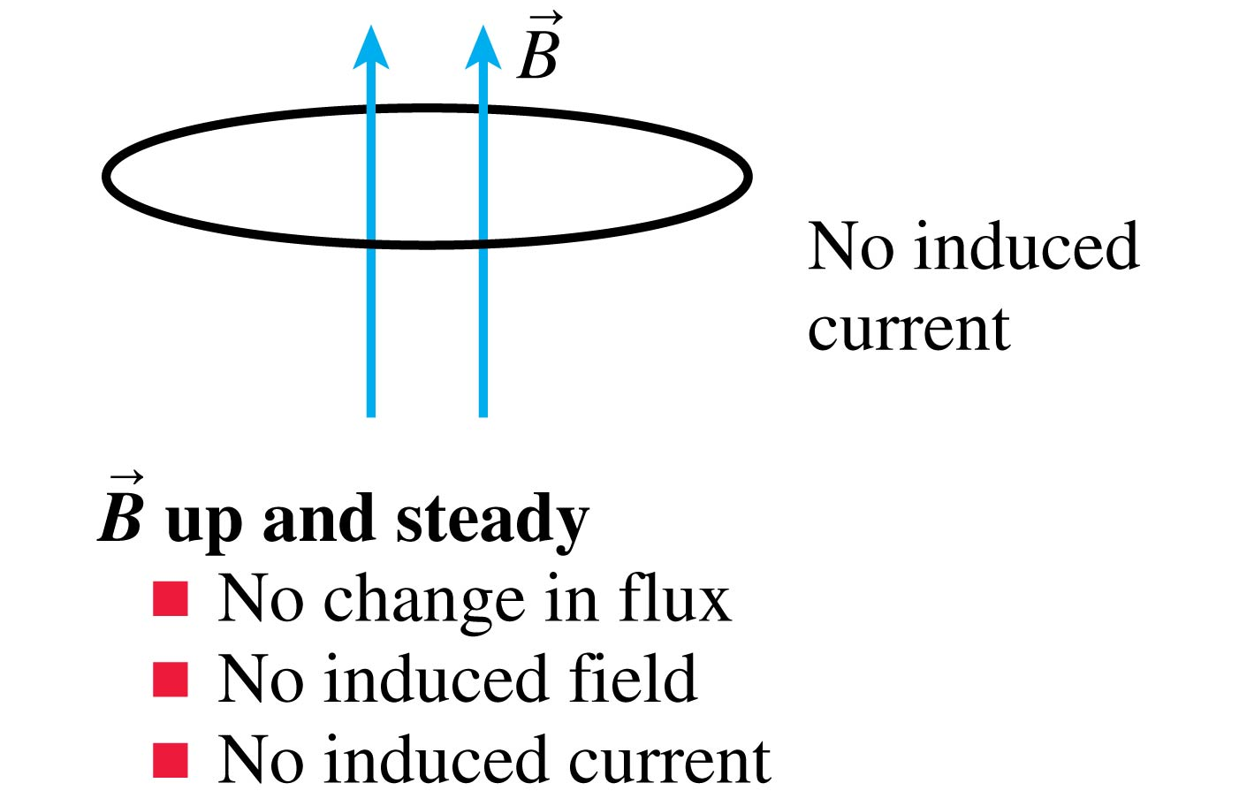
The Induced Current for Six Different Situations: Slide 1
Slide 33-62

Slide 59
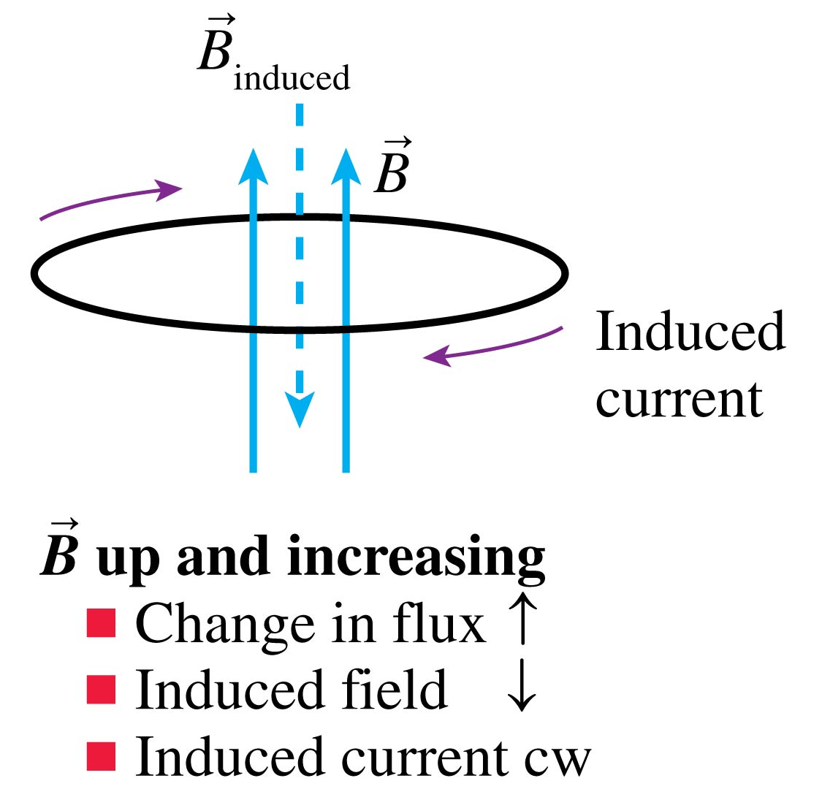
The Induced Current for Six Different Situations: Slide 2
Slide 33-63

Slide 60
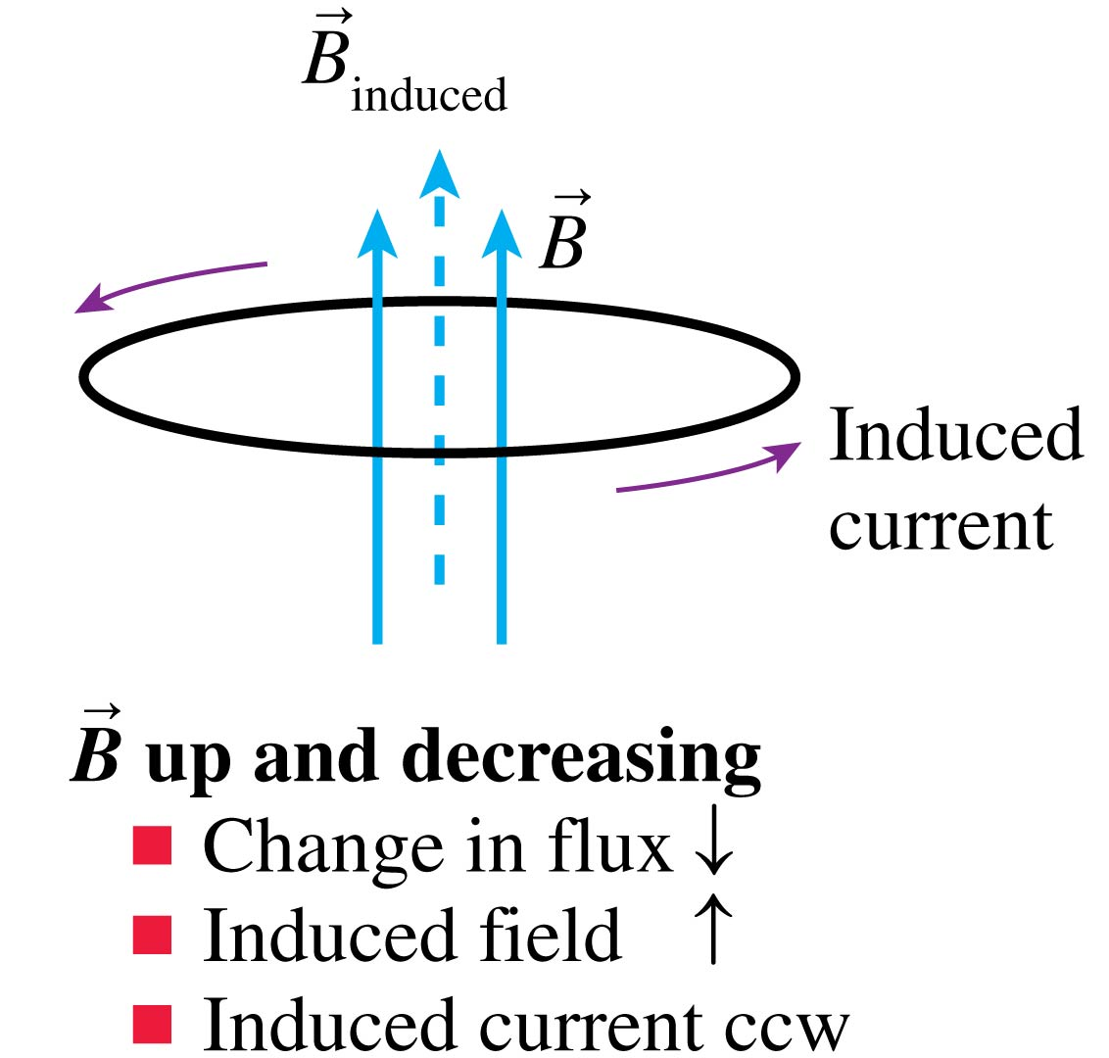
The Induced Current for Six Different Situations: Slide 3
Slide 33-64

Slide 61
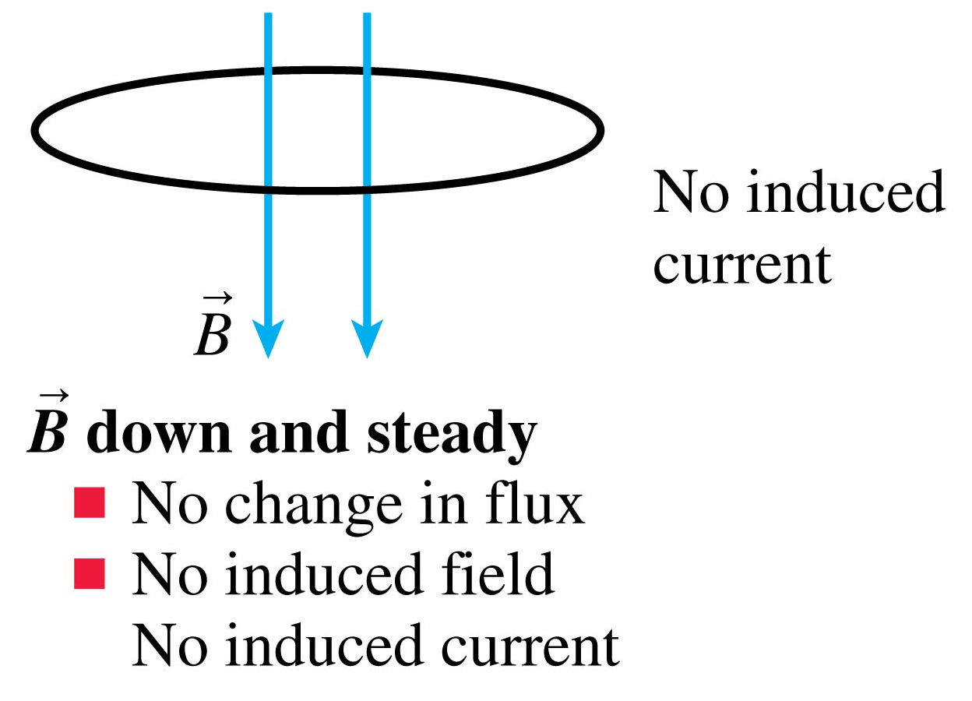
The Induced Current for Six Different Situations: Slide 4
Slide 33-65

Slide 62
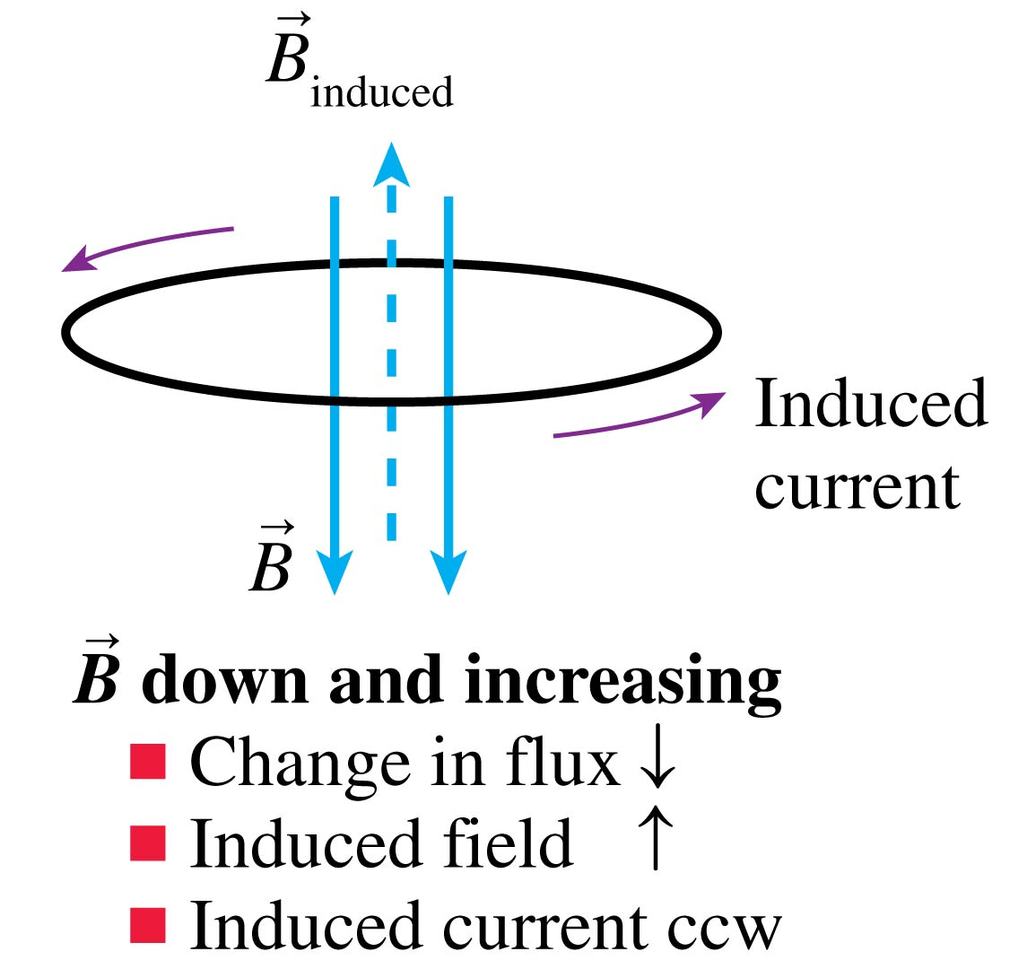
The Induced Current for Six Different Situations: Slide 5
Slide 33-66

Slide 63
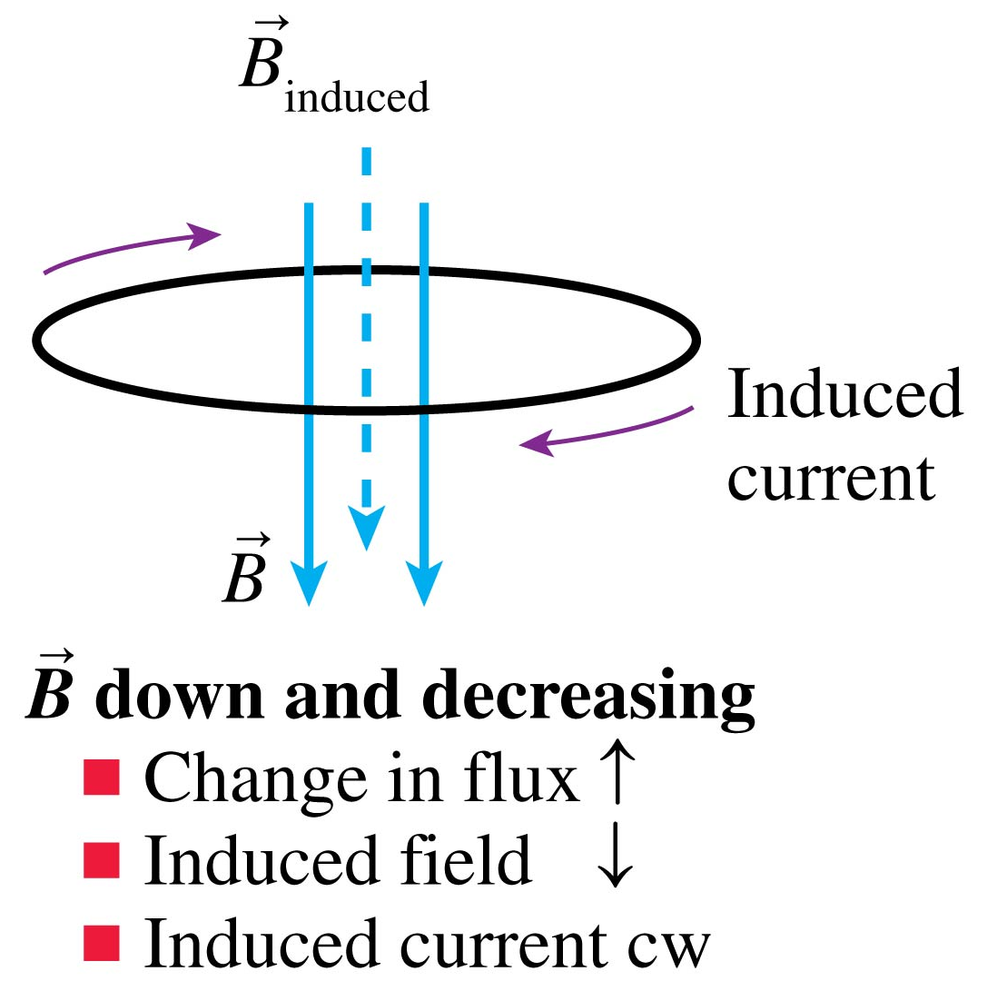
The Induced Current for Six Different Situations: Slide 6
Slide 33-67

Slide 64
Tactics: Using Lenz’s Law
Slide 33-68

Slide 65
QuickCheck 33.9
The current in the straight wire is decreasing. Which is true?
There is a clockwise induced current in the loop.
There is a counterclockwise induced current in the loop.
There is no induced current in the loop.
Slide 33-69
Notes:
65

Slide 66
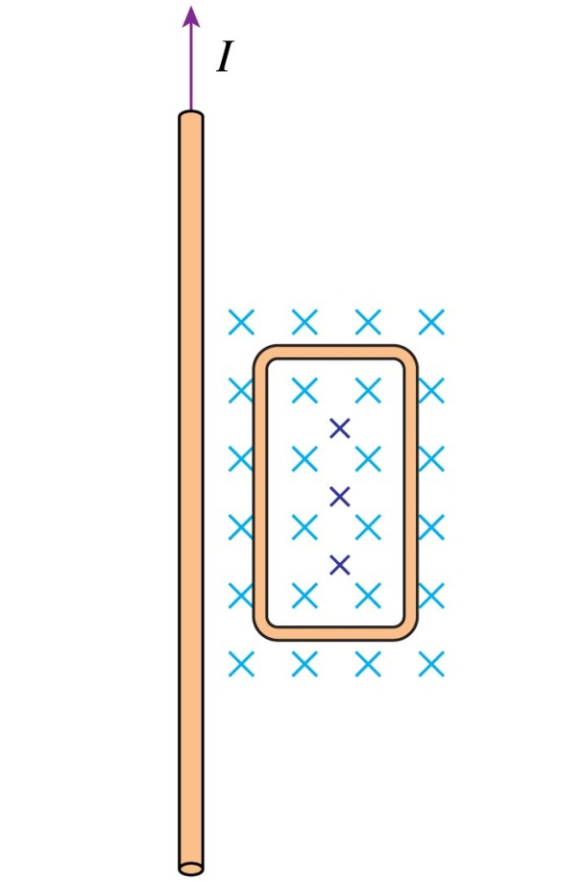
QuickCheck 33.9
The current in the straight wire is decreasing. Which is true?
There is a clockwise induced current in the loop.
There is a counterclockwise induced current in the loop.
There is no induced current in the loop.
The flux from wire’s field is into the screen and decreasing.
To oppose the decrease, the field of the induced current must point into the screen.
From the right-hand rule, an inward field needs a cw current.
Slide 33-70
Notes:
66

Slide 67
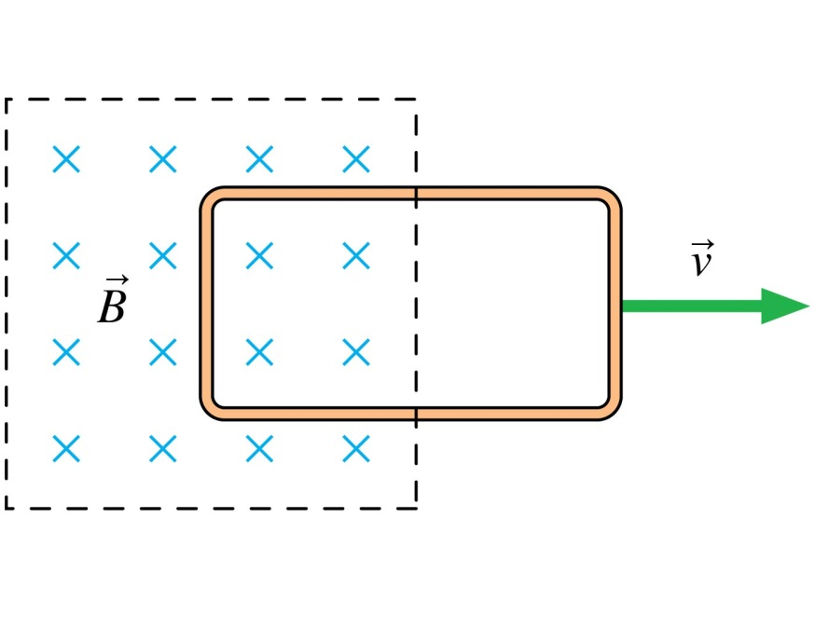
QuickCheck 33.10
The magnetic field is confined to the region inside the dashed lines; it is zero outside. The metal loop is being pulled out of the magnetic field. Which is true?
There is a clockwise induced current in the loop.
There is a counterclockwise induced current in the loop.
There is no induced current in the loop.
Slide 33-71
Notes:
67

Slide 68
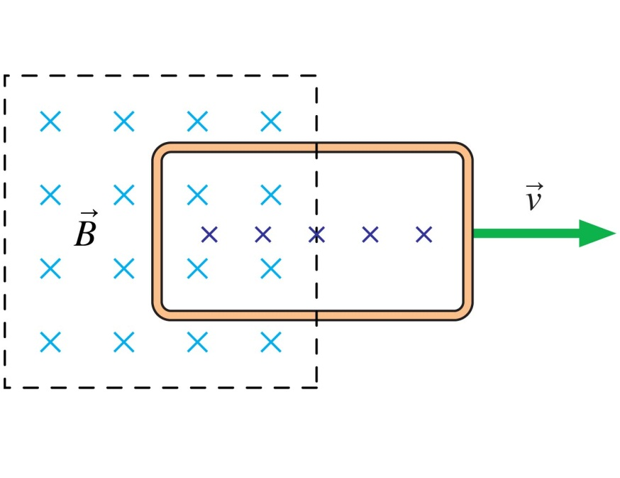
QuickCheck 33.10
The magnetic field is confined to the region inside the dashed lines; it is zero outside. The metal loop is being pulled out of the magnetic field. Which is true?
There is a clockwise induced current in the loop.
There is a counterclockwise induced current in the loop.
There is no induced current in the loop.
The flux through the loop is into the screen and decreasing.
To oppose the decrease, the field of the induced current must point into the screen.
From the right-hand rule, an inward field needs a cw current.
Slide 33-72
Notes:
68

Slide 69
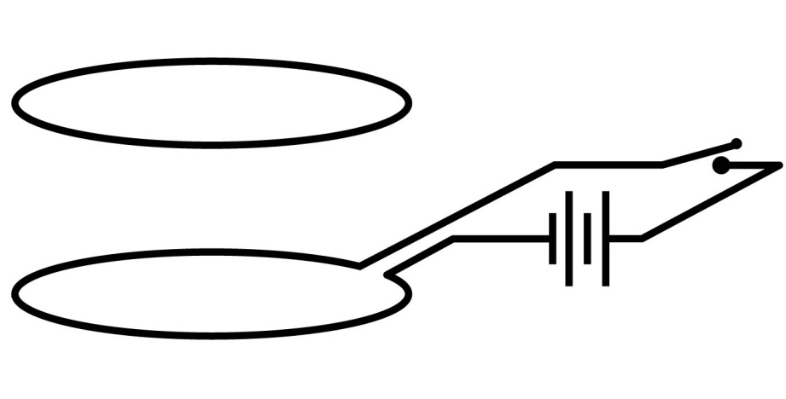
QuickCheck 33.11
Immediately after the switch is closed, the lower loop exerts ____ on the upper loop.
a torque
an upward force
a downward force
no force or torque
Slide 33-73
Notes:
69

Slide 70
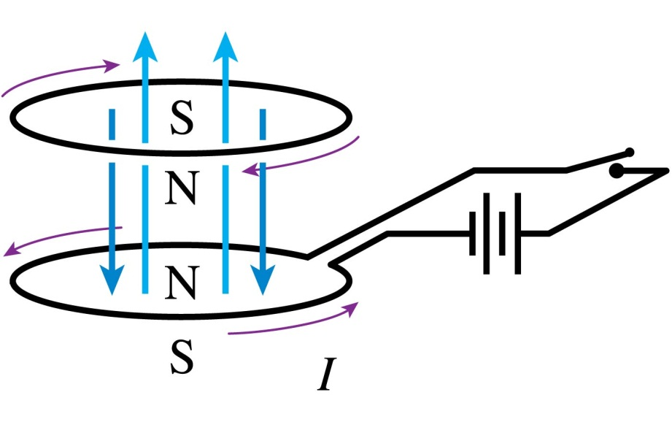
QuickCheck 33.11
Immediately after the switch is closed, the lower loop exerts ____ on the upper loop.
a torque
an upward force
a downward force
no force or torque
The battery drives a ccw current that, briefly, increases rapidly.
The flux through the top loop is upward and increasing.
To oppose the increase, the field of the induced current must point downward.
From the right-hand rule, a downward field needs a cw current.
The ccw current in the lower loop makes the upper face a north pole. The cw induced current in the upper loop makes the lower face a north pole.
Facing north poles exert repulsive forces on each other.
Slide 33-74
Notes:
70

Slide 71
Faraday’s Law
An emf is induced in a conducting loop if the magnetic flux through the loop changes.
The magnitude of the emf is:
The direction of the emf is such as to drive an induced current in the direction given by Lenz’s law.
Slide 33-75

Slide 72
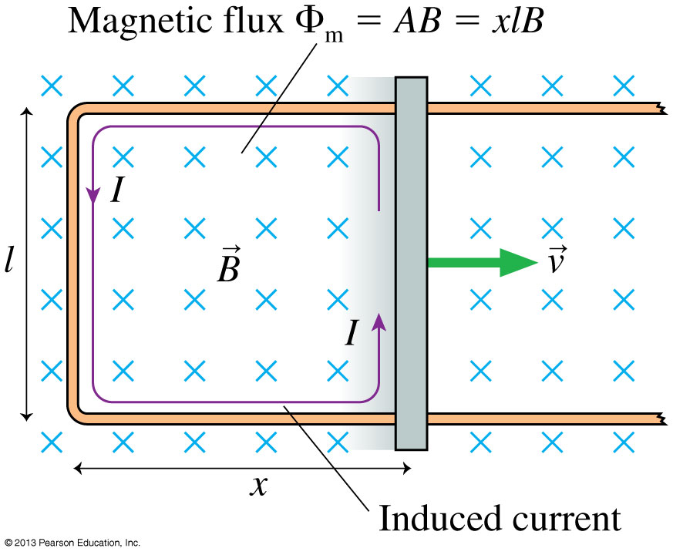
Using Faraday’s Law
If we slide a conducting wire along a U-shaped conducting rail, we can complete a circuit and drive an electric current.
We can find the induced emf and current by using Faraday’s law and Ohm’s law:
Slide 33-76

Slide 73
Problem-Solving Strategy: Electromagnetic Induction
Slide 33-77

Slide 74
QuickCheck 33.12
The induced emf around this loop is
200 V.
50 V.
2 V.
0.5 V.
0.02 V.
Slide 33-78
Notes:
74

Slide 75
QuickCheck 33.12
The induced emf around this loop is
200 V.
50 V.
2 V.
0.5 V.
0.02 V.
Slide 33-79
Notes:
75

Slide 76
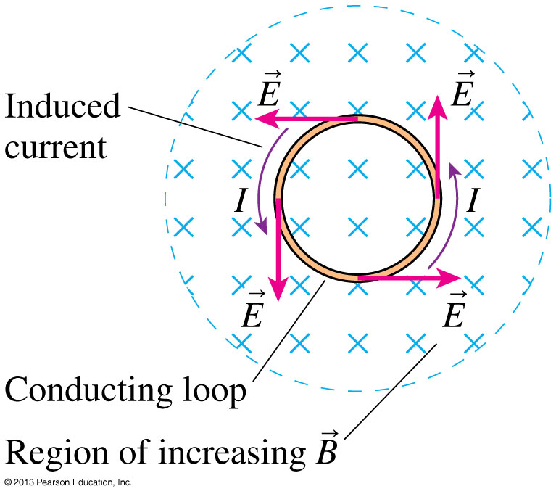
Induced Fields
The figure shows a conducting loop in an increasing magnetic field.
According to Lenz’s law, there is an induced current in the counterclockwise direction.
Something has to act on the charge carriers to make them move, so we infer that there must be an induced electric field tangent to the loop at all points.
Slide 33-80

Slide 77
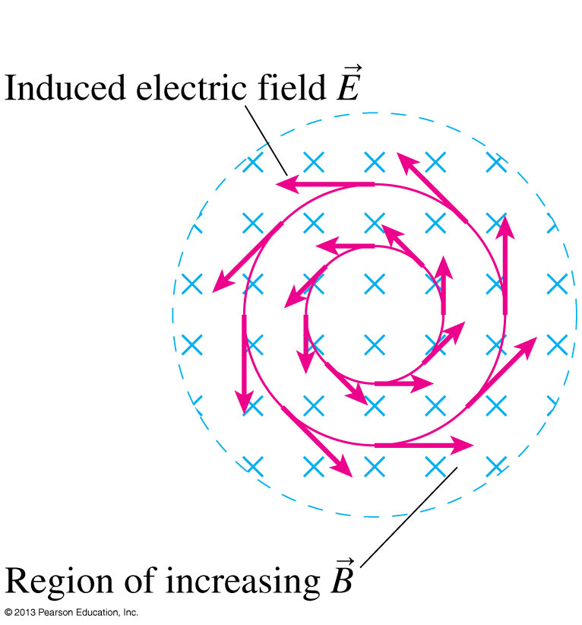
The Induced Electric Field
When the magnetic field is increasing in a region of space, we may define a closed loop which is perpendicular to the magnetic field.
Faraday’s Law specifies the loop integral of the induced electric field around this loop:
Slide 33-81

Slide 78
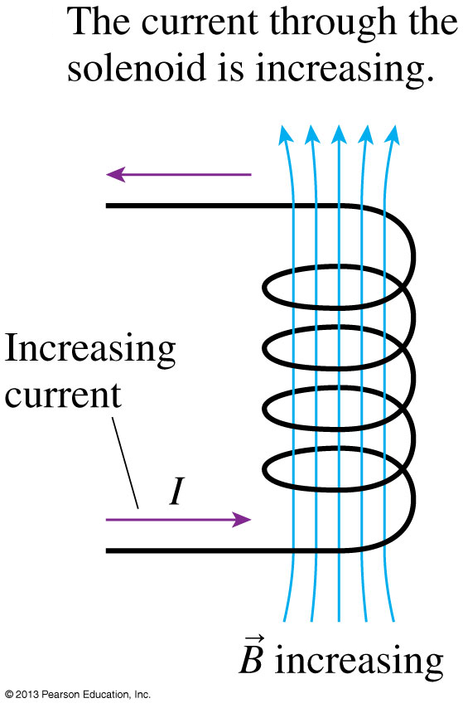
Induced Electric Field in a Solenoid Slide 1 of 3
The current through the solenoid creates an upward pointing magnetic field.
As the current is increasing, B is increasing, so it must induce an electric field.
Slide 33-82

Slide 79
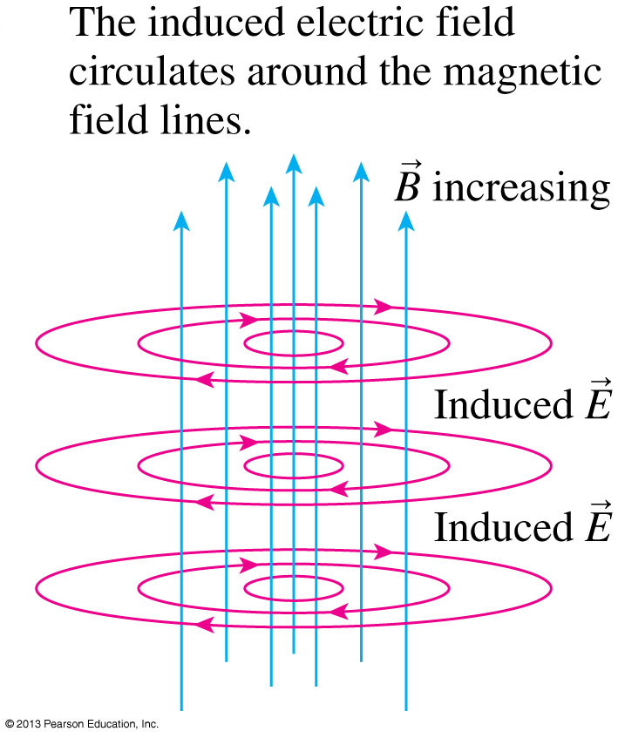
Induced Electric Field in a Solenoid Slide 2 of 3
We could use Lenz’s law to determine that if there were a conducting loop in the solenoid, the induced current would be clockwise.
The induced electric field must therefore be clockwise around the magnetic field lines.
Slide 33-83

Slide 80
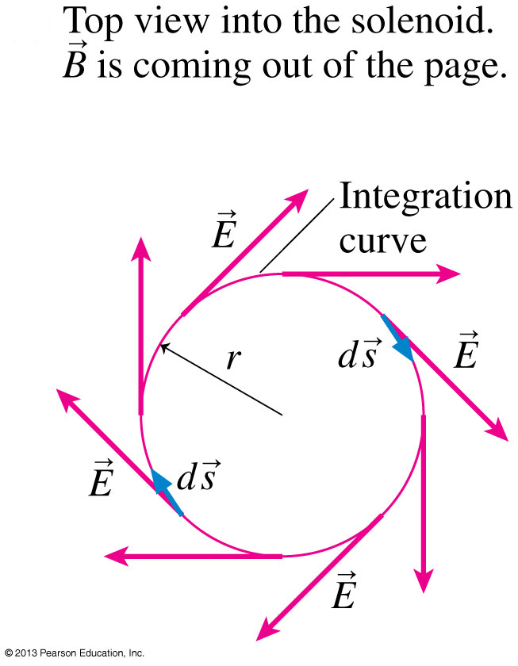
Induced Electric Field in a Solenoid Slide 3 of 3
To use Faraday’s law, integrate around a clockwise circle of radius r:
Thus the strength of the induced electric field inside the solenoid is:
Slide 33-84

Slide 81
Example 33.10 An Induced Electric Field
Slide 33-85

Slide 82
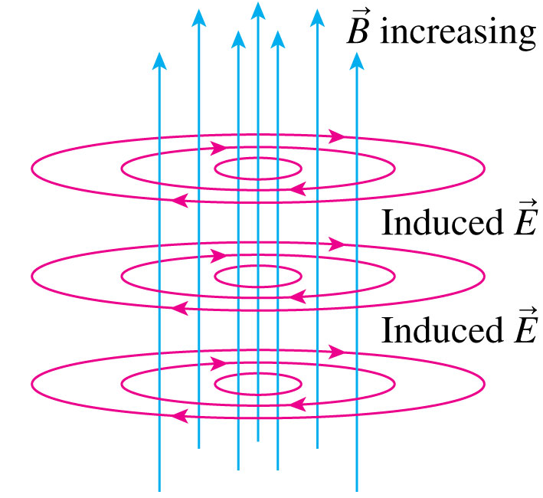
Example 33.10 An Induced Electric Field
Slide 33-86

Slide 83
Example 33.10 An Induced Electric Field
Slide 33-87

Slide 84
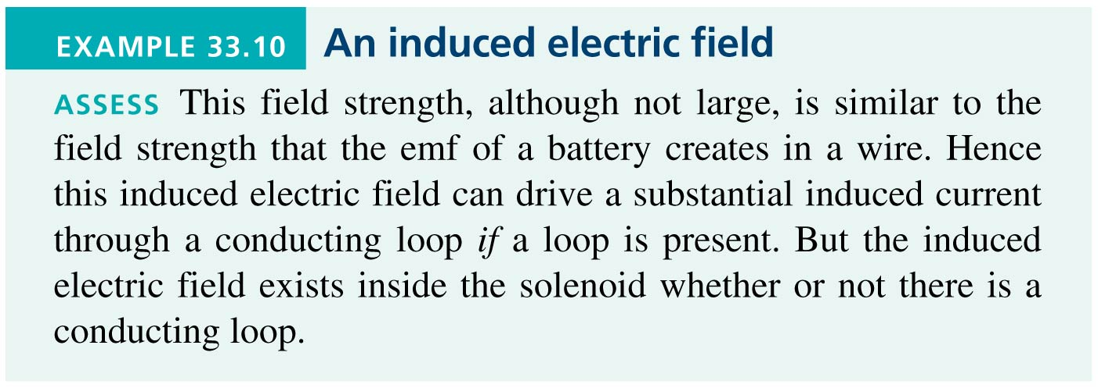
Example 33.10 An Induced Electric Field
Slide 33-88

Slide 85
QuickCheck 33.13
The magnetic field is decreasing. Which is the induced electric field?
E. There’s no induced field in this case.
Slide 33-89
Notes:
85

Slide 86
QuickCheck 33.13
The magnetic field is decreasing. Which is the induced electric field?
The field is the same direction as induced current would flow if there were a loop in the field.
E. There’s no induced field in this case.
Slide 33-90
Notes:
86

Slide 87
The Induced Electric Field
Faraday’s law and Lenz’s law may be combined by noting that the emf must oppose the change in Φ_{m}.
Mathematically, emf must have the opposite sign of dB/dt.
Faraday’s law may be written as:
Slide 33-91

Slide 88
The Induced Magnetic Field
As we know, changing the magnetic field induces a circular electric field.
Symmetrically, changing the electric field induces a circular magnetic field.
The induced magnetic field was first suggested as a possibility by James Clerk Maxwell in 1855.
Slide 33-92

Slide 89
Maxwell’s Theory of Electromagnetic Waves
A changing electric field creates a magnetic field, which then changes in just the right way to recreate the electric field, which then changes in just the right way to again recreate the magnetic field, and so on.
This is an electromagnetic wave.
Slide 33-93

Slide 90
Generators
A generator is a device that transforms mechanical energy into electric energy.
A generator inside a hydroelectric dam uses electromagnetic induction to convert the mechanical energy of a spinning turbine into electric energy.
Slide 33-94

Slide 91
An Alternating-Current Generator
Slide 33-95

Slide 92
Example 33.11 An AC Generator
Slide 33-96

Slide 93
Example 33.11 An AC Generator
Slide 33-97

Slide 94
Transformers
A transformer sends an alternating emf V₁ through the primary coil.
This causes an oscillating magnetic flux through the secondary coil and, hence, an induced emf V₂.
The induced emf of the secondary coil is delivered to the load:
Slide 33-98

Slide 95
Transformers
A step-up transformer, with N₂ >> N₁, can boost the voltage of a generator up to several hundred thousand volts.
Delivering power with smaller currents at higher voltages reduces losses due to the resistance of the wires.
High-voltage transmission lines carry electric power to urban areas, where step-down transformers (N₂ << N₁) lower the voltage to 120 V.
Slide 33-99

Slide 96
Metal Detectors
A metal detector consists of two coils: a transmitter coil and a receiver coil.
A high-frequency AC current in the transmitter coil causes a field which induces current in the receiver coil.
The net field at the receiver decreases when a piece of metal is inserted between the coils.
Electronic circuits detect the current decrease in the receiver coil and set off an alarm.
Slide 33-100

Slide 97
Inductors
A coil of wire, or solenoid, can be used in a circuit to store energy in the magnetic field.
We define the inductance of a solenoid having N turns, length l and cross-section area A as:
The SI unit of inductance is the henry, defined as:
1 henry = 1 H = 1 Wb/A = 1 T m2/A
A coil of wire used in a circuit for the purpose of inductance is called an inductor.
The circuit symbol for an ideal inductor is .
Slide 33-101

Slide 98
Example 33.12 The Length of an Inductor
Slide 33-102

Slide 99
Example 33.12 The Length of an Inductor
Slide 33-103

Slide 100
Potential Difference Across an Inductor
The figure above shows a steady current into the left side of an inductor.
The solenoid’s magnetic field passes through the coils, establishing a flux.
The next slide shows what happens if the current increases.
Slide 33-104

Slide 101
Potential Difference Across an Inductor
In the figure, the current into the solenoid is increasing.
This creates an increasing flux to the left.
Therefore the induced magnetic field must point to the right.
The induced emf ΔV_{L} must be opposite to the current into the solenoid:
Slide 33-105

Slide 102
Potential Difference Across an Inductor
In the figure, the current into the solenoid is decreasing.
To oppose the decrease in flux, the induced emf ΔV_{L} is in the same direction as the input current.
The potential difference across an inductor, measured along the direction of the current, is:
Slide 33-106

Slide 103
Potential Difference Across an Inductor
Slide 33-107

Slide 104
QuickCheck 33.14
Which current is changing more rapidly?
Current I₁.
Current I₂.
They are changing at the same rate.
Not enough information to tell.
Slide 33-108
Notes:
104

Slide 105
QuickCheck 33.14
Which current is changing more rapidly?
Current I₁.
Current I₂.
They are changing at the same rate.
Not enough information to tell.
Slide 33-109
Notes:
105

Slide 106
Example 33.13 Large Voltage Across an Inductor
Slide 33-110

Slide 107
Example 33.13 Large Voltage Across an Inductor
Slide 33-111

Slide 108
Energy in Inductors and Magnetic Fields
As current passes through an inductor, the electric power is:
P_{elec} is negative because the current is losing energy.
That energy is being transferred to the inductor, which is storing energy U_{L} at the rate:
We can find the total energy stored in an inductor by integrating:
Slide 33-112

Slide 109
Energy in Inductors and Magnetic Fields
Inside a solenoid, the magnetic field strength is B = μ₀NI/l.
The inductor’s energy can be related to B:
But Al is the volume inside the solenoid.
Dividing by Al, the magnetic field energy density (energy per m³) is:
Slide 33-113

Slide 110
Energy in Electric and Magnetic Fields
Slide 33-114

Slide 111
Example 33.14 Energy Stored in an Inductor
Slide 33-115

Slide 112
Example 33.14 Energy Stored in an Inductor
Slide 33-116

Slide 113
LC Circuits
The figure shows a capacitor with initial charge Q₀, an inductor, and a switch.
The switch has been open for a long time, so there is no current in the circuit.
At t = 0, the switch is closed.
How does the circuit respond?
The charge and current oscillate in a way that is analogous to a mass on a spring.
Slide 33-117

Slide 114
LC Circuits: Step A
Slide 33-118

Slide 115
LC Circuits: Step B
Slide 33-119

Slide 116
LC Circuits: Step C
Slide 33-120

Slide 117
LC Circuits: Step D
Slide 33-121

Slide 118
LC Circuits
An LC circuit is an electric oscillator.
The letters on the graph correspond to the four steps in the previous slides.
The charge on the upper plate is Q = Q₀cosωt and the current through the inductor is I = I_{max}sinωt, where:
Slide 33-122

Slide 119
QuickCheck 33.15
If the top circuit has an oscillation frequency of 1000 Hz, the frequency of the bottom circuit is
500 Hz.
707 Hz.
1000 Hz.
1410 Hz.
2000 Hz.
Slide 33-123
Notes:
119

Slide 120
QuickCheck 33.15
If the top circuit has an oscillation frequency of 1000 Hz, the frequency of the bottom circuit is
500 Hz.
707 Hz.
1000 Hz.
1410 Hz.
2000 Hz.
Series capacitors have equivalent C/2.
Slide 33-124
Notes:
120

Slide 121
LC Circuits
A cell phone is actually a very sophisticated two-way radio that communicates with the nearest base station via high-frequency radio waves—roughly 1000 MHz. As in any radio or communications device, the transmission frequency is established by the oscillating current in an LC circuit.
Slide 33-125

Slide 122
Example 33.15 An Am Radio Oscillator
Slide 33-126

Slide 123
LR Circuits
The figure shows an inductor and resistor in series.
Initially there is a steady current I₀ being driven through the LR circuit by an external battery.
At t = 0, the switch is closed.
How does the circuit respond?
The current through the circuit decays exponentially, with a time constant τ = L/R.
Slide 33-127

Slide 124
LR Circuits
Slide 33-128

Slide 125
QuickCheck 33.16
What is the battery current immediately after the switch has closed?
0 A
1 A
2 A
Undefined
Slide 33-129
Notes:
125

Slide 126
QuickCheck 33.16
What is the battery current immediately after the switch has closed?
0 A
1 A
2 A
Undefined
Slide 33-130
Notes:
126

Slide 127
QuickCheck 33.17
What is the battery current immediately after the switch has been closed for a very long time?
0 A
1 A
2 A
Undefined
Slide 33-131
Notes:
127

Slide 128
QuickCheck 33.17
What is the battery current immediately after the switch has been closed for a very long time?
0 A
1 A
2 A
Undefined
Slide 33-132
Notes:
128

Slide 129
Chapter 33 Summary Slides
Slide 33-133

Slide 130
General Principles
Slide 33-134

Slide 131
General Principles
Slide 33-135

Slide 132
General Principles
Slide 33-136

Slide 133
Important Concepts
Slide 33-137

Slide 134
Important Concepts
Slide 33-138

