Slide 1
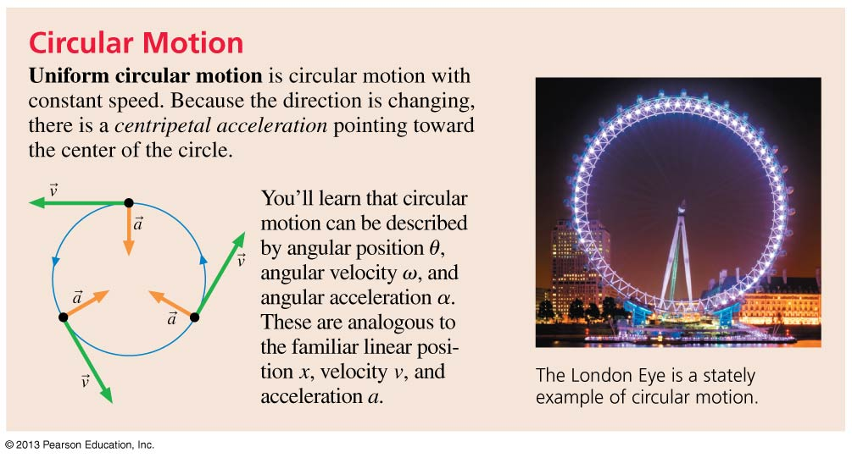
Chapter 4 Preview
Slide 4-5

Slide 2
Reading Question 4.4
The quantity with the symbol ω (wonky w) is called
The circular weight.
The circular velocity.
The angular velocity / speed.
The centripetal acceleration.
The angular acceleration.
Slide 4-14

Slide 3
Reading Question 4.5
The quantity with the symbol α is called
The circular weight.
The circular velocity.
The angular velocity.
The centripetal acceleration.
The angular acceleration.
Slide 4-16

Slide 4
Reading Question 4.6
For uniform circular motion, the acceleration
Points toward the center of the circle.
Points away from the circle.
Is tangent to the circle.
Is zero.
Slide 4-18

Slide 5
Acceleration
The average acceleration of a moving object is defined as the vector:
The acceleration points in the same direction as , the change in velocity.
As an object moves, its velocity vector can change in two possible ways:
The magnitude of the velocity can change, indicating a change in speed, or
2. The direction of the velocity can change, indicating that the object has changed direction.
Slide 4-20

Slide 6
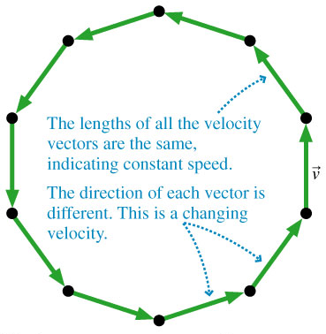
Acceleration
The figure to the right shows a motion diagram of Maria riding a Ferris wheel.
Maria has constant speed but not constant velocity, so she is accelerating.
For every pair of adjacent velocity vectors, we can subtract them to find the average acceleration near that point.
Slide 4-25

Slide 7
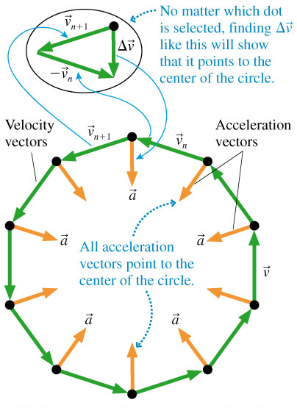
Acceleration
At every point Maria’s acceleration points toward the center of the circle.
This is an acceleration due to changing direction, not to changing speed.
Slide 4-26

Slide 8
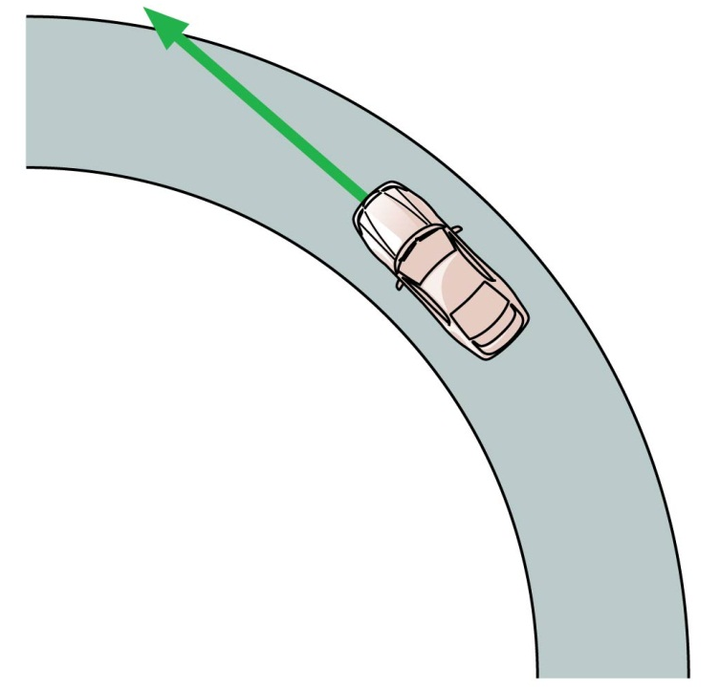
QuickCheck 4.2
A car is traveling around a curve at a steady 45 mph. Is the car accelerating?
Yes
No
Slide 4-28

Slide 9
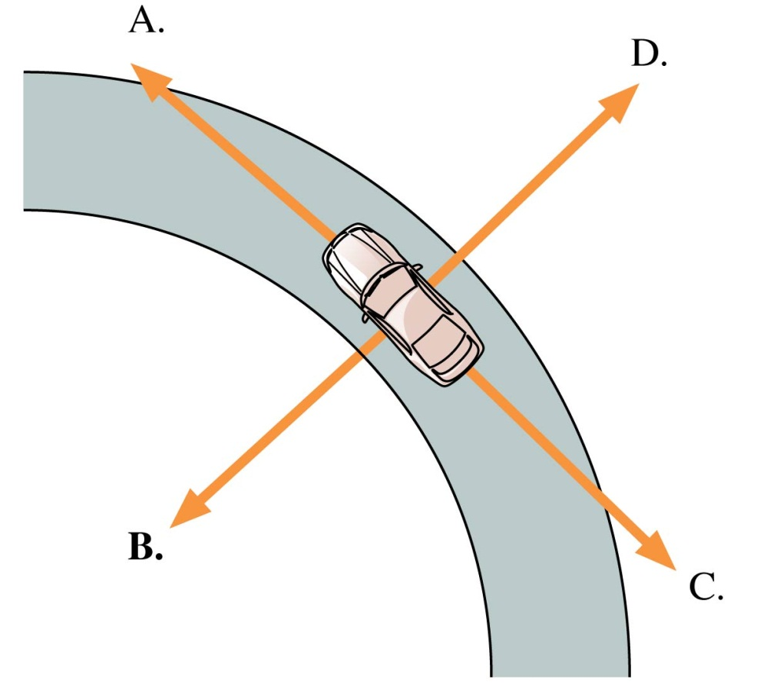
QuickCheck 4.3
A car is traveling around a curve at a steady 45 mph. Which vector shows the direction of the car’s acceleration?
E. The acceleration is zero.
Slide 4-30

Slide 10
Analyzing the Acceleration Vector
An object’s acceleration can be decomposed into components parallel and perpendicular to the velocity.
is the piece of the acceleration that causes the object to change speed.
is the piece of the acceleration that causes the object to change direction.
An object changing direction always has a component of acceleration perpendicular to the direction of motion.
Slide 4-33

Slide 11
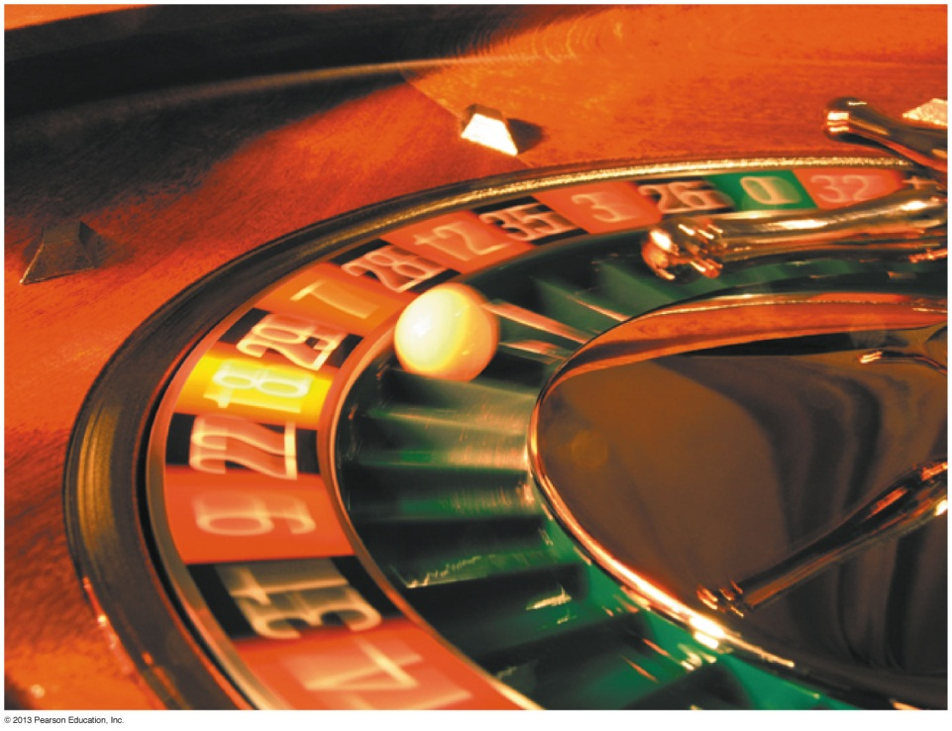
Circular Motion
Consider a ball on a roulette wheel.
It moves along a circular path of radius r.
Other examples of circular motion are a satellite in an orbit or a ball on the end of a string.
Circular motion is an example of two-dimensional motion in a plane.
Slide 4-79

Slide 12
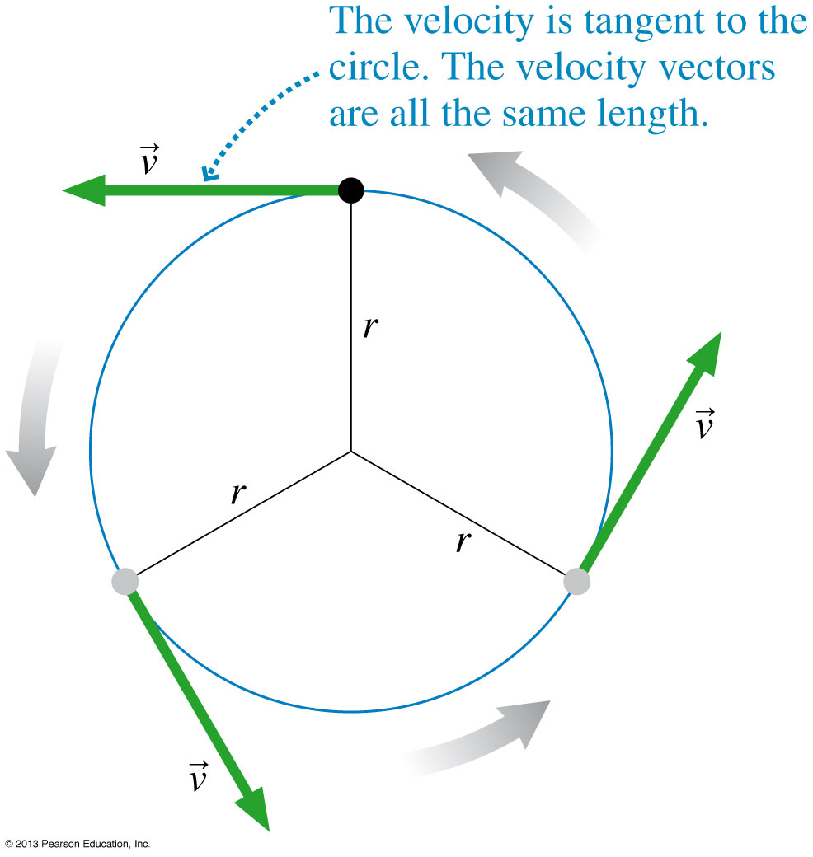
Uniform Circular Motion
To begin the study of circular motion, consider a particle that moves at constant speed around a circle of radius r.
This is called uniform circular motion.
The time interval to complete one revolution is called the period, T.
The period T is related to the speed v:
Slide 4-80

Slide 13
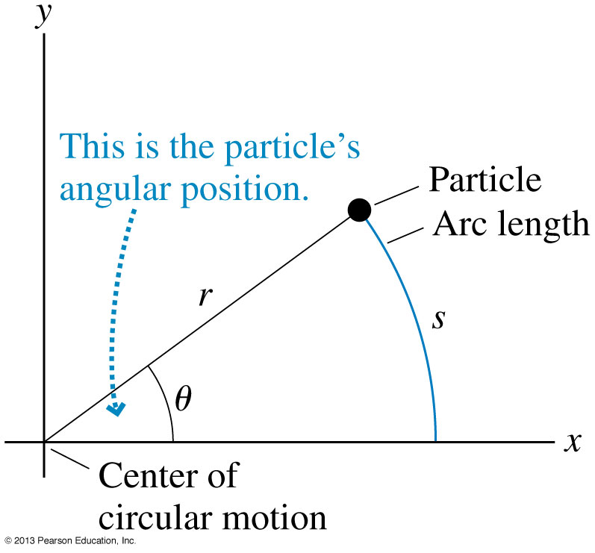
Angular Position
Consider a particle at a distance r from the origin, at an angle θ from the positive x axis.
The angle may be measured in degrees, revolutions (rev) or radians (rad), that are related by:
If the angle is measured in radians, then there is a simple relation between θ and the arc length s that the particle travels along the edge of a circle of radius r:
1 rev = 360° = 2π rad
Slide 4-82

Slide 14
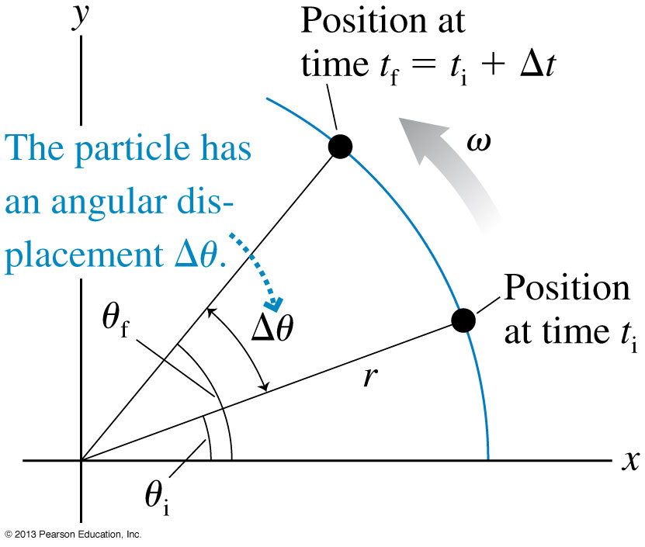
Angular Velocity
A particle on a circular path moves through an angular displacement ∆θ = θ_{f} – θ_{i} in a time interval ∆t = t_{f} – t_{i}.
In analogy with linear motion, we define:
As the time interval ∆t becomes very small, we arrive at the definition of instantaneous angular velocity.
Slide 4-83

Slide 15
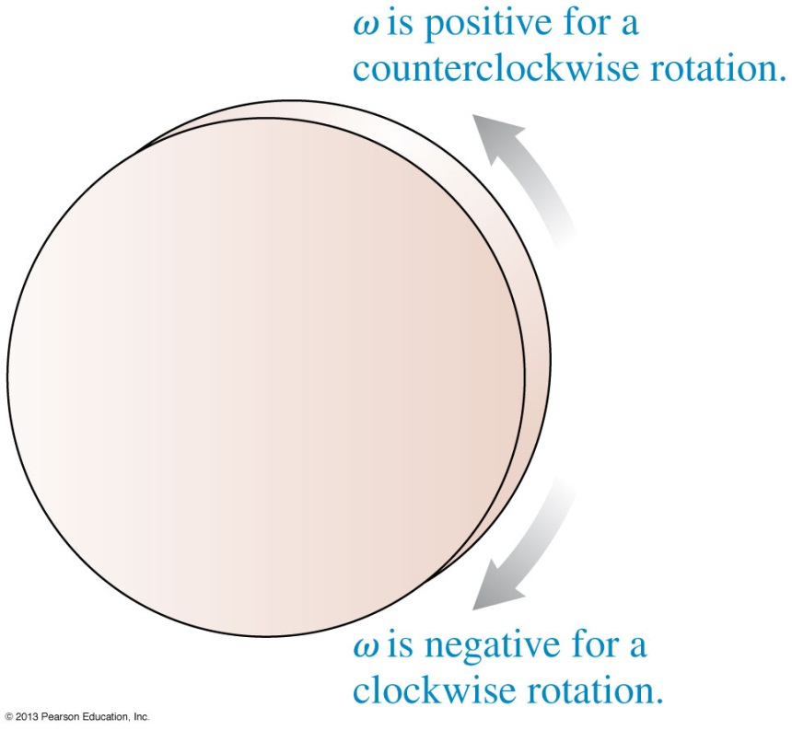
Angular Velocity
Angular velocity ω is the rate at which a particle’s angular position is changing.
As shown in the figure, ω can be positive or negative, and this follows from our definition of θ.
A particle moves with uniform circular motion if ω is constant.
ω and θ are related graphically:
Slide 4-84

Slide 16
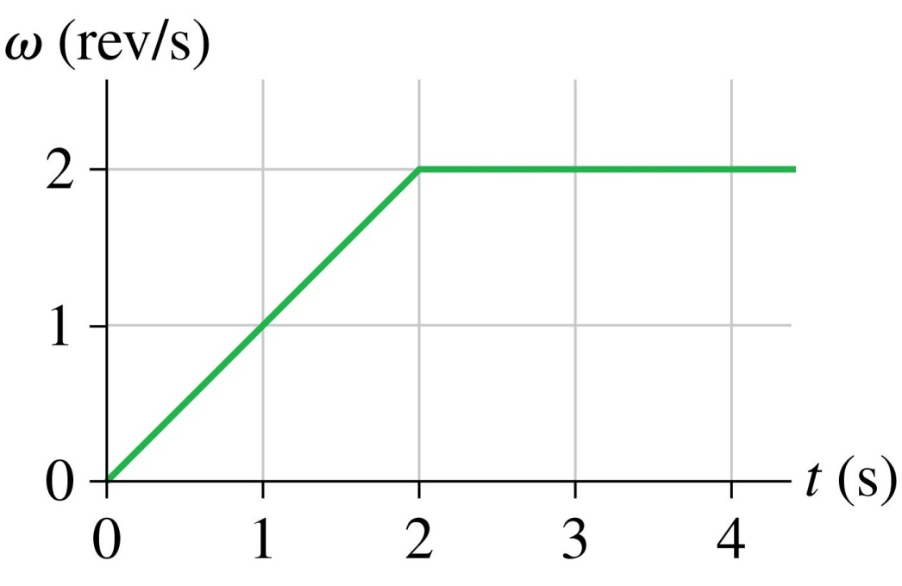
QuickCheck 4.10
This is the angular velocity graph of a wheel. How many revolutions does the wheel make in the first 4 s?
1
2
4
6
8
Δθ = area under the angular velocity curve
Slide 4-86

Slide 17
Angular Velocity in Uniform Circular Motion
When angular velocity ω is constant, this is uniform circular motion.
In this case, as the particle goes around a circle one time, its angular displacement is Δθ = 2π during one period Δt = T.
The absolute value of the constant angular velocity is related to the period of the motion by:
Slide 4-87

Slide 18
QuickCheck 4.11
A ball rolls around a circular track with an angular velocity of 4π rad/s. What is the period of the motion?
s
1 s
2 s
s
s
Slide 4-89

Slide 19
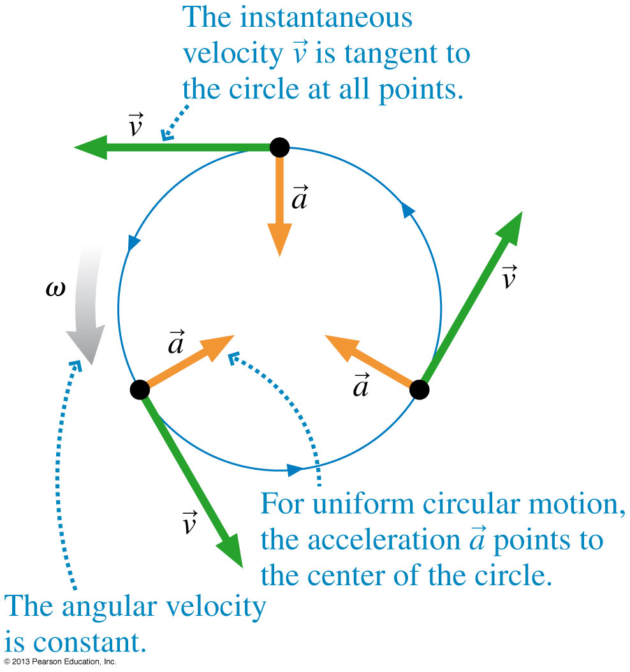
Tangential Velocity
The tangential velocity component v_{t} is the rate ds/dt at which the particle moves around the circle, where s is the arc length.
The tangential velocity and the angular velocity are related by:
In this equation, the units of v_{t} are m/s, the units of ω are rad/s, and the units of r are m.
Slide 4-92

Slide 20
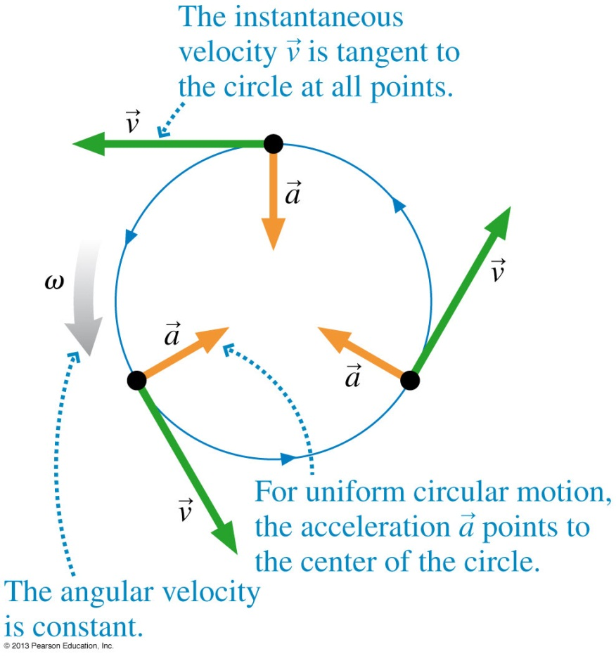
Centripetal Acceleration
In uniform circular motion, although the speed is constant, there is an acceleration because the direction of the velocity vector is always changing.
The acceleration of uniform circular motion is called centripetal acceleration.
The direction of the centripetal acceleration is toward the center of the circle.
The magnitude of the centripetal acceleration is constant for uniform circular motion.
Slide 4-93

Slide 21
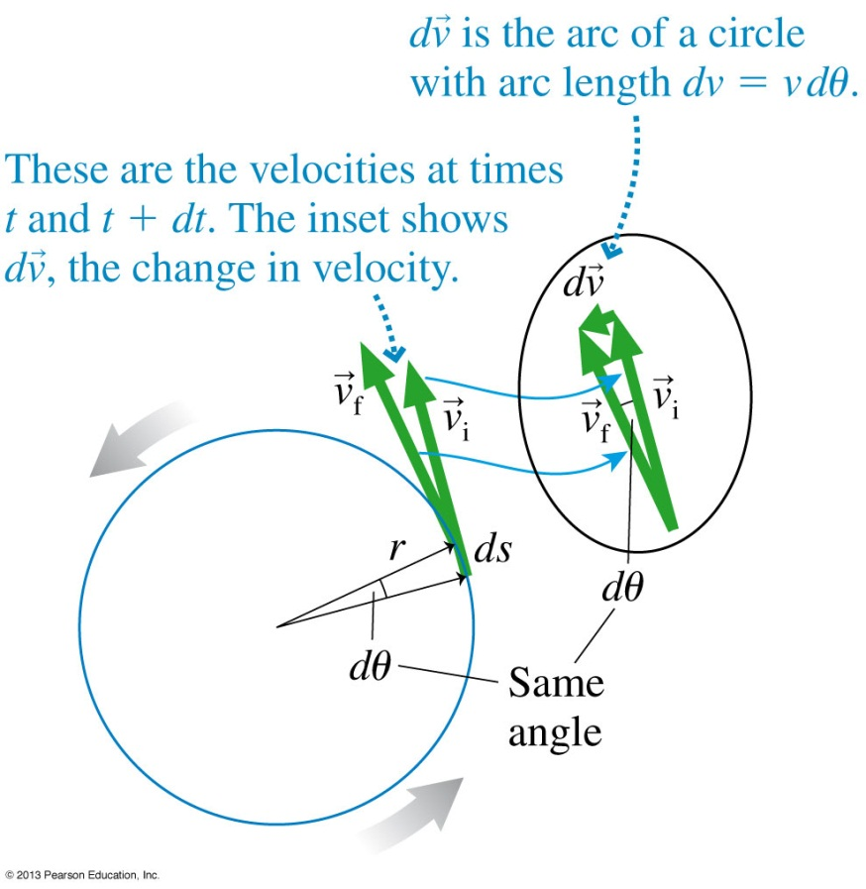
Centripetal Acceleration
The figure shows the velocity at one instant and the velocity an infinitesimal amount of time dt later.
By definition, .
By analyzing the isosceles triangle of velocity vectors, we can show that:
which can be written in terms of angular velocity as: a = ω²r.
Slide 4-94

Slide 22
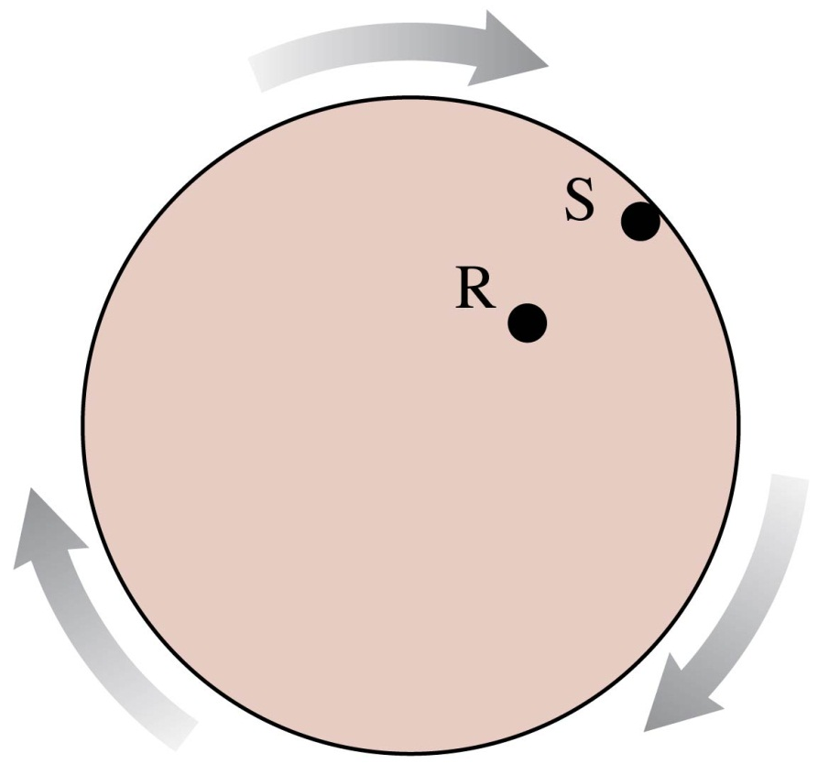
QuickCheck 4.12
Rasheed and Sofia are riding a merry-go-round that is spinning steadily. Sofia is twice as far from the axis as is Rasheed. Sofia’s angular velocity is ______ that of Rasheed.
half
the same as
twice
four times
We can’t say without knowing their radii.
Slide 4-96

Slide 23
QuickCheck 4.13
Rasheed and Sofia are riding a merry-go-round that is spinning steadily. Sofia is twice as far from the axis as is Rasheed. Sofia’s speed is ______ that of Rasheed.
half
the same as
twice
four times
We can’t say without knowing their radii.
Slide 4-98

Slide 24
QuickCheck 4.14
Rasheed and Sofia are riding a merry-go-round that is spinning steadily. Sofia is twice as far from the axis as is Rasheed. Sofia’s acceleration is ______ that of Rasheed.
half
the same as
twice
four times
We can’t say without knowing their radii.
Slide 4-100

Slide 25
Chapter 4 Summary Slides
Slide 4-117

