Slide 1
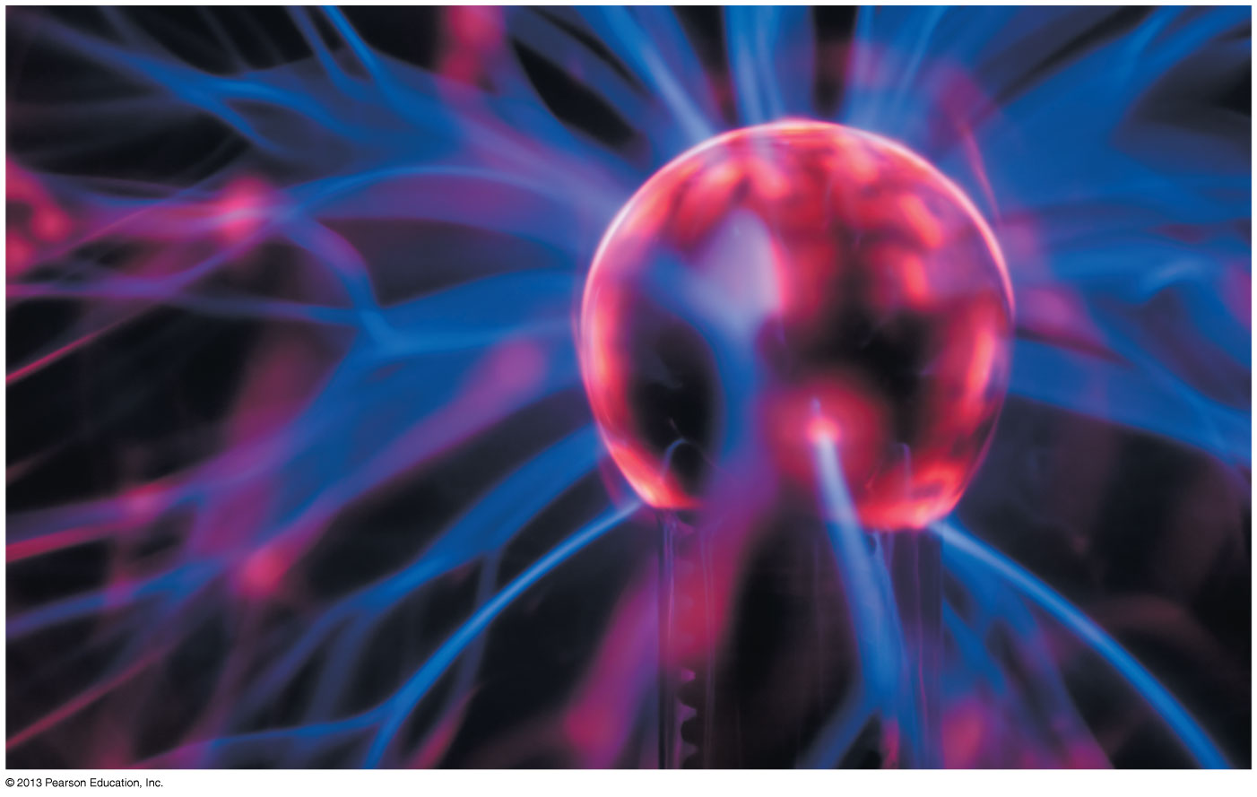
Chapter 26 The Electric Field
Chapter Goal: To learn how to calculate and use the electric field.
Slide 26-2

Slide 2
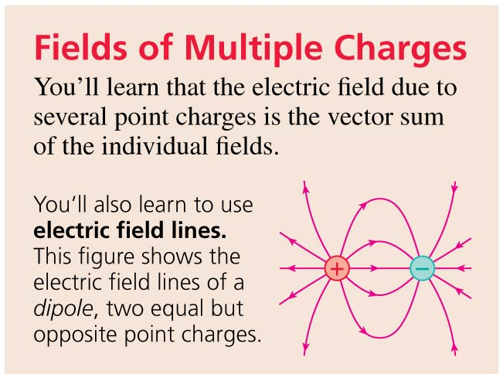
Chapter 26 Preview
Slide 26-3

Slide 3
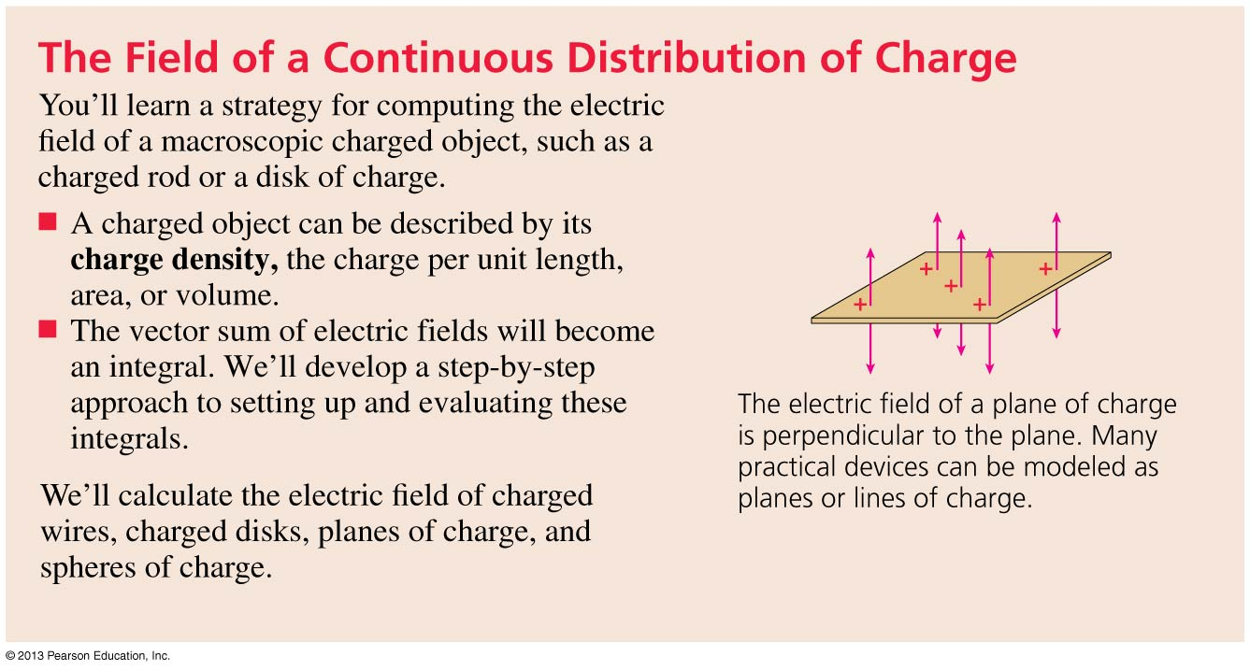
Chapter 26 Preview
Slide 26-4

Slide 4
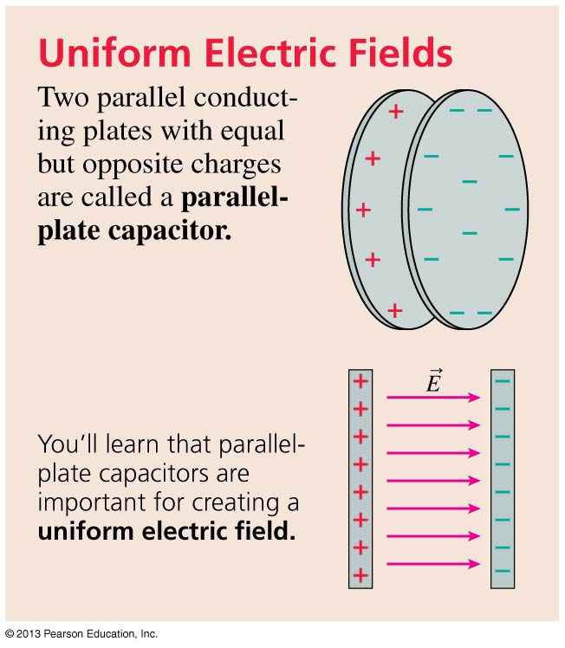
Chapter 26 Preview
Slide 26-5

Slide 5
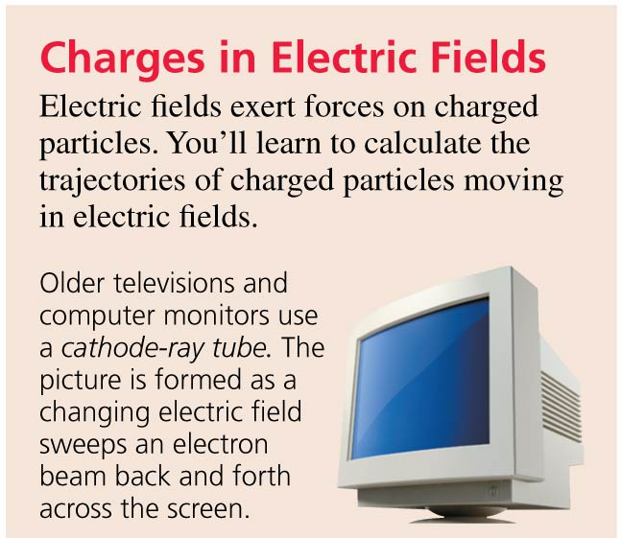
Chapter 26 Preview
Slide 26-6

Slide 6
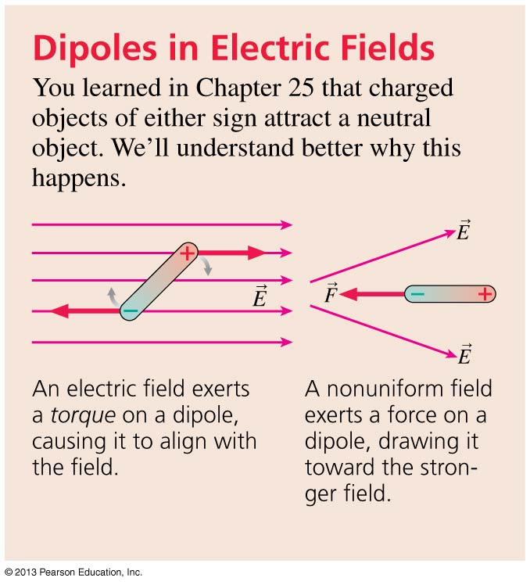
Chapter 26 Preview
Slide 26-7

Slide 7
Chapter 26 Content, Examples, and QuickCheck Questions
Slide 26-17

Slide 8
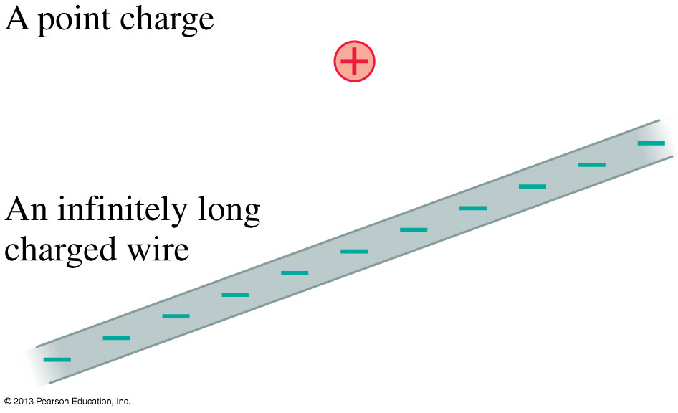
Electric Field Models
Most of this chapter will be concerned with the sources of the electric field.
We can understand the essential physics on the basis of simplified models of the sources of electric field.
The drawings show models of a positive point charge and an infinitely long negative wire.
We also will consider an infinitely wide charged plane and a charged sphere.
Slide 26-18

Slide 9
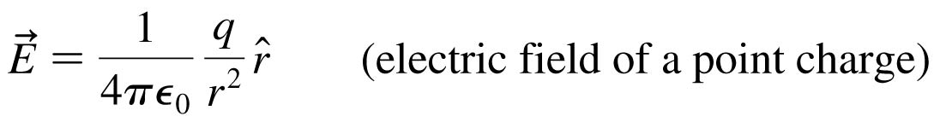
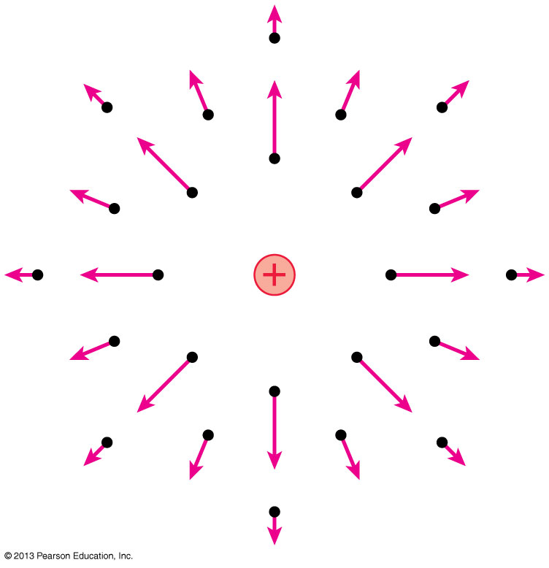
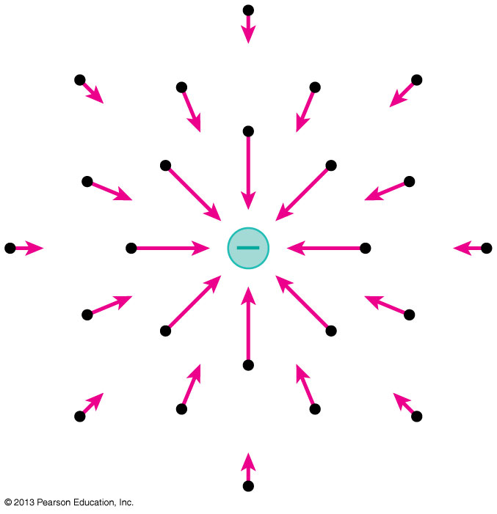
Electric Field of a Point Charge
Slide 26-19

Slide 10
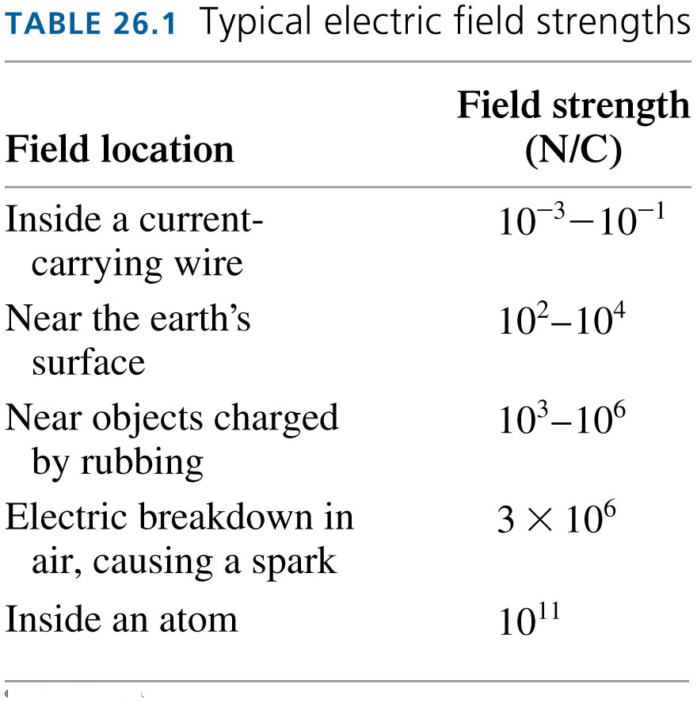
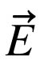
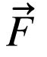
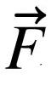
The Electric Field
The electric field was defined as:
where _{on q} is the electric force on test charge q.
The SI units of electric field are therefore Newtons per Coulomb (N/C).
= _{on q} / q
Slide 26-20

Slide 11

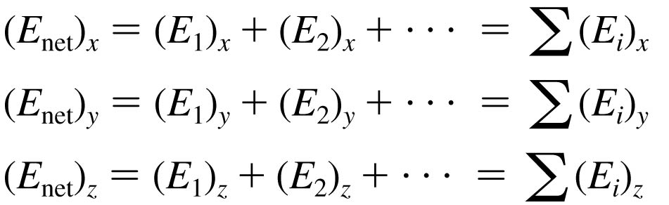
The Electric Field of Multiple Point Charges
Suppose the source of an electric field is a group of point charges q₁, q₂, …
The net electric field E_{net} at each point in space is a superposition of the electric fields due to each individual charge:
Slide 26-21

Slide 12
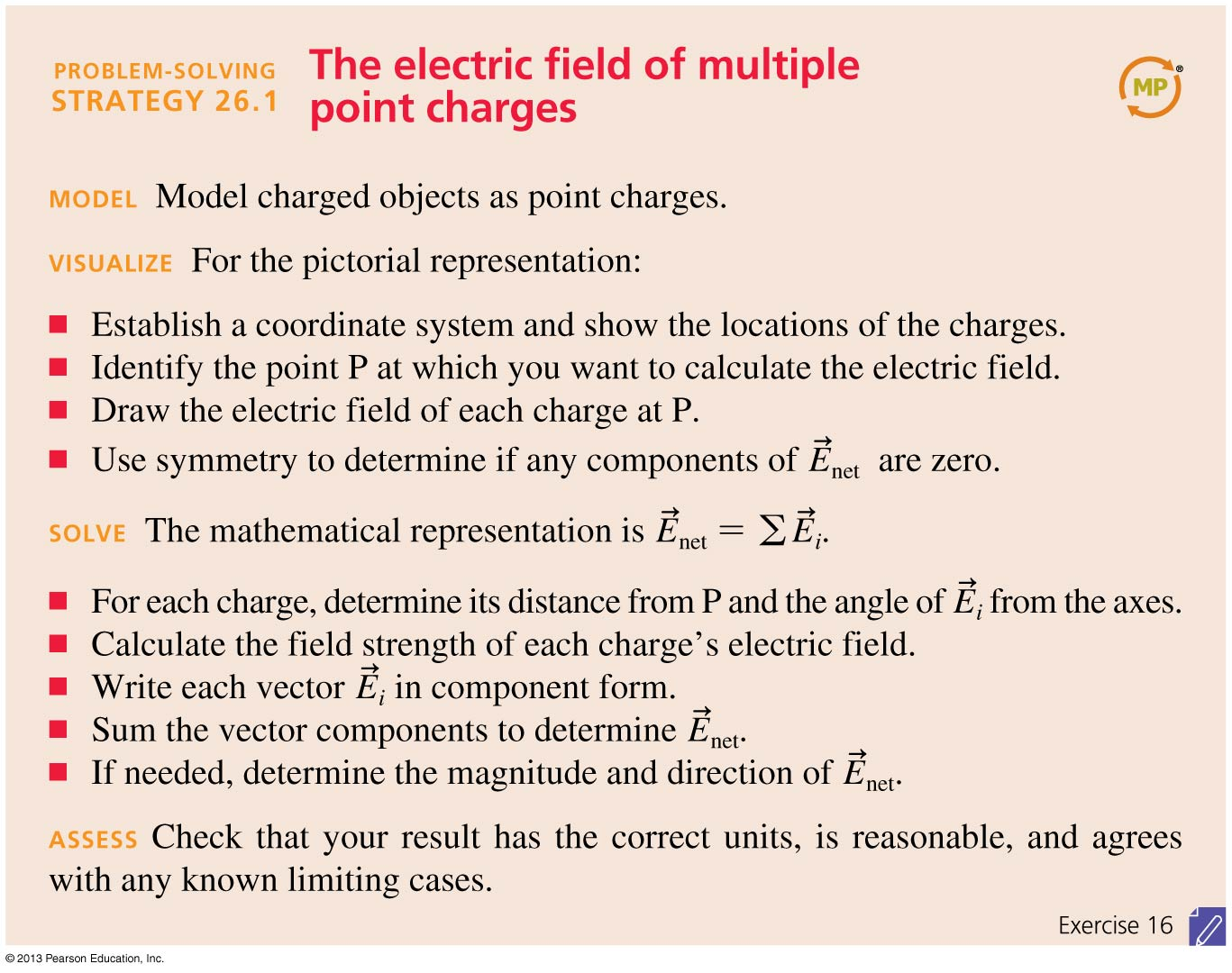
Problem-Solving Strategy: The Electric Field of Multiple Point Charges
Slide 26-24

Slide 13
Problem-Solving Strategy: The Electric Field of Multiple Point Charges
Slide 26-25

Slide 14
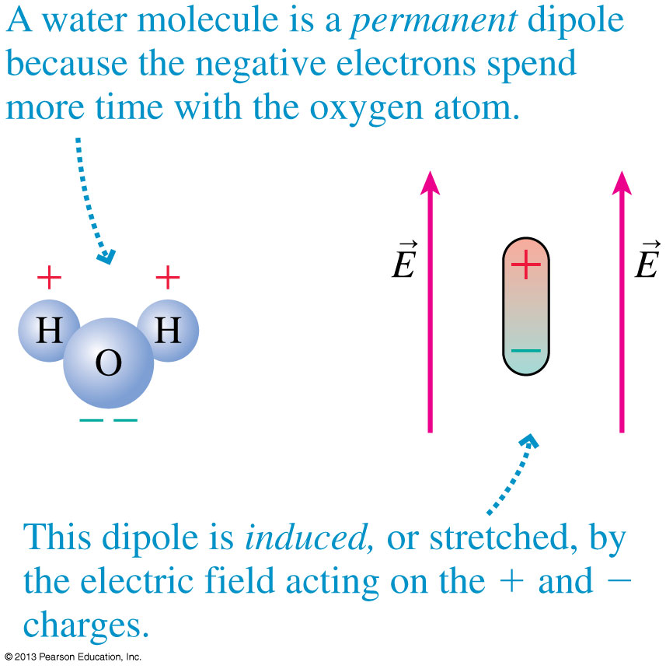
Electric Dipoles
Two equal but opposite charges separated by a small distance form an electric dipole.
The figure shows two examples.
Slide 26-30

Slide 15
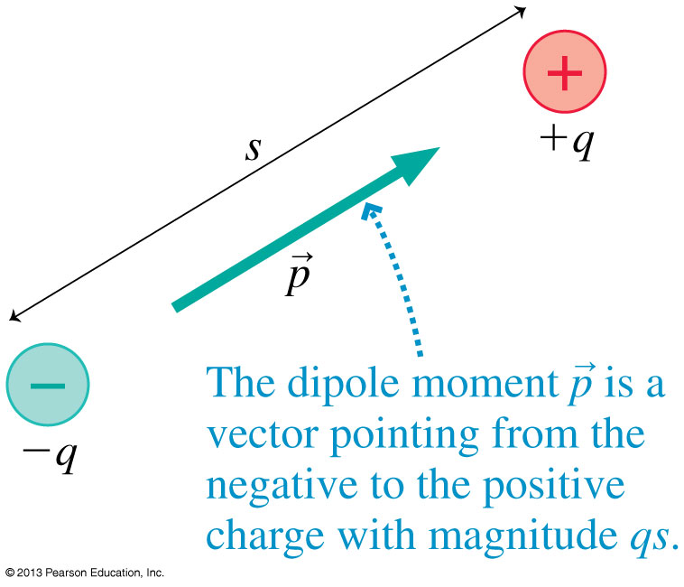
The Dipole Moment
It is useful to define the dipole moment p, shown in the figure, as the vector:
The SI units of the dipole moment are C m.
Slide 26-31

Slide 16
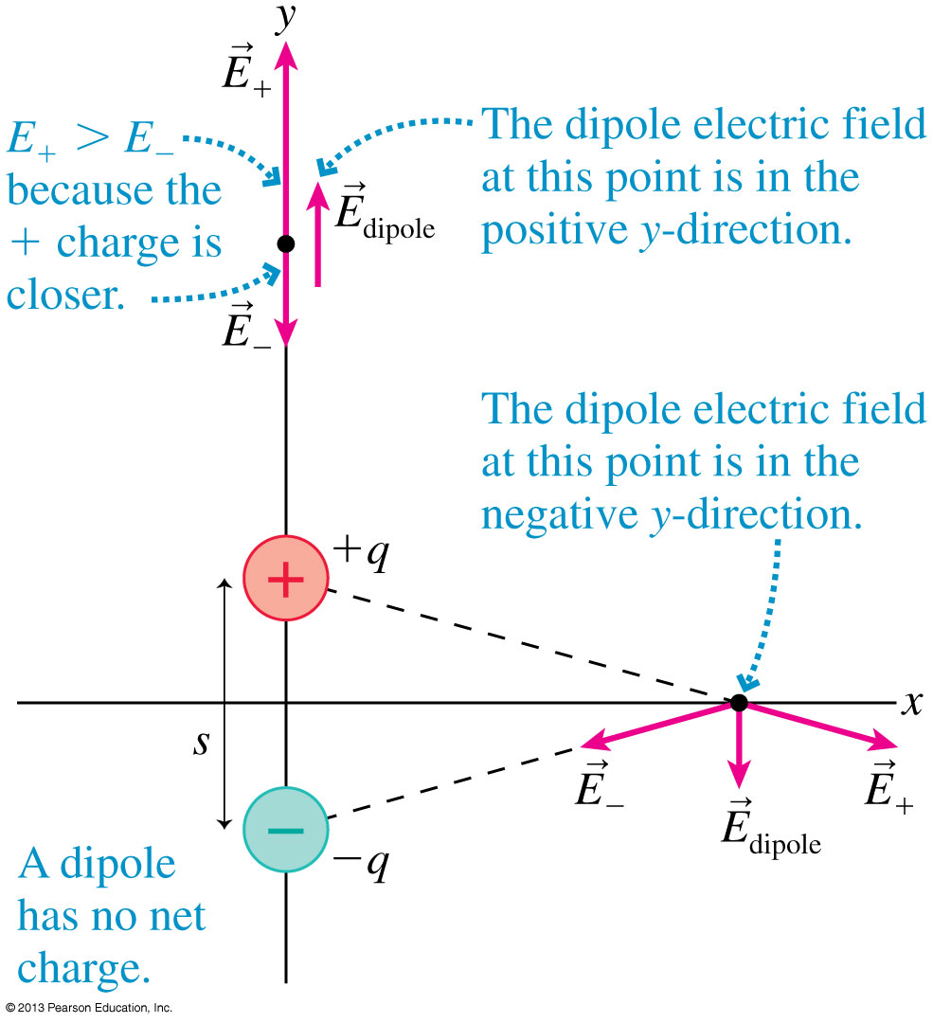
The Dipole Electric Field at Two Points
Slide 26-32

Slide 17
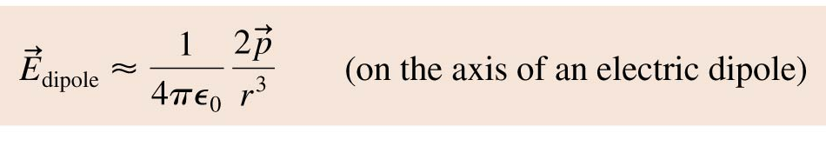

The Electric Field of a Dipole
The electric field at a point on the axis of a dipole is:
where r is the distance measured from the center of the dipole.
The electric field in the plane that bisects and is perpendicular to the dipole is
This field is opposite to the dipole direction, and it is only half the strength of the on-axis field at the same distance.
Slide 26-33

Slide 18
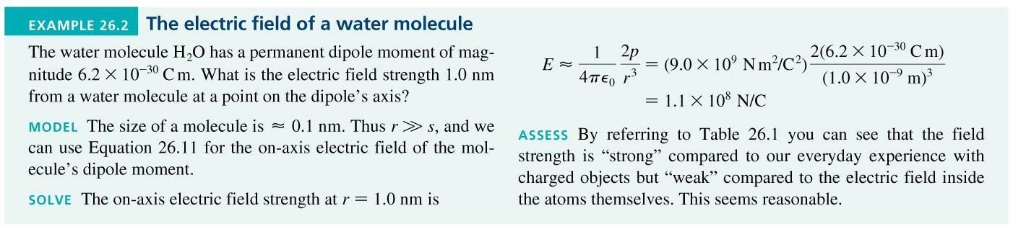
Example 26.2 The Electric Field of a Water Molecule
Slide 26-34

Slide 19
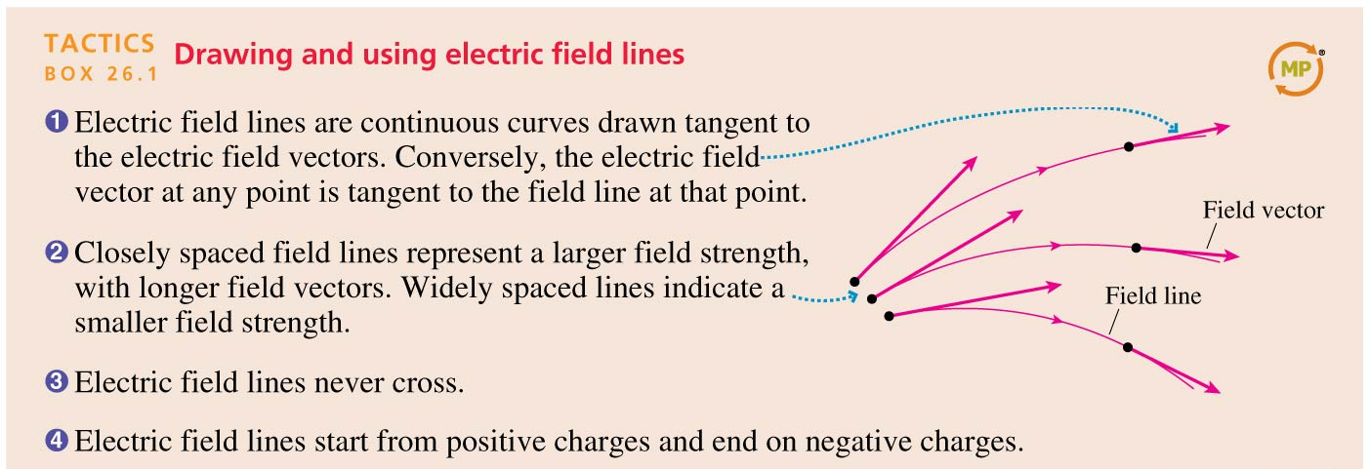
Tactics: Drawing and Using Electric Field Lines
Slide 26-35

Slide 20
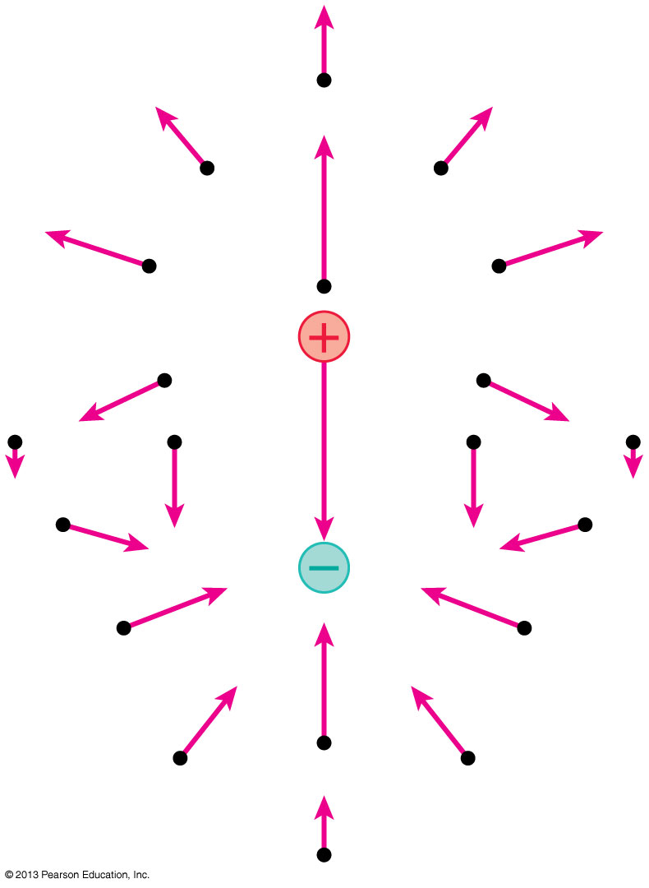
The Electric Field of a Dipole
This figure represents the electric field of a dipole as a field-vector diagram.
Slide 26-36

Slide 21
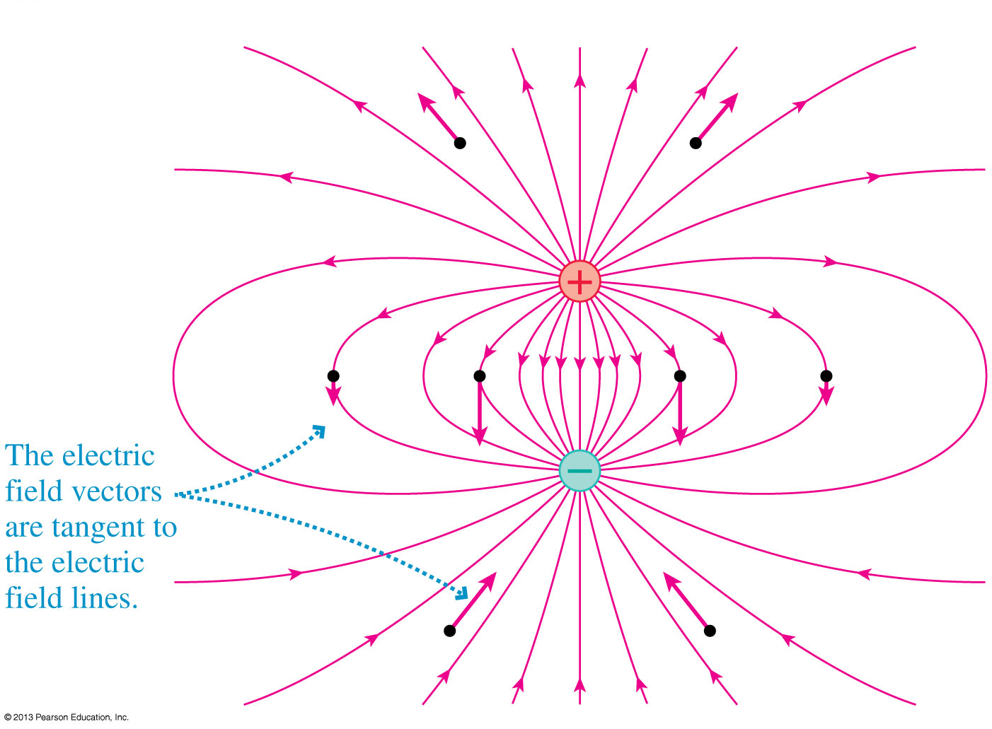
The Electric Field of a Dipole
This figure represents the electric field of a dipole using electric field lines.
Slide 26-37

Slide 22
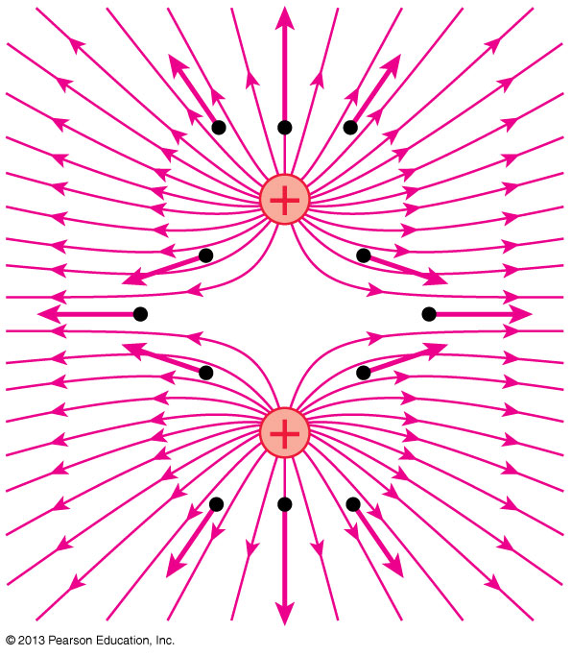
The Electric Field of Two Equal Positive Charges
This figure represents the electric field of two same-sign charges using electric field lines.
Slide 26-38

Slide 23
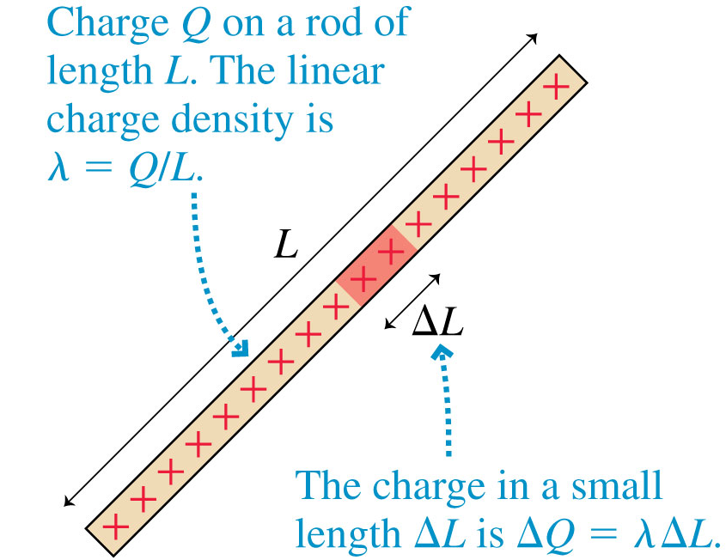
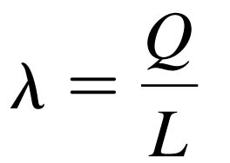
Continuous Charge Distributions
The linear charge density of an object of length L and charge Q is defined as
Linear charge density, which has units of C/m, is the amount of charge per meter of length.
Slide 26-43

Slide 24
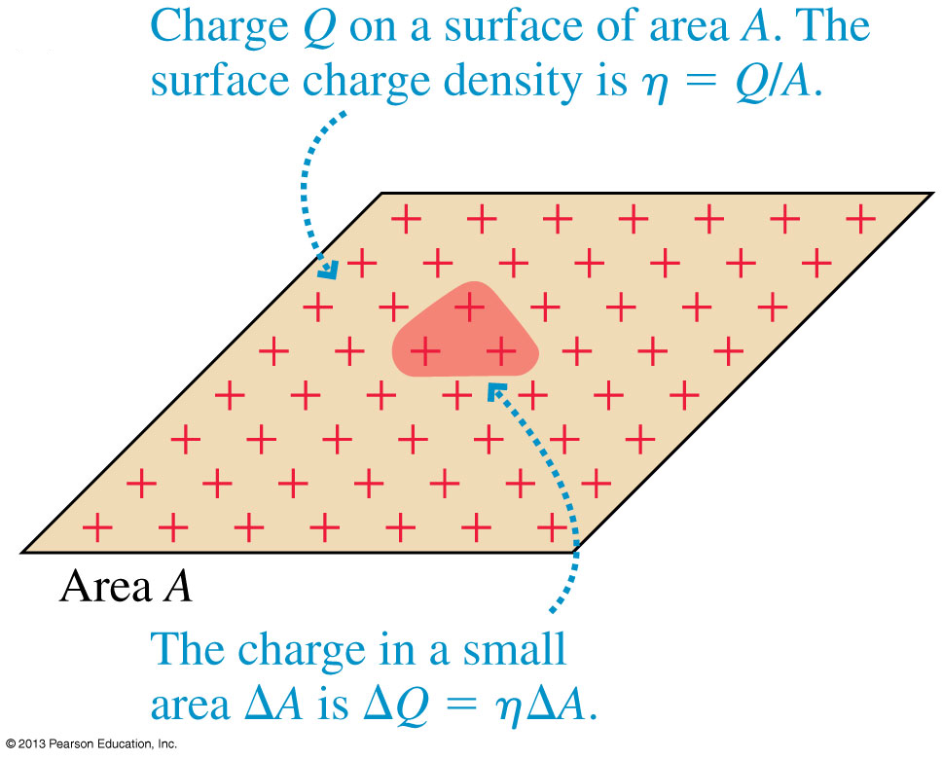
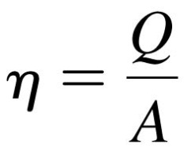
Continuous Charge Distributions
The surface charge density of a two-dimensional distribution of charge across a surface of area A is defined as:
Surface charge density, with units C/m², is the amount of charge per square meter.
Slide 26-46

Slide 25
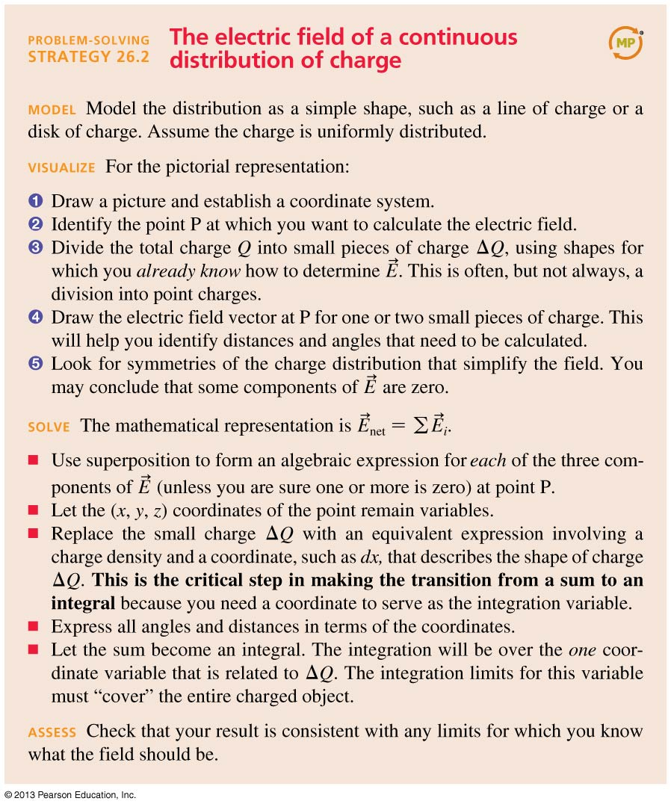
Problem-Solving Strategy: The Electric Field of a Continuous Distribution of Charge
Slide 26-49

Slide 26
Problem-Solving Strategy: The Electric Field of a Continuous Distribution of Charge
Slide 26-50

Slide 27
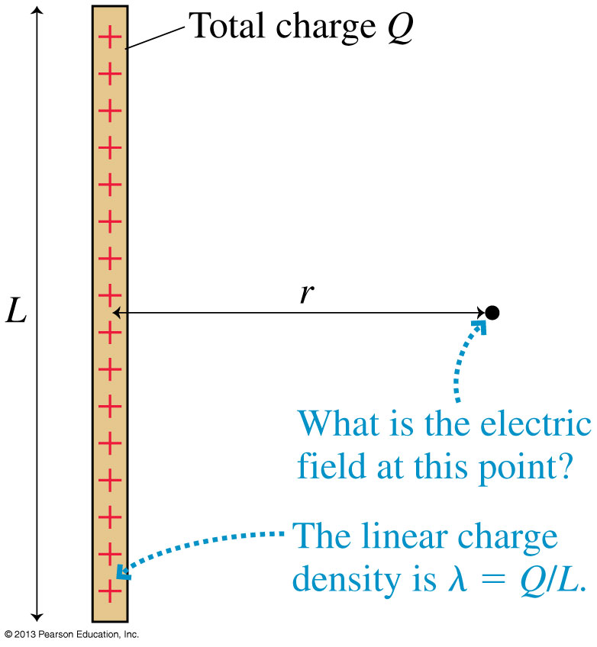
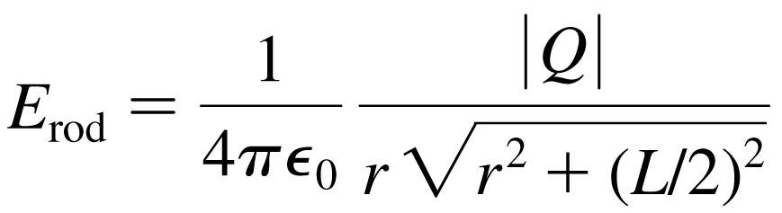
The Electric Field of a Finite Line of Charge
The Electric Field of a Finite Line of Charge
Example 26.3 in the text uses integration to find the electric field strength at a radial distance r in the plane that bisects a rod of length L with total charge Q:
Slide 26-51

Slide 28
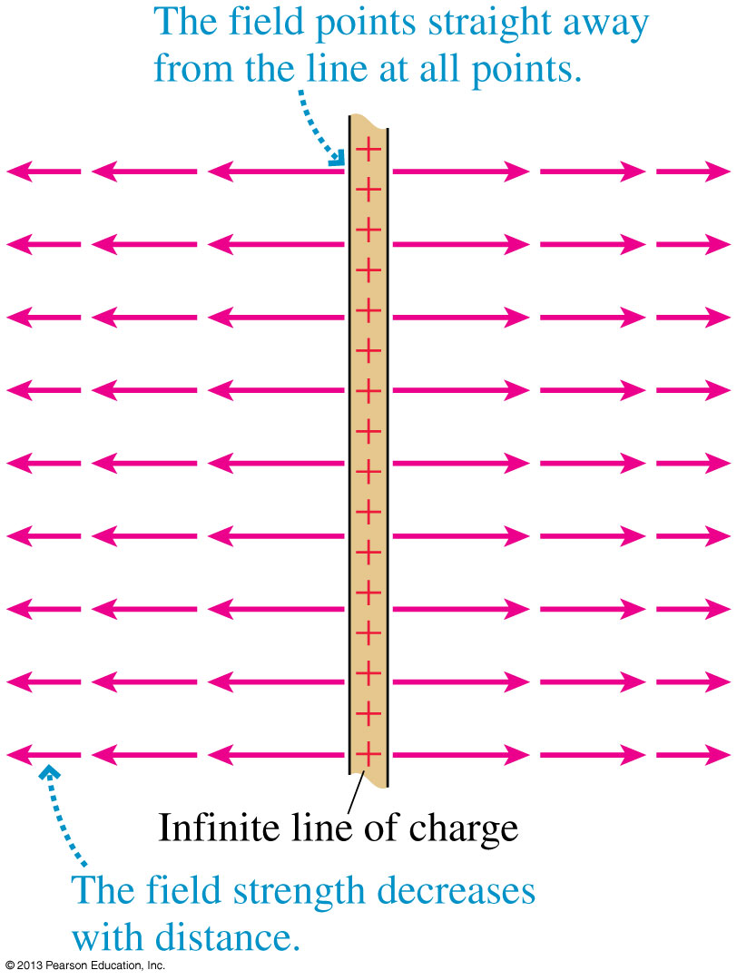
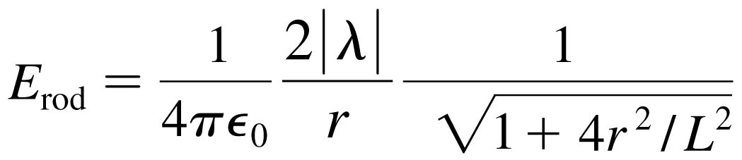

An Infinite Line of Charge
The electric field of a thin, uniformly charged rod may be written:
If we now let L → ∞, the last term becomes simply 1 and we’re left with:
Slide 26-54

Slide 29
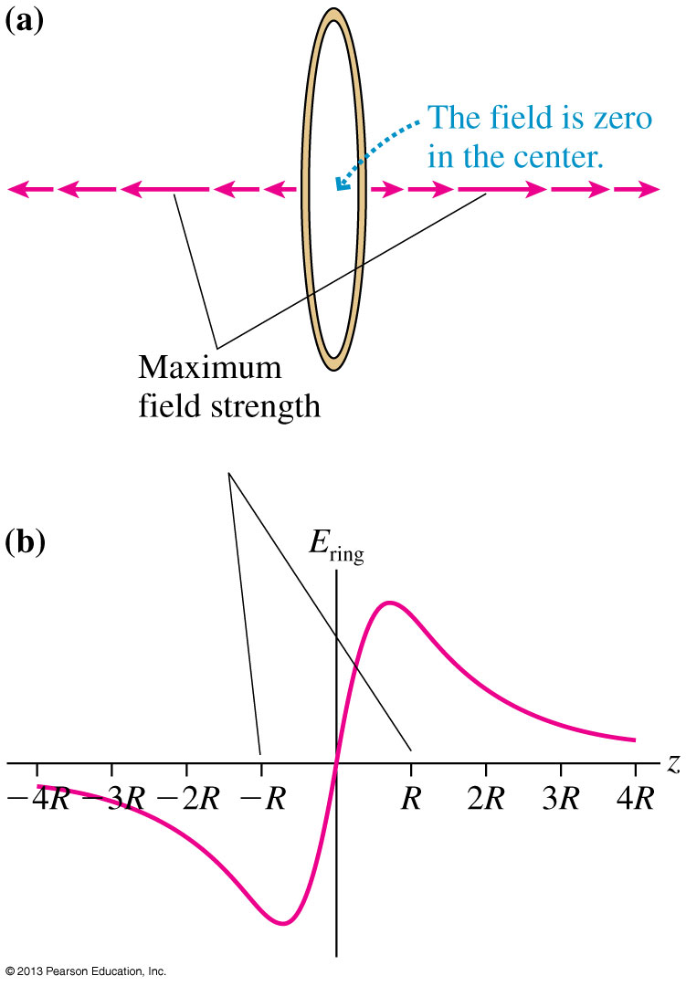
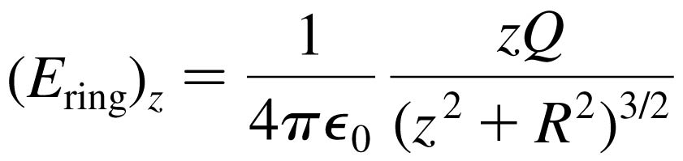
A Ring of Charge
Consider the on-axis electric field of a positively charged ring of radius R.
Define the z-axis to be the axis of the ring.
The electric field on the
z-axis points away from the center of the ring, increasing in strength until reaching a maximum when |z| ≈ R, then decreasing:
Slide 26-55

Slide 30
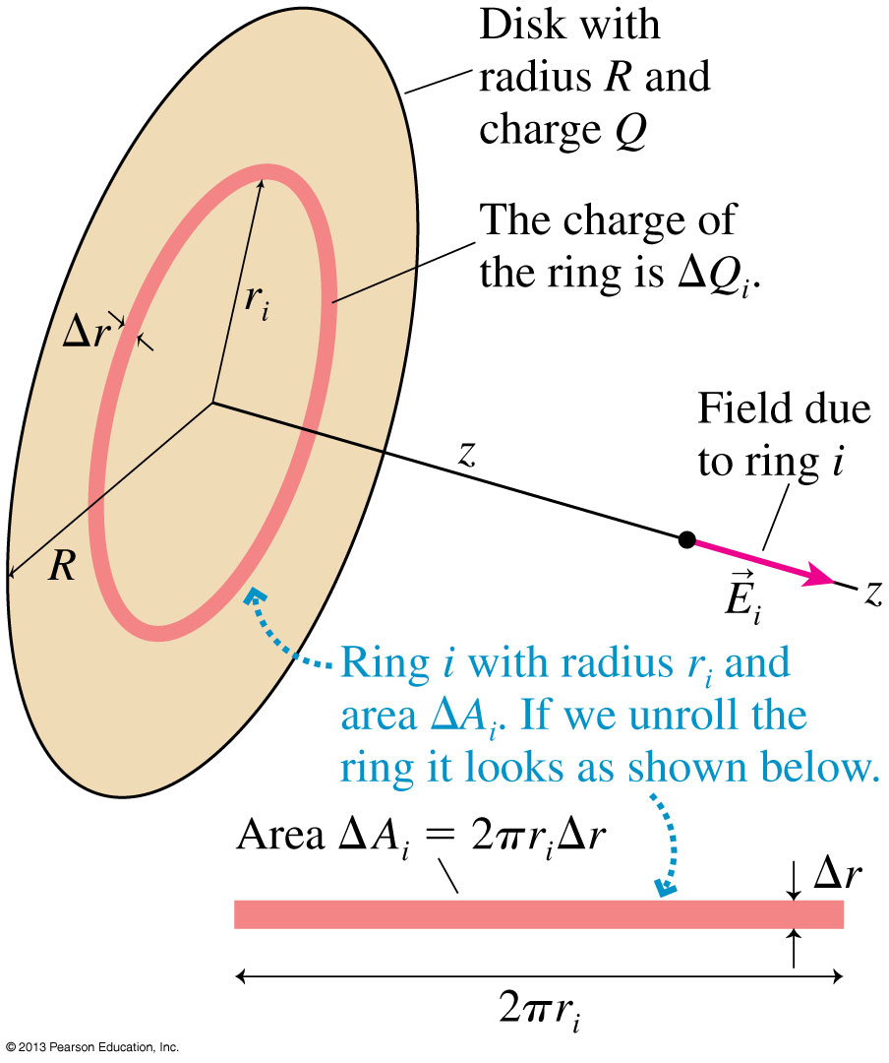
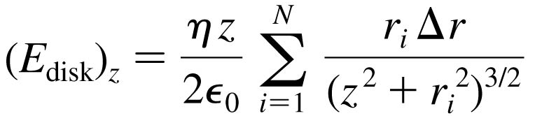
A Disk of Charge
Consider the on-axis electric field of a positively charged disk of radius R.
Define the z-axis to be the axis of the disk.
The electric field on the
z-axis points away from the center of the disk, with magnitude:
Slide 26-56

Slide 31
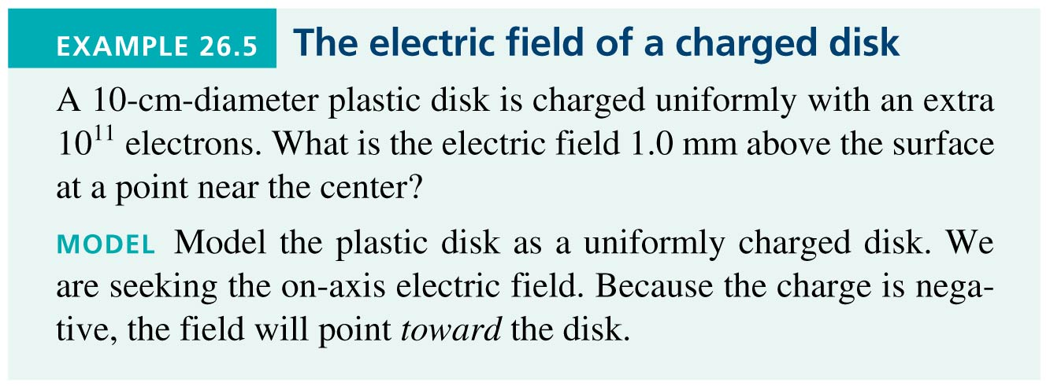
Example 26.5 The Electric Field of a Charged Disk
Slide 26-57

Slide 32
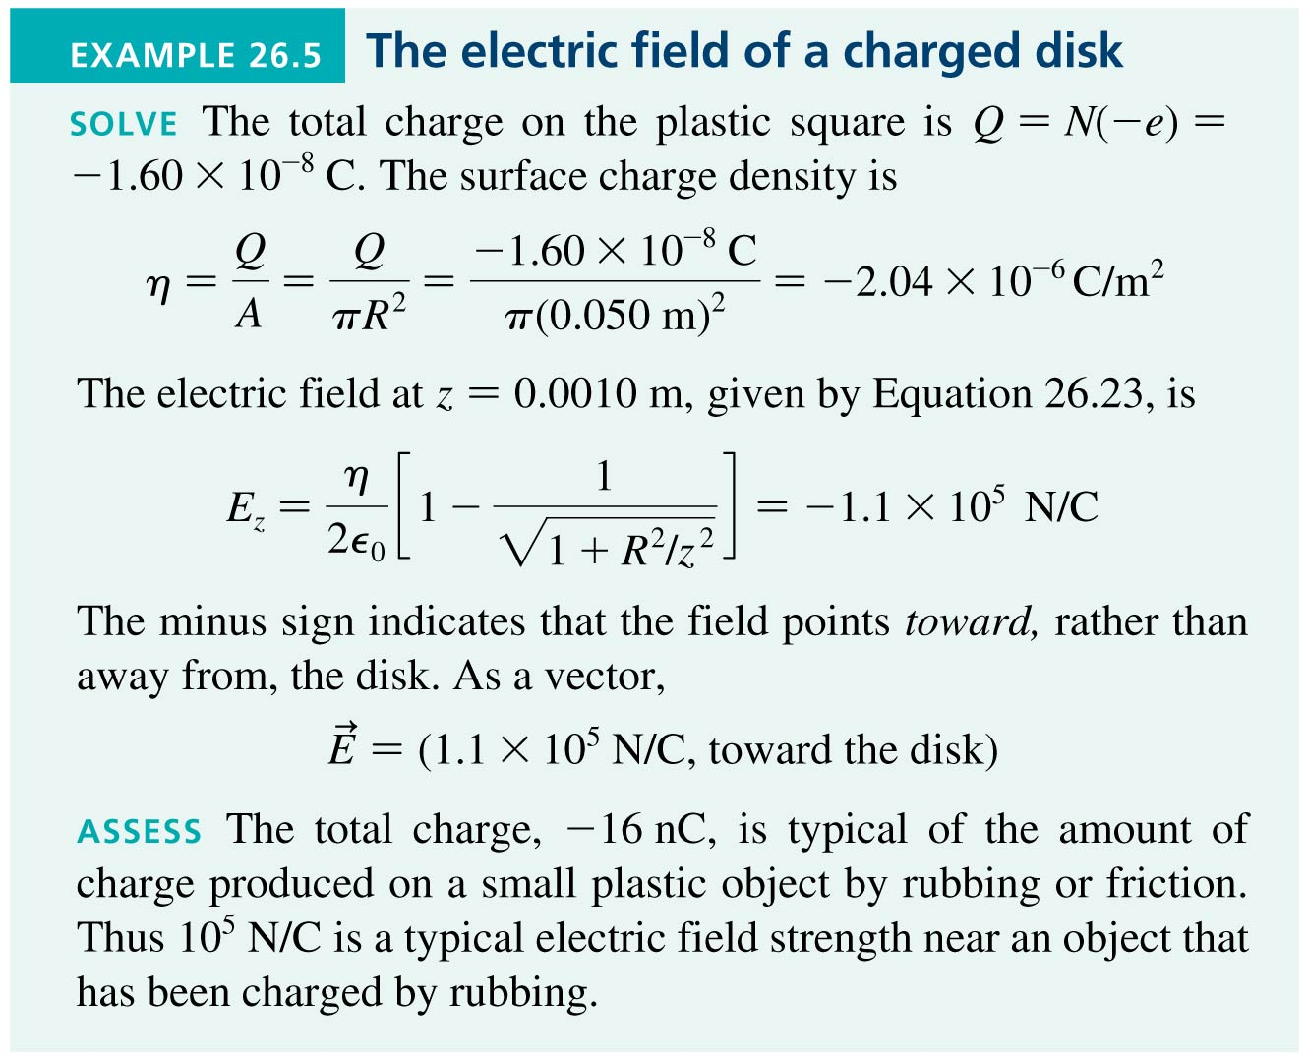
Example 26.5 The Electric Field of a Charged Disk
Slide 26-58

Slide 33
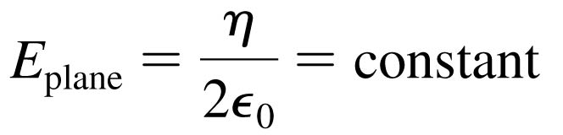
A Plane of Charge
The electric field of a plane of charge is found from the on-axis field of a charged disk by letting the radius R → ∞.
The electric field of an infinite plane of charge with surface charge density η is:
For a positively charged plane, with η > 0, the electric field points away from the plane on both sides of the plane.
For a negatively charged plane, with η < 0, the electric field points towards the plane on both sides of the plane.
Slide 26-59

Slide 34
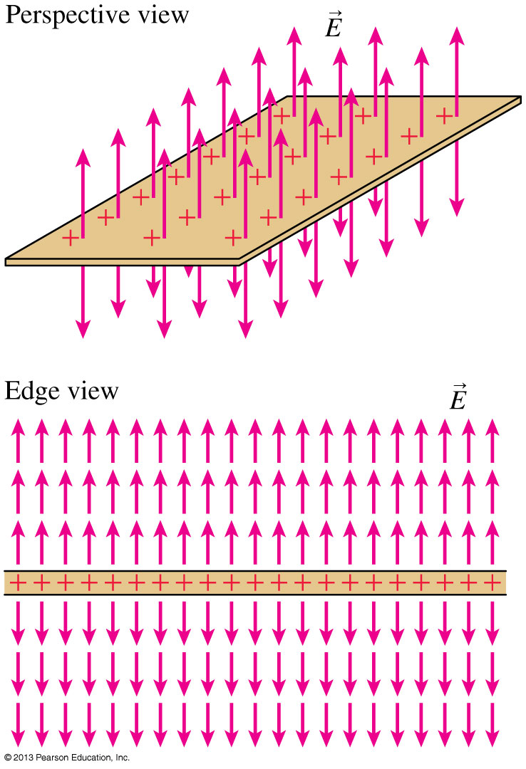
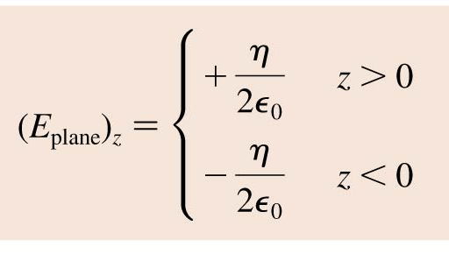
A Plane of Charge
Slide 26-60

Slide 35
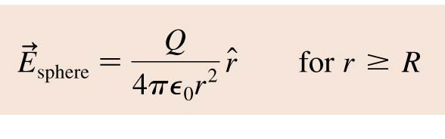
A Sphere of Charge
A sphere of charge Q and radius R, be it a uniformly charged sphere or just a spherical shell, has an electric field outside the sphere that is exactly the same as that of a point charge Q located at the center of the sphere:
Slide 26-63

Slide 36
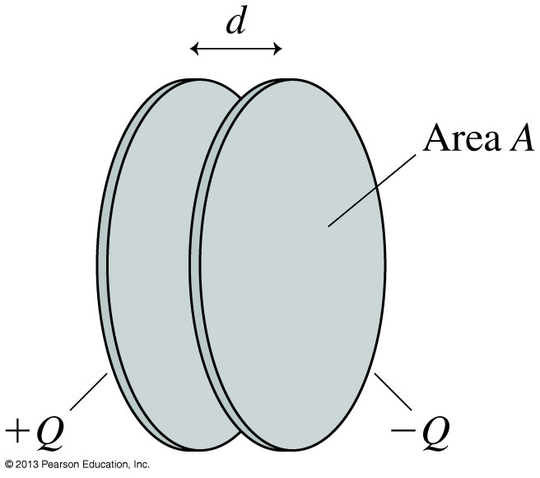
The Parallel-Plate Capacitor
The figure shows two electrodes, one with charge +Q and the other with −Q placed face-to-face a distance d apart.
This arrangement of two electrodes, charged equally but oppositely, is called a parallel-plate capacitor.
Capacitors play important roles in many electric circuits.
Slide 26-64

Slide 37
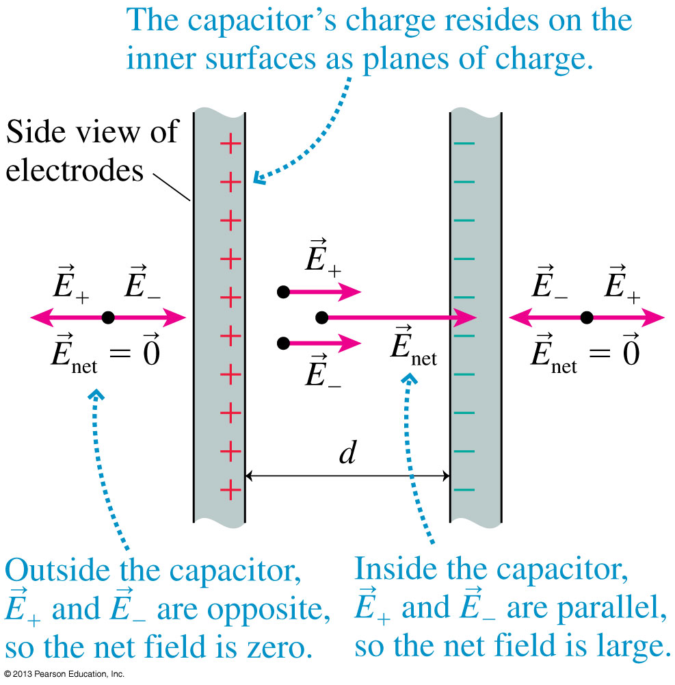
The Parallel-Plate Capacitor
The figure shows two capacitor plates, seen from the side.
Because opposite charges attract, all of the charge is on the inner surfaces of the two plates.
Inside the capacitor, the net field points toward the negative plate.
Outside the capacitor, the net field is zero.
Slide 26-65

Slide 38
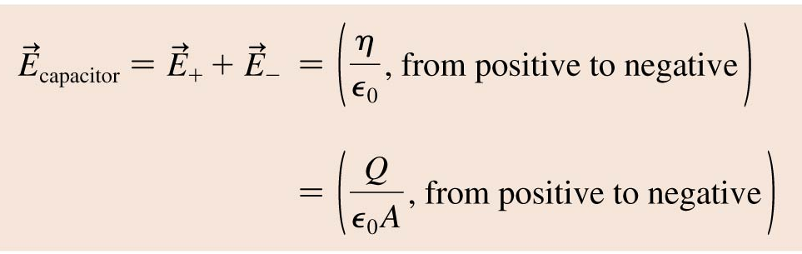
The Parallel-Plate Capacitor
The electric field inside a capacitor is
where A is the surface area of each electrode. Outside the capacitor plates, where E₊ and E₋ have equal magnitudes but opposite directions, the electric field is zero.
Slide 26-66

Slide 39
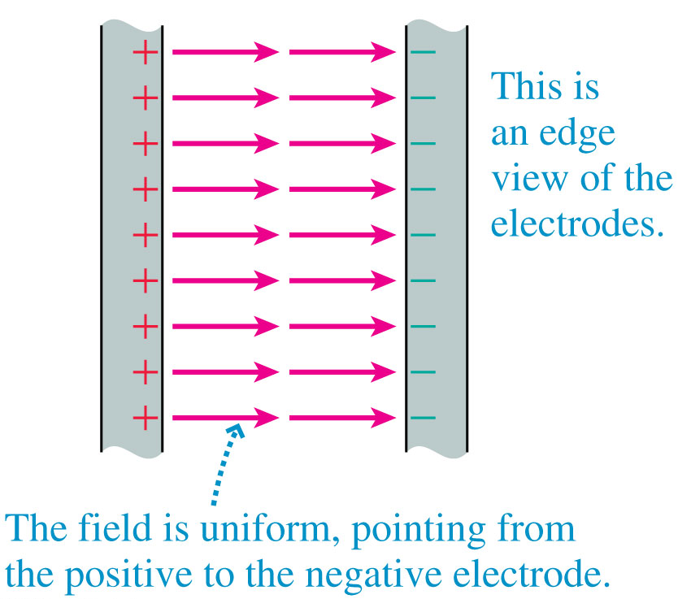
The Ideal Capacitor
The figure shows the electric field of an ideal parallel-plate capacitor constructed from two infinite charged planes
The ideal capacitor is a good approximation as long as the electrode separation d is much smaller than the electrodes’ size.
Slide 26-69

Slide 40
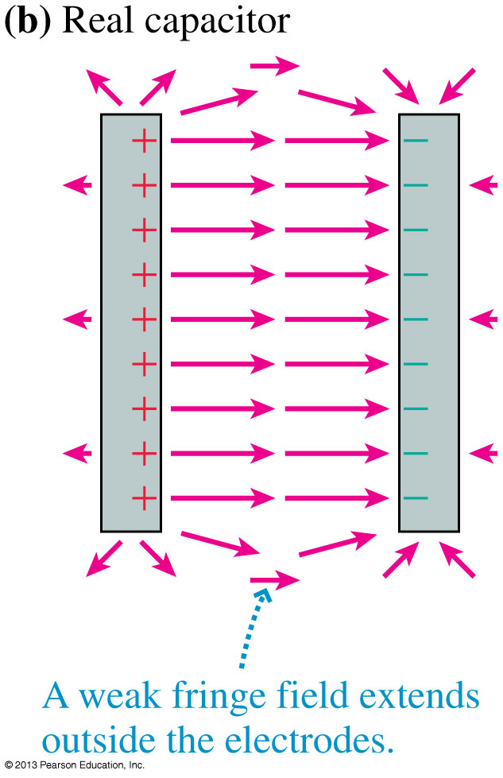
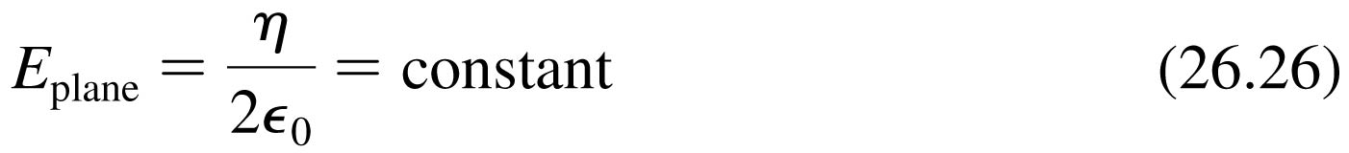
A Real Capacitor
Outside a real capacitor and near its edges, the electric field is affected by a complicated but weak fringe field.
We will keep things simple by always assuming the plates are very close together and using E = η/ ₀ for the magnitude of the field inside a parallel-plate capacitor.
Slide 26-70

Slide 41

Example 26.6 The Electric Field of a Charged Disk
Slide 26-71

Slide 42

Example 26.6 The Electric Field of a Charged Disk
Slide 26-72

Slide 43

Example 26.6 The Electric Field of a Charged Disk
Slide 26-73

Slide 44

Uniform Electric Fields
The figure shows an electric field that is the same—in strength and direction—at every point in a region of space.
This is called a uniform electric field.
The easiest way to produce a uniform electric field is with a parallel-plate capacitor.
Slide 26-74

Slide 45

Example 26.7 Charge Density on a Cell Wall
Slide 26-75

Slide 46


Example 26.7 Charge Density on a Cell Wall
Slide 26-76

Slide 47

Example 26.7 Charge Density on a Cell Wall
Slide 26-77

Slide 48

Example 26.7 Charge Density on a Cell Wall
Slide 26-78

Slide 49

Motion of a Charged Particle in an Electric Field
Consider a particle of charge q and mass m at a point where an electric field E has been produced by other charges, the source charges.
The electric field exerts a force F_{on q} = qE.
Slide 26-79

Slide 50


Motion of a Charged Particle in an Electric Field
The electric field exerts a force F_{on q} = qE on a charged particle.
If this is the only force acting on q, it causes the charged particle to accelerate with
In a uniform field, the acceleration is constant:
Slide 26-80

Slide 51

Motion of a Charged Particle in an Electric Field
“DNA fingerprints” are measured with the technique of gel electrophoresis.
A solution of negatively charged DNA fragments migrate through the gel when placed in a uniform electric field.
Because the gel exerts a drag force, the fragments move at a terminal speed inversely proportional to their size.
Slide 26-81

Slide 52

Dipoles in a Uniform Electric Field
The figure shows an electric dipole placed in a uniform external electric field.
The net force on the dipole is zero.
The electric field exerts a torque on the dipole which causes it to rotate.
Slide 26-86

Slide 53

Dipoles in a Uniform Electric Field
The figure shows an electric dipole placed in a uniform external electric field.
The torque causes the dipole to rotate until it is aligned with the electric field, as shown.
Notice that the positive end of the dipole is in the direction in which E points.
Slide 26-87

Slide 54

Dipoles in a Uniform Electric Field
The figure shows a sample of permanent dipoles, such as water molecules, in an external electric field.
All the dipoles rotate until they are aligned with the electric field.
This is the mechanism by which the sample becomes polarized.
Slide 26-92

Slide 55

The Torque on a Dipole
The torque on a dipole placed in a uniform external electric field is
Slide 26-93

Slide 56

Example 26.10 The Angular Acceleration of a Dipole Dumbbell
Slide 26-94

Slide 57


Example 26.10 The Angular Acceleration of a Dipole Dumbbell
Slide 26-95

Slide 58

Example 26.10 The Angular Acceleration of a Dipole Dumbbell
Slide 26-96

Slide 59

Example 26.10 The Angular Acceleration of a Dipole Dumbbell
Slide 26-97

Slide 60

Example 26.10 The Angular Acceleration of a Dipole Dumbbell
Slide 26-98

Slide 61

Dipoles in a Nonuniform Electric Field
Suppose that a dipole is placed in a nonuniform electric field, such as the field of a positive point charge.
The first response of the dipole is to rotate until it is aligned with the field.
Once the dipole is aligned, the leftward attractive force on its negative end is slightly stronger than the rightward repulsive force on its positive end.
This causes a net force to the left, toward the point charge.
Slide 26-99

Slide 62

Dipoles in a Nonuniform Electric Field
A dipole near a negative point charge is also attracted toward the point charge.
The net force on a dipole is toward the direction of the strongest field.
Because field strength increases as you get closer to any finite-sized charged object, we can conclude that a dipole will experience a net force toward any charged object.
Slide 26-100

Slide 63


Example 26.11 The Force on a Water Molecule
Slide 26-101

Slide 64

Example 26.11 The Force on a Water Molecule
Slide 26-102

Slide 65

Example 26.11 The Force on a Water Molecule
Slide 26-103

Slide 66

Example 26.11 The Force on a Water Molecule
Slide 26-104

Slide 67
Chapter 26 Summary Slides
Slide 26-105

Slide 68

General Principles
General Principles
Slide 26-106

Slide 69
General Principles
Slide 26-107

Slide 70
General Principles
Slide 26-108

Slide 71
General Principles
Slide 26-109

