Slide 1
Chapter 27 Gauss’s Law
Chapter Goal: To understand and apply Gauss’s law.
Slide 27-2

Slide 2
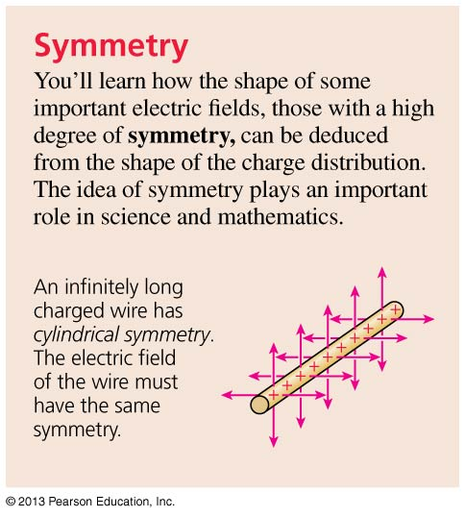
Chapter 27 Preview
Slide 27-3

Slide 3
Chapter 27 Preview
Slide 27-4

Slide 4
Chapter 27 Preview
Slide 27-5

Slide 5
Chapter 27 Preview
Slide 27-6

Slide 6
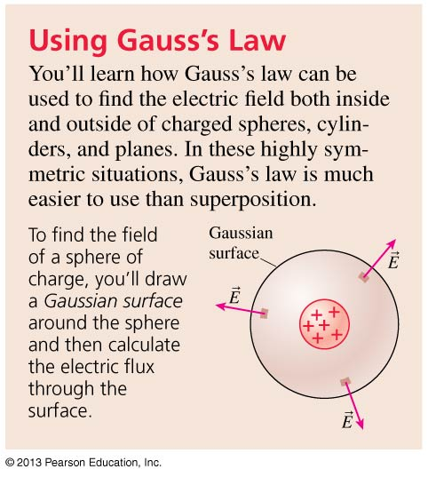
Chapter 27 Preview
Slide 27-7

Slide 7
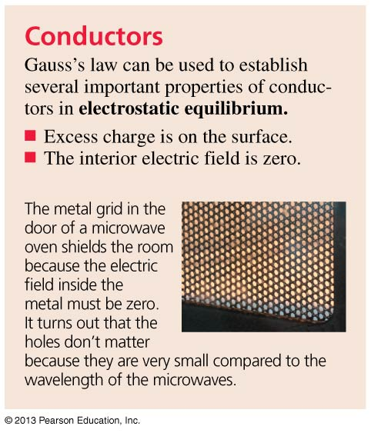
Chapter 27 Preview
Slide 27-8

Slide 8
Electric Field of a Charged Cylinder
Suppose we knew only two things about electric fields:
The field points away from positive charges, toward negative charges.
An electric field exerts a force on a charged particle.
From this information alone, what can we deduce about the electric field of an infinitely long charged cylinder?
All we know is that this charge is positive, and that it has cylindrical symmetry.
Slide 27-19

Slide 9
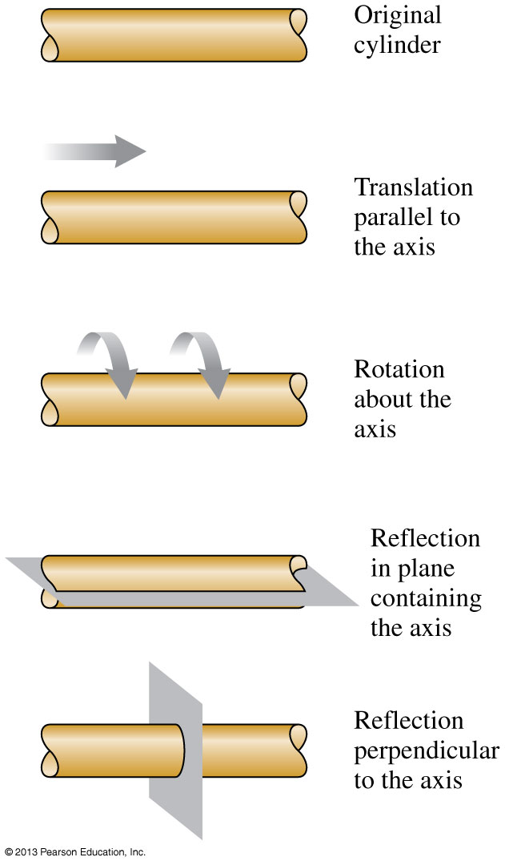
Cylindrical Symmetry
An infinitely long charged cylinder is symmetric with respect to:
Translation parallel to the cylinder axis.
Rotation by an angle about the cylinder axis.
Reflections in any plane containing or perpendicular to the cylinder axis.
The symmetry of the electric field must match the symmetry of the charge distribution.
Slide 27-20

Slide 10
Electric Field of a Charged Cylinder
Could the field look like the figure below? (Imagine this picture rotated about the axis.)
The next slide shows what the field would look like reflected in a plane perpendicular to the axis (left to right).
Slide 27-21

Slide 11
Electric Field of a Charged Cylinder
This reflection, which does not make any change in the charge distribution itself, does change the electric field.
Therefore, the electric field of a cylindrically symmetric charge distribution cannot have a component parallel to the cylinder axis.
Slide 27-22

Slide 12
Electric Field of a Charged Cylinder
Could the field look like the figure below? (Here we’re looking down the axis of the cylinder.)
The next slide shows what the field would look like reflected in a plane containing the axis (left to right).
Slide 27-23

Slide 13
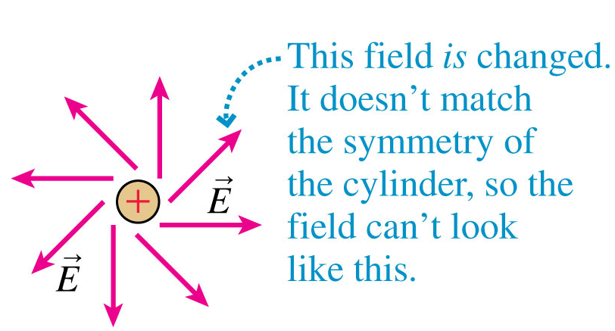
Electric Field of a Charged Cylinder
This reflection, which does not make any change in the charge distribution itself, does change the electric field.
Therefore, the electric field of a cylindrically symmetric charge distribution cannot have a component tangent to the circular cross section.
Slide 27-24

Slide 14
Electric Field of a Charged Cylinder
Based on symmetry arguments alone, an infinitely long charged cylinder must have a radial electric field, as shown below.
This is the one electric field shape that matches the symmetry of the charge distribution.
Side view
End view
Slide 27-25

Slide 15
Planar Symmetry
There are three fundamental symmetries; the first is planar symmetry.
Planar symmetry involves symmetry with respect to:
Translation parallel to the plane.
Rotation about any line perpendicular to the plane.
Reflection in the plane.
Slide 27-26

Slide 16
Cylindrical Symmetry
There are three fundamental symmetries; the second is cylindrical symmetry.
Cylindrical symmetry involves symmetry with respect to:
Translation parallel to the axis.
Rotation about the axis.
Reflection in any plane containing or perpendicular to the axis.
Slide 27-27

Slide 17
Spherical Symmetry
There are three fundamental symmetries; the third is spherical symmetry.
Spherical symmetry involves symmetry with respect to:
Rotation about any axis which passes through the center point.
Reflection in any plane containing the center point.
Slide 27-28

Slide 18
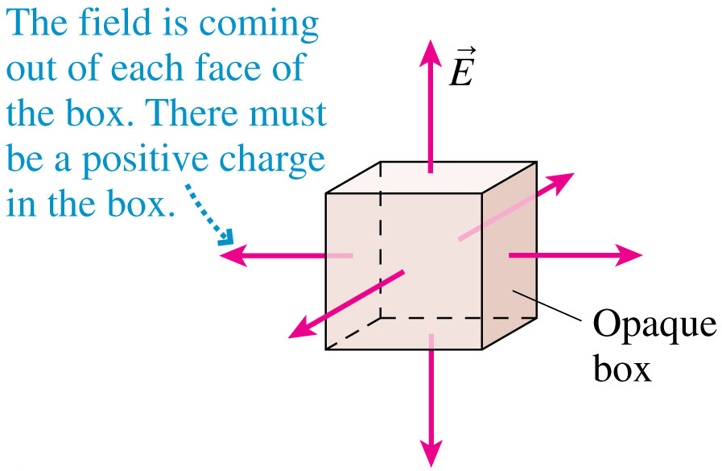
The Concept of Flux
Consider a box surrounding a region of space.
We can’t see into the box, but we know there is an outward-pointing electric field passing through every surface.
Since electric fields point away from positive charges, we can conclude that the box must contain net positive electric charge.
Slide 27-29

Slide 19
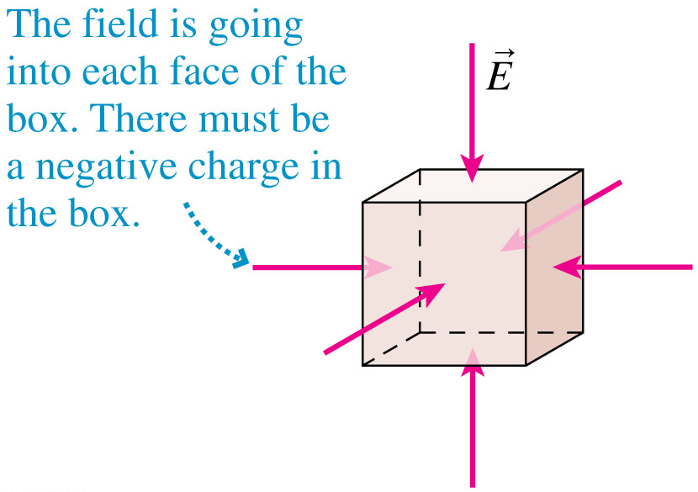
The Concept of Flux
Consider a box surrounding a region of space.
We can’t see into the box, but we know there is an inward-pointing electric field passing through every surface.
Since electric fields point toward negative charges, we can conclude that the box must contain net negative electric charge.
Slide 27-30

Slide 20
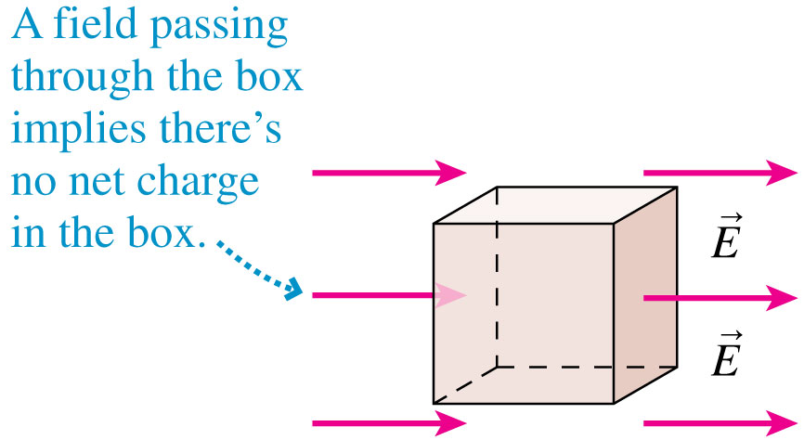
The Concept of Flux
Consider a box surrounding a region of space.
We can’t see into the box, but we know that the electric field points into the box on the left, and an equal electric field points out of the box on the right.
Since this external electric field is not altered by the contents of the box, the box must contain zero net electric charge.
Slide 27-31

Slide 21
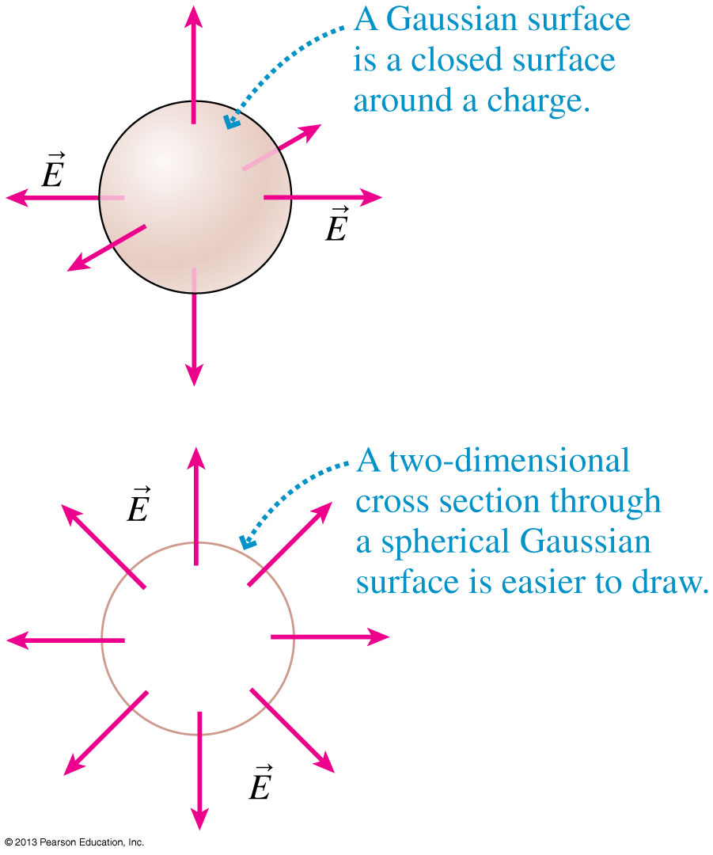
Gaussian Surfaces
A closed surface through which an electric field passes is called a Gaussian surface.
This is an imaginary, mathematical surface, not a physical surface.
Slide 27-32

Slide 22
Gaussian Surfaces
A Gaussian surface is most useful when it matches the shape and symmetry of the field.
Figure (a) below shows a cylindrical Gaussian surface.
Figure (b) simplifies the drawing by showing two-dimensional end and side views.
The electric field is everywhere perpendicular to the side wall and no field passes through the top and bottom surfaces.
Slide 27-33

Slide 23
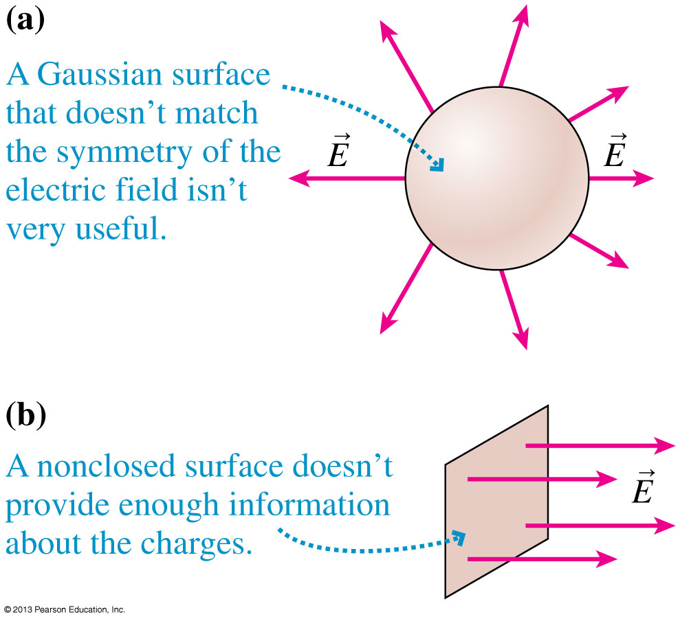
Gaussian Surfaces
Not every surface is useful for learning about charge.
Figure (a) shows a Gaussian surface, but it doesn’t match the symmetry of the charge distribution.
Figure (b) shows a nonclosed surface, which also doesn’t provide enough information about the charge distribution to be useful.
Slide 27-34

Slide 24
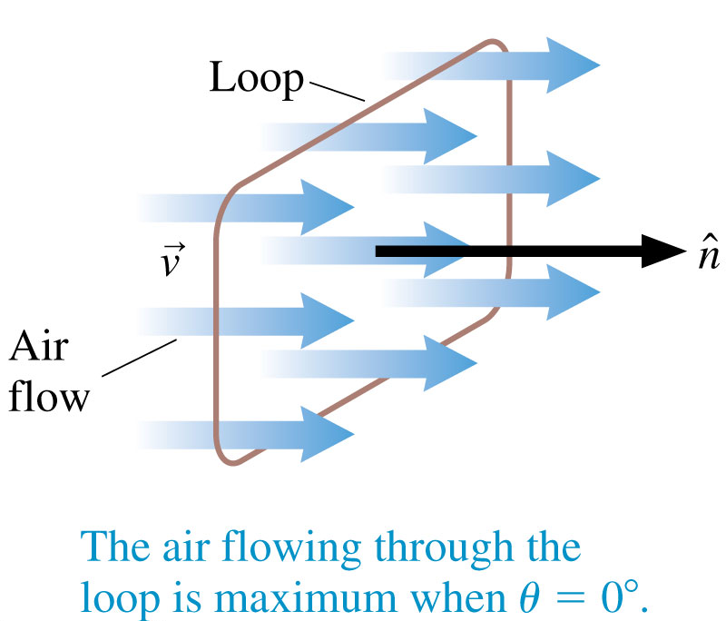
The Basic Definition of Flux
Imagine holding a rectangular wire loop of area A in front of a fan.
The volume of air flowing through the loop each second depends on the angle between the loop and the direction of flow.
The flow is maximum through a loop that is perpendicular to the airflow.
Slide 27-35

Slide 25
The Basic Definition of Flux
Imagine holding a rectangular wire loop of area A in front of a fan.
No air goes through the same loop if it lies parallel to the flow.
Slide 27-36

Slide 26
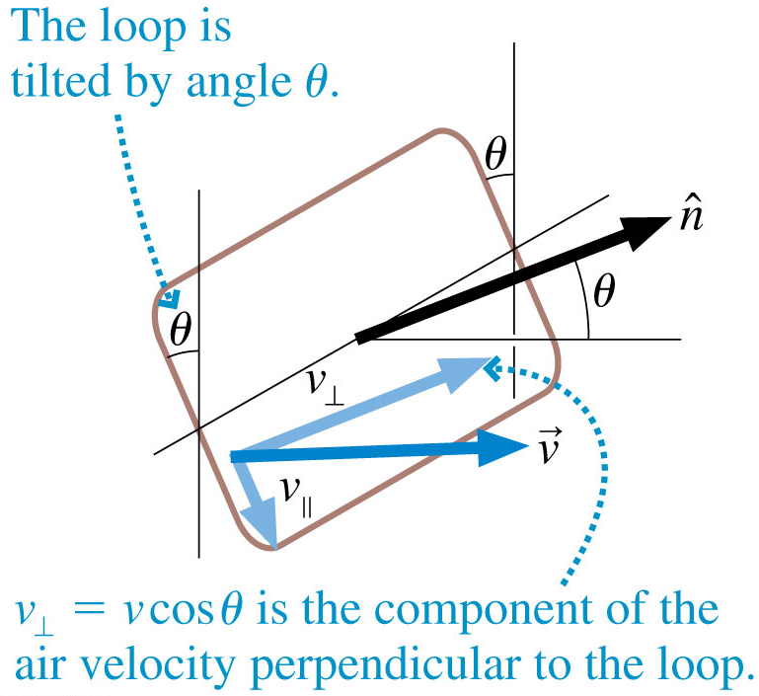
The Basic Definition of Flux
Imagine holding a rectangular wire loop of area A in front of a fan.
The volume of air flowing through the loop each second depends on the angle θ between the loop normal and the velocity of the air:
Slide 27-37

Slide 27
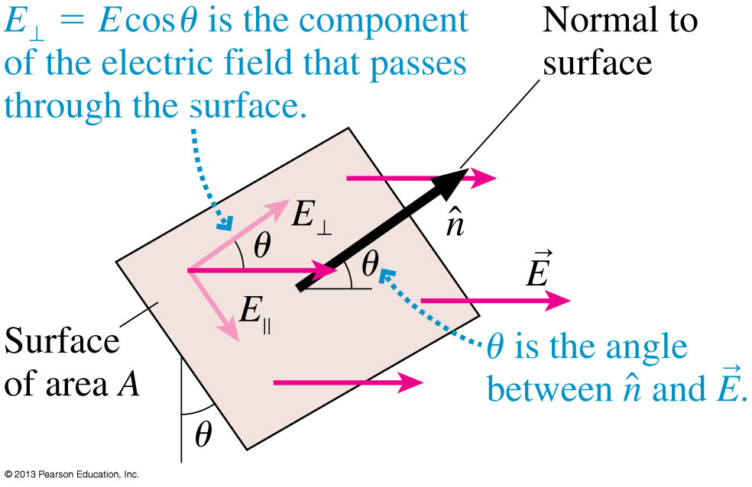
The Electric Flux
The electric flux Φ_{e} measures the amount of electric field passing through a surface of area A whose normal to the surface is tilted at angle θ from the field.
Slide 27-38

Slide 28
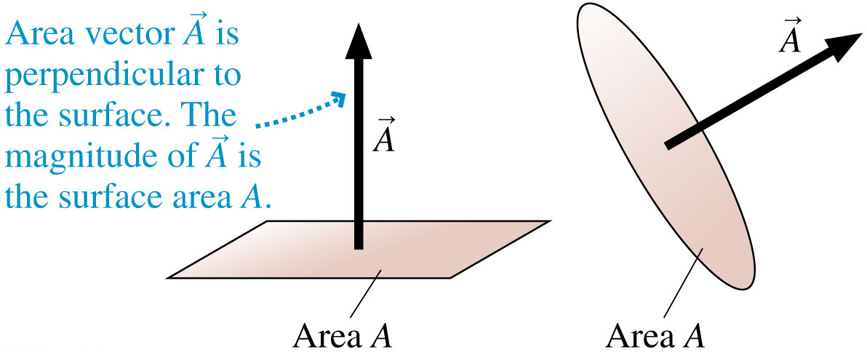
The Area Vector
Let’s define an area vector to be a vector in the direction of , perpendicular to the surface, with a magnitude A equal to the area of the surface.
Vector has units of m².
Slide 27-45

Slide 29
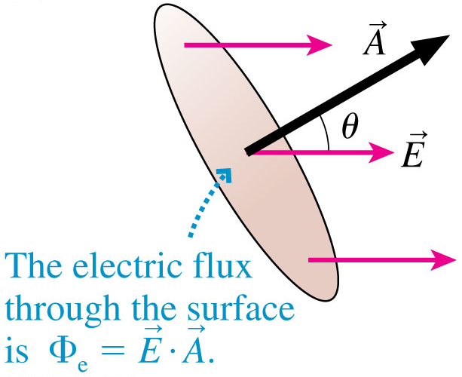
The Electric Flux
An electric field passes through a surface of area A.
The electric flux can be defined as the dot-product:
Slide 27-46

Slide 30
Example 27.1 The Electric Flux Inside a Parallel-Plate Capacitor
Slide 27-47

Slide 31
Example 27.1 The Electric Flux Inside a Parallel-Plate Capacitor
Slide 27-48

Slide 32
Example 27.1 The Electric Flux Inside a Parallel-Plate Capacitor
Slide 27-49

Slide 33
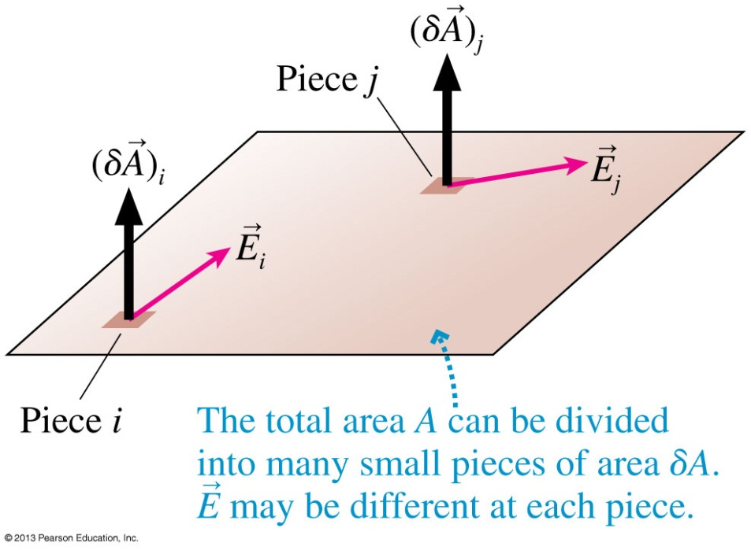
The Electric Flux of a Nonuniform Electric Field
Consider a surface in a nonuniform electric field.
Divide the surface into many small pieces of area δA.
The electric flux through each small piece is:
The electric flux through the whole surface is the surface integral:
Slide 27-50

Slide 34
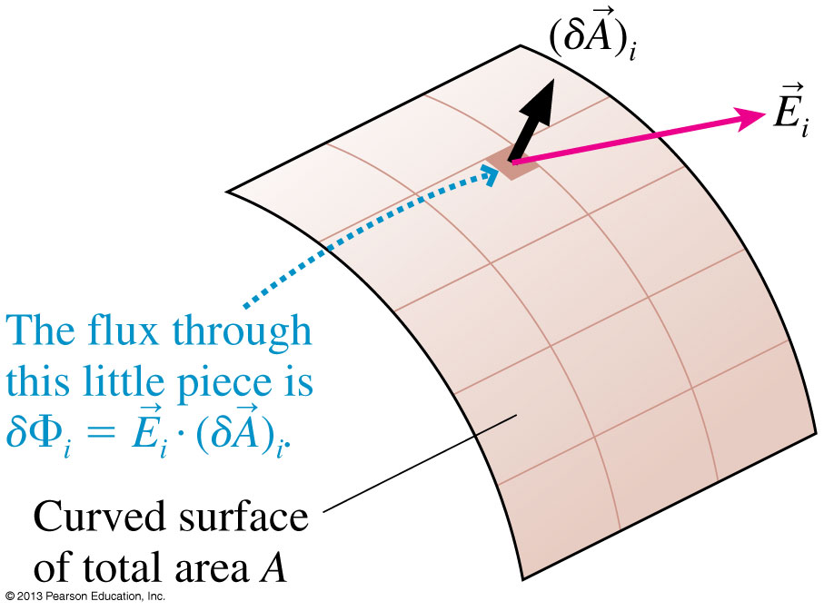
The Flux Through a Curved Surface
Consider a curved surface in an electric field.
Divide the surface into many small pieces of area δA.
The electric flux through each small piece is:
The electric flux through the whole surface is the surface integral:
Slide 27-51

Slide 35
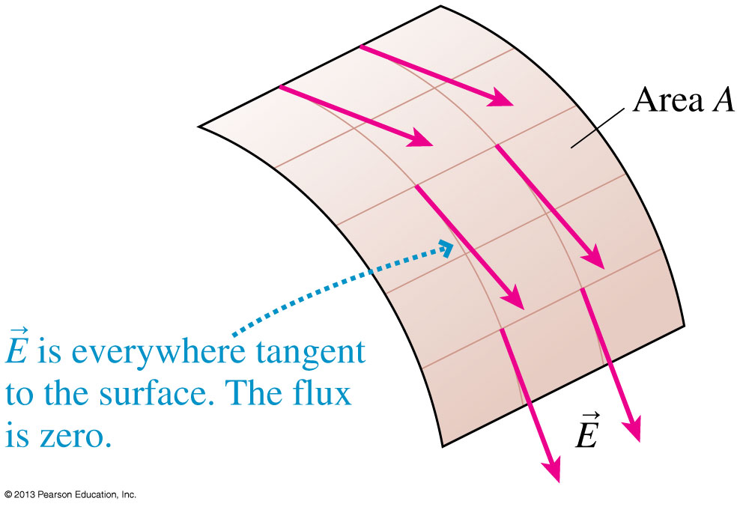
Electric Fields Tangent to a Surface
Consider an electric field that is everywhere tangent, or parallel, to a curved surface.
is zero at every point on the surface, because is perpendicular to at every point.
Thus Φ_{e} = 0.
Slide 27-52

Slide 36
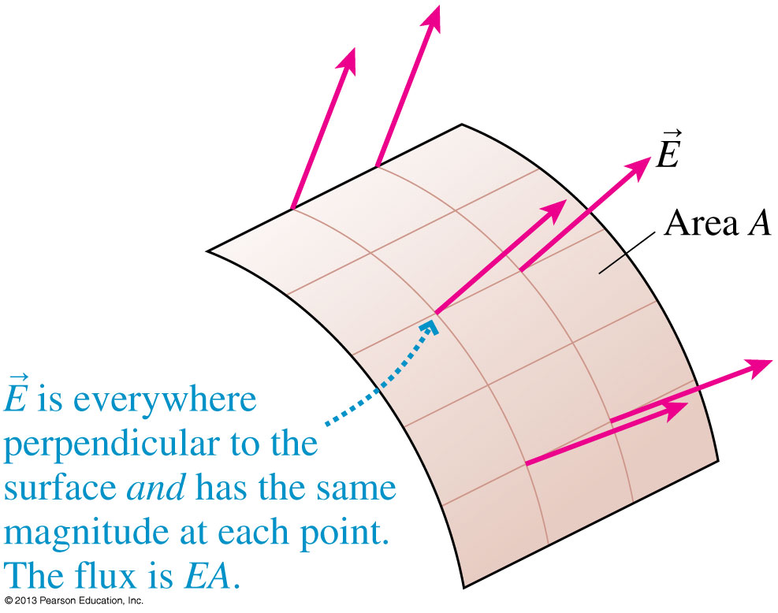
Electric Fields Perpendicular to a Surface
Consider an electric field that is everywhere perpendicular to the surface and has the same magnitude E at every point.
In this case:
Slide 27-53

Slide 37
Tactics: Evaluating Surface Integrals
Slide 27-54

Slide 38
The Electric Flux Through a Closed Surface
The electric flux through a closed surface is:
The electric flux is still the summation of the fluxes through a vast number of tiny pieces, pieces that now cover a closed surface.
NOTE: For a closed surface, we use the convention that the area vector dA is defined to always point toward the outside.
Slide 27-59

Slide 39
Tactics: Finding the Flux Through a Closed Surface
Slide 27-60

Slide 40
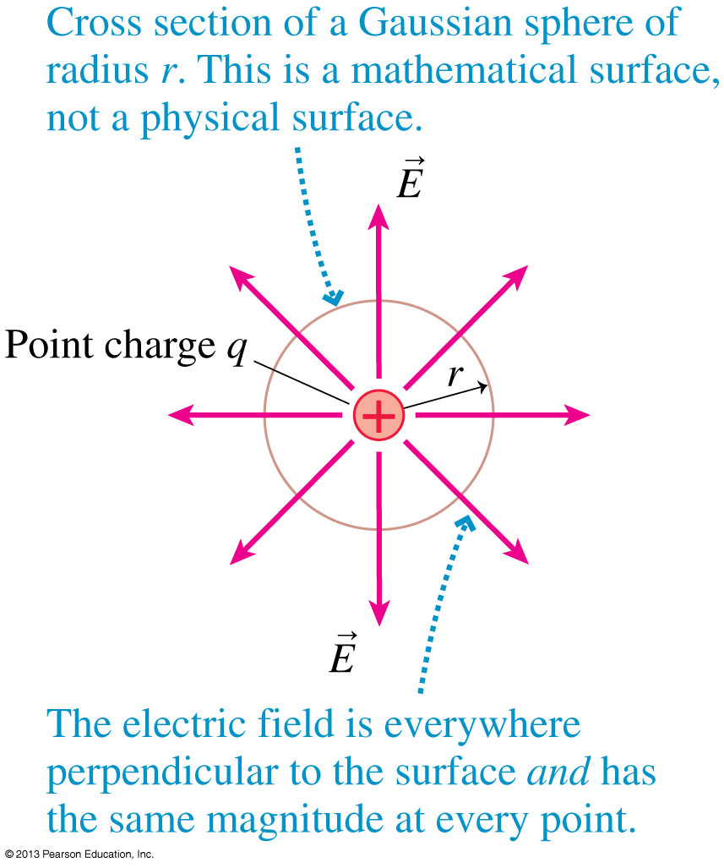
Electric Flux of a Point Charge
The flux integral through a spherical Gaussian surface centered on a single point charge is:
The surface area of a sphere is A_{sphere} = 4πr².
Using Coulomb’s law for E, we find:
Slide 27-63

Slide 41
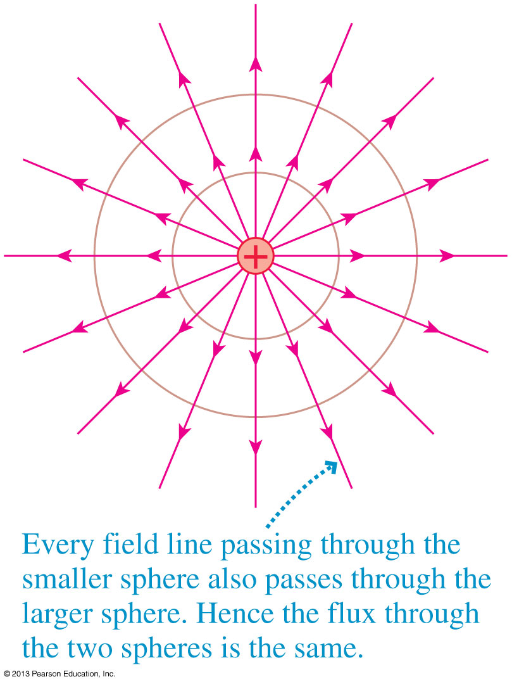
Electric Flux of a Point Charge
The electric flux through a spherical surface centered on a single positive point charge is Φ_{e} = q/ .
This depends on the amount of charge, but not on the radius of the sphere.
For a point charge, electric flux is independent of r.
⁰∋
Slide 27-64

Slide 42
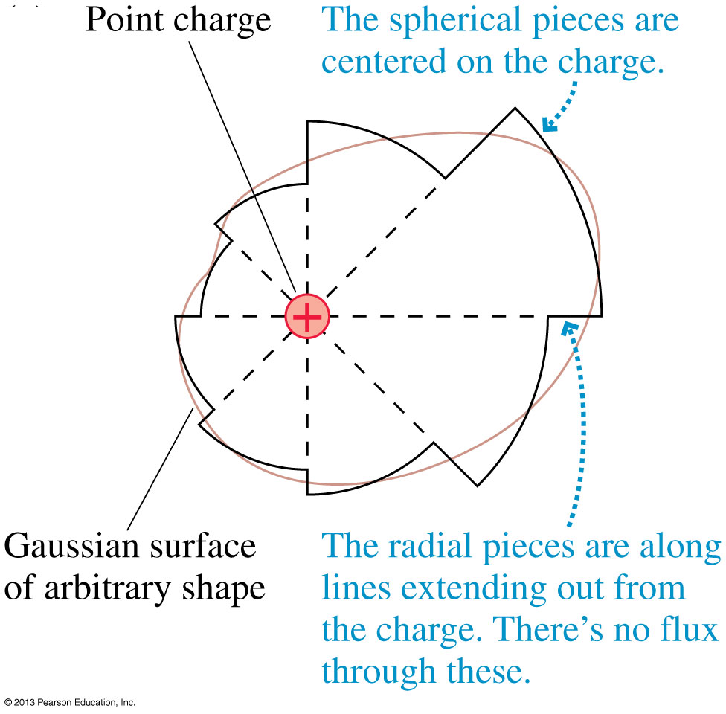
Electric Flux of a Point Charge
The electric flux through any arbitrary closed surface surrounding a point charge q may be broken up into spherical and radial pieces.
The total flux through the spherical pieces must be the same as through a single sphere:
Slide 27-65

Slide 43
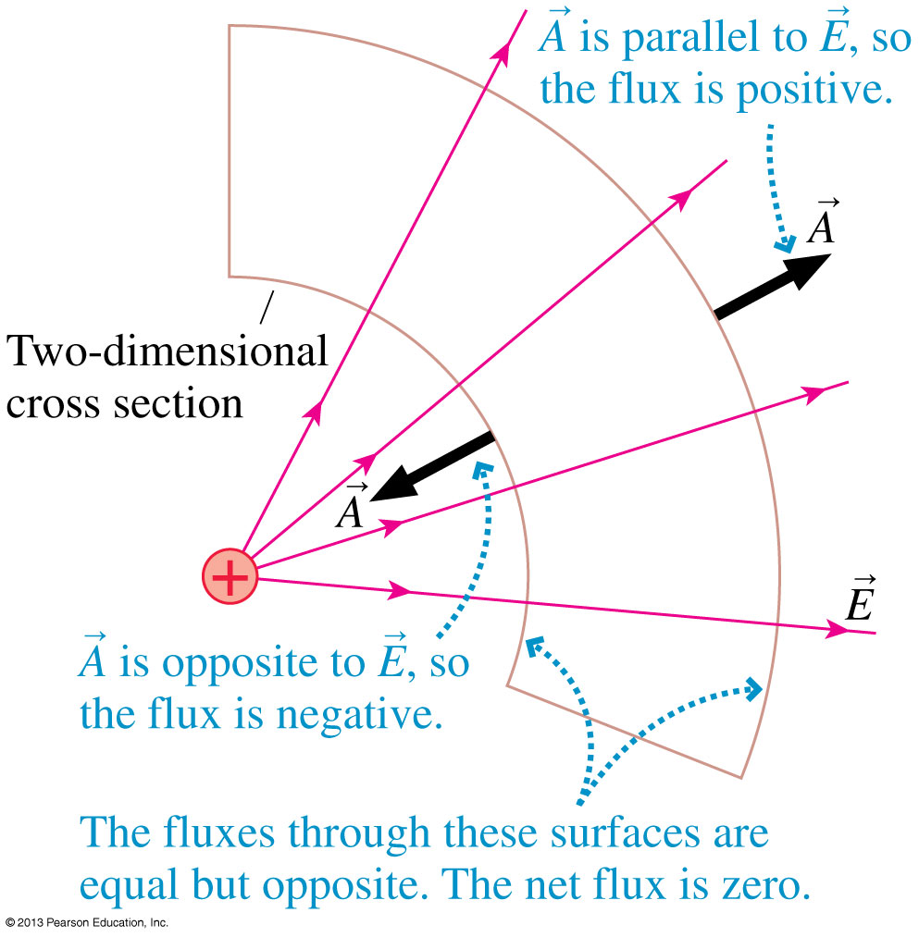
Electric Flux of a Point Charge
The electric flux through any arbitrary closed surface entirely outside a point charge q may also be broken up into spherical and radial pieces.
The total flux through the concave and convex spherical pieces must cancel each other.
The net electric flux is zero through a closed surface that does not contain any net charge.
Slide 27-66

Slide 44
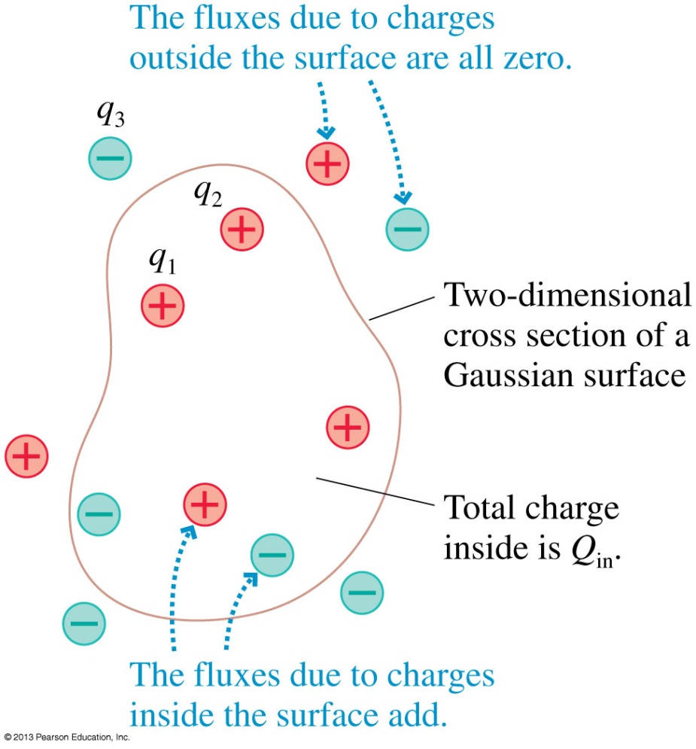
Electric Flux of Multiple Charges
Consider an arbitrary Gaussian surface and a group of charges q₁, q₂, q₃, …
The contribution to the total flux for any charge q_{i} inside the surface is q_{i}/ .
The contribution for any charge outside the surface is zero.
Defining Q_{in} to be the sum of all the charge inside the surface, we find Φ_{e} = Q_{in}/ .
⁰∋
⁰∋
Slide 27-67

Slide 45
Gauss’s Law
For any closed surface enclosing total charge Q_{in}, the net electric flux through the surface is:
This result for the electric flux is known as Gauss’s Law.
Slide 27-68

Slide 46
Using Gauss’s Law
Gauss’s law applies only to a closed surface, called a Gaussian surface.
A Gaussian surface is not a physical surface. It need not coincide with the boundary of any physical object (although it could if we wished). It is an imaginary, mathematical surface in the space surrounding one or more charges.
We can’t find the electric field from Gauss’s law alone. We need to apply Gauss’s law in situations where, from symmetry and superposition, we already can guess the shape of the field.
Slide 27-75

Slide 47
Problem-Solving Strategy: Gauss’s Law
Slide 27-76

Slide 48
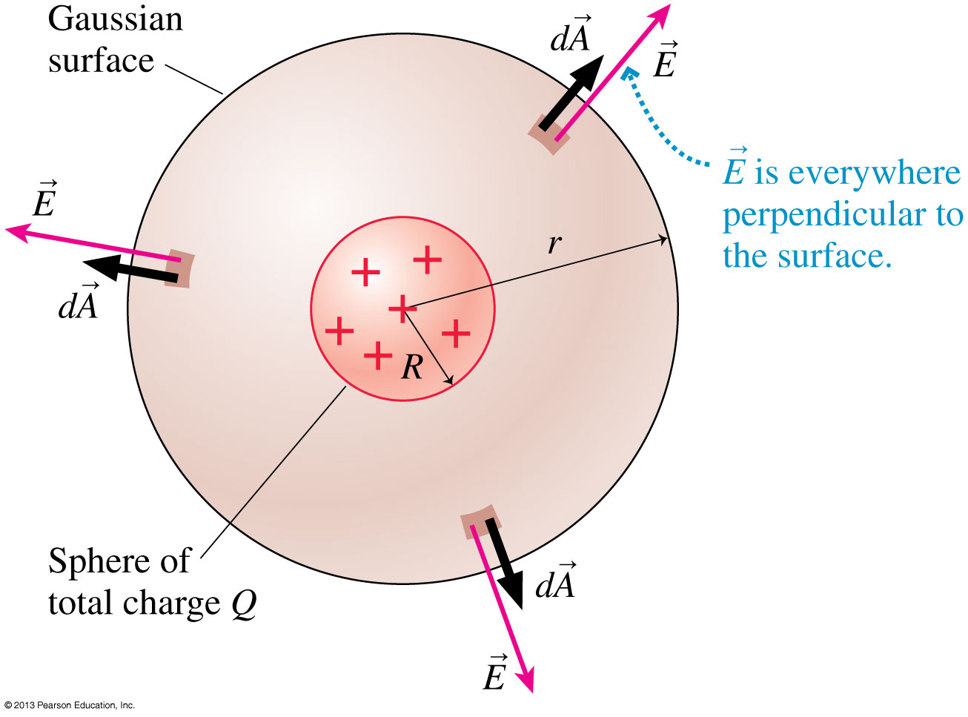
Example 27.3 Outside a Sphere of Charge
Slide 27-83

Slide 49
Example 27.3 Outside a Sphere of Charge
Slide 27-84

Slide 50
Example 27.3 Outside a Sphere of Charge
Slide 27-85

Slide 51
Example 27.3 Outside a Sphere of Charge
Slide 27-86

Slide 52
Example 27.6 The Electric Field of a Plane of Charge
Slide 27-87

Slide 53
Example 27.6 The Electric Field of a Plane of Charge
Slide 27-88

Slide 54
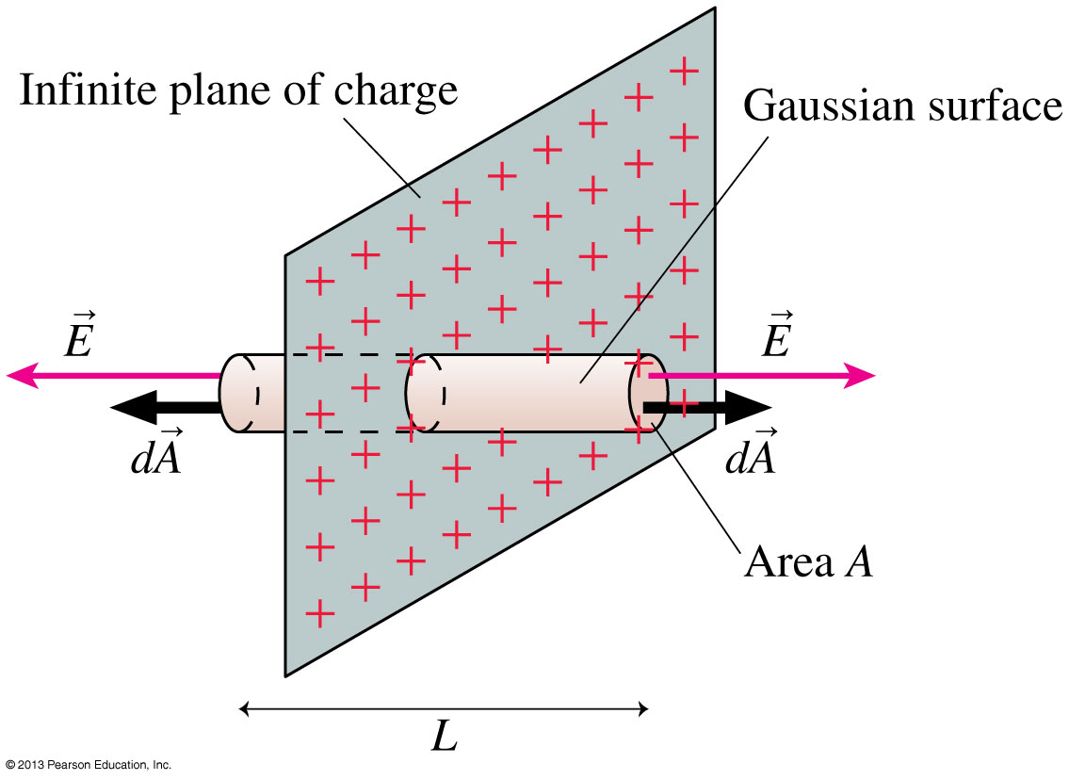
Example 27.6 The Electric Field of a Plane of Charge
Slide 27-89

Slide 55
Example 27.6 The Electric Field of a Plane of Charge
Slide 27-90

Slide 56
Example 27.6 The Electric Field of a Plane of Charge
Slide 27-91

Slide 57
Example 27.6 The Electric Field of a Plane of Charge
Slide 27-92

Slide 58
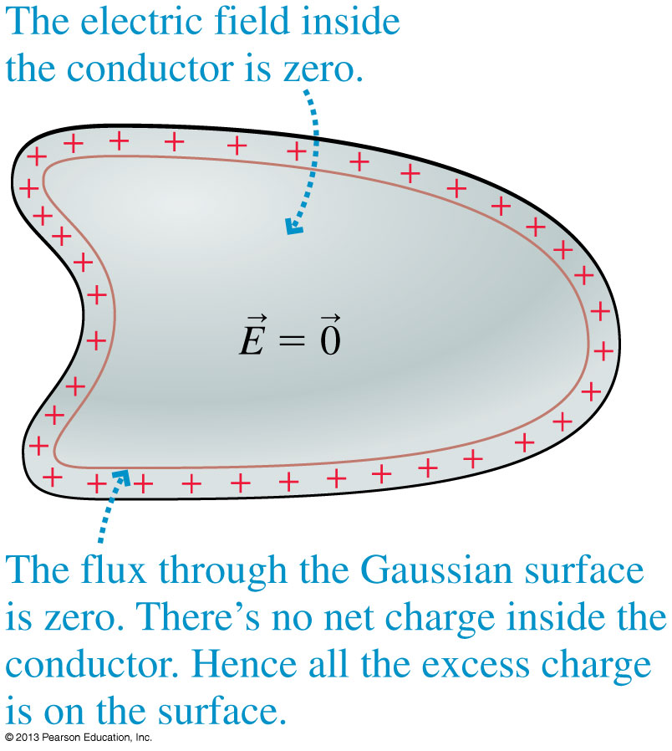
Conductors in Electrostatic Equilibrium
The figure shows a Gaussian surface just inside the physical surface of a conductor that’s in electrostatic equilibrium.
The electric field must be zero at all points within the conductor, or else the electric field would cause the charge carriers to move and it wouldn’t be in equilibrium.
By Gauss’s Law, Q_{in} = 0.
Slide 27-97

Slide 59
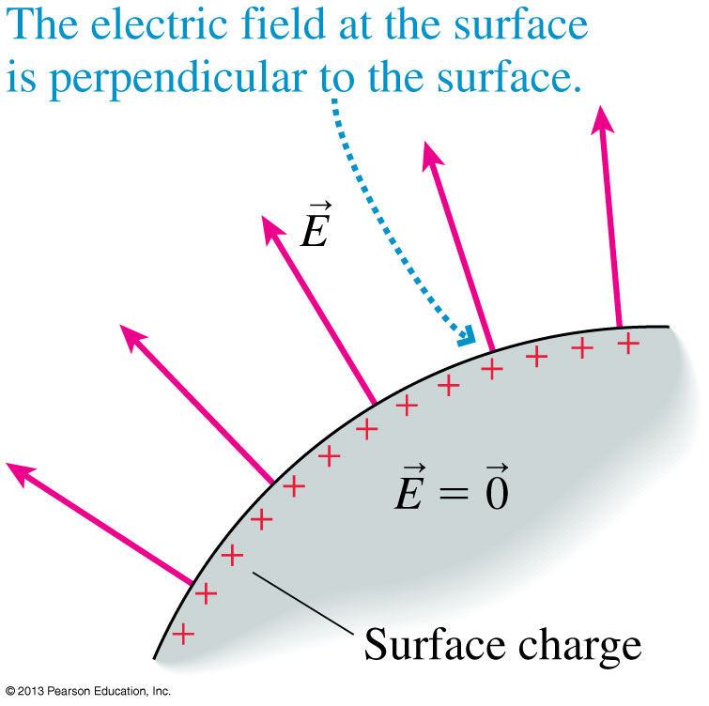
Conductors in Electrostatic Equilibrium
The external electric field right at the surface of a conductor must be perpendicular to that surface.
If it were to have a tangential component, it would exert a force on the surface charges and cause a surface current, and the conductor would not be in electrostatic equilibrium.
Slide 27-98

Slide 60
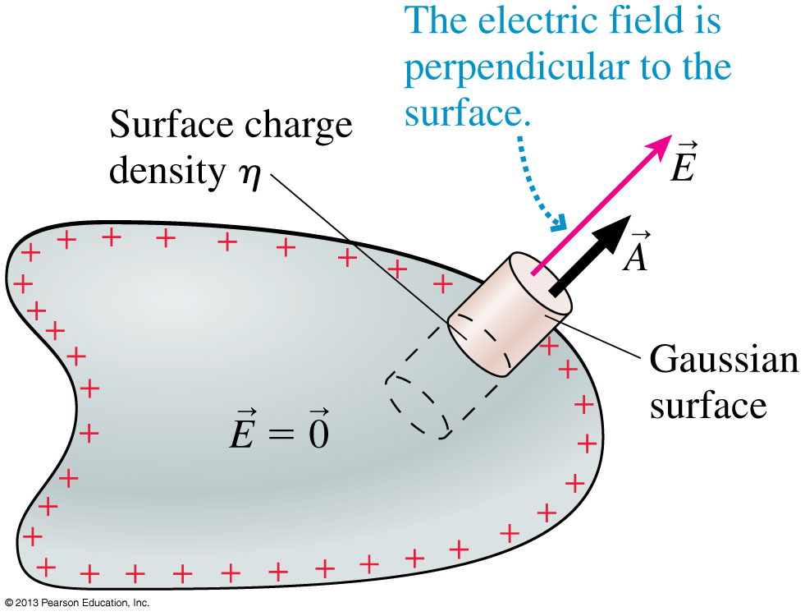
Electric Field at the Surface of a Conductor
A Gaussian surface extending through the surface of a conductor has a flux only through the outer face.
The net flux is: Φ_{e} = AE_{surface} = Q_{in}/ .
Here Q_{in} = ηA, so the electric field at the surface of a conductor is:
⁰∋
where η is the surface charge density of the conductor.
Slide 27-99

Slide 61
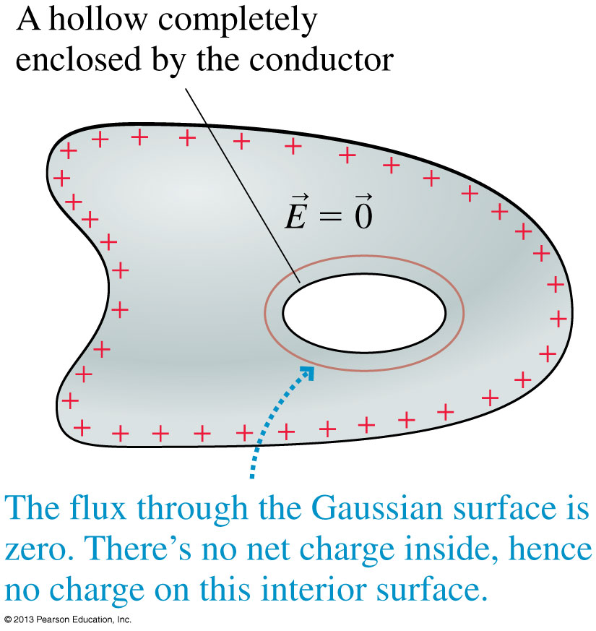
Conductors in Electrostatic Equilibrium
The figure shows a charged conductor with a hole inside.
Since the electric field is zero inside the conductor, we must conclude that Q_{in} = 0 for the interior surface.
Furthermore, since there’s no electric field inside the conductor and no charge inside the hole, the electric field in the hole must be zero.
Slide 27-102

Slide 62
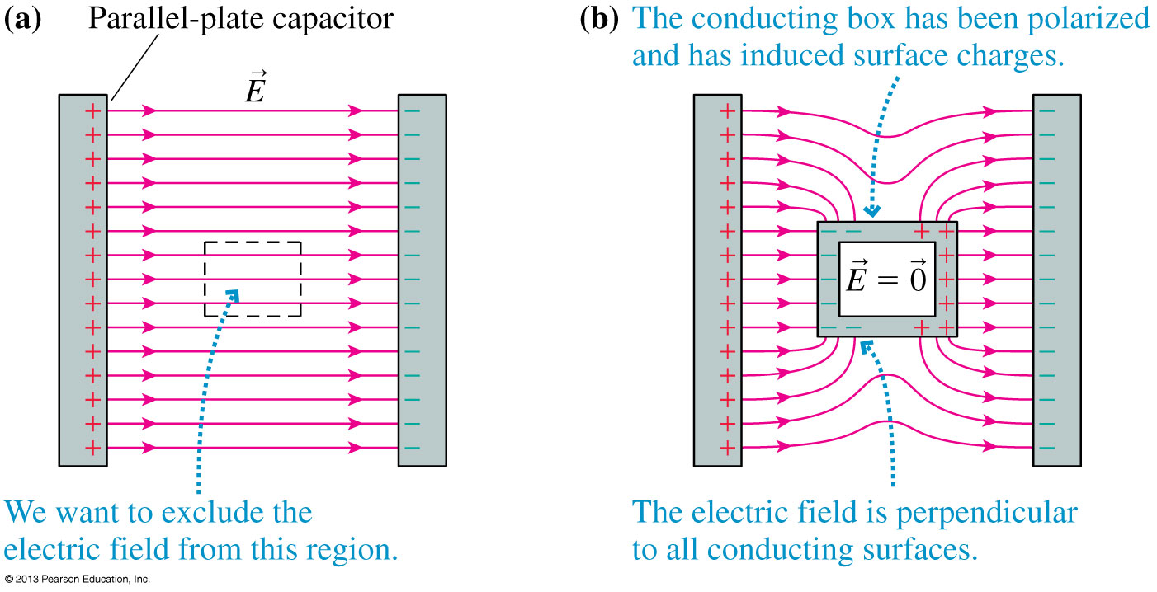
Faraday Cages
The use of a conducting box, or Faraday cage, to exclude electric fields from a region of space is called screening.
Slide 27-103

Slide 63
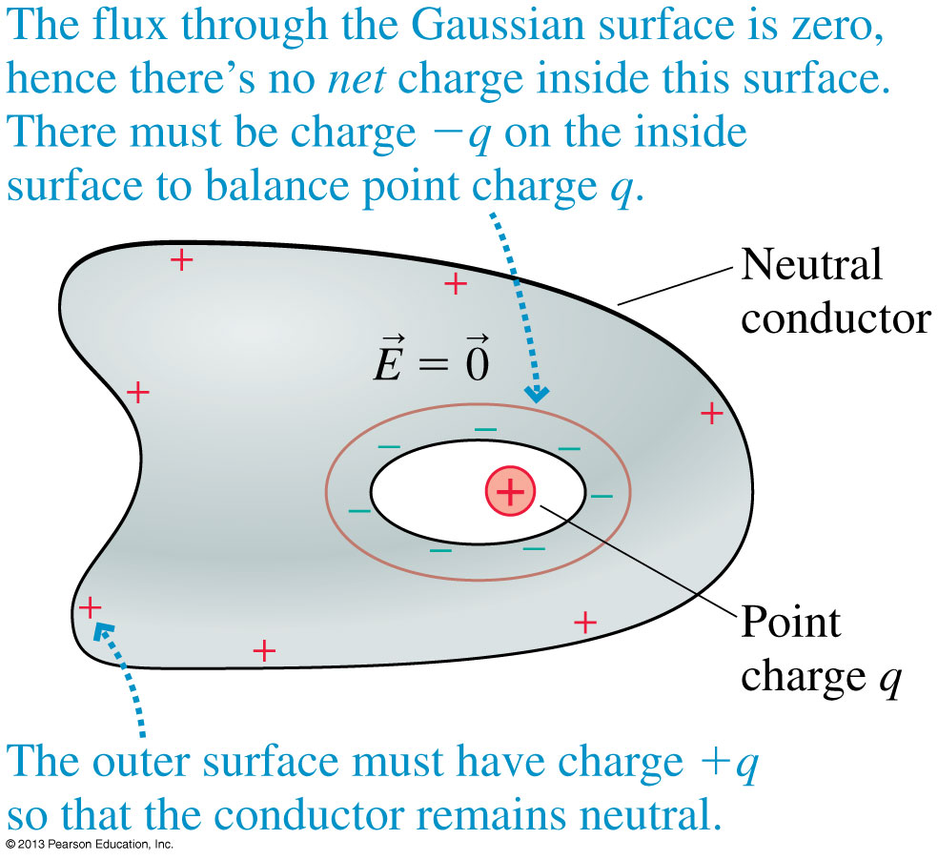
Conductors in Electrostatic Equilibrium
The figure shows a charge q inside a hole within a neutral conductor.
Net charge −q moves to the inner surface and net charge +q is left behind on the exterior surface.
Slide 27-104

Slide 64
Tactics: Finding the Electric Field of a Conductor in Electrostatic Equilibrium
Slide 27-107

Slide 65
Example 27.7 The Electric Field at the Surface of a Charged Metal Sphere
Slide 27-108

Slide 66
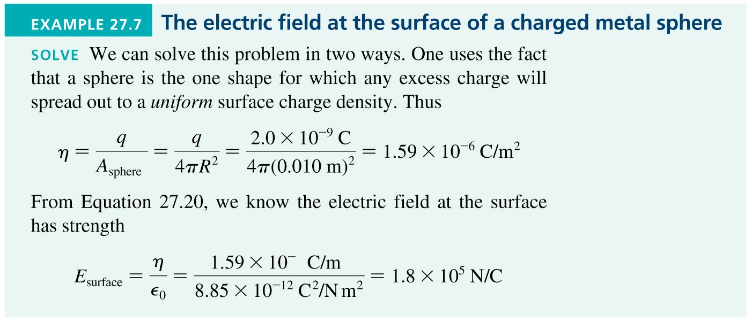
Example 27.7 The Electric Field at the Surface of a Charged Metal Sphere
Slide 27-109

Slide 67
Example 27.7 The Electric Field at the Surface of a Charged Metal Sphere
Slide 27-110

Slide 68
Chapter 27 Summary Slides
Slide 27-111

Slide 69
General Principles
Slide 27-112

Slide 70
General Principles
Slide 27-113

Slide 71
Important Concepts
Slide 27-114

Slide 72
Important Concepts
Slide 27-115

Slide 73
Important Concepts
Slide 27-116

