Slide 1
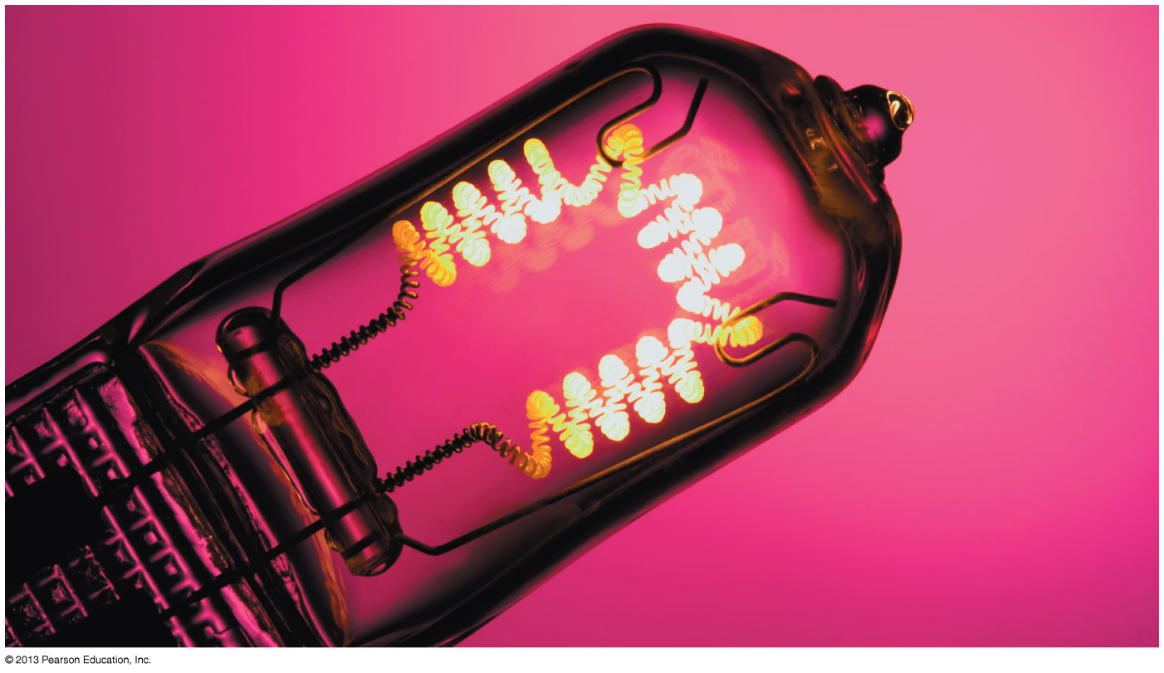
Chapter 30 Current and Resistance
Chapter Goal: To learn how and why charge moves through a conductor as what we call a current.
Slide 30-2

Slide 2
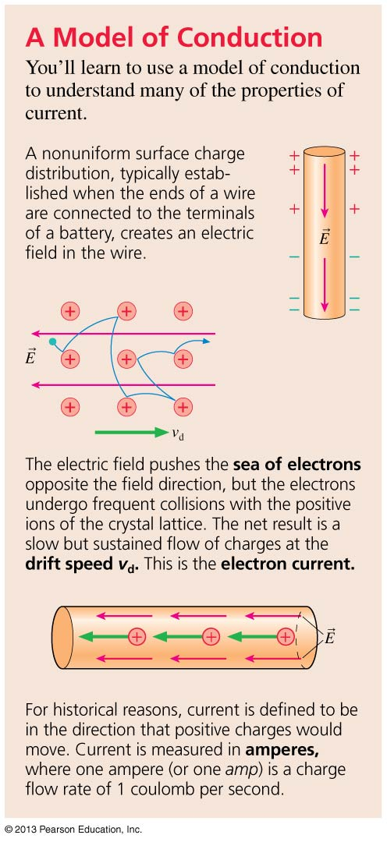
Chapter 30 Preview
Slide 30-3

Slide 3
Chapter 30 Preview
Slide 30-4

Slide 4
Chapter 30 Preview
Slide 30-5

Slide 5
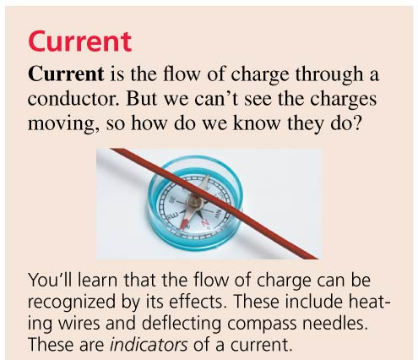
Chapter 30 Preview
Slide 30-6

Slide 6
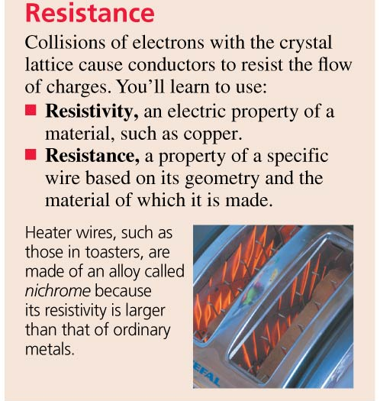
Chapter 30 Preview
Slide 30-7

Slide 7
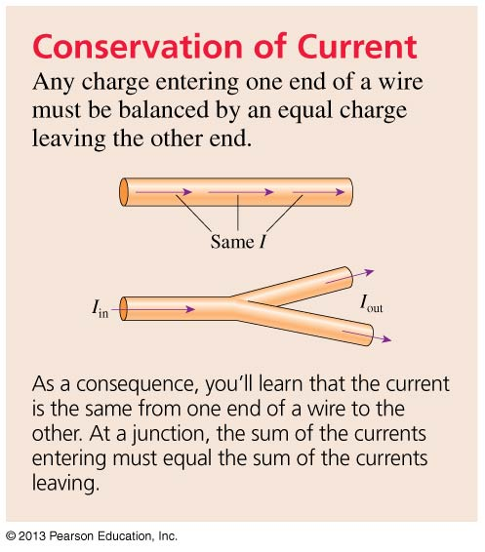
Chapter 30 Preview
Slide 30-8

Slide 8
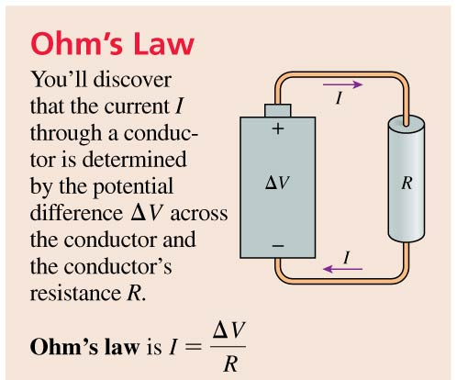
Chapter 30 Preview
Slide 30-9

Slide 9
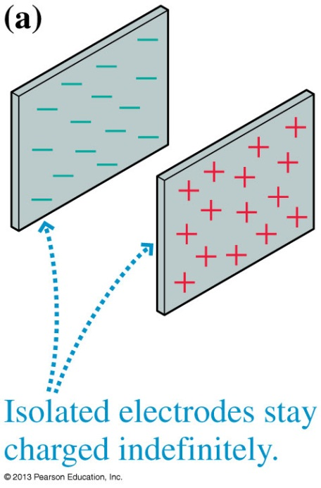
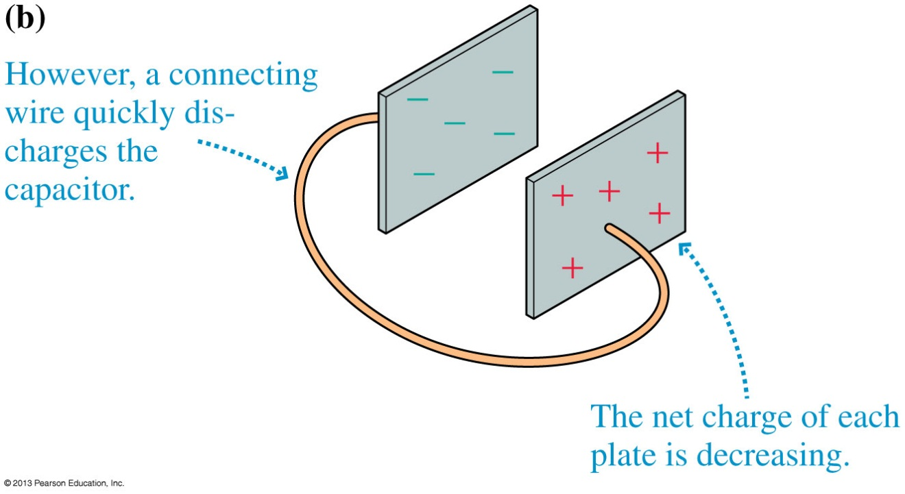
Electric Current
How does a capacitor get discharged?
Figure (a) shows a charged capacitor in equilibrium.
Figure (b) shows a wire discharging the capacitor.
As the capacitor is discharging, there is a current in the wire.
Slide 30-20

Slide 10
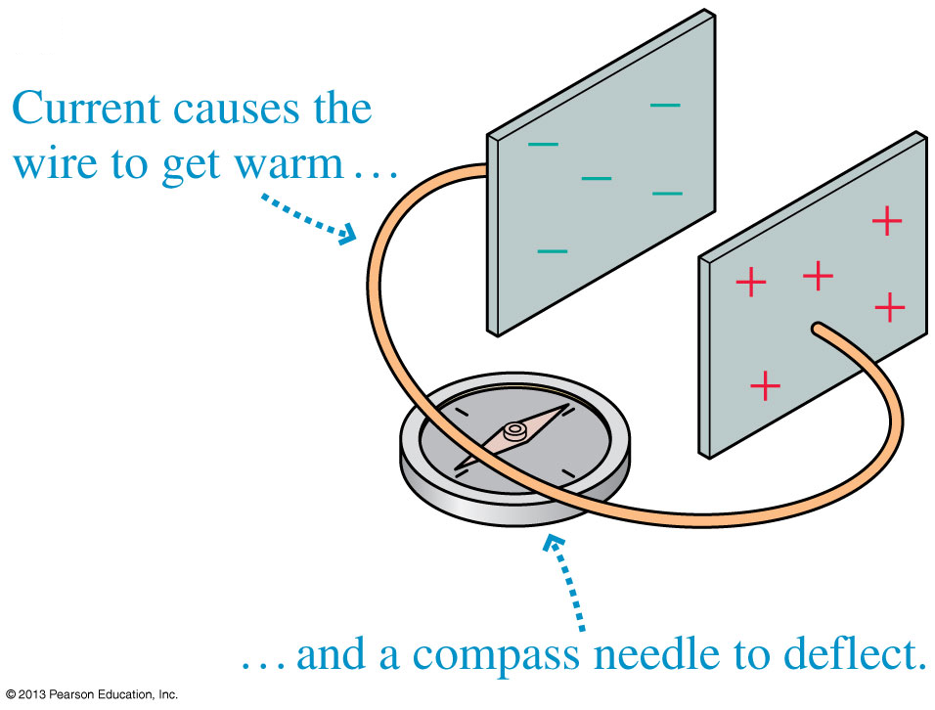
Electric Current
When a current is flowing, the conductors are not in electrostatic equilibrium.
Though you cannot see current directly, there are certain indicators that current is present in a wire.
Slide 30-21

Slide 11
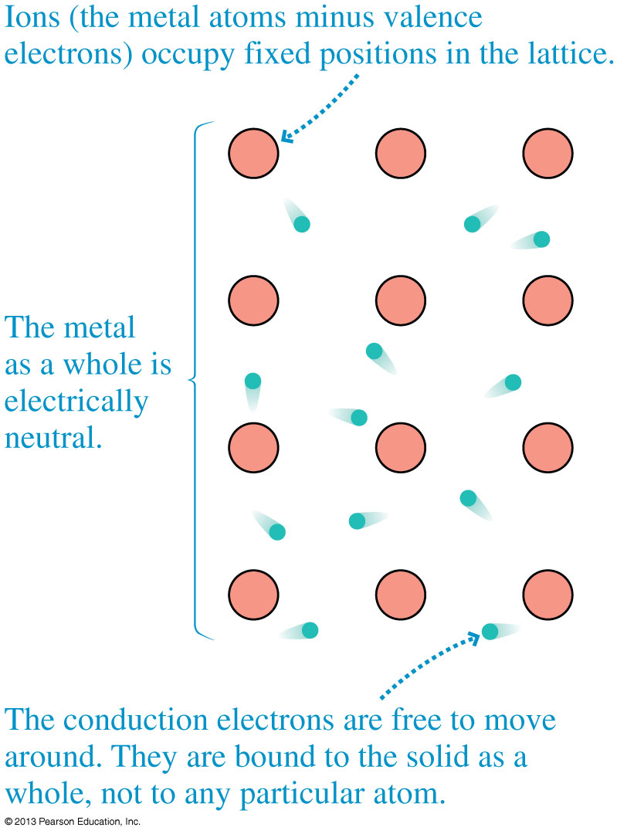
Charge Carriers
The outer electrons of metal atoms are only weakly bound to the nuclei.
In a metal, the outer electrons become detached from their parent nuclei to form a fluid-like sea of electrons that can move through the solid.
Electrons are the charge carriers in metals.
Slide 30-22

Slide 12
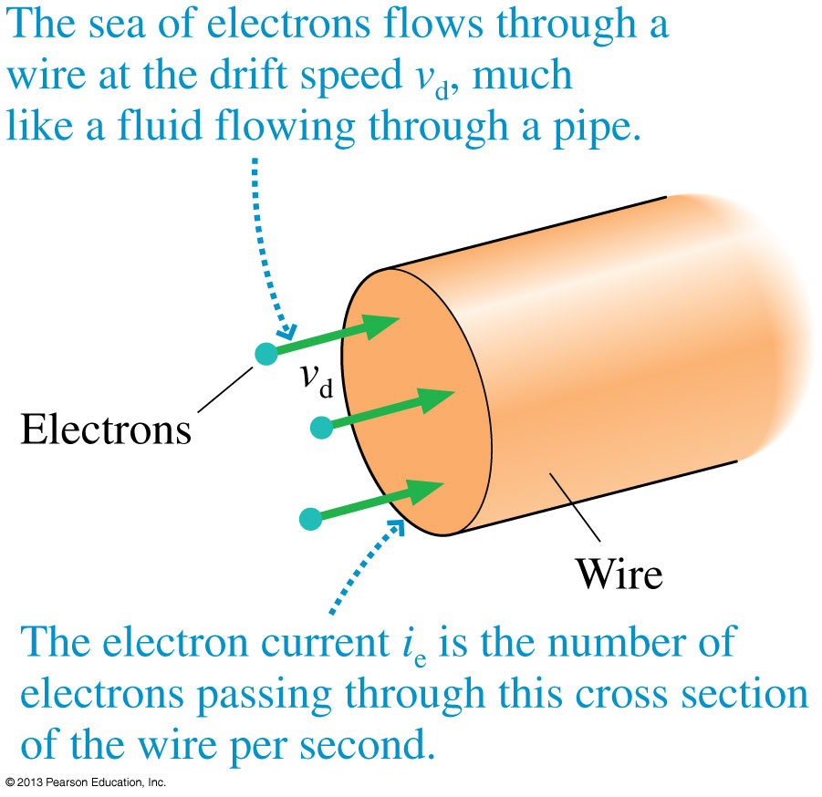
The Electron Current
We define the electron current i_{e} to be the number of electrons per second that pass through a cross section of the conductor.
The number N_{e} of electrons that pass through the cross section during the time interval Δt is
Slide 30-23

Slide 13
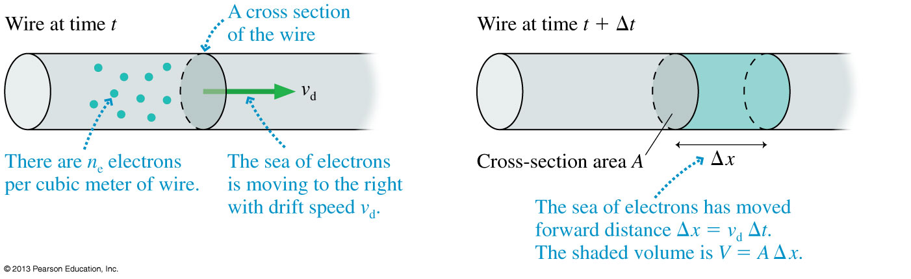
The Electron Current
If the number density of conduction electrons is n_{e}, then the total number of electrons in the shaded cylinder is
N_{e} = n_{e}V ← V=Volume
= n_{e}AΔx
= n_{e}Av_{d}Δt
So the electron current is:
Slide 30-24

Slide 14
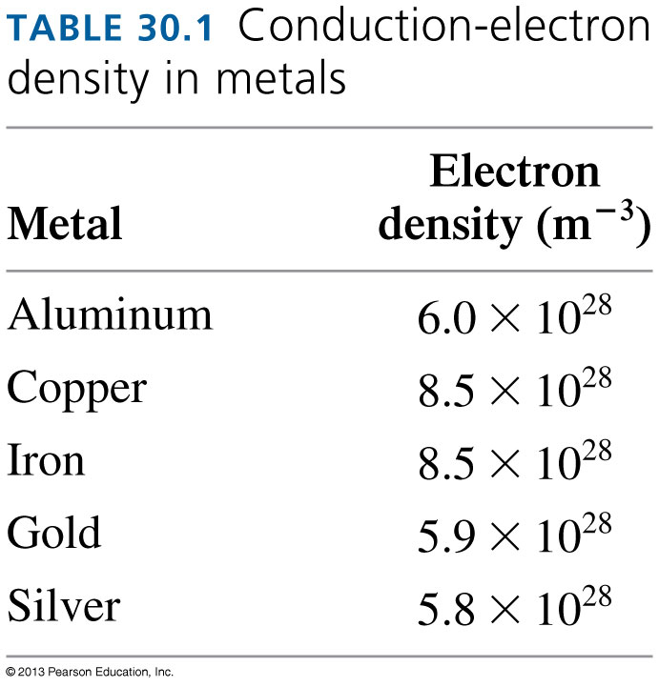
The Electron Density
In most metals, each atom contributes one valence electron to the sea of electrons.
Thus the number of conduction electrons n_{e} is the same as the number of atoms per cubic meter.
Slide 30-27

Slide 15
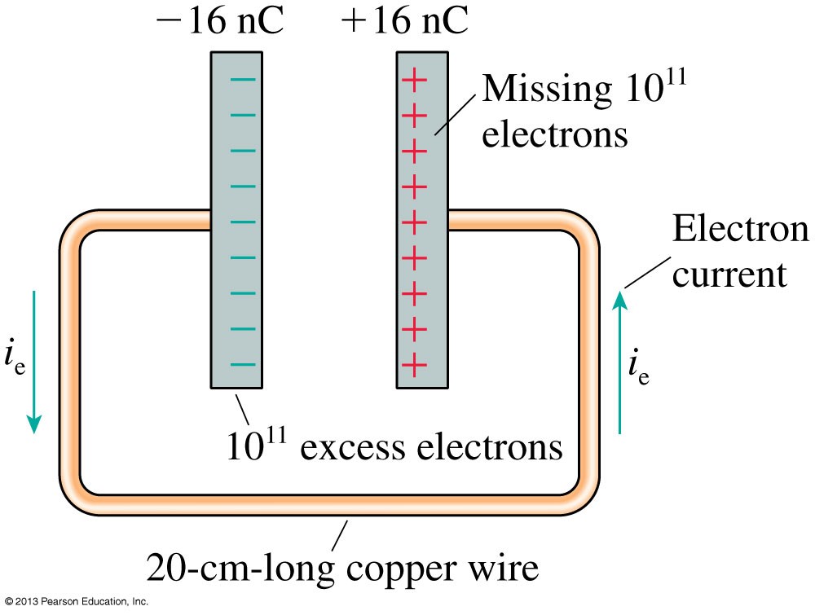
Discharging a Capacitor
How long should it take to discharge this capacitor?
A typical drift speed of electron current through a wire is
v_{d} ≈ 10⁻⁴ m/s.
At this rate, it would take an electron about 2000 s (over half an hour) to travel 20 cm.
But real capacitors discharge almost instantaneously!
What’s wrong with our calculation?
Slide 30-29

Slide 16
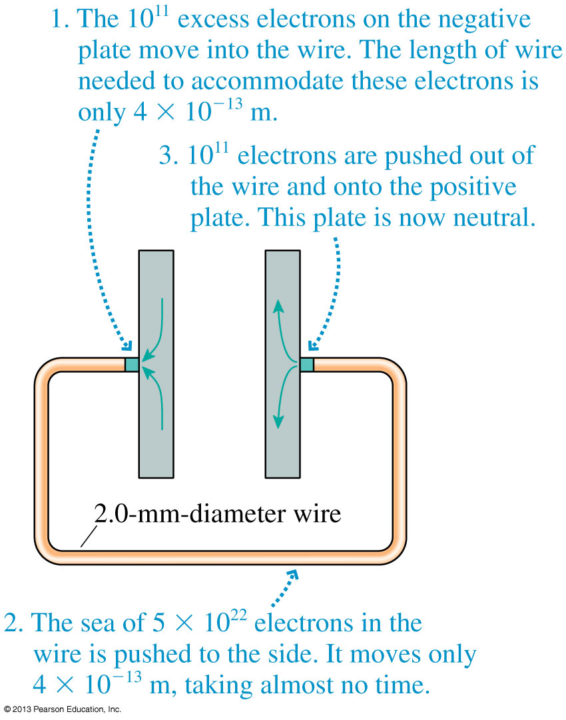
Discharging a Capacitor
The wire is already full of electrons!
We don’t have to wait for electrons to move all the way through the wire from one plate to another.
We just need to slightly rearrange the charges on the plates and in the wire.
Slide 30-30

Slide 17
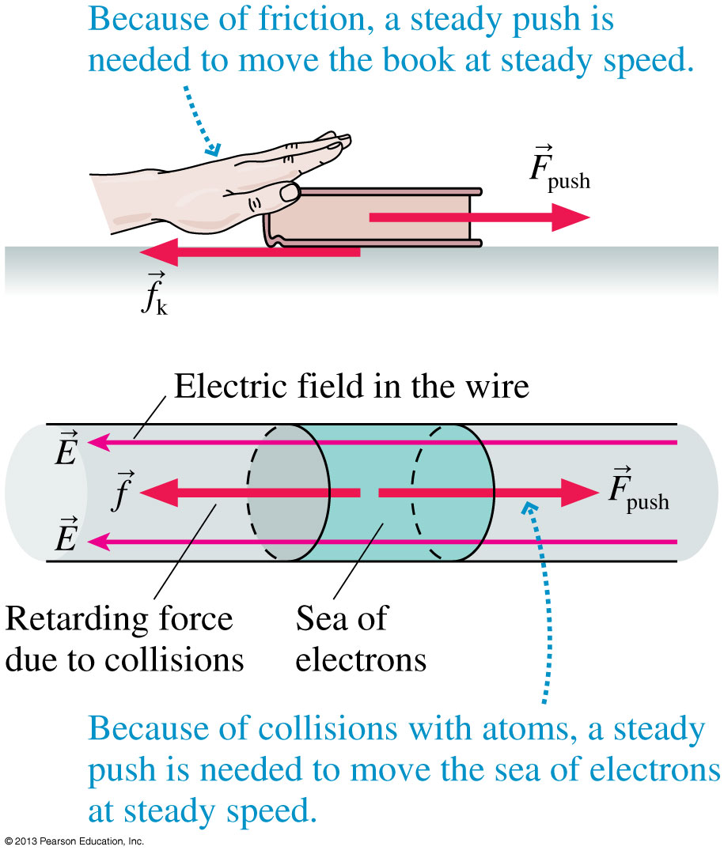
Creating a Current
A book on a table will slow down and stop unless you continue pushing.
Analogously, the sea of electrons will slow down and stop unless you continue pushing with an electric field.
Slide 30-31

Slide 18
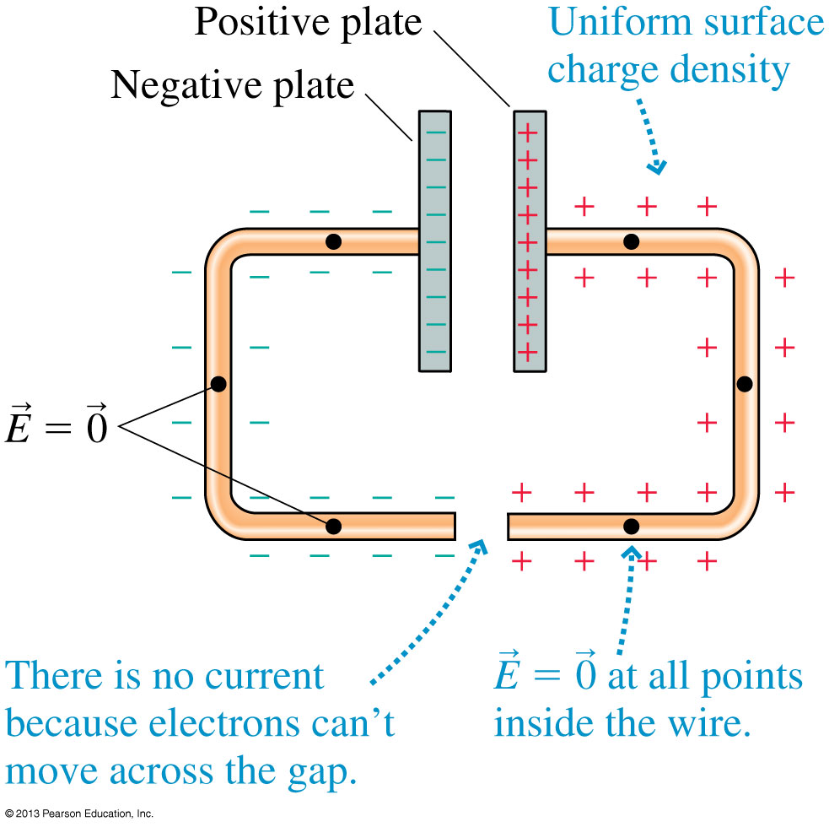
Establishing the Electric Field in a Wire
The figure shows two metal wires attached to the plates of a charged capacitor.
This is an electrostatic situation.
What will happen if we connect the bottom ends of the wires together?
Slide 30-32

Slide 19
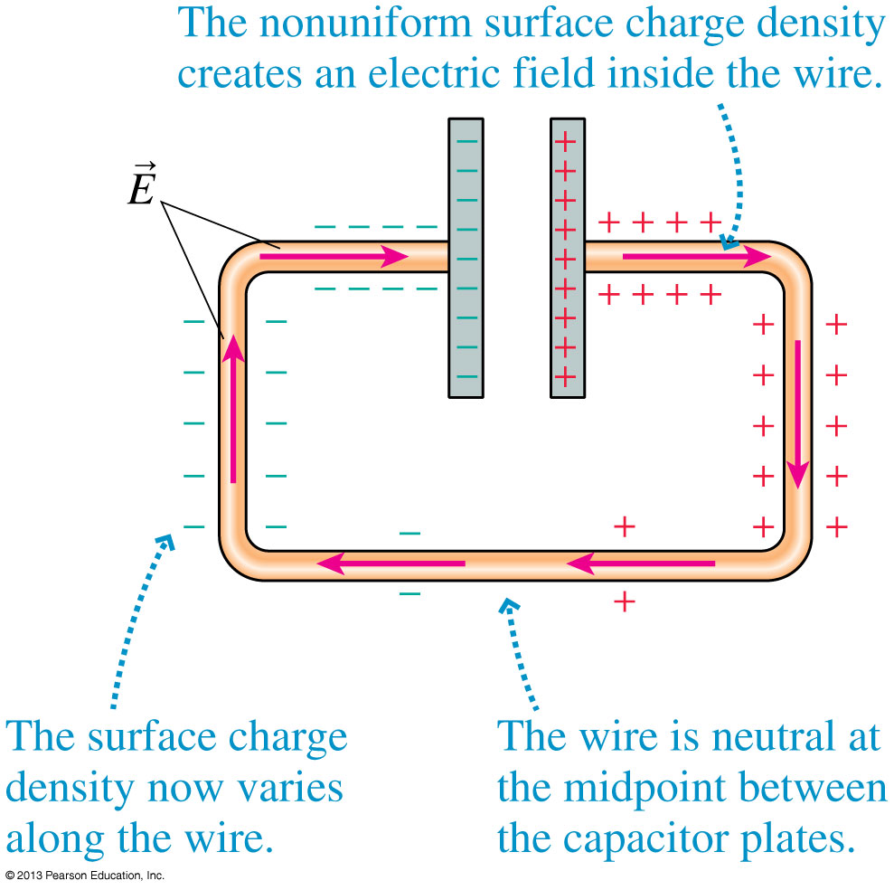
Establishing the Electric Field in a Wire
Within a very brief interval of time
(≈10⁻⁹ s) of connecting the wires, the sea of electrons shifts slightly.
The surface charge is rearranged into a nonuniform distribution, as shown in the figure.
Slide 30-33

Slide 20
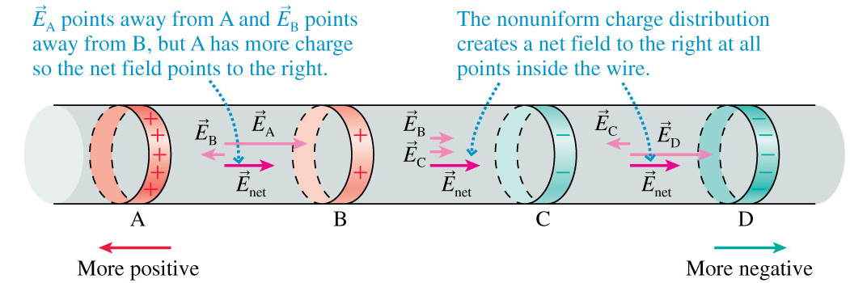
Establishing the Electric Field in a Wire
The nonuniform distribution of surface charges along a wire creates a net electric field inside the wire that points from the more positive end toward the more negative end of the wire.
This is the internal electric field that pushes the electron current through the wire.
Slide 30-34

Slide 21
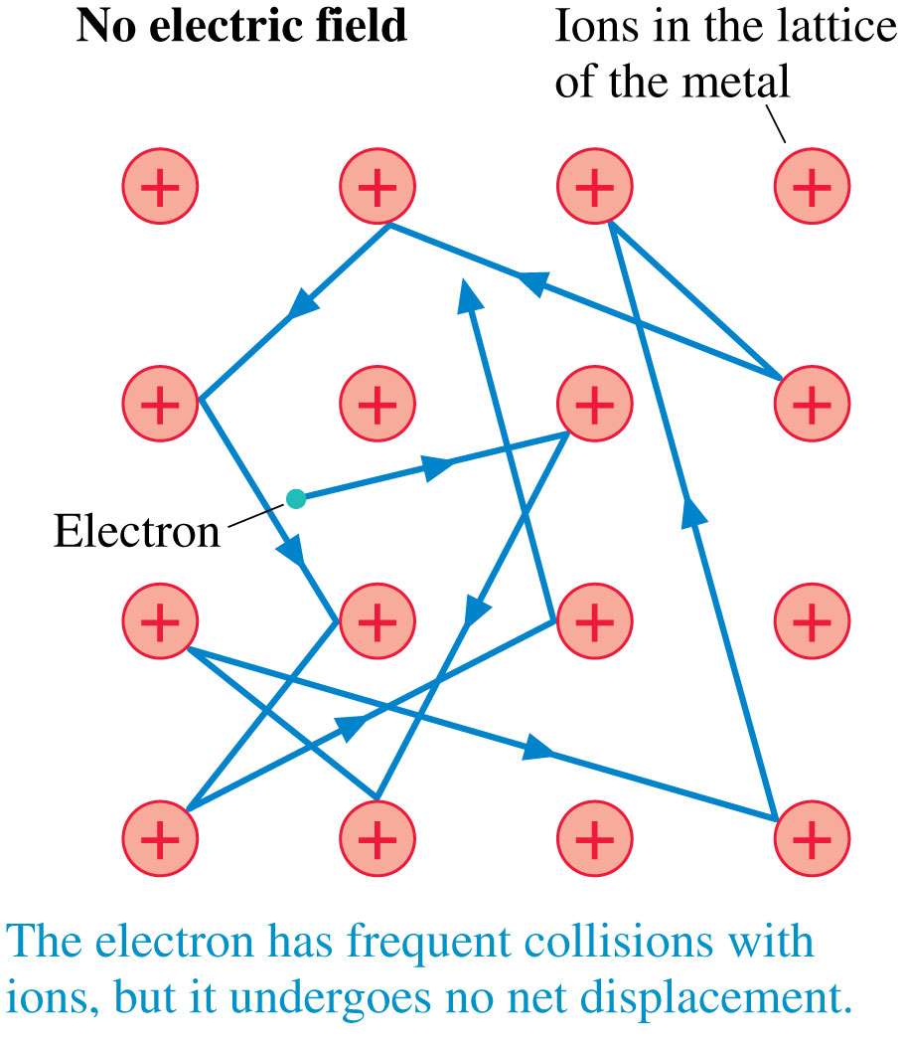
A Model of Conduction
Within a conductor in electrostatic equilibrium, there is no electric field.
In this case, an electron bounces back and forth between collisions, but its average velocity is zero.
Slide 30-37

Slide 22
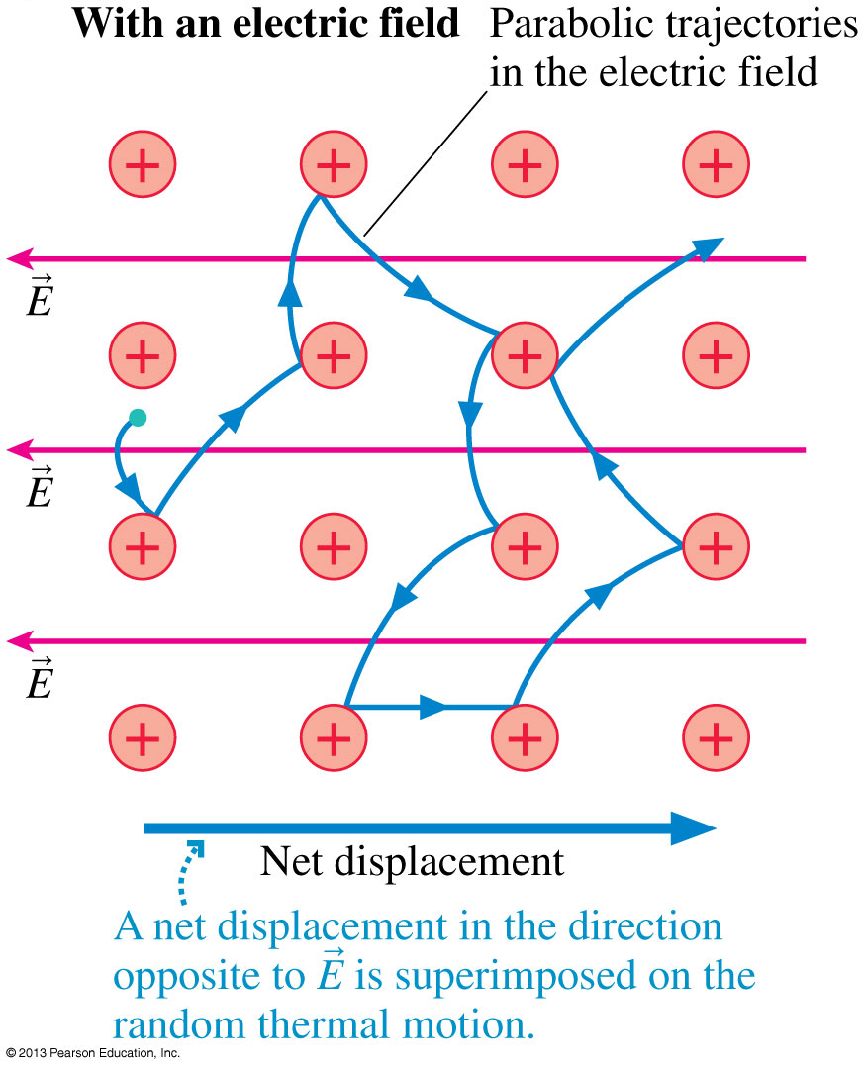
A Model of Conduction
In the presence of an electric field, the electric force causes electrons to move along parabolic trajectories between collisions.
Because of the curvature of the trajectories, there is a slow net motion in the “downhill” direction.
Slide 30-38

Slide 23
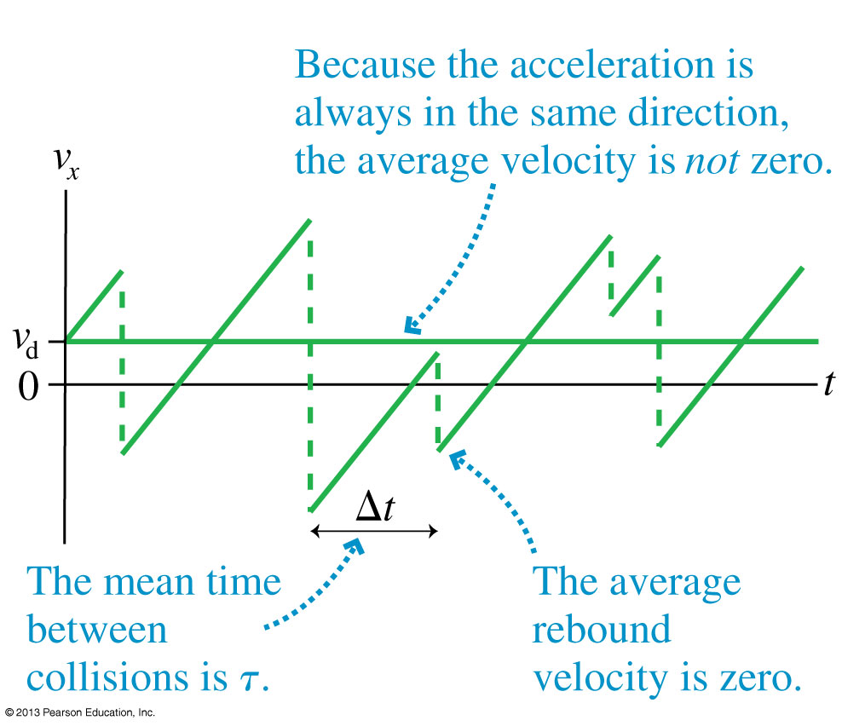
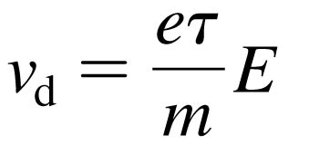
A Model of Conduction
The graph shows the speed of an electron during multiple collisions.
The average drift speed is
Slide 30-39

Slide 24
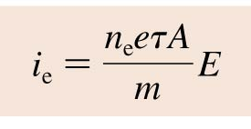
Electron Current
Electron Current
The electric field strength E in a wire of cross-section A causes an electron current.
The electron density n_{e} and the mean time between collisions τ are properties of the metal.
The electron current is directly proportional to the electric field strength.
Slide 30-40

Slide 25
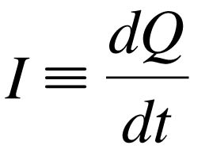
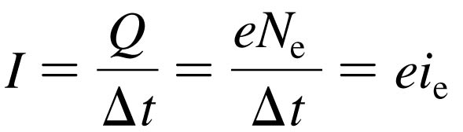
Current
Current
If Q is the total amount of charge that has moved past a point in a wire, we define the current I in the wire to be the rate of charge flow:
current is the rate at which charge flows
The SI unit for current is the coulomb per second, which is called the ampere.
1 ampere = 1 A = 1 C/s.
The conventional current I and the electron current i_{e} are related by
Slide 30-43

Slide 26
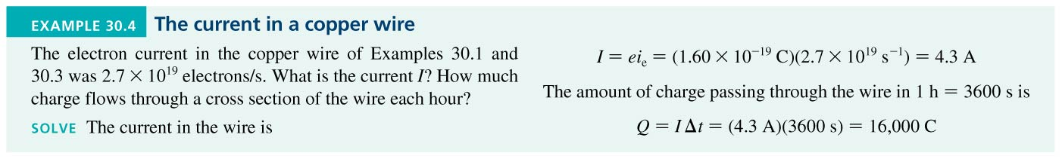
Example 30.4 The Current in a Copper Wire
Slide 30-46

Slide 27
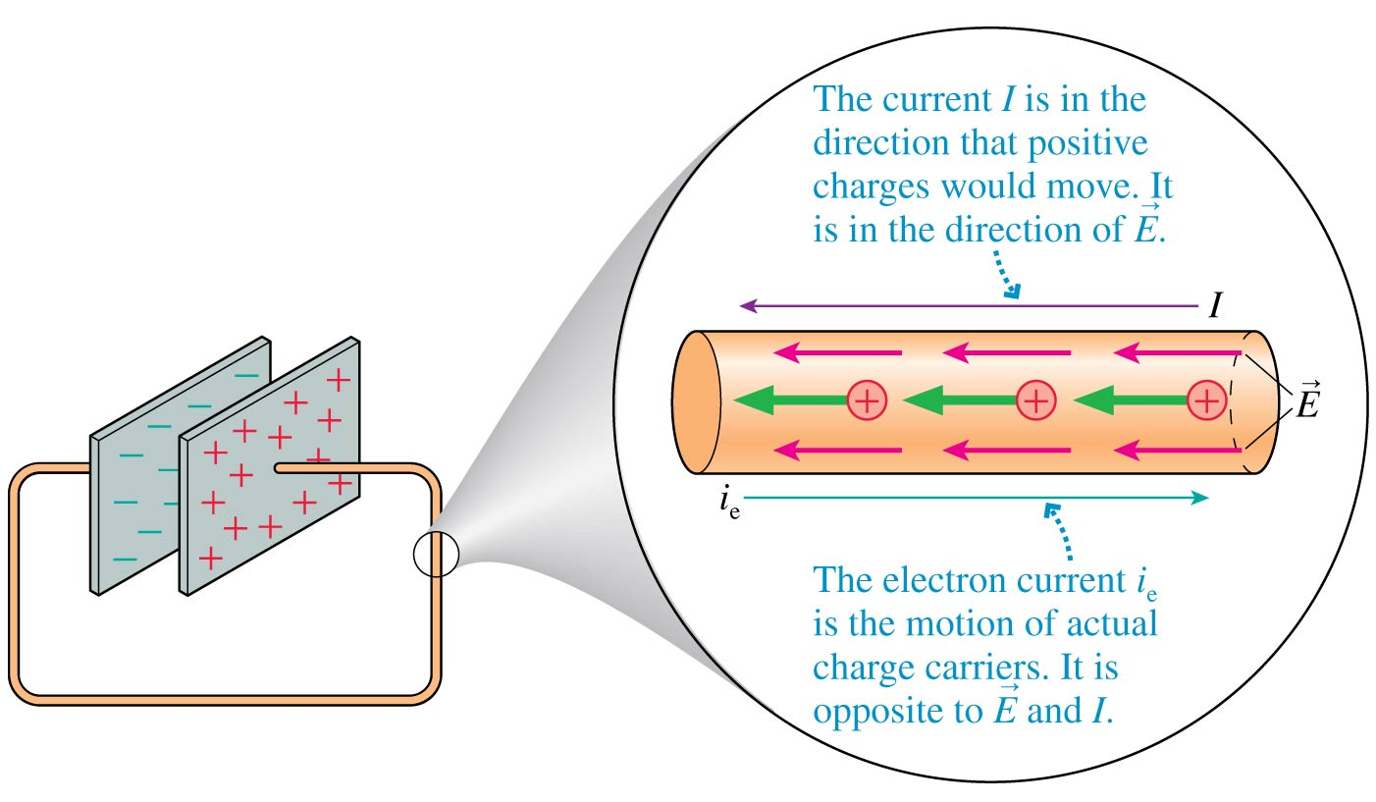
Current
Note that the direction of the current I in a metal is opposite to the direction of the electron current i_{e}.
Slide 30-47

Slide 28
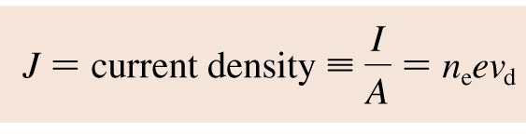
The Current Density in a Wire
The Current Density in a Wire
The current density J in a wire is the current per square meter of cross section:
The current density has units of A/m².
Slide 30-48

Slide 29
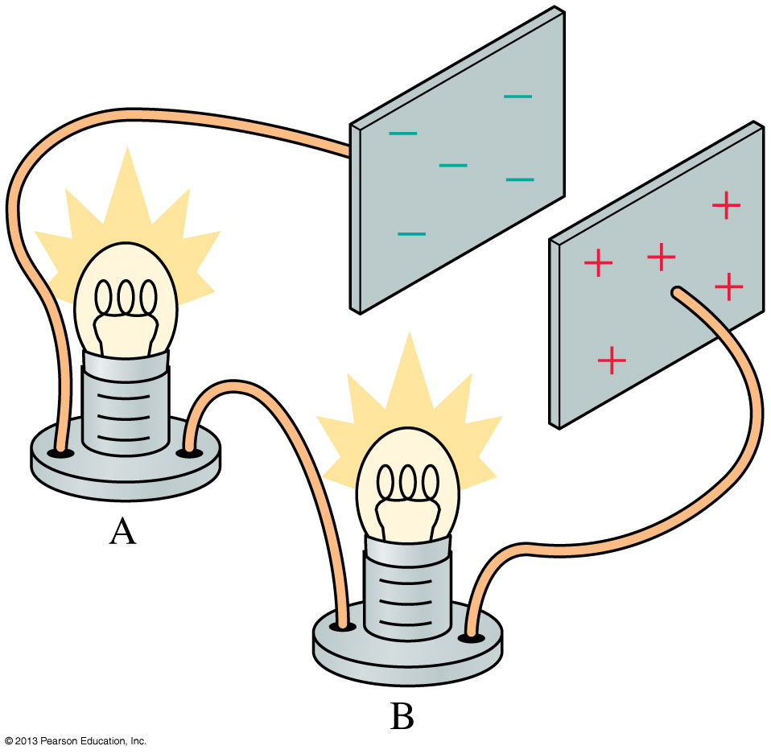
Conservation of Current
The figure shows two lightbulbs in the wire connecting two charged capacitor plates.
As the capacitor discharges, the current through both bulbs is exactly the same!
The rate of electrons leaving a lightbulb (or any other device) is exactly the same as the rate of electrons entering the lightbulb.
Slide 30-52

Slide 30
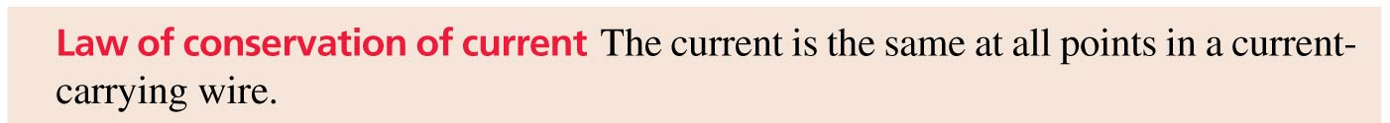
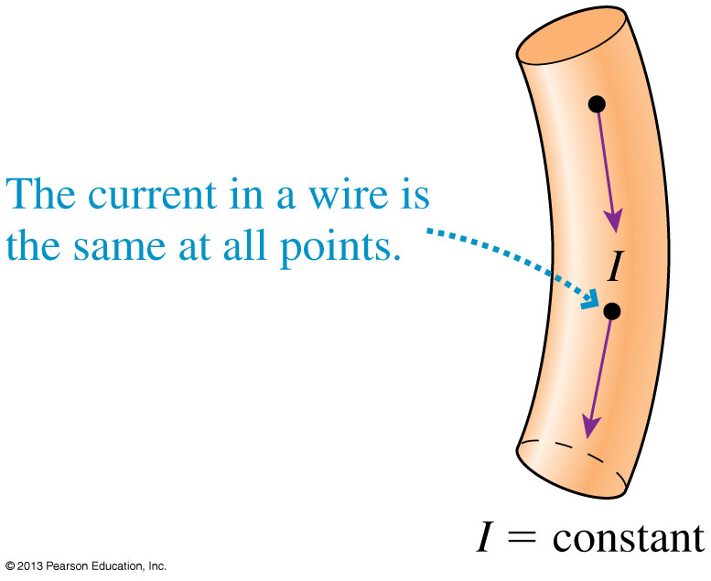
Conservation of Current
Slide 30-53

Slide 31
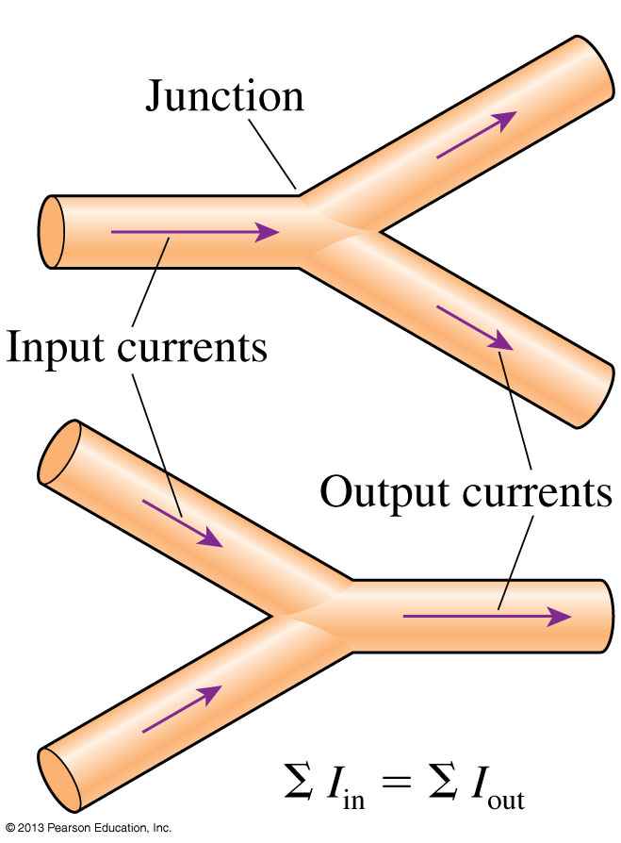
Kirchhoff’s Junction Law
For a junction, the law of conservation of current requires that
where the Σ symbol means summation.
This basic conservation statement is called Kirchhoff’s junction law.
Slide 30-56

Slide 32
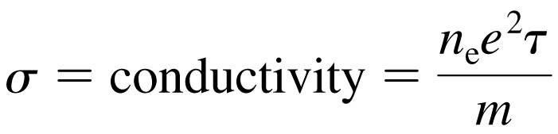
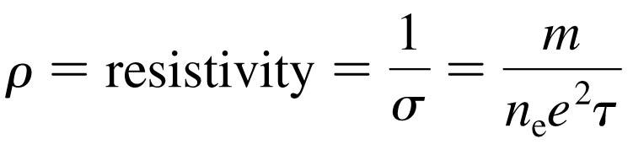
Conductivity and Resistivity
The conductivity of a material is
Conductivity, like density, characterizes a material as a whole.
The current density J is related to the electric field E by:
The resistivity tells us how reluctantly the electrons move in response to an electric field:
Slide 30-59

Slide 33
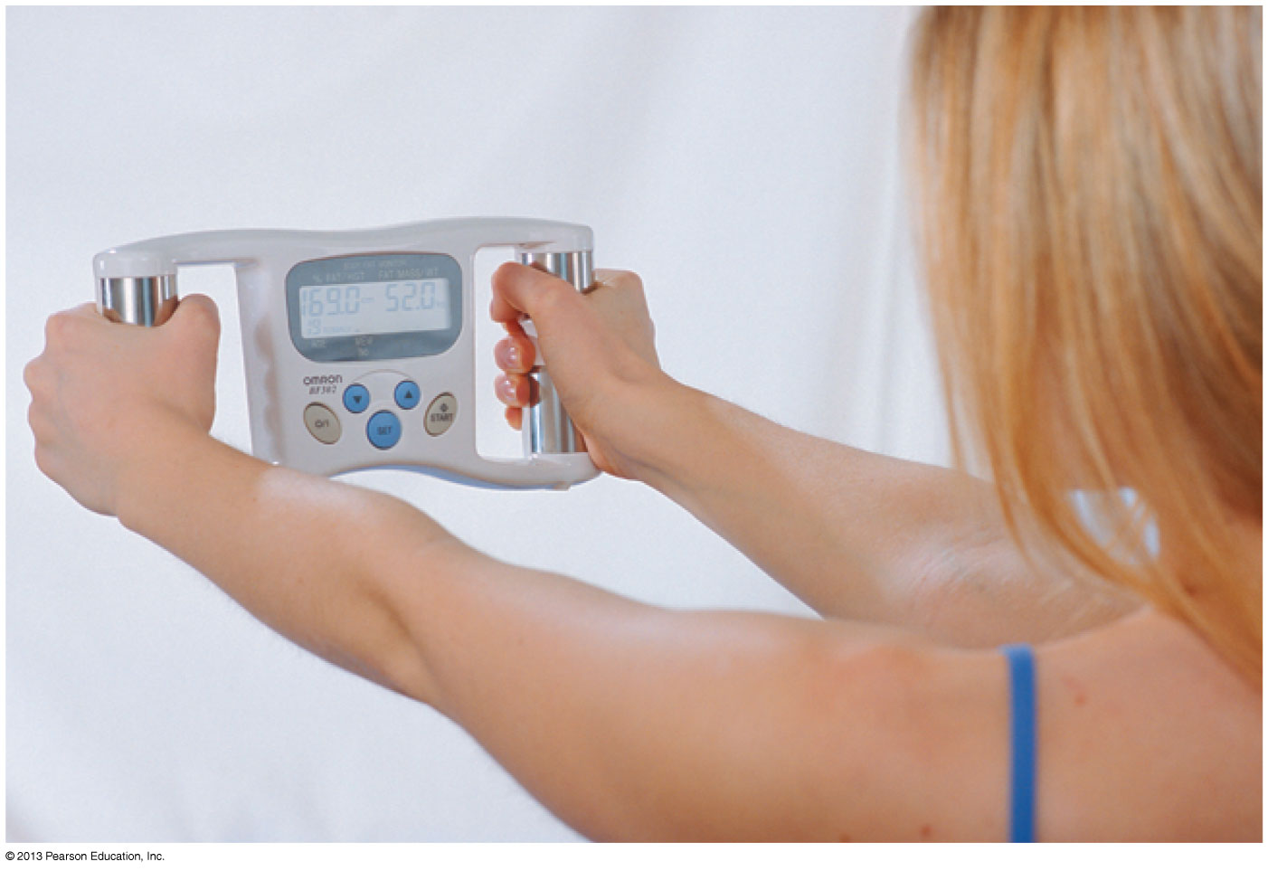
Conductivity and Resistivity
This woman is measuring her percentage body fat by gripping a device that sends a small electric current through her body. Because muscle and fat have different resistivities, the amount of current allows the fat-to-muscle ratio to be determined.
Slide 30-66

Slide 34
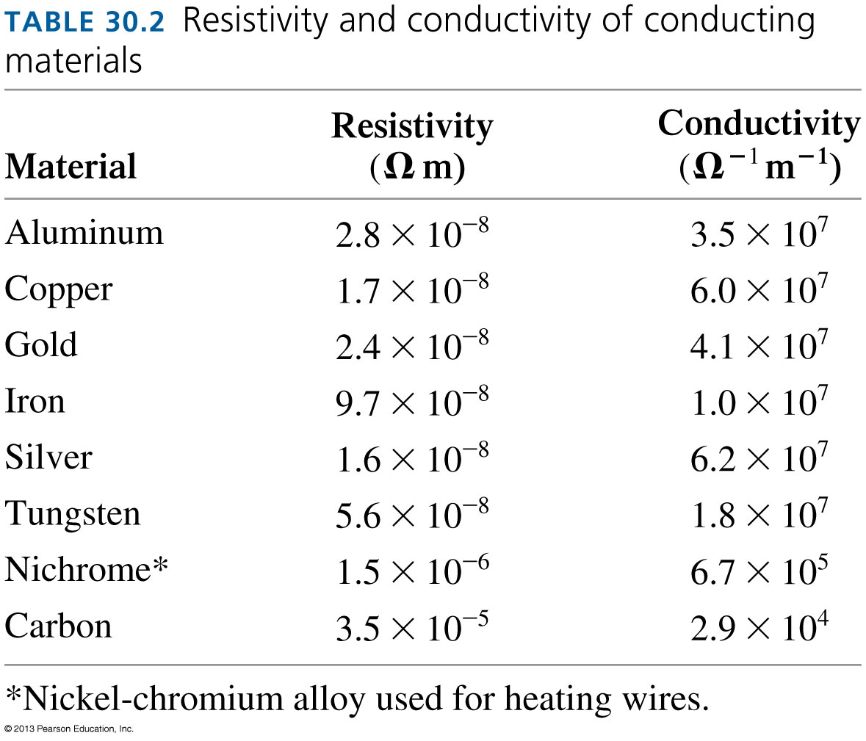
Conductivity and Resistivity
Slide 30-67

Slide 35
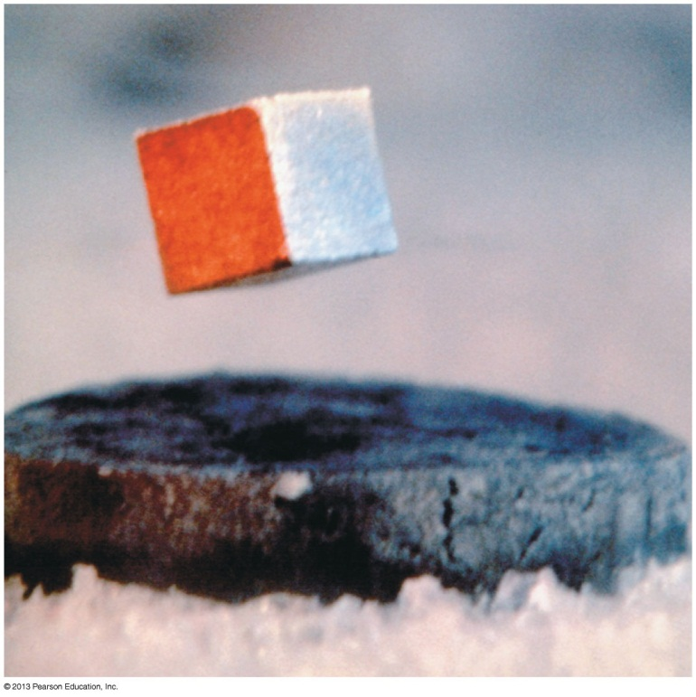
Superconductivity
In 1911, the Dutch physicist Kamerlingh Onnes discovered that certain materials suddenly and dramatically lose all resistance to current when cooled below a certain temperature.
This complete loss of resistance at low temperatures is called superconductivity.
Superconductors have unusual magnetic properties. Here a small permanent magnet levitates above a disk of the high temperature
superconductor YBa₂Cu₃O₇ that has been cooled to liquid-nitrogen temperature.
Slide 30-69

Slide 36
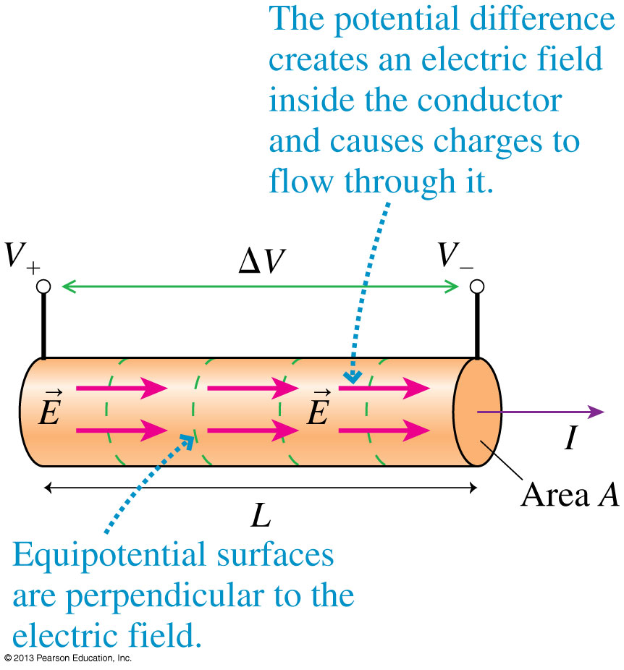

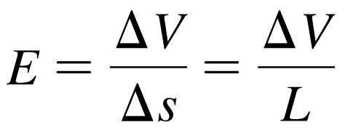
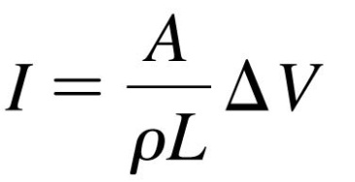
Resistance and Ohm’s Law
The figure shows a section of a conductor in which an electric field E is creating current I by pushing the charge carriers.
The field strength is
The current density is J = I/A = E/ρ.
So the current is related to ΔV by
Slide 30-70

Slide 37
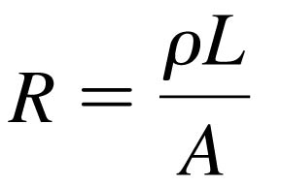
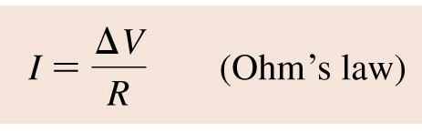
Resistance and Ohm’s Law
The current through a conductor is proportional to the potential difference between its ends.
We define the resistance R of a long, thin conductor of length L and cross-sectional area A to be:
The SI unit of resistance is the ohm.
1 ohm = 1 Ω = 1 V/A.
The current through a conductor is determined by the potential difference ΔV along its length:
Slide 30-71

Slide 38
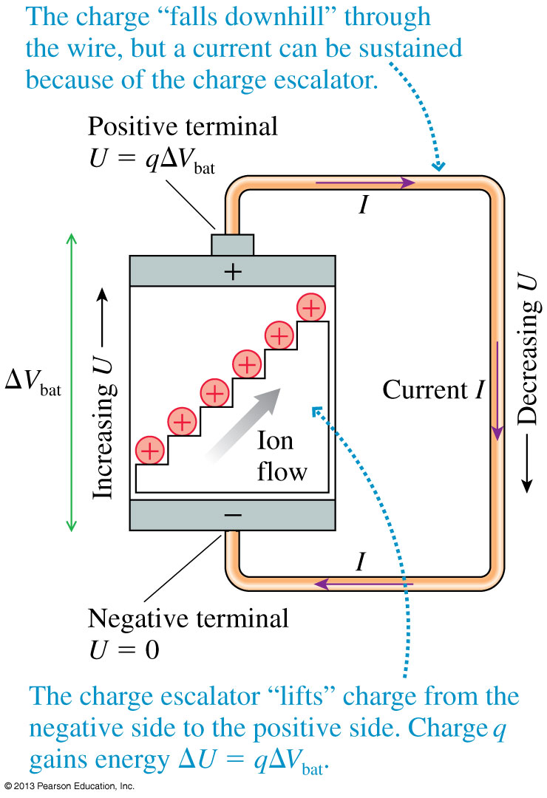
Batteries and Current
A battery is a source of potential difference ΔV_{bat}.
The battery creates a potential difference between the ends of the wire.
The potential difference in the wire creates an electric field in the wire.
The electric field pushes a current I through the wire.
The current in the wire is:
I = ΔV_{wire}/R
Slide 30-74

Slide 39
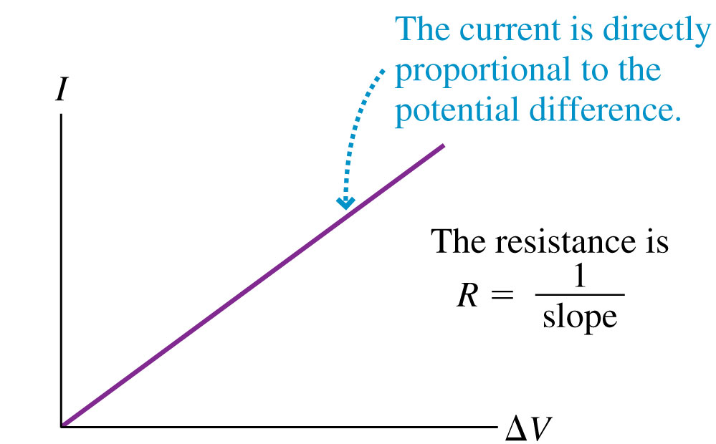
Ohm’s Law
Ohm’s law is limited to those materials whose resistance R remains constant—or very nearly so—during use.
The materials to which Ohm’s law applies are called ohmic.
The current through an ohmic material is directly proportional to the potential difference; doubling the potential difference doubles the current.
Metal and other conductors are ohmic devices.
Slide 30-75

Slide 40
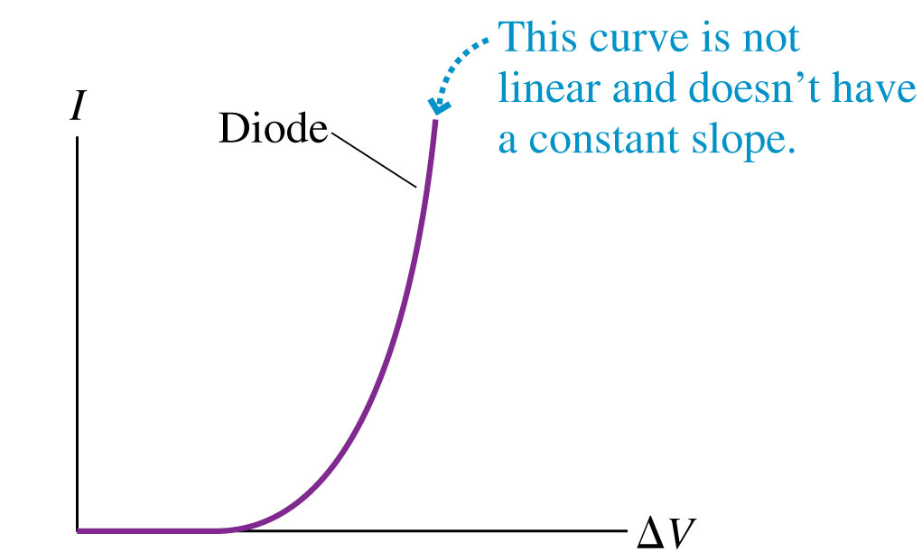
Nonohmic Materials
Some materials and devices are nonohmic, meaning that the current through the device is not directly proportional to the potential difference.
Diodes, batteries, and capacitors are all nonohmic devices.
Slide 30-78

Slide 41
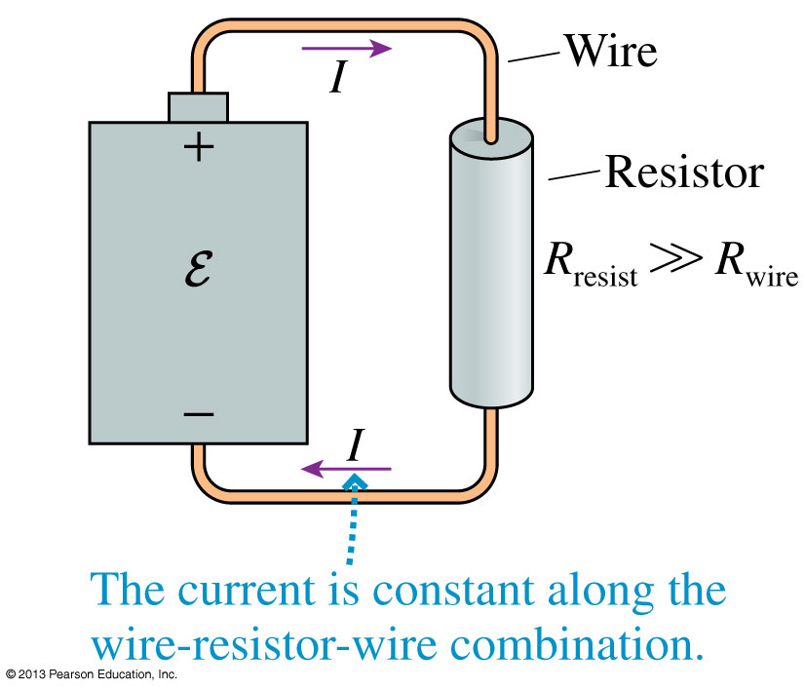
Battery-Wire-Resistor-Wire Circuit
The figure shows a resistor connected to a battery with current-carrying wires.
Current must be conserved; hence the current I through the resistor is the same as the current in each wire.
The next two slides show how the electric potential varies through the circuit .
Slide 30-79

Slide 42
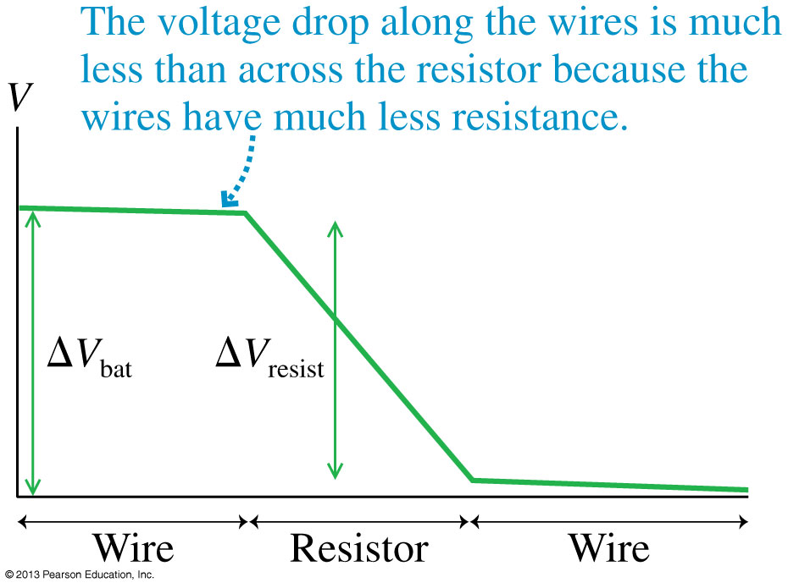
Battery-Wire-Resistor-Wire Circuit
Slide 30-80

Slide 43
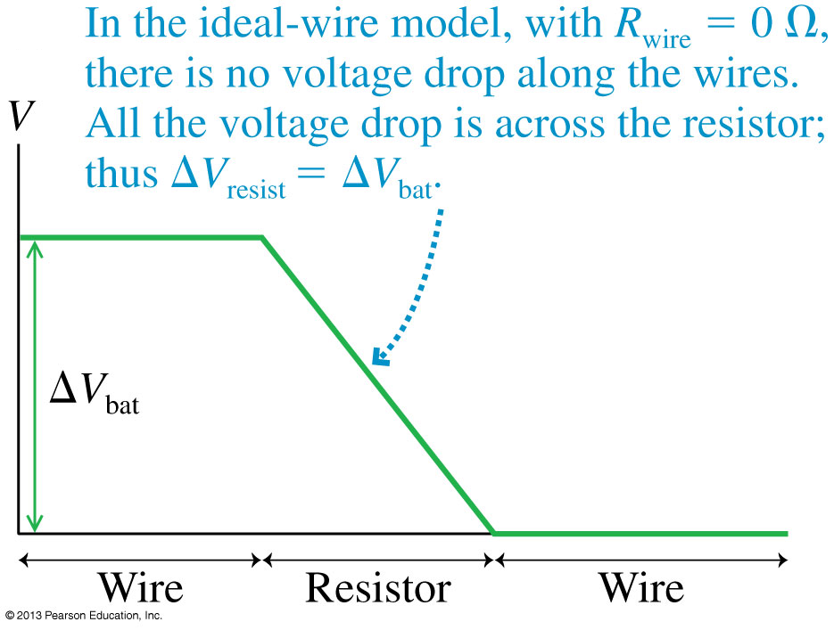
Battery-Wire-Resistor-Wire Circuit
Slide 30-81

Slide 44
Chapter 30 Summary Slides
Slide 30-83

Slide 45
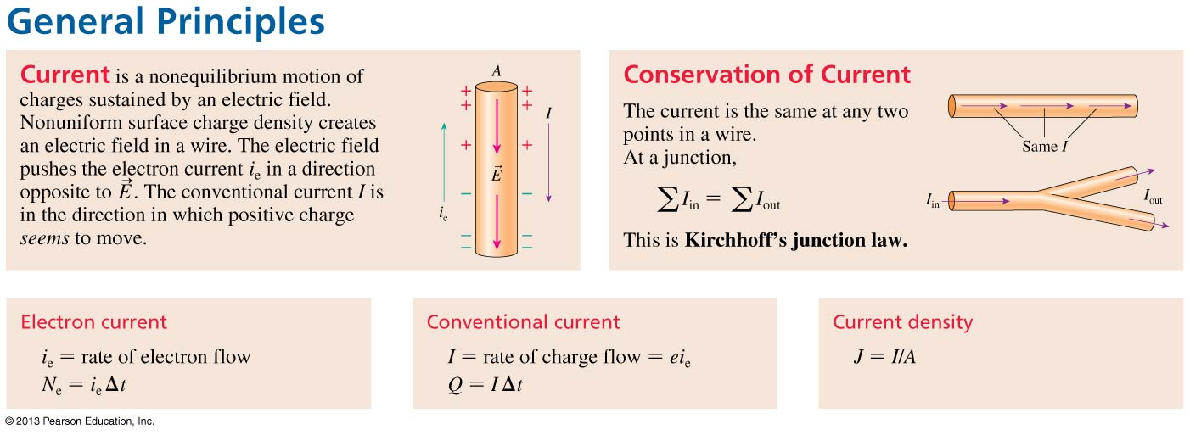
General Principles
General Principles
Slide 30-84

Slide 46
General Principles
Slide 30-85

Slide 47
General Principles
Slide 30-86

Slide 48

Important Concepts
Important Concepts
Slide 30-87

Slide 49
Important Concepts
Slide 30-88

Slide 50
Important Concepts
Slide 30-89

