Slide 1
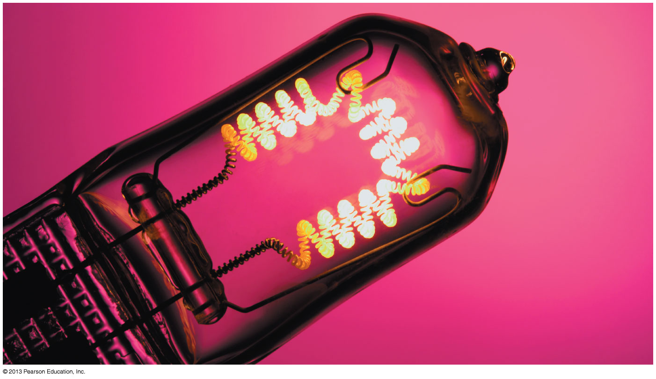
Chapter 30 Current and Resistance
Chapter Goal: To learn how and why charge moves through a conductor as what we call a current.
Slide 30-2

Slide 2
Reading Question 30.1
What quantity is represented by the symbol J ?
Resistivity.
Conductivity.
Current density.
Complex impedance.
Johnston’s constant.
Slide 30-11

Slide 3
Reading Question 30.2
The electron drift speed in a typical current-carrying wire is
Extremely slow (≈10^{–4} m/s).
Moderate (≈ 1 m/s).
Very fast (≈ 10⁴ m/s).
Could be any of A, B, or C.
No numerical values were provided.
Slide 30-13

Slide 4
Reading Question 30.3
All other things being equal, current will be larger in a wire that has a larger value of
Conductivity.
Resistivity.
The coefficient of current.
Net charge.
Potential.
Slide 30-15

Slide 5
Reading Question 30.4
The equation I = ΔV/R is called
Ampère’s law
Ohm’s law.
Faraday’s law.
Weber’s law.
Slide 30-17
Notes:
5

Slide 6
QuickCheck 30.1
A wire carries a current. If both the wire diameter and the electron drift speed are doubled, the electron current increases by a factor of
2.
4.
6.
8.
Some other value.
Slide 30-25
Notes:
6

Slide 7
QuickCheck 30.2
Surface charge is distributed on a wire as shown. Electrons in the wire
Drift to the right.
Drift to the left.
Move upward.
Move downward.
On average, remain at rest.
Slide 30-35
Notes:
7

Slide 8
QuickCheck 30.3
Every minute, 120 C of charge flow through this cross section of the wire.
The wire’s current is
240 A.
120 A.
60 A.
2 A.
Some other value.
Slide 30-44
Notes:
8

Slide 9
QuickCheck 30.4
The current density in this wire is
4 × 10⁶ A/m².
2 × 10⁶ A/m².
4 × 10³ A/m².
2 × 10³ A/m².
Some other value.
Slide 30-49
Notes:
9

Slide 10
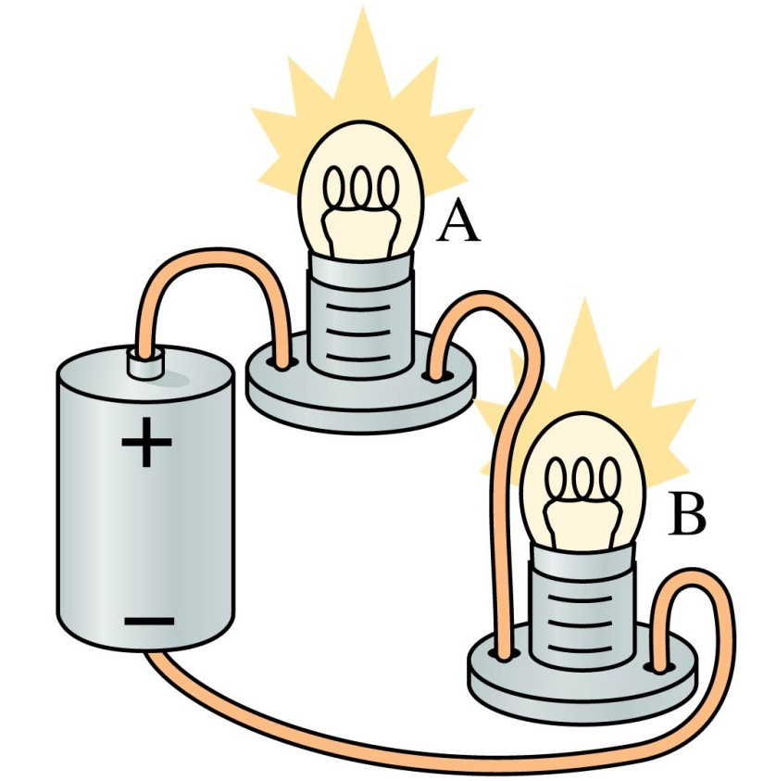
QuickCheck 30.5
A and B are identical lightbulbs connected to a battery as shown. Which is brighter?
Bulb A.
Bulb B.
The bulbs are equally bright.
Slide 30-54
Notes:
10

Slide 11
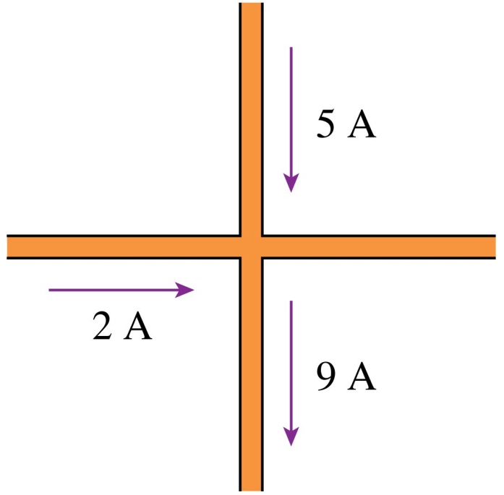
QuickCheck 30.6
The current in the fourth wire is
16 A to the right.
4 A to the left.
2 A to the right.
2 A to the left.
Not enough information to tell.
Slide 30-57
Notes:
11

Slide 12
QuickCheck 30.7
Both segments of the wire are made of the same metal. Current I₁ flows into segment 1 from the left. How does current I₁ in segment 1 compare to current I₂ in segment 2?
I₁ > I₂.
I₁ = I₂.
I₁ < I₂.
There’s not enough information to compare them.
Slide 30-60
Notes:
12

Slide 13
QuickCheck 30.8
Both segments of the wire are made of the same metal. Current I₁ flows into segment 1 from the left. How does current density J₁ in segment 1 compare to current density J₂ in segment 2?
J₁ > J₂.
J₁ = J₂.
J₁ < J₂.
There’s not enough information to compare them.
Slide 30-62
Notes:
13

Slide 14
QuickCheck 30.9
Both segments of the wire are made of the same metal. Current I₁ flows into segment 1 from the left. How does the electric field E₁ in segment 1 compare to the electric field E₂ in segment 2?
E₁ > E₂.
E₁ = E₂ but not zero.
E₁ < E₂.
Both are zero because metal is a conductor.
There’s not enough information to compare them.
Slide 30-64
Notes:
14

Slide 15
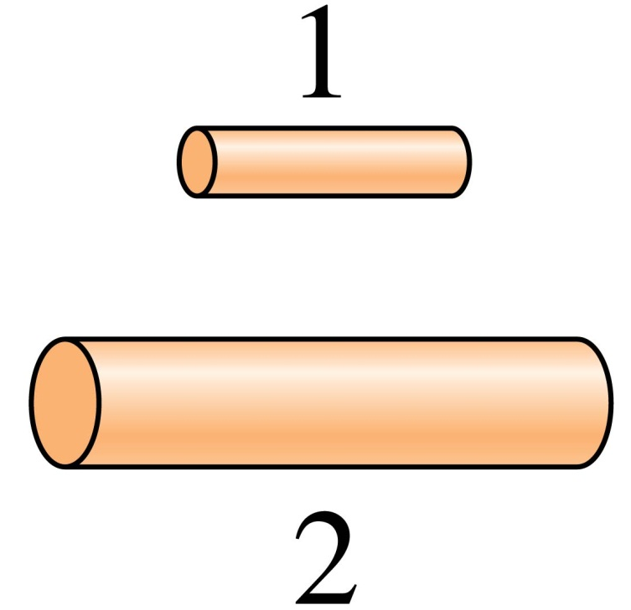
QuickCheck 30.10
Wire 2 is twice the length and twice the diameter of wire 1. What is the ratio R₂/R₁ of their resistances?
1/4.
1/2.
1.
2.
4.
Slide 30-72
Notes:
15

Slide 16
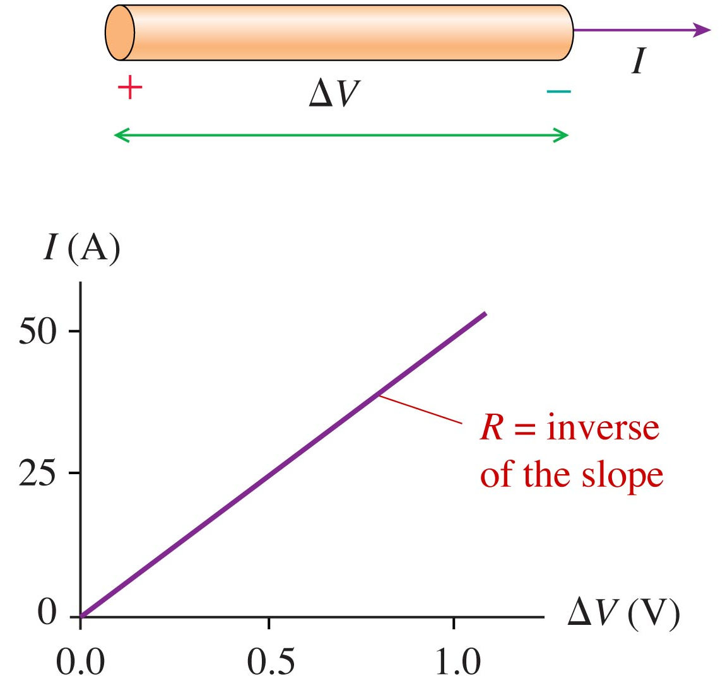
QuickCheck 30.11
The current through a wire is measured as the potential difference ΔV is varied. What is the wire’s resistance?
0.01 Ω.
0.02 Ω.
50 Ω.
100 Ω.
Some other value.
Slide 30-76
Notes:
16

Slide 17
Reading Question 30.1
What quantity is represented by the symbol J ?
Resistivity.
Conductivity.
Current density.
Complex impedance.
Johnston’s constant.
Slide 30-12

Slide 18
Reading Question 30.2
The electron drift speed in a typical current-carrying wire is
Extremely slow (≈ 10^{–4} m/s).
Moderate (≈ 1 m/s).
Very fast (≈ 10⁴ m/s).
Could be any of A, B, or C.
No numerical values were provided.
Slide 30-14

Slide 19
Reading Question 30.3
All other things being equal, current will be larger in a wire that has a larger value of
Conductivity.
Resistivity.
The coefficient of current.
Net charge.
Potential.
Slide 30-16

Slide 20
Reading Question 30.4
The equation I = ΔV/R is called
Ampère’s law
Ohm’s law.
Faraday’s law.
Weber’s law.
Slide 30-18
Notes:
20

Slide 21
QuickCheck 30.1
A wire carries a current. If both the wire diameter and the electron drift speed are doubled, the electron current increases by a factor of
2.
4.
6.
8.
Some other value.
i_{e} ∝ Aν_{d}
Slide 30-26
Notes:
21

Slide 22
QuickCheck 30.2
Surface charge is distributed on a wire as shown. Electrons in the wire
Drift to the right.
Drift to the left.
Move upward.
Move downward.
On average, remain at rest.
Electric field from nonuniform surface charges is to the right. Force on negative electrons is to the left.
Slide 30-36
Notes:
22

Slide 23
QuickCheck 30.3
Every minute, 120 C of charge flow through this cross section of the wire.
The wire’s current is
240 A.
120 A.
60 A.
2 A.
Some other value.
Slide 30-45
Notes:
23

Slide 24
QuickCheck 30.4
The current density in this wire is
4 × 10⁶ A/m².
2 × 10⁶ A/m².
4 × 10³ A/m².
2 × 10³ A/m².
Some other value.
Slide 30-50
Notes:
24

Slide 25
QuickCheck 30.6
The current in the fourth wire is
16 A to the right.
4 A to the left.
2 A to the right.
2 A to the left.
Not enough information to tell.
Conservation of current
Slide 30-58
Notes:
25

Slide 26
QuickCheck 30.7
Both segments of the wire are made of the same metal. Current I₁ flows into segment 1 from the left. How does current I₁ in segment 1 compare to current I₂ in segment 2?
I₁ > I₂.
I₁ = I₂.
I₁ < I₂.
There’s not enough information to compare them.
Conservation of current
Slide 30-61
Notes:
26

Slide 27
QuickCheck 30.8
Both segments of the wire are made of the same metal. Current I₁ flows into segment 1 from the left. How does current density J₁ in segment 1 compare to current density J₂ in segment 2?
J₁ > J₂.
J₁ = J₂.
J₁ < J₂.
There’s not enough information to compare them.
Smaller cross-section area
Slide 30-63
Notes:
27

Slide 28
QuickCheck 30.9
Both segments of the wire are made of the same metal. Current I₁ flows into segment 1 from the left. How does the electric field E₁ in segment 1 compare to the electric field E₂ in segment 2?
E₁ > E₂.
E₁ = E₂ but not zero.
E₁ < E₂.
Both are zero because metal is a conductor.
There’s not enough information to compare them.
J = σE
Slide 30-65
Notes:
28

Slide 29
QuickCheck 30.10
Wire 2 is twice the length and twice the diameter of wire 1. What is the ratio R₂/R₁ of their resistances?
1/4.
1/2.
1.
2.
4.
Slide 30-73
Notes:
29

Slide 30
QuickCheck 30.11
The current through a wire is measured as the potential difference ΔV is varied. What is the wire’s resistance?
0.01 Ω.
0.02 Ω.
50 Ω.
100 Ω.
Some other value.
Slide 30-77
Notes:
30

Slide 31
QuickCheck 30.5
A and B are identical lightbulbs connected to a battery as shown. Which is brighter?
Bulb A.
Bulb B.
The bulbs are equally bright.
Conservation of current
Slide 30-55
Notes:
31

